Slide 1
Using JavaScript and Canvas to Create an Interactive Website (And Why Maybe You Shouldn’t)
Colleen van Lent

Slide 2
How Are Web Pages Created?
HTML5
Tags are used to markup the content
CSS3
Rules are used to style the content
JavaScript
Traditional coding is used to create popups, animations, visual effects, etc. as well as validation

Slide 3

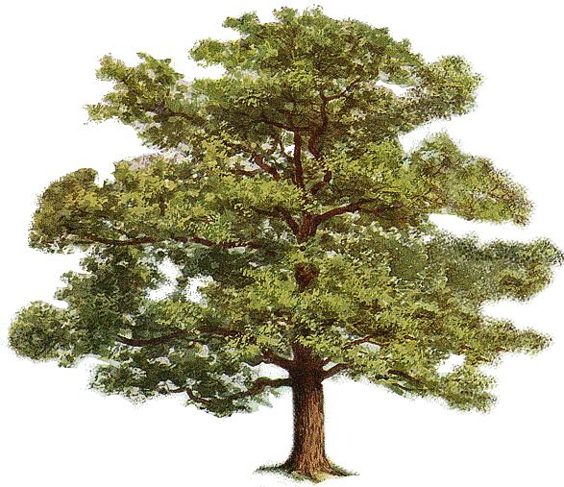

HTML Structure

Slide 5
Common tags
h1,h2, …h6
ol,ul, li
p, div
img, a
header, nav, footer, main, article, figure

Slide 6
Tags Take Attributes
Image filename
<img src=“logo.jpg”
alt="company logo"
title = "AAA1 LLC"
class = "thumbnail"/>
Info for screen readers, broken links
Displays on hover
Extra formatting (height, width, position, etc.)

Slide 7
Evolution of HTML
1993 | HTML 1.0 - Developed by Tim Berners-Lee to link documents
1995 | HTML 2.0 - Developed by Internet Engineering Task Force RFC to include stylized text and tables
1996 | CSS 1
1997 | HTML 3.2 – Developed by W3C and included browser specific features
1997 | HTML 4.0 – A move back to normalizing the pages across platforms.
1998 | CSS 2
1999 | HTML 4.01 – Introduced different document types
2012 | HTML 5 - Back to HTML plus multimedia and semantic tags

Slide 8
Semantics and Accessibility
Early pages were full of “div” tags
Now, semantic tags and attributes are used to assist in page access
header, nav, figure, footer, aside, article, date, time…
In addition, there is more consideration for how people interact with the web when faced with barriers, e.g vision, mobility, etc.

Slide 9
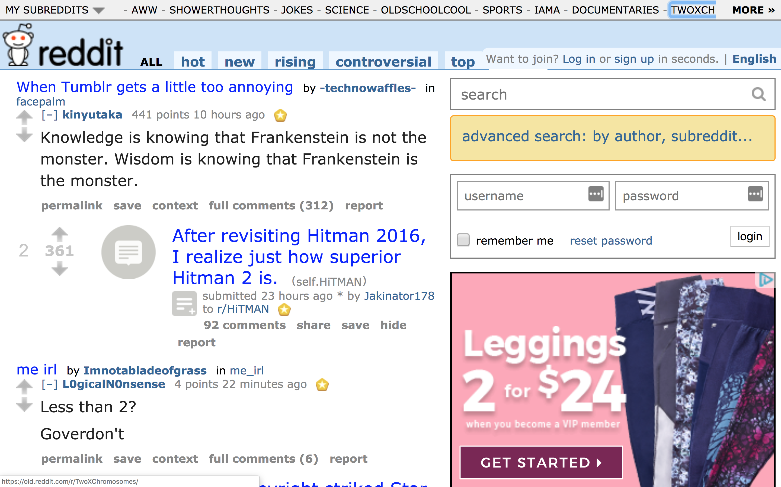

Slide 10
CSS3
Once you have the content, you can add style
It is important to separate content from style

Slide 11
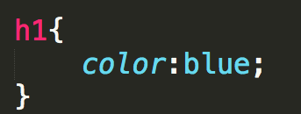

CSS Rule syntax
CSS3 defines generic rules that can apply to multiple elements
selector {
property; value;
}

Slide 12
Code Time (All Code available on Github)
Simple Site
Simple Site with CSS

Slide 13
JavaScript
Adding JavaScript adds interactivity
Uses the DOM to access elements of the page
Finally back to “programming”

Slide 14
Syntax Details
var element;
Variables are not type specific
function myMove(){}
Functions defined with keyword function

Slide 15
Using the API
Thanks to the structure of the DOM, there are plenty of API calls available
document.getElementById()
document.getElemetsByClassName()
document.getElementsByTagName()
document.querySelector()
You can also link Events
Mouse events, clicks, window interactions, …

Slide 16
Code Time
JavaScript Animate
JavaScript Snow

Slide 17
The Canvas Element
A drawable region defined with height and width attributes
Can be accessed through JavaScript through drawing functions similar to those of other common 2D APIs.
Used for (dynamically) building graphs, animations, games, and image composition.

Slide 18
Super Cool Things You Can Do With Canvas
Fireworks
Drawing With Text
Blob

Slide 19
How it Works
Create a canvas element in HTML
Use JS to the element
Initialize the mainContext variable by calling the getContext function on our canvas element. This returns a mainContext object that has all the methods required to draw in Canvas

Slide 20
Code Time
Sample Canvas
Canvas Animate
Canvas-Pacman
One more outside example

Slide 21
DOM vs Canvas
DOM | CANVAS
+ Easy to use + Redrawing is handled by Graphics API + Easy to apply CSS | + Fast + Flexible + Better for many elements
Memory intensive Less control (handled by Graphics API) | Slow for large areas Is complex

Slide 22
Issues with Canvas
Privacy
Canvas fingerprinting
Accessibility
The bitmap does not provide information about any drawn objects.
Canvas content is not exposed to accessibility tools like semantic HTML is
Many canvas elements controlled by mouse, and not keyboard accessible

Slide 23
General Issues with Accessibility
Many sites are already inaccessible
Automated testing can detect about 30% of issues
https://www.cse.umich.edu/

Slide 24
Review
Popular web creation platforms hide the HTML, CSS, and JavaScript from you
There is a lot you can do with Web Design beyond simple sites
Skilled programmers are needed to make sure they are accessible

Slide 25
Thank you
Code and slides can be found at:
https://github.com/cvanlent/IntroToCanvas

