Slide 1
SaltStack
Thomas S Hatch is the man behind SaltStack
Developed in 2011

Slide 2
Why SALT ?
Agent-based or agent less execution engine.
Eliminating manual processes
Reduce errors that occur in IT organizations
Known for High stability
Remotely executes commands across all machines
Puppet, which came out in 2005, and Chef, which debuted in 2009.
Automate Everything and Everything as a code
Notes:
Plus: All computations are performed on Languard Console PC.
Minus: high LAN utilization, poor report

Slide 3
Over view
SaltStack Overview
Introduction to YAML
Installation of SaltStack
Salt Command Line Basics
Targeting Minions
States
Templating
Pillar

Slide 4
General Intro
SaltStack is an open-source configuration management and remote execution engine.
Salt can also operate as an agent-based or agentless execution engine.
Agent installation - you install agent on client computer
Agentless installation - you add the computer in Dashboard but do not deploy the agent
Salt Main Idea is to make Infrastructure as a code
Automatically manage the technology stack for an application through software instead of Manual
Notes:
infrastructure management
Automate everything and everything as a code 2 main principles
high-speed communication with large numbers of systems
The backbone of Salt is the remote execution engine
Bi-directional

Slide 5
Zero MQ / Master / Minion
SaltStack uses the ZeroMQ messaging library to process high-speed requirements
ZeroMQ can talk to 10,000+ systems in parallel (so can connect to as many as systems in milliseconds and command them)
Salt uses a slave-master setup that enables push and pull execution.
->Salt functions on a master/minion topology.
A master server acts as a central control bus for the clients (called minions), and the minions connect back to the master.

Slide 6
Simple Architecture Slat Master---->Event Bus----->(n) No of minions
SALT Minion Server 2
SALT Minion Server 3
SALT Minion Server 4
SALT MASTER (Server 1)
4505 4506
EVENT BUS(Zero MQ)
Notes:
An Eventbus is a mechanism that allows different components to communicate with each other without knowing about each other. A component can send an Event to the Eventbus without knowing who will pick it up or how many others will pick it up.
ZeroMQ is a high-performance asynchronous messaging library, aimed at use in distributed or concurrent applications.
Who is Using ZeroMQ? some organizations that we know use it are: AT&T, Cisco, EA, NASA, Weta Digital, Zynga, Spotify, Samsung Electronics, Microsoft, and CERN

Slide 7
How it works
Salt Master will PUBLISH to Event Bus
Event Bus will communicate to Salt Minions
All Salt Minion Subscribe to Event Bus
The Matching Salt Minion ID will get the request others will Reject
Zero MQ is the Event Bus used here which is used for very high volume of data messages with minimal delay
4505 and 4506 Both are Event bus port used for publish and respond

Slide 8
FINDING THE SALT MASTER
When a minion starts, by default it searches for a system that resolves to the salt hostname on the network
If found, the minion initiates the handshake and key authentication process with the Salt master.
USING SALT-KEY
Salt authenticates minions using public-key encryption and authentication.
For a minion to start accepting commands from the master, the minion keys need to be accepted by the master
Notes:
On the master:
# salt-key -f foo.domain.com
Unaccepted Keys:
foo.domain.com: 39:f9:e4:8a:aa:74:8d:52:1a:ec:92:03:82:09:c8:f9
On the minion:
# salt-call key.finger --local
local:
39:f9:e4:8a:aa:74:8d:52:1a:ec:92:03:82:09:c8:f9

Slide 9
YAML
Data serialization language designed to be human-readable and working well with modern programming languages for everyday tasks.
.yml files represent YAML (Simulates JASON or XML)
YAML File is used to represent Data with a KEY: Value pair using Arrays , Dictionary or list.
Make Sure of Indentations (Space Between)
Any line beginning with # is considered as COMMENT.

Slide 10
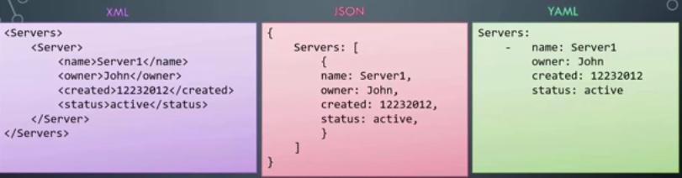
XML / JSON / YAML
Notes:
yaml IS A Data structure FORMAT LIKE XML AND JASON
Blank space between each item

Slide 11
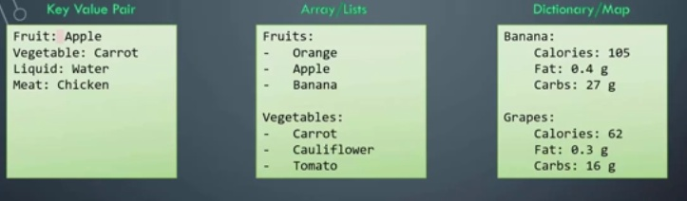
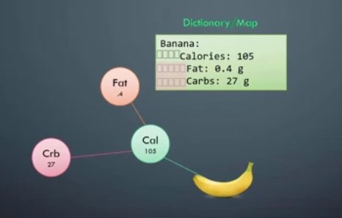
No of spaces why it’s important
Notes:
Key value pair in YAML is simplest form
space after colon
Array / list fruits:
list in next line
Dic set of group properties under a item blank space before each item
will become properties of the above item

Slide 12
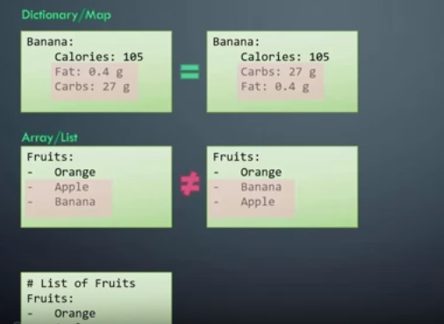
Dictionary is un ordered and Arrays or list is ordered

Slide 13
How to Install
Master Runs only on Linux
Minions Run both on Windows and Linux
### install Salt Latest version
curl -L https://bootstrap.saltstack.com -o install_salt.sh
## install salt with Master and Minion
sudo sh install_salt.sh -P –M (-P pip Packages / -M master)
## installation complete!
sudo vi /etc/salt/minion
### update the minion id and master
master: localhost
id: SALT Minion Server 2

Slide 14
Working on SALT
Need to know
Master
Minion
GLOB *
SLS or SaLt State file
Two types of Variables
Grains (used for gathering minion property dynamically)
Pillars (user defined push some data to minion)

Slide 15
Salt Master
The Salt master daemon, used to control the Salt minions
Salt master will publish to Event bus which is zero MQ
Some Times Master will also do the subscribe
Master runs only on Linux
Salt Master is the central bus for all the minions
We can also have Multi Master configuration
sudo vi /etc/salt/minion(Enter the master)
master: localhost (or the FQDN name)
id: admaticweb1 -> Minion ID
To Check Salt Master status
Sudo Service salt-master status

Slide 16
Salt Minion
Salt Minion will subscribe to the event bus
Minion will have Minion ID(SALTMinion Server 2)
, If missed Hostname will be taken as Minion ID.
Minions runs both on Linux and windows
To Check the status of Minion
Sudo Service salt-minionstatus
To Check the log files if Minion
sudo tail -100 /var/log/salt/minion
Minions will be mentioned under
sudo vi /etc/salt/minion

Slide 17
Some Basic commands
How to restart Master
sudo service salt-master restart
To Check the log files
sudo tail -100 /var/log/salt/master
netstat –nltp
You should see 4505 and 4506 port running
To list the available Minions sudo salt-key
sudo salt-key
To Accept the Minion
sudo salt-key –a SALT Minion Server 2
Notes:
sudo salt --version
salt 2018.3.0 (Oxygen)

Slide 18
Grains
Grains used to collect Minion property dynamically
sudo salt '*' test.ping -> we used Glob here which takes the list and o/p of all Minions
Grains are used for Gathering
sys.list_functions are used to check all commands available for a function
sudo salt '*' sys.list_functions test
Grains provide information about the target system -- for example, its OS version -- to the minions.
Notes:
Two types of variables
- Grains ->Dynamic
-Pillars -> Static
# sudo salt 'test' grains.items
# sudo salt 'test' grains.item os
# sudo salt --grain 'os_family:Debian' test.ping
#GLOB matching (default)
*
web*

Slide 19
Pillars
Pillars are user defined variables
Push some data to Minion
Pillar data is useful for:
Highly Sensitive Data
Minion Configuration
Variables
To start setting up the pillar, the /srv/pillar directory needs to be present:
mkdir /srv/pillar
Note
Grains and Pillar are sometimes confused, just remember that Grains are data about a minion which is stored or generated from the minion. This is why information like the OS and CPU type are found in Grains.
Pillar is information about a minion or many minions stored or generated on the Salt Master.
Notes:
vi /srv/salt/cron.sls
#cat cron.sls
crontabs:
pkg.installed
crond:
service.running
Command : root@ip-172-31-82-145:/srv/salt# salt '*' state.sls admaticweb

Slide 20
Top File
Top.sls file is Default on the top . Top files are named top.sls by default.
In a infrastructure There would be different domains with a group of machines the configuration roles that should be applied to them is called a top file.
To trigger top.sls is called state.highstate
Salt * state.highstate
State File Pillar file
For config mgmt For Data Access
/srv/salt/top.sls /srv/pillar/top.sls
Salt command (Remote Execution)
Salt Run (On Master)
Salt-call (Local Machine)
Notes:
Templating is Dynamic to produce value we enter and it refer to the Static file on minion
In the minion we enter the path to refer for the Template
Temlating is Known as JinJa 2 Template
root@ubuntu-s-6vcpu-16gb-blr1-01:/srv/salt# cat top.sls
base: # Apply SLS files from the directory root for the 'base' environment
'*': # All minions with a minion_id
- cron # Apply the state file named 'cron.sls'

Slide 21
Quick refresh
Salt which is a latest and highly Stable Configuration management and Devops tool uses a Master slave concept with a Event Bus called Zero MQ
By This time we should know why Salt is one of the better configuration management tool and installation of salt as exe and Bootstrap format
And General commands like how to start, stop or add a Minion and to gather Grain or Push data to a Pillar where to set a top value to see logs and some basic commands.

