Slide 1
Meeting #3
July 13

Slide 2
Agenda
Why does Tesseract OCR the ligatures?
Missing file
Some analysis
Crop out marginalia
Before and after comparison
Improve code/framework
Progress and plans

Slide 3
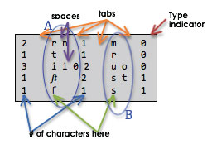
Ligature OCR?
Missing unicharambigs file

Slide 7
Marginalia
Used Photoshop CS6 on library computers
Cropped files are OCR’d with Reg Font Training with only the mandatory unicharambigs file

Slide 8
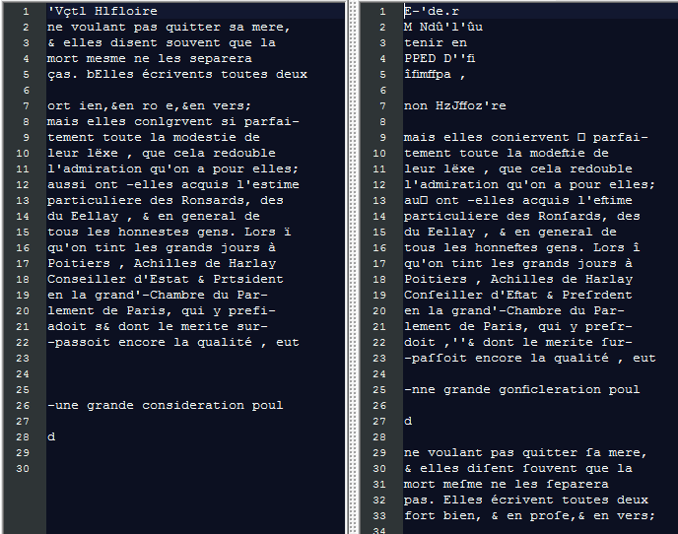
After Crop
Before Crop

Slide 9
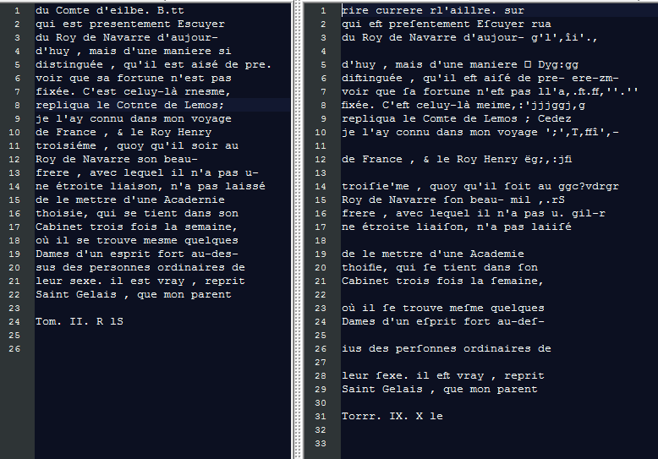
After Crop
Before Crop

Slide 10
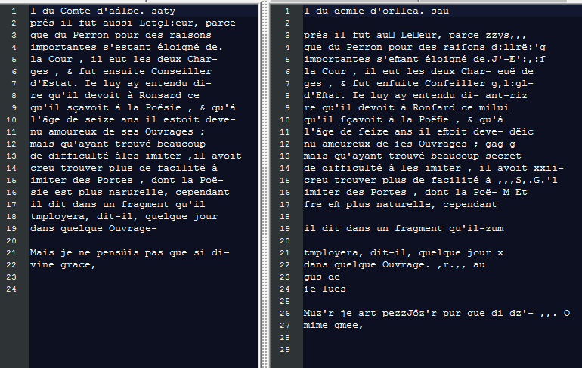
After Crop
Before Crop

Slide 11
Improve framework
Dictionary storage
Execution of WillModule
Order of stops in the flowchart
Reading dictionaries

Slide 12
Data Storage
Used three French dictionaries 2015
Two old plus one modern
(124,741 + 147,185 + 338,986 = 610,912)
Risk of reading duplicate values
All combined into single dictionary
Duplicates removed
Length of new dictionary = 428,564 (30% less words)

Slide 13
Frequent word dictionary
Ground truth from Conversations
Sorted by word frequency
7,514 unique words
3,853 occur 2+ times -> Used for training
The 1000th word occurred about 20 times
Check this dictionary before the combined one in Will Module

Slide 14
Order of Flowchart
Write some code to see how many errors are fixed at each step

Slide 15
Multiprocessing
Multithreading is no good in Python
Global Interpreter Lock (GIL)
Ideal for programs with lots of I/O
Multiprocessing
Does not have GIL
Ideal for CPU Bound programs
Lots of different ways to implement
Figuring this out…

