Slide 1
Introduction to the PDM Professional API
Chris Vaught
Founder – Flatter Files
cvaught@flatterfiles.com

Slide 2
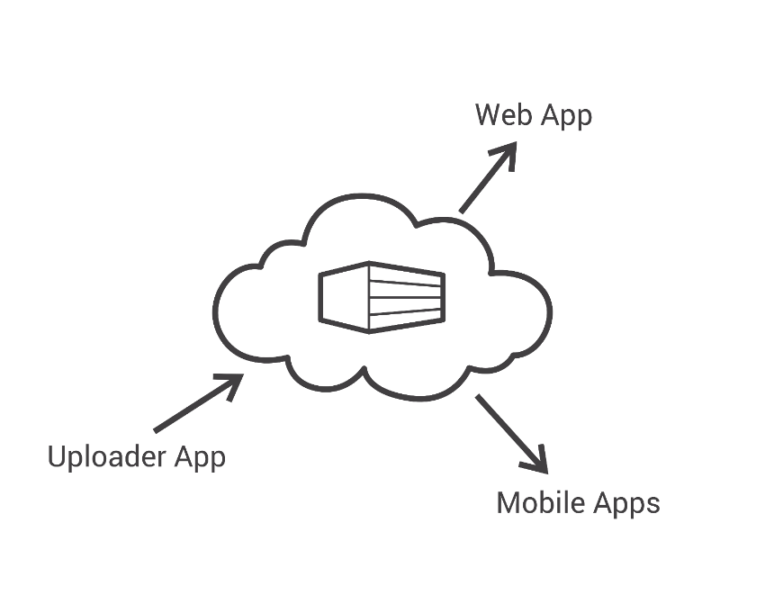

My Background
Engineer
Self taught programmer
Founder and Developer of Flatter Files
Full Stack Development
Uploader – C# .NET
Server Side – Java
Web App – Javascript
iOS – Objective C
Android - Java

Slide 3
Overview
Why Write an Application
General Getting Started Tips
Tools for SOLIDWORKS Development
Discuss SOLIDWORKS PDM Professional API
Build Application

Slide 4
Why Write an Application?
Never do a task more than one time
Improve Productivity
Impress your boss
Expand your capabilities

Slide 5
Getting Started Tips
Google Search, Google Search, Google Search
Never write code more than once in a project
Learn object oriented programming and fully understand it
Online tutorials
Microsoft Virtual Academy - https://mva.microsoft.com
https://www.microsoft.com/net/tutorials/csharp/getting-started

Slide 6
Tools for SOLIDWORKS Development
Visual Studio 2015
Community Edition
C#
.NET Framework
Windows Forms Application

Slide 7
SOLIDWORKS API Development
Document Manager API
Application API
PDM Professional API

Slide 8
PDM Professional API
Two types of applications can be created
Stand-alone (.exe and .dll)
Add-in
Two primary interop assemblies located in the installation folder
EPDM.Interop.epdm.dll
EPDM.interop.EPDMResultCode.dll
API is not available for PDM Standard
Online documentation
http://help.solidworks.com/2017/English/api/epdmapi/Welcome-epdmapi.html

Slide 9
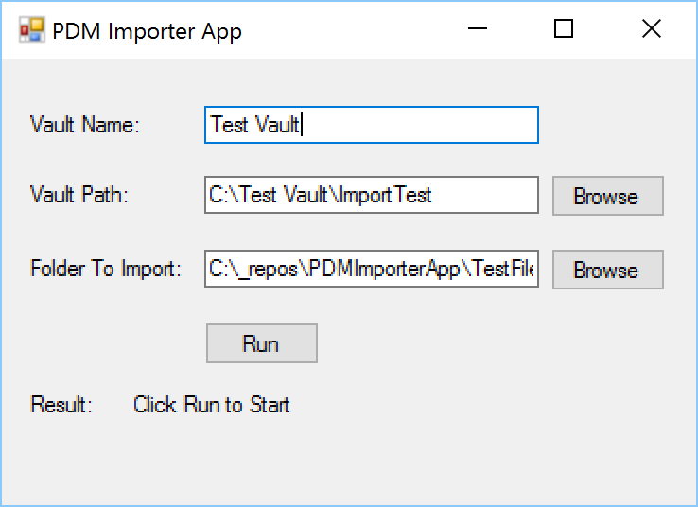
Application
PDM Importer App
C# .NET Windows Forms Stand-alone Application
Single Window
Inputs:
Vault Name
Vault Path
Folder To Import
Imports the file, checks it in, and changes state

Slide 10
Build Application
Create a new Visual Studio Solution
Create the UI
Implement the required UI logic to support the inputs
Add the interop
Implement the task logic to import files into PDM
Test the resulting application

Slide 11
Questions?
Source Code:
https://github.com/cvaught/PDMImporterApp
Chris Vaught
Founder – Flatter Files
cvaught@flatterfiles.com

