Slide 1
Introduction to the SOLIDWORKS API
Chris Vaught
Founder – Flatter Files
cvaught@flatterfiles.com

Slide 2
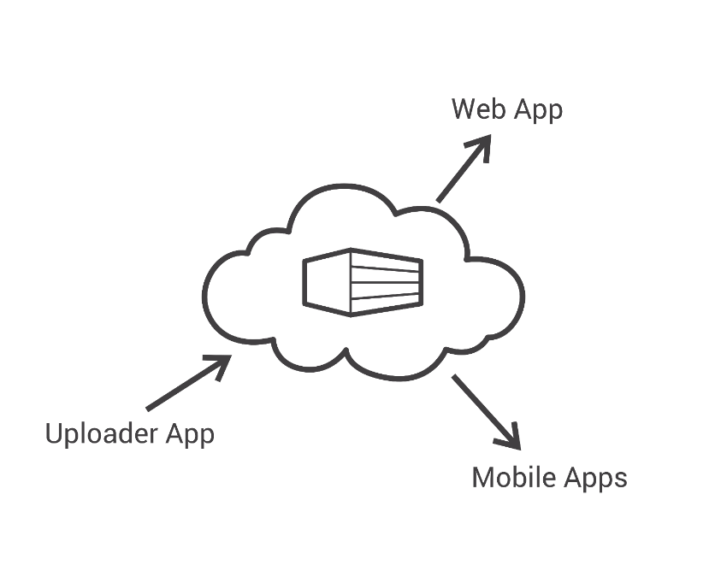
My Background
Engineer
Self taught programmer
Founder and Developer of Flatter Files
Full Stack Development
Uploader – C# .NET
Server Side – Java
Web App – Javascript
iOS – Objective C
Android - Java
Notes:
The result of developing for all of those platforms is that I’m not necessarily an expert in anything.

Slide 3
Overview
Why Write an Application?
Getting Started Tips
Macros vs Add-ins vs Stand-alone
Discuss SOLIDWORKS API
Tools for SOLIDWORKS Development
Create a Simple Application
Notes:
- As mentioned previously we are primarily going to discuss what it takes to build a batch processing app. Thus we will start with an overview of the current state of the application

Slide 4
Why Write an Application?
Never do a task more than one time
Improve Productivity
Impress your boss
Expand your capabilities
Notes:
Emphasize the part about making it easy to add additional capabilities and how that will impact the architecture of the application.

Slide 5
Getting Started Tips
Google Search, Google Search, Google Search
Never write code more than once in a project.
Learn object oriented programming and fully understand it.
Online Tutorials
Microsoft Virtual Academy - https://mva.microsoft.com
https://www.microsoft.com/net/tutorials/csharp/getting-started

Slide 6
Macros vs Add-ins vs Stand-alones
Macros
VBA scripting to automate tasks inside of SOLIDWORKS
Add-ins
More capable/professional automation but also runs inside of SOLIDWORKS
Stand-alones
Automate SOLIDWORKS from another application.
Reference
http://www.cadsharp.com/blog/macro-vs-add-in-vs-stand-alone/

Slide 7
When to use Macros vs Add-ins vs Stand-alones?
Macros
Need to automate a task for personal use and likely has limited long term use.
Add-ins
Need to automate a task that will be distributed company wide or to customers.
Stand-alones
Want to build a single application that integrates with multiple applications or simply are processing many files at once.
Stand-alone applications allow you to manage SW independently. For example you can handle SW crashes.

Slide 8
SOLIDWORKS API
SOLIDWORKS Document Manager API
Interop.SwDocumentMgr.dll
SOLIDWORKS API
Interop.SldWorks.dll
Interop.SwConst.dll

Slide 9
SOLIDWORKS Document Manager API
Allows you to write applications that emulate file management tools to perform such tasks as renaming, replacing, and copying SOLIDWORKS documents.
SOLIDWORKS does not have to be installed on the machine
Specific License Key for the Document Manager API must be obtained
http://www.solidworks.com/sw/support/api-support.htm
License key must be updated each year for the latest version of SOLIDWORKS
Way faster since SOLIDWORKS doesn’t have to be opened on the machine.
Notes:
Briefly explain the difference between the Doc Manager api and the full SW API where you control the full application.

Slide 10
SOLIDWORKS API
Full access to control SOLIDWORKS
Generally anything you can do in SOLIDWORKS can be done via the API
API steps required is similar to user controlling SOLIDWORKS.
Notes:
Briefly explain the difference between the Doc Manager api and the full SW API where you control the full application.

Slide 11
Tools for SOLIDWORKS Stand-alone Development
Visual Studio 2017
Community Edition
C#
.NET Framework
Windows Forms Application

Slide 12
Demo Application
Stand-alone Application
Open or connect to SOLIDWORKS
Open example part
Delete hidden solid bodies
Export to STEP file
Close SOLIDWORKS

Slide 13
Build Application

Slide 14
Questions?
Source Code:
https://github.com/cvaught/SimpleSldWorks
Chris Vaught
Founder – Flatter Files
cvaught@flatterfiles.com

