Slide 1

Welcome to Python!
Session 1: Introduction to Python & Programming Basics
Duration: 1 hour 40 minutes
Your instructor is excited to meet you! 🎉

Slide 2
📋 What We'll Cover Today
1. What is Python & why learn it?
2. Setting up your environment
3. Hello, World!
4. Literals & Variables
5. Comments in Python
6. Arithmetic & Assignment Operators
7. Data Types
8. Type Conversion
9. User Input with input()
10. Comparison Operators
11. if, elif, else statements
Notes:
Question 1
What best describes programming as a process?
A physical activity involving hardware manipulation
A random set of commands given to a computer
A sequence of instructions executed by a computer
A language only understood by humans
Question 2
What is the role of main memory in a computer's hardware architecture?
To execute instructions
To permanently store data files and applications
To store data that is actively being used by the CPU
To connect the CPU to external devices
Question 3
What is one common challenge beginners face when learning Python?
Configuring Python to run on a quantum computer
Understanding indentation and its role in Python syntax
Writing code without using any variables
Memorizing all Python libraries

Slide 3
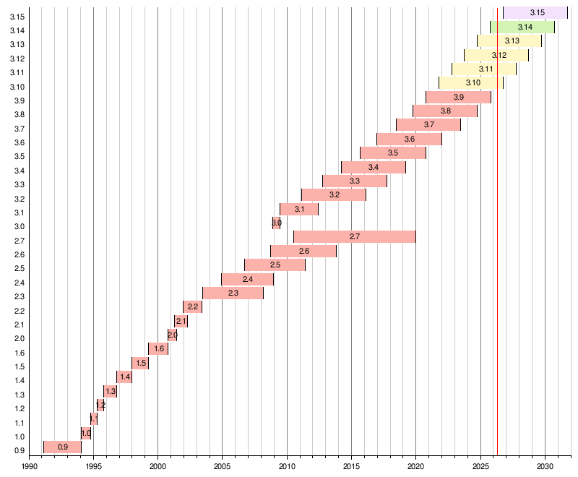
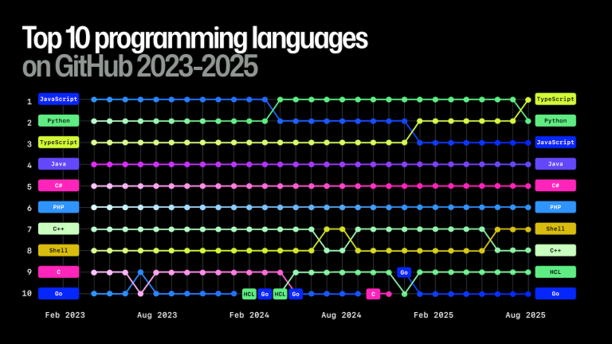
🌍 What is Python?
• A general-purpose, high-level programming language
• Created by Guido van Rossum in 1991
• Named after Monty Python's Flying Circus 🎭
• One of the most popular languages in the world
https://survey.stackoverflow.co/2025/technology
https://www.tiobe.com/tiobe-index/
https://spectrum.ieee.org/top-programming-languages-2025
Notes:
A general-purpose language (GPL) is a programming language designed to create software across a wide variety of application domains, rather than being limited to one specific area.
Unlike domain-specific languages (DSLs) like SQL or HTML, GPLs are versatile, offering general constructs to build applications such as web servers, desktop tools, and complex systems.

Slide 4
🚀 What Can Python Do?
Field | Examples
🌐 Web Development | Django, Flask, FastAPI
🤖 AI & Machine Learning | TensorFlow, PyTorch, NLTK, Keras
📊 Data Science | Pandas, NumPy
🎮 Game Development | Pygame
🔬 Science & Research | NASA, CERN
🤖 Automation | Scripts, bots, task automation
Python is everywhere — and it's beginner-friendly!
Notes:
Web Development: Python powers backend systems for websites. Frameworks such as Django and Flask allow for fast, secure development and handling of database interactions.
AI & Machine Learning: Developers use Python to build artificial intelligence, machine learning models, and deep learning algorithms for tasks like predictions, object recognition, and natural language processing (NLP).
Data Analysis & Visualization: Python is a dominant language in data science. It is used to analyze complex datasets, create visualizations (graphs, plots), and perform numerical calculations using libraries like NumPy and Pandas.
Game Development: While not used for heavy 3D titles, it’s great for 2D games and rapid prototyping with the Pygame library.
Real-World Examples
Field Real-World Use Case
Space NASA uses it for data processing and astrophysics.
Finance Banks use it for algorithmic trading and risk analysis.
VFX Programs like Blender and DaVinci Resolve use it for scripting custom tools.
Cybersecurity Used for ethical hacking, penetration testing, and digital forensics.
CERN Scientists at the European Organization for Nuclear Research used Python to process data from the Large Hadron Collider, playing a key role in the discovery of the Higgs boson particle.
Medical Pharmaceutical companies like AstraZeneca use Python to speed up drug discovery. Researchers at MIT recently used Python-based neural networks to discover a powerful new antibiotic named Halicin.
Python is a highly versatile language, and there’s a lot you can do with it. However, you can’t do everything. There are things Python isn’t well-suited for.
As an interpreted language, Python has trouble interacting with low-level hardware. You’d have a problem if you wanted to write a device driver or an operating system with Python.
You’re better off sticking with C or C++ for low-level applications.
To learn Python effectively, focus on fundamental programming principles and basic syntax first. Decide if your goal is general programming, data science, or web development, as this will guide your course choice. Beginners should start with introductory courses that cover core concepts like variables, control flow, and functions. If you aim to use Python for data analysis or AI, build foundational skills in data handling and libraries. Consider your available time and preferred learning style to pick a course that fits your schedule and depth of study. To learn Python effectively, focus on fundamental programming principles and basic syntax first. Decide if your goal is general programming, data science, or web development, as this will guide your course choice. Beginners should start with introductory courses that cover core concepts like variables, control flow, and functions. If you aim to use Python for data analysis or AI, build foundational skills in data handling and libraries. Consider your available time and preferred learning style to pick a course that fits your schedule and depth of study.
However, even that might not be true for much longer.
As a testament to Python’s flexibility, there are people out there who are working on projects that extend Python’s usability to low-level interactions.
MicroPython and CircuitPython are just some of these projects designing low-level capabilities for Python.

Slide 5
💻 Setting Up Your Environment
Option 1: Local Install (Recommended)
Verify your installation:
1. Go to python.org/downloads
2. Download Python 3.10 or newer
3. Install VS Code + Python extension
python --version
# Should show: Python 3.10.x or higher
Option 2: Online (Zero Setup)
• Google Colab — free, in your browser
Notes:
Popular IDEs and Editors
Visual Studio Code (VS Code): A highly popular, free, and open-source editor from Microsoft. It is lightweight but becomes a powerful IDE with the Python extension, which adds support for debugging, linting, and IntelliSense.
PyCharm: A dedicated Python IDE by JetBrains. The Community edition is free, while the Professional version includes tools for web frameworks like Django and Flask.
IDLE: The default, minimal IDE that comes bundled with Python installations. It is extremely lightweight and useful for quick scripts.

Slide 6
👋 Your First Python Program
Open your editor and type:
print("Hello, World!")
Run it! You should see:
Hello, World!
Congratulations — you're a programmer! 🎉
More print examples:
print("My name is Bob.")
print("There are", 60 * 60 * 24, "seconds in a day.")
print("The answer to the Ultimate Question of Life, The Universe, and Everything is", 42)
Notes:
Interactive
- You type directly to Python one line at a time and it responds
Script
- You enter a sequence of statements (lines) into a file using a text editor and tell Python to execute the statements in the file
Interactive Python is good for experiments and programs of 3-4 lines long.
Most programs are much longer, so we type them into a file and tell Python to run the commands in the file.
In a sense, we are “giving Python a script”.
As a convention, we add “.py” as the suffix on the end of these files to indicate they contain Python.
Great! Let's dive into The Programmer's Role. To start, what do you think a programmer does on a daily basis?
Writing programs is definitely a core part of a programmer's job. But what else might they do besides just typing code?
Think about the whole process of creating software or an application. What other activities might be involved?
A crucial part of a programmer's work-> the high-level design and structure of a system.
Problem-solving is at the heart of what programmers do! They're constantly analyzing challenges and devising solutions.

Slide 7
📦 Literals
A literal is a textual representation (notation) of a value as it is written in source code.
Fixed values such as numbers, letters, and strings.
String constants use single quotes (‘) or double quotes (").
print("My name is Bob.")
print('Also a string')
print("""This is a string that
can span multiple lines""")
print('''This is also a string that
can span multiple lines''')
print(255)
print(10_000_000)
print(7.5)
print(1.0e-3)
Notes:
"foobar" # a string literal
b"\0\0\7" # a bytes literal
42 # an integer literal
7.0 # a float literal
16j # an imaginary literal
True # a boolean literal
None # the None literal
[1, 2, 3] # a list literal (made of integer literals)
('x', 'y', 'z') # a tuple literal (made with string literals)
{ 'a': 1, 'b': 2 } # a dictionary literal
{ 1, 2, 3 } # a set literal
print(255)
print(0b11111111)
print(0o377)
print(0xFF)
print(10_000_000)
print(7.5)
print(1.0e-3)
print(3 + 4j)
print([1, 2, 3])
print(True)
print(False)
print(None)

Slide 8
📦 Variables — Boxes That Hold Values
A variable is a named place in the memory where a programmer can store data and later retrieve the data using the variable “name”.
Programmers get to choose the names of the variables.
x = 12
y = 14
print(x)
print(y)
z = x + y
print(z)
x
12
y
14
z
26

Slide 9
📦 Variables — Boxes That Hold Values
You can change the contents of a variable in a later statement
x = 12
y = 14
print(x)
print(y)
z = x + y
print(z)
x = 100
x
12 100
y
14
z
26

Slide 10
📦 Variables — Reserved Words
You cannot use reserved words as variable names / identifiers
False await else import pass
None break except in raise
True class finally is return
and continue for lambda try
as def from nonlocal while
assert del global not with
async elif if or yield

Slide 11
📦 Variables — Name Rules
• Must start with a letter or underscore _ (not a number)
• No spaces, use underscore _ instead: first_name
• Case-sensitive: age ≠ Age
Rules for variable names:
Good: spam eggs spam23 _speed
Bad: 23spam #sign var.12
Different: spam Spam SPAM
Notes:
Snake case (snake_case) and camel case (camelCase) are popular naming conventions used to combine multiple words into a single identifier, as spaces are invalid in programming code.
Snake case uses underscores to separate words, favored in Python and Rust, while camel case capitalizes new words, common in JavaScript and Java.

Slide 12
📦 Mnemonic Variable Names
Since we programmers are given a choice in how we choose our variable names, there is a bit of “best practice”
We name variables to help us remember what we intend to store in them (“mnemonic” = “memory aid”)
What is this bit of code doing?
x1q3z9ocd = 35.0
x1q3z9afd = 12.50
x1q3p9afd = x1q3z9ocd * x1q3z9afd
print(x1q3p9afd)
a = 35.0
b = 12.50
c = a * b
print(c)
hours = 35.0
rate = 12.50
pay = hours * rate
print(pay)

Slide 13
💬 Comments in Python
Comments explain your code — they are ignored by Python.
# This is a single-line comment
# Calculate the area of a rectangle
width = 5
height = 3
area = width * height # multiply width by height
print(area) # prints 15
# Multi-line comment (use multiple #):
# Step 1: Get user input
# Step 2: Do calculation
# Step 3: Display result
"""
This is a multi-line comment (use triple quotes).
It is often used for docstrings (documentation strings) in functions and classes.
This text will not be executed as code.
Multi-line comments are useful for providing detailed explanations or for temporarily
commenting out blocks of code during development.
"""

Slide 14
📦 Assignment Statements
We assign a value to a variable using the assignment statement (=)
An assignment statement consists of an expression on the right-hand side and a variable to store the result
hours_per_day = 24
days_per_week = 7
seconds_per_week = 60 * 60 * hours_per_day * days_per_week
print(seconds_per_week)

Slide 15
➕ Arithmetic Operators
a = 10
b = 3
print(a + b) # 13 Addition
print(a - b) # 7 Subtraction
print(a * b) # 30 Multiplication
print(a / b) # 3.333 Division (always float)
print(a // b) # 3 Floor Division
print(a % b) # 1 Modulo (remainder)
print(a ** b) # 1000 Exponentiation (10³)
Highest precedence rule to lowest precedence rule
Parentheses are always respected
Exponentiation (raise to a power)
Multiplication, Division, and Remainder
Addition and Subtraction
Left to right
x = 1 + 2 * 3 - 8 / 2 ** 3
x = 1 + (2 * 3) - (8 / (2 ** 3))
print(x)
Notes:
PEMDAS și BODMAS sunt acronime utilizate pentru a memora ordinea operațiilor matematice (paranteze, exponenți/puteri, înmulțire/împărțire, adunare/scădere).
Deși folosesc termeni diferiți (ex: Paranteze vs Brackets), ambele urmează aceleași reguli fundamentale: operațiile de același nivel se rezolvă de la stânga la dreapta.
Ce înseamnă acronimele:
PEMDAS (SUA/Franța): P-Paranteze, E-Expoenți, M-Înmulțire, D-Împărțire, A-Adunare, S-Scădere.
BODMAS (UK/Commonwealth): B-Brackets (Paranteze), O-Orders (Puteri/Radicale), D-Division (Împărțire), M-Multiplication (Înmulțire), A-Addition (Adunare), S-Subtraction (Scădere)
Reguli cheie de aplicare:
Paranteze (P/B): Rezolvați mai întâi tot ce este în paranteze.
Exponenți/Ordin (E/O): Calculați puterile și radicalii.
Înmulțire și Împărțire (M&D): Au prioritate egală. Important: Se calculează de la stânga la dreapta, în ordinea în care apar.
Adunare și Scădere (A&S): Au prioritate egală. Se calculează de la stânga la dreapta.

Slide 16
🔄 Assignment Operators
x = 10 # Assign
x += 5 # x = x + 5 → 15
x -= 3 # x = x - 3 → 12
x *= 2 # x = x * 2 → 24
x /= 4 # x = x / 4 → 6.0
x //= 2 # x = x // 2 → 3.0
x **= 3 # x = x ** 3 → 27.0
String operations:
first = "Hello"
last = "World"
full = first + " " + last # "Hello World" — concatenation
repeated = "Ha" * 3 # "HaHaHa" — repetition
text = "=" * 50
text += "\n ⭐ ⭐ ⭐ Welcome to Python ⭐ ⭐ ⭐ \n"
text += "=" * 50
print(text)

Slide 17
🔠 Data Types
Python knows what “type” everything is
# Integer — whole numbers
score = 100
year = 2024
# Float — decimal numbers
price = 9.99
pi = 3.14159
# String — text (use quotes)
greeting = "Hello!"
city = 'Bucharest'
# Boolean — True or False
is_raining = False
passed_exam = True
# Check a type with type()
print(type(score)) # <class 'int'>
print(type(price)) # <class 'float'>
print(type(greeting)) # <class 'str'>
print(type(is_raining)) # <class 'bool'>

Slide 18
🔠 Type Matters
score = 100
greeting = "Hello!"
# Check a type with type()
print(type(score)) # <class 'int'>
print(type(greeting)) # <class 'str'>
# Type matters
# Python knows what type everything is, and it will not allow you to mix
# incompatible types without explicit conversion.
# For example, you cannot add a number and a string directly:
# This will cause an error:
# result = score + greeting # TypeError: unsupported operand type(s) for +: 'int' and 'str'
# To combine different types, you need to convert them to a common type:
result = str(score) + " " + greeting # Convert score to string and concatenate
print(result) # "100 Hello!"

Slide 19
🔁 Dynamic typing
Dynamic typing is one of Python's core features that sets it apart from statically typed languages.
In Python, variables are not bound to a specific type at declaration.
Instead, the type is determined at runtime based on the assigned value.
This means that a single variable can hold data of different types throughout its lifetime.
# Initially assigning an integer value
x = 42
print("x =", x, "| Type:", type(x))
# Reassigning a string value to the same variable
x = "Dynamic Typing in Python"
print("x =", x, "| Type:", type(x))
Notes:
Benefits of Dynamic Typing
Flexibility: Variables can change types over time which can simplify code during rapid prototyping or when handling data that may vary in type.
Ease of Use: Developers don't need to explicitly declare types, which can reduce boilerplate code and make the language more accessible, especially to beginners.
Rapid Development: Since types are determined at runtime, developers can iterate quickly without the overhead of static type checks during the coding process.
Disadvantages of Dynamic Typing
Runtime Errors – Type-related issues are detected only at runtime leading to unexpected crashes if incompatible types are used.
Reduced Performance – Since types are determined dynamically, Python incurs extra overhead compared to statically typed languages.
Code Maintainability Issues – Without explicit types understanding variable types in large codebases can be difficult thereby making debugging harder.

Slide 20
🔁 Type Conversion
Convert between types using built-in functions:
# String → number
age = int("25") # 25
age = int("0x35", 16) # 53 (hexadecimal to decimal)
# age = int("test") # This would cause a ValueError
price = float("9.99") # 9.99
# Number → string
text = str(42) # "42"
text = str(3.14) # "3.14"
# Boolean conversions
bool(0) # False
bool(1) # True
bool("") # False
bool("hi") # True
int(True) # 1
int(False) # 0
# One-liner (common pattern):
int(bool("hi")) # True → 1

Slide 21
⌨️ User Input with input()
input() pauses the program and waits for the user to type something.
name = input("What is your name? ")
print("Hello,", name)
age = input("How old are you? ")
print("You are", age, "years old.")
⚠ Important: input() always returns a string!
# If you want to treat the input as a number, you need to convert it using int() or float():
print(type(age)) # <class 'str'> — age is a string
print("You are " + age + " years old.") # This works because age is a string
new_age = age + 1 # This will cause an error because you cannot add a string and an integer.
# To fix this, we need to convert age to an integer first:
new_age = int(age) + 1 # Convert age to an integer before adding 1
print("Next year, you will be " + str(new_age) + " years old.")

Slide 22
⚖️ Comparison Operators
These return: True or False.
Comparison operators look at variables but do not change the variables.
x = 10
y = 5
print(x == y) # False — Equal to
print(x != y) # True — Not equal to
print(x > y) # True — Greater than
print(x < y) # False — Less than
print(x >= 10) # True — Greater than or equal
print(x <= 9) # False — Less than or equal
is_x_greater = x > y
print(is_x_greater) # True
print(5 < x < 15) # True — x is greater than 5 and less than 15
# Works with strings too!
name = "Alice"
print(name == "Alice") # True
print(name == "alice") # False ← case-sensitive!
print(name != "Bob") # True
print(name > "Bob") # False — "Alice" comes before "Bob"

Slide 23

📋 Program Steps or Program Flow
Like a recipe or installation instructions, a program is a sequence of steps to be done in order.
Some steps are conditional - they may be skipped.
Sometimes a step or group of steps is to be repeated.
Sometimes we store a set of steps to be used over and over as needed several places throughout the program.

Slide 24
🔀 if / elif / else
One-Way Decisions
x = 5
print('Before 5')
if x == 5 :
print('Is 5')
print('Is Still 5')
print('Third 5')
print('Afterwards 5')
print('Before 6')
if x == 6 :
print('Is 6')
print('Is Still 6')
print('Third 6')
print('Afterwards 6')
Before 5
Is 5
Is Still 5
Third 5
Afterwards 5
Before 6
Afterwards 6
Yes
x == 5 ?
No
print('Is 5’)
print('Still 5')
print('Third 5')

Slide 25
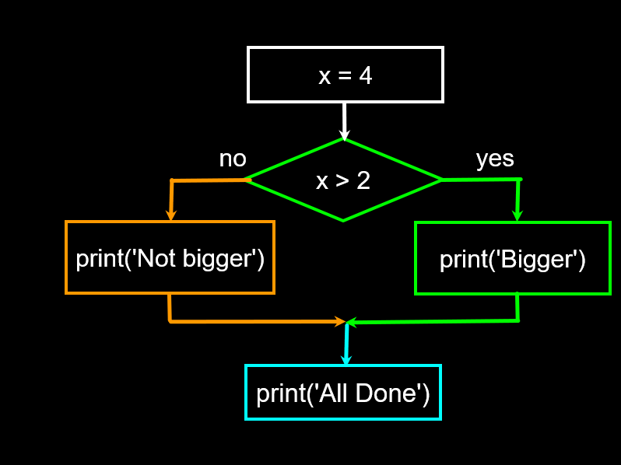
🔀 if / elif / else
Two-Way Decisions with else:
x = 4
if x > 2 :
print('Bigger')
else :
print('Smaller')
print('All done')

Slide 26
🔀 More if / elif / else Examples
# Grade classifier
score = int(input("Enter your score: "))
if score >= 90:
grade = "A"
elif score >= 80:
grade = "B"
elif score >= 70:
grade = "C"
elif score >= 60:
grade = "D"
else:
grade = "F"
print(f"Your grade is: {grade}")
★ Key rule: Conditions are checked top to bottom — first True wins!

Slide 27
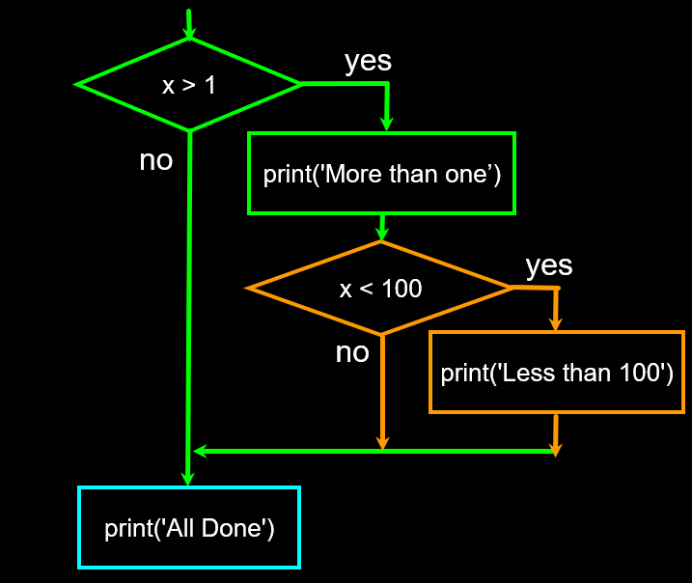
🔀 Nested decisions
Nested decisions
x = 42
if x > 1 :
print('More than one')
if x < 100 :
print('Less than 100')
print('All done')

Slide 28
📝 Indentation
Increase indentation after an if statement (after : )
Maintain indentation to indicate the scope of the block (which lines are affected by the if)
Reduce indentation back to the level of the if statement to indicate the end of the block
Blank lines are ignored - they do not affect indentation
Comments on a line by themselves are ignored with regard to indentation
x = 5
if x > 2 :
print('Bigger than 2’)
print('Still bigger’)
print('Done with 2')
for i in range(5) :
print(i)
if i > 2 :
print('Bigger than 2’)
print('Done with i', i)
print('All Done')

Slide 29
🧮 Putting It All Together
import random
# use random integer to select a random option for the computer to play against the user
computer_choice = random.randint(0, 2) # Random integer between 0 and 2 (inclusive)
# assume 0 = rock, 1 = paper, 2 = scissors
if computer_choice == 0:
computer_choice = "rock"
elif computer_choice == 1:
computer_choice = "paper"
else:
computer_choice = "scissors"
user_choice = input("Enter your choice (rock, paper, scissors): ").lower()
if user_choice == computer_choice:
print(f"Both chose {user_choice}. It's a tie!")
elif user_choice == "rock" and computer_choice == "scissors":
print(f"You win! {user_choice} beats {computer_choice}.")
elif user_choice == "paper" and computer_choice == "rock":
print(f"You win! {user_choice} beats {computer_choice}.")
elif user_choice == "scissors" and computer_choice == "paper":
print(f"You win! {user_choice} beats {computer_choice}.")
else:
print(f"You lose! {computer_choice} beats {user_choice}.")

Slide 30
🎯 Practice Exercises
Try these on your own:
Exercise 1
Print your name and age using variables
Exercise 2
Calculate and print the area of a circle • Get the radius from the user • Use pi = 3.14159 • Area = π × r²
Exercise 3
Temperature converter • Ask for temperature in Celsius • Convert to Fahrenheit: F = C × 9/5 + 32 • Print the result

Slide 31
🎉 Session 1 Recap
✅ What Python is and why it's awesome
✅ How to set up your coding environment
✅ print() — displaying output
✅ Variables and the 4 basic data types
✅ Arithmetic and assignment operators
✅ input() — getting user input
✅ Type conversion: int(), float(), str()
✅ Comparison operators
✅ if/elif/else
See you in Session 2! 🚀

