Slide 1

PARKINSON’S DISEASE
SPIRAL DRAWINGS
Bernardi Alberto, Ma Jiawei, Andrea Sinigaglia
Statistical Methods for High Dimensional Data
Data Science
Master Degree
January 11th, 2021

Slide 2
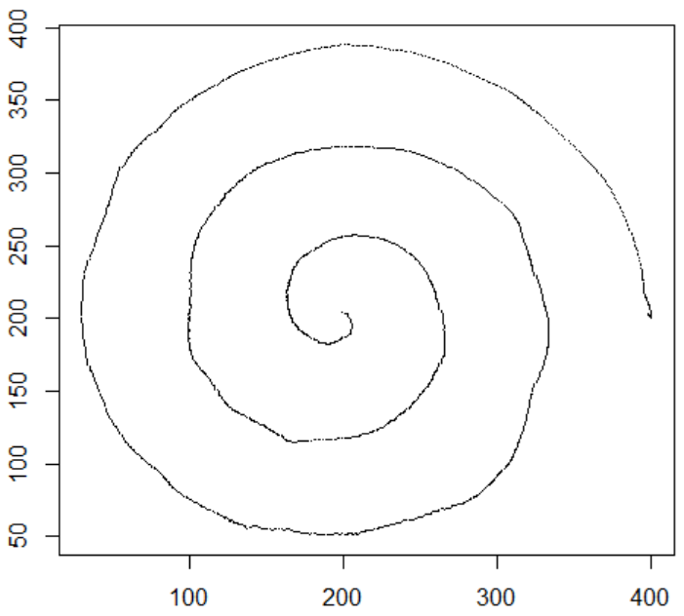
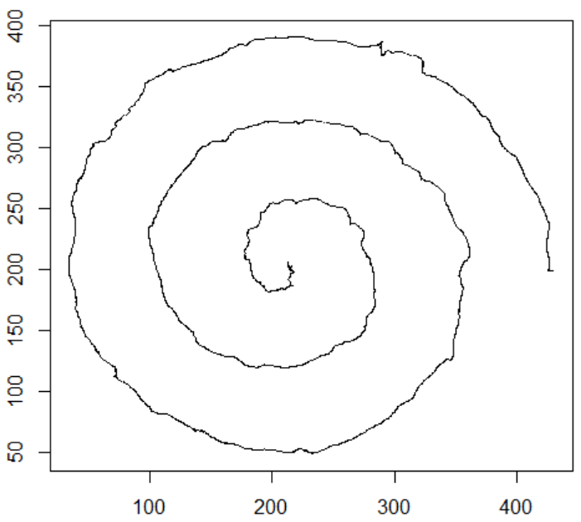
Dataset
Static Test
Parkinson Disease Spiral Drawings Using Digitized Graphics Tablet Data Set
77 people, but 72 considered: 15 control patients and 57 Parkinson’s ones.
Static and Dynamic Spiral tests
(x,y,z) coordinates, pressure, grip angle and timestamp of sampling in .txt files
Dynamic Test
Figures: two examples of drawn spirals obtained plotting the (x,y) coordinates for two patients, a control one (left) and a Parkinson’s one (right)

Slide 3
Goals & Specifications
Work in a high dimensional framework
Focus not on the predictive power but on the interpretability of the models Look for salient features
Investigate tremor importance and characteristics
Three approaches:
Graphical
Distance at Timestamps
Multi-Statistics
Few data available and unbalance between the classes Cross-Validation for model fitting

Slide 4
Distance at Timestamps Approach
FIT SPIRAL
MODEL TEST0
PROCESS DATA COMPUTING DEGREES
PREPROCESS RAW DATA
ANALYZE RESULTS
LOGISTIC
GROUP LASSO
FIT SPIRAL
MODEL TEST1
Remark: Static and Dynamic tests are considered separately and referred to as Test0 and Test1.

Slide 5
Distance at Timestamps Approach
We transformed.txt documents into R lists of data frames
For this method we considered only x and y spatial coordinates and the timestamp information
For each patient we considered the same number of observations
PREPROCESS RAW DATA
X | Y | Z | Grip Angle | Pressure | Sampling Time | Test
213 | 205 | 0 | 15 | 1440 | 1351716 | 0
213 | 205 | 0 | 47 | 1440 | 1351725 | 0
213 | 205 | 0 | 68 | 1440 | 1351734 | 0
213 | 205 | 0 | 84 | 1420 | 1351743 | 0
214 | 205 | 0 | 88 | 1440 | 1351752 | 0
214 | 205 | 0 | 97 | 1430 | 1351761 | 0
214 | 205 | 0 | 123 | 1440 | 1351770 | 0
 | X | Y | Degree | Timestamp | Label
1 | 0.000000 | 0.000000 | 0.000000 | 1 | 0
2 | -5.065464 | -21.702646 | -1.800094 | 2 | 0
3 | -26.539923 | -12.622147 | -2.697662 | 3 | 0
4 | -34.132356 | 18.131809 | -3.629904 | 4 | 0
5 | -12.537961 | 45.229875 | -4.441974 | 5 | 0
6 | 27.604886 | 48.874580 | -5.226532 | 6 | 0
7 | 59.739113 | 19.304678 | -5.970628 | 7 | 0
8 | 66.596312 | -31.636971 | -6.726679 | 8 | 0
Table: example of raw data in the .txt file for a random patient.
Table: example of the processed data for a random patient.

Slide 6
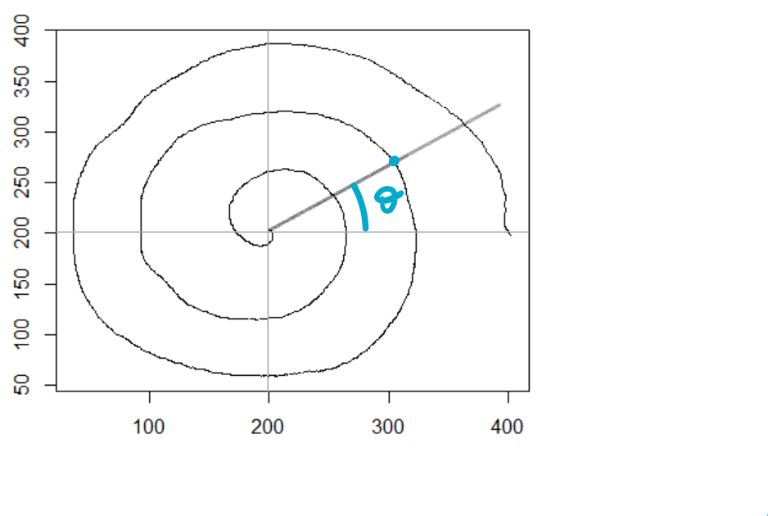
Distance at Timestamps Approach
PROCESS DATA COMPUTING DEGREES
PREPROCESS RAW DATA
Drawn points translated
We fixed, for each patient, the first drawn point as the center of the underlying spiral, since the initial values are very close to each other
We used the arc tangent function for computing the degrees of the angle with the x-axis for each of the selected drawn points

Slide 7
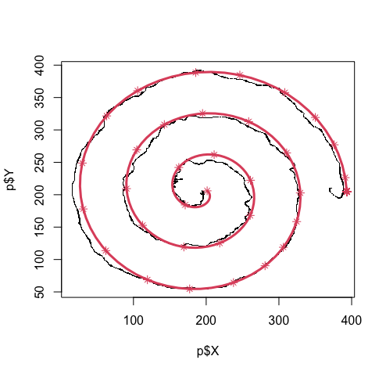
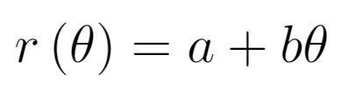
Distance at Timestamps Approach
PROCESS DATA COMPUTING DEGREES
FIT SPIRAL
MODEL TEST0
We need to fit the ideal spiral to compute the distances, so we recall the Archimidean spiral formula
We have the angles, we need parameters (a,b)
Linear model (R² = 0.87)
Figure: the red line represents the ideal spiral fitted on the points highlighted by a star.

Slide 8
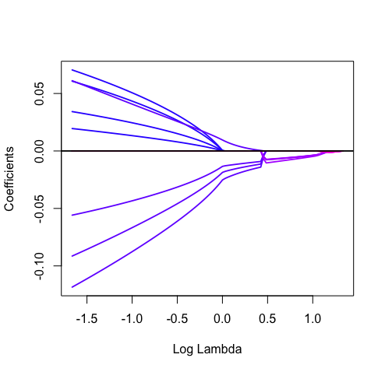
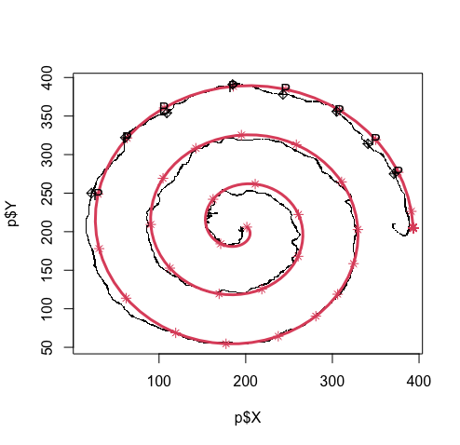
Distance at Timestamps Approach
FIT SPIRAL
MODEL TEST0
LOGISTIC
GROUP LASSO
Figures: on the left we can see the shrinkage of the coefficients; on the right we display with a P the points selected by Group Lasso for a random patients.
We applied Group Lasso grouping 4 consecutive terms.
It was the best performing among all the high dimensional tools we considered

Slide 9
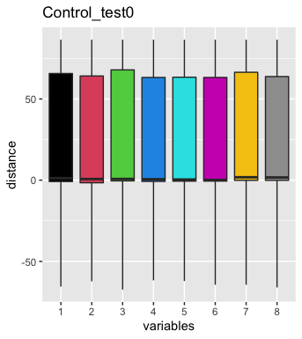
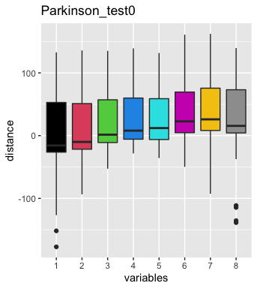
Distance at Timestamps Approach
ANALYZE RESULTS
Control
Parkinson’s
LOGISTIC
GROUP LASSO
We tried to visualize the results graphically in order to find interesting patterns
The plots seems to present pattern reconducible to the tremor.
Figure: Boxplots of the distributions of the distances computed in the points selected by Logistic Group Lasso.

Slide 10
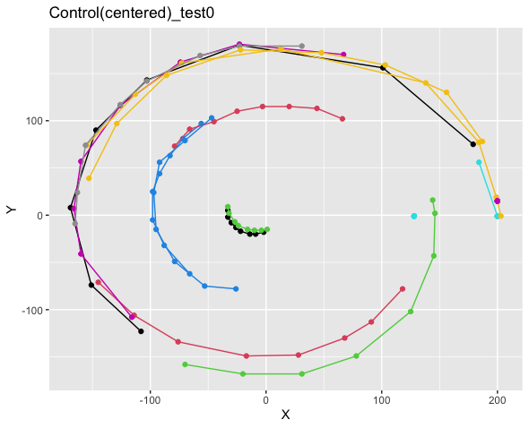
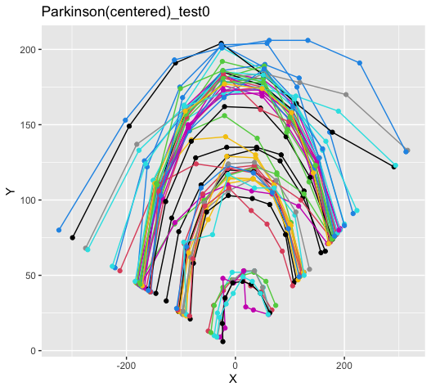
Distance at Timestamps Approach
Figure: Spatial distribution of the points selected by the Logistic Group Lasso for control patients (left) and Parkinson’s patients (right)

Slide 11











Graphical Approach
Matrix of predictors
Matrix of predictors (pixels) based on the images
Preprocessing
Obtaining all the binary images of size 64x64px
Modelling
Logistic Lasso, Elastic-Net, SparseSVM and Group Lasso
Image segmentation
Applying K-means clustering to better recognize different overlapping pixels regions of the image.
Analysis of results
Analysis and interpretation of the results

Slide 12

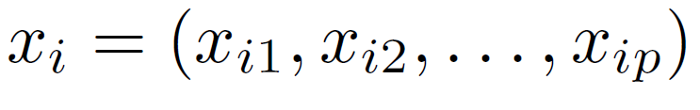
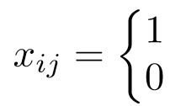
Matrix of predictors
Graphical approach
Consider both spiral images, in the dynamic and static test, for each patient
Consider each pixel of both images as a variable and exclude all those white for all the images
n = 72 subjects and p = 2006 variables
Matrix of predictors X (nxp) sparse: 11.64% of non-zero elements
For the i-th subject the corresponding row vector is where:
Before applying the models we did not perform any standardization since all the variables had the same unit
if the corresponding j-th pixel was black
otherwise

Slide 13
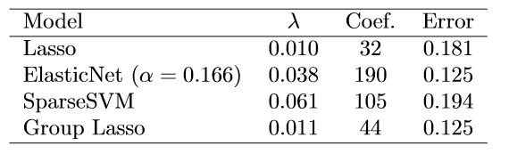
Modelling
Graphical approach
Different regularization models
Group Lasso, where each group consisted of two variables related to two pixels:
both mapped on the same position in the single spiral's image but each of them belonging to either the static or dynamic image.
Group Lasso seems to be the best model identified in terms of number of non-zero coefficients and misclassification error
The grouping gives results that are easier to interpet thanks also to the preservation of spatial correspondence in the images

Slide 14
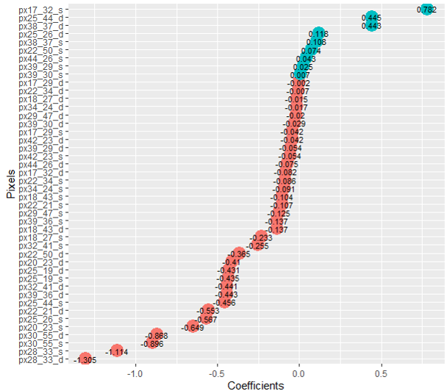
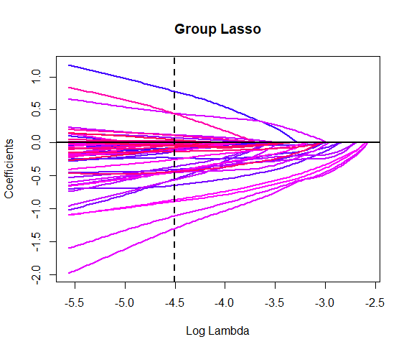
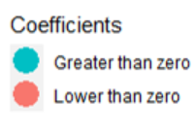
Coefficients Group Lasso
Graphical approach
(*) ‘d’ refers to dynamic pixels, while ‘s’ to the static pixels)

Slide 15
Coefficients Group Lasso
Graphical approach
(*) ‘d’ refers to dynamic pixels, while ‘s’ to the static pixels)

Slide 16
Coefficients Group Lasso
Graphical approach
(*) ‘d’ refers to dynamic pixels, while ‘s’ to the static pixels)

Slide 17
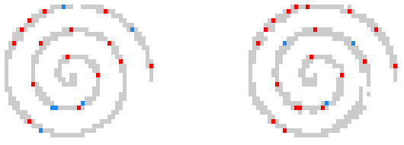
Coefficients Group Lasso
Graphical approach
Static test
Dynamic test

Slide 18
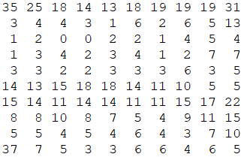
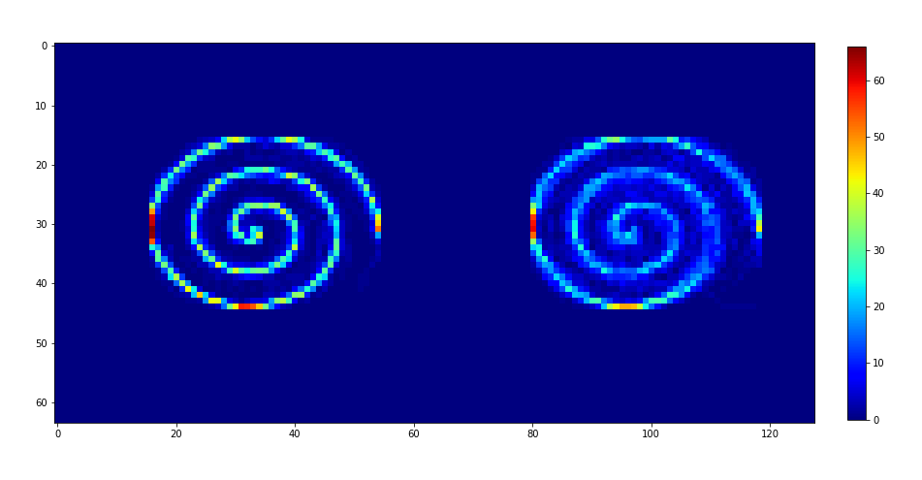
Image segmentation
Graphical approach
The idea is to create a matrix of overlapped spirals, where each cell represents the number of times in which a black pixel appears in one particular position
Apply K-means clustering to better recognize different overlapping pixels regions of the image
More variability in the dynamic test
Static test
Dynamic test

Slide 19
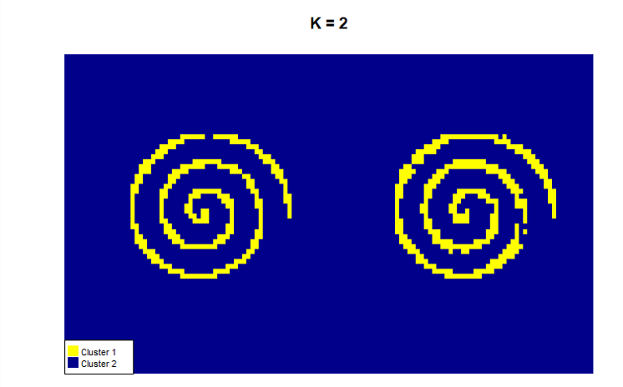
Image segmentation: K-means
Graphical approach
Static test
Dynamic test

Slide 20
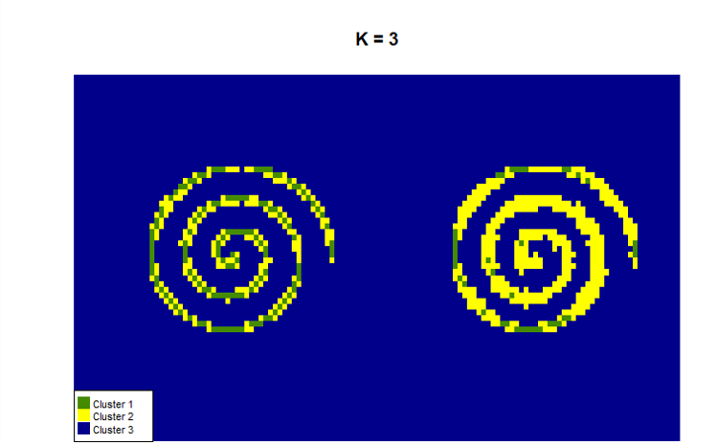
Image segmentation: K-means
Graphical approach
Static test
Dynamic test

Slide 21
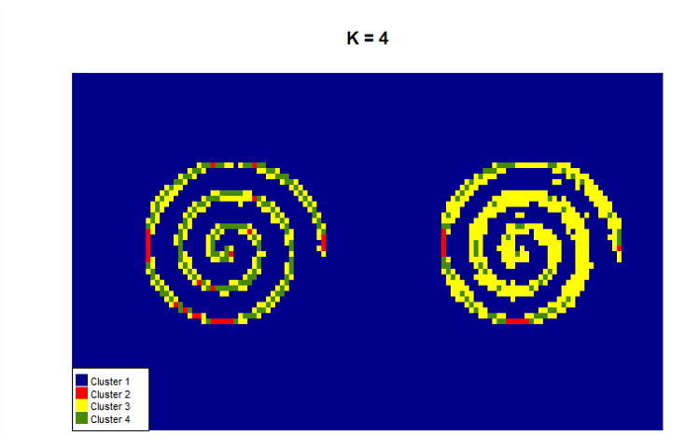
Image segmentation: K-means
Graphical approach
Static test
Dynamic test

Slide 22
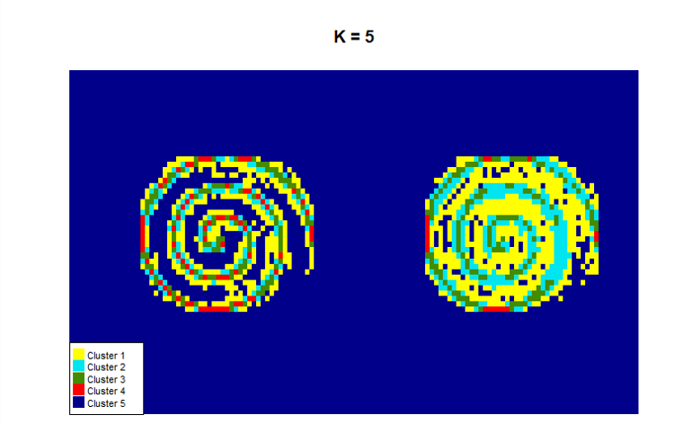
Image segmentation: K-means
Graphical approach
Static test
Dynamic test
Static test
Dynamic test

Slide 23
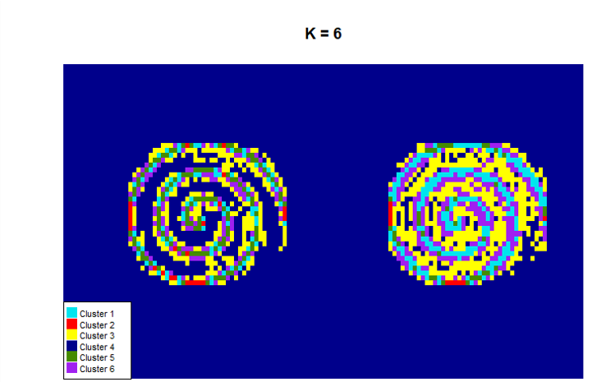
Image segmentation: K-means
Graphical approach
Static test
Dynamic test

Slide 24
Multi-Statistics Approach
Extraction of Features from Raw Data
Model Fitting
Analysis of the Results

Slide 25
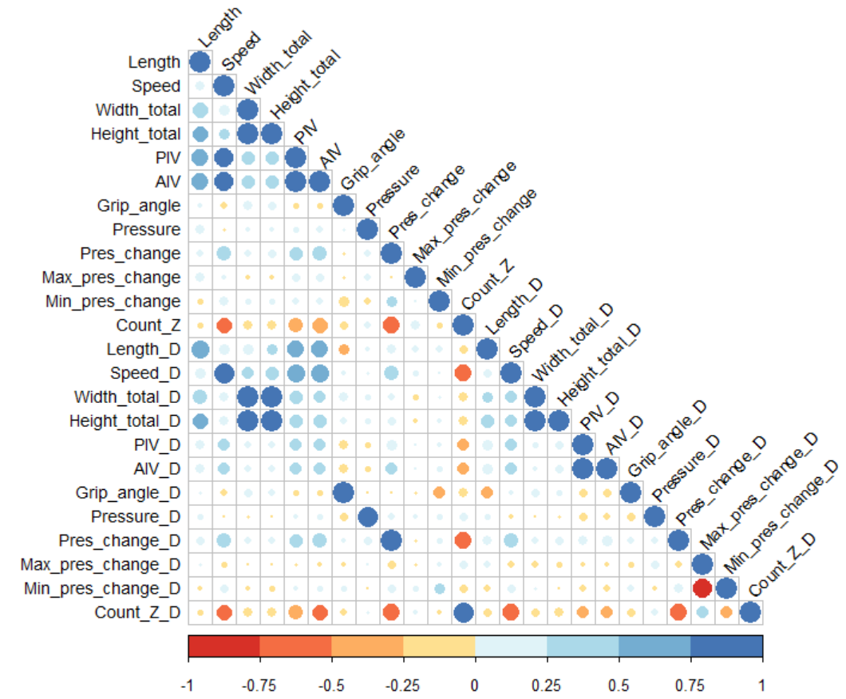
Feature Extraction
Multi-Statistics approach
12 features for both the static and dynamic tests
Length, Speed, Peak Instantaneous Velocity, Count Z, Pressure and Pressure Change statistics…
Correlation

Slide 26
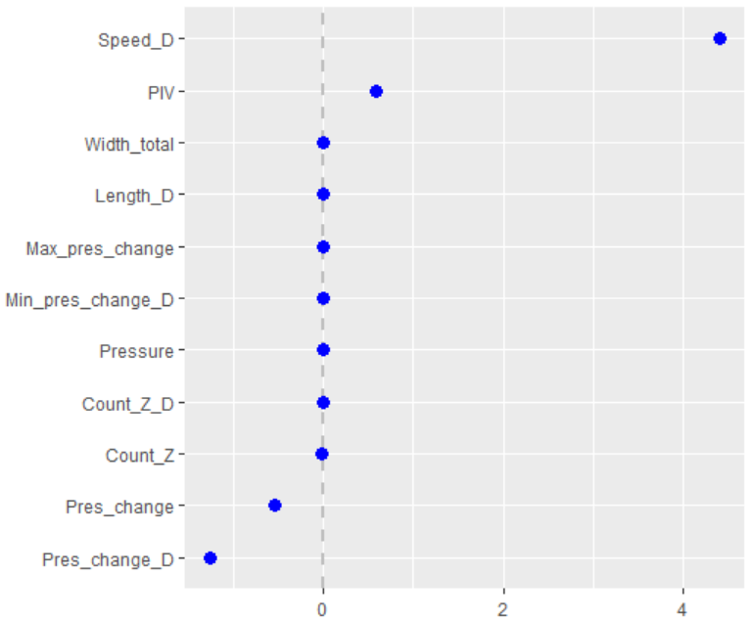
Model Fitting
Multi-Statistics approach
Logistic Lasso, SparseSVM, ElasticSVM, Group Lasso
ElasticNet Lasso
11 non-zero coefficients
Speed and Pressure Change relevance
Figure: Coefficients different from zero ElasticNet Lasso.

Slide 27
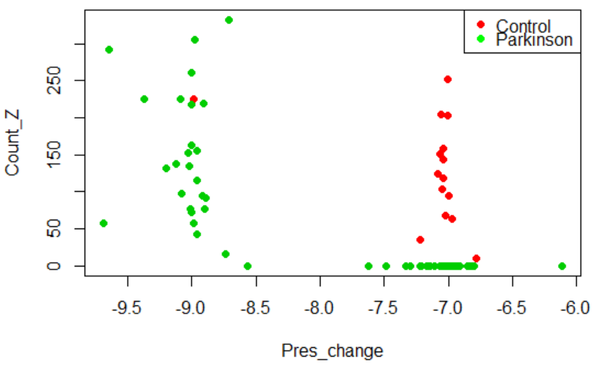
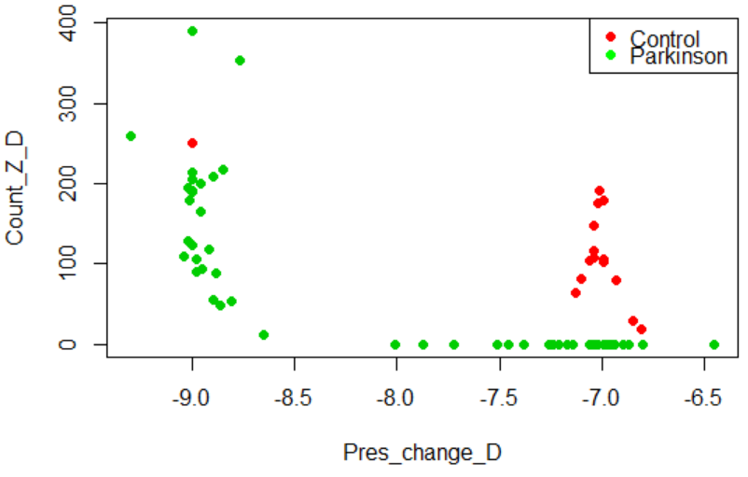
More on Pressure Change
Multi-Statistics approach
Tremor increases the variability in Pressure Change
Control patients have a precise drawing techinque

Slide 28
Conclusions
Tremor is the most salient characteristic of Parkinson’s disease capturable and interpretable with these drawing tasks
Though very different in principle, our approaches have some similarities and could be used together for better insights
Models useful for analysis of the features, but with more data we could also verify their predictive power
Anyway, Parkinson’s is more complex then just tremor. We need specialists’ evaluation and other clynical analysis to get a model for prediction to be exploit in practice

Slide 29
Further investigations
Assess more in detail the quality of the results
Implement different techniques, not necessarily for dimensionality reduction
Study only Parkinson’s patients and assess the gravity of the disease among them

