Slide 1
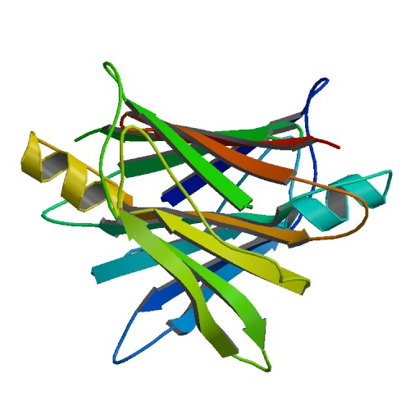


webPDB
A fast storage and retrieval web-service for proteins
by
Conte, Furiani, Nardini, Pasquantonio, Ungania

Slide 2
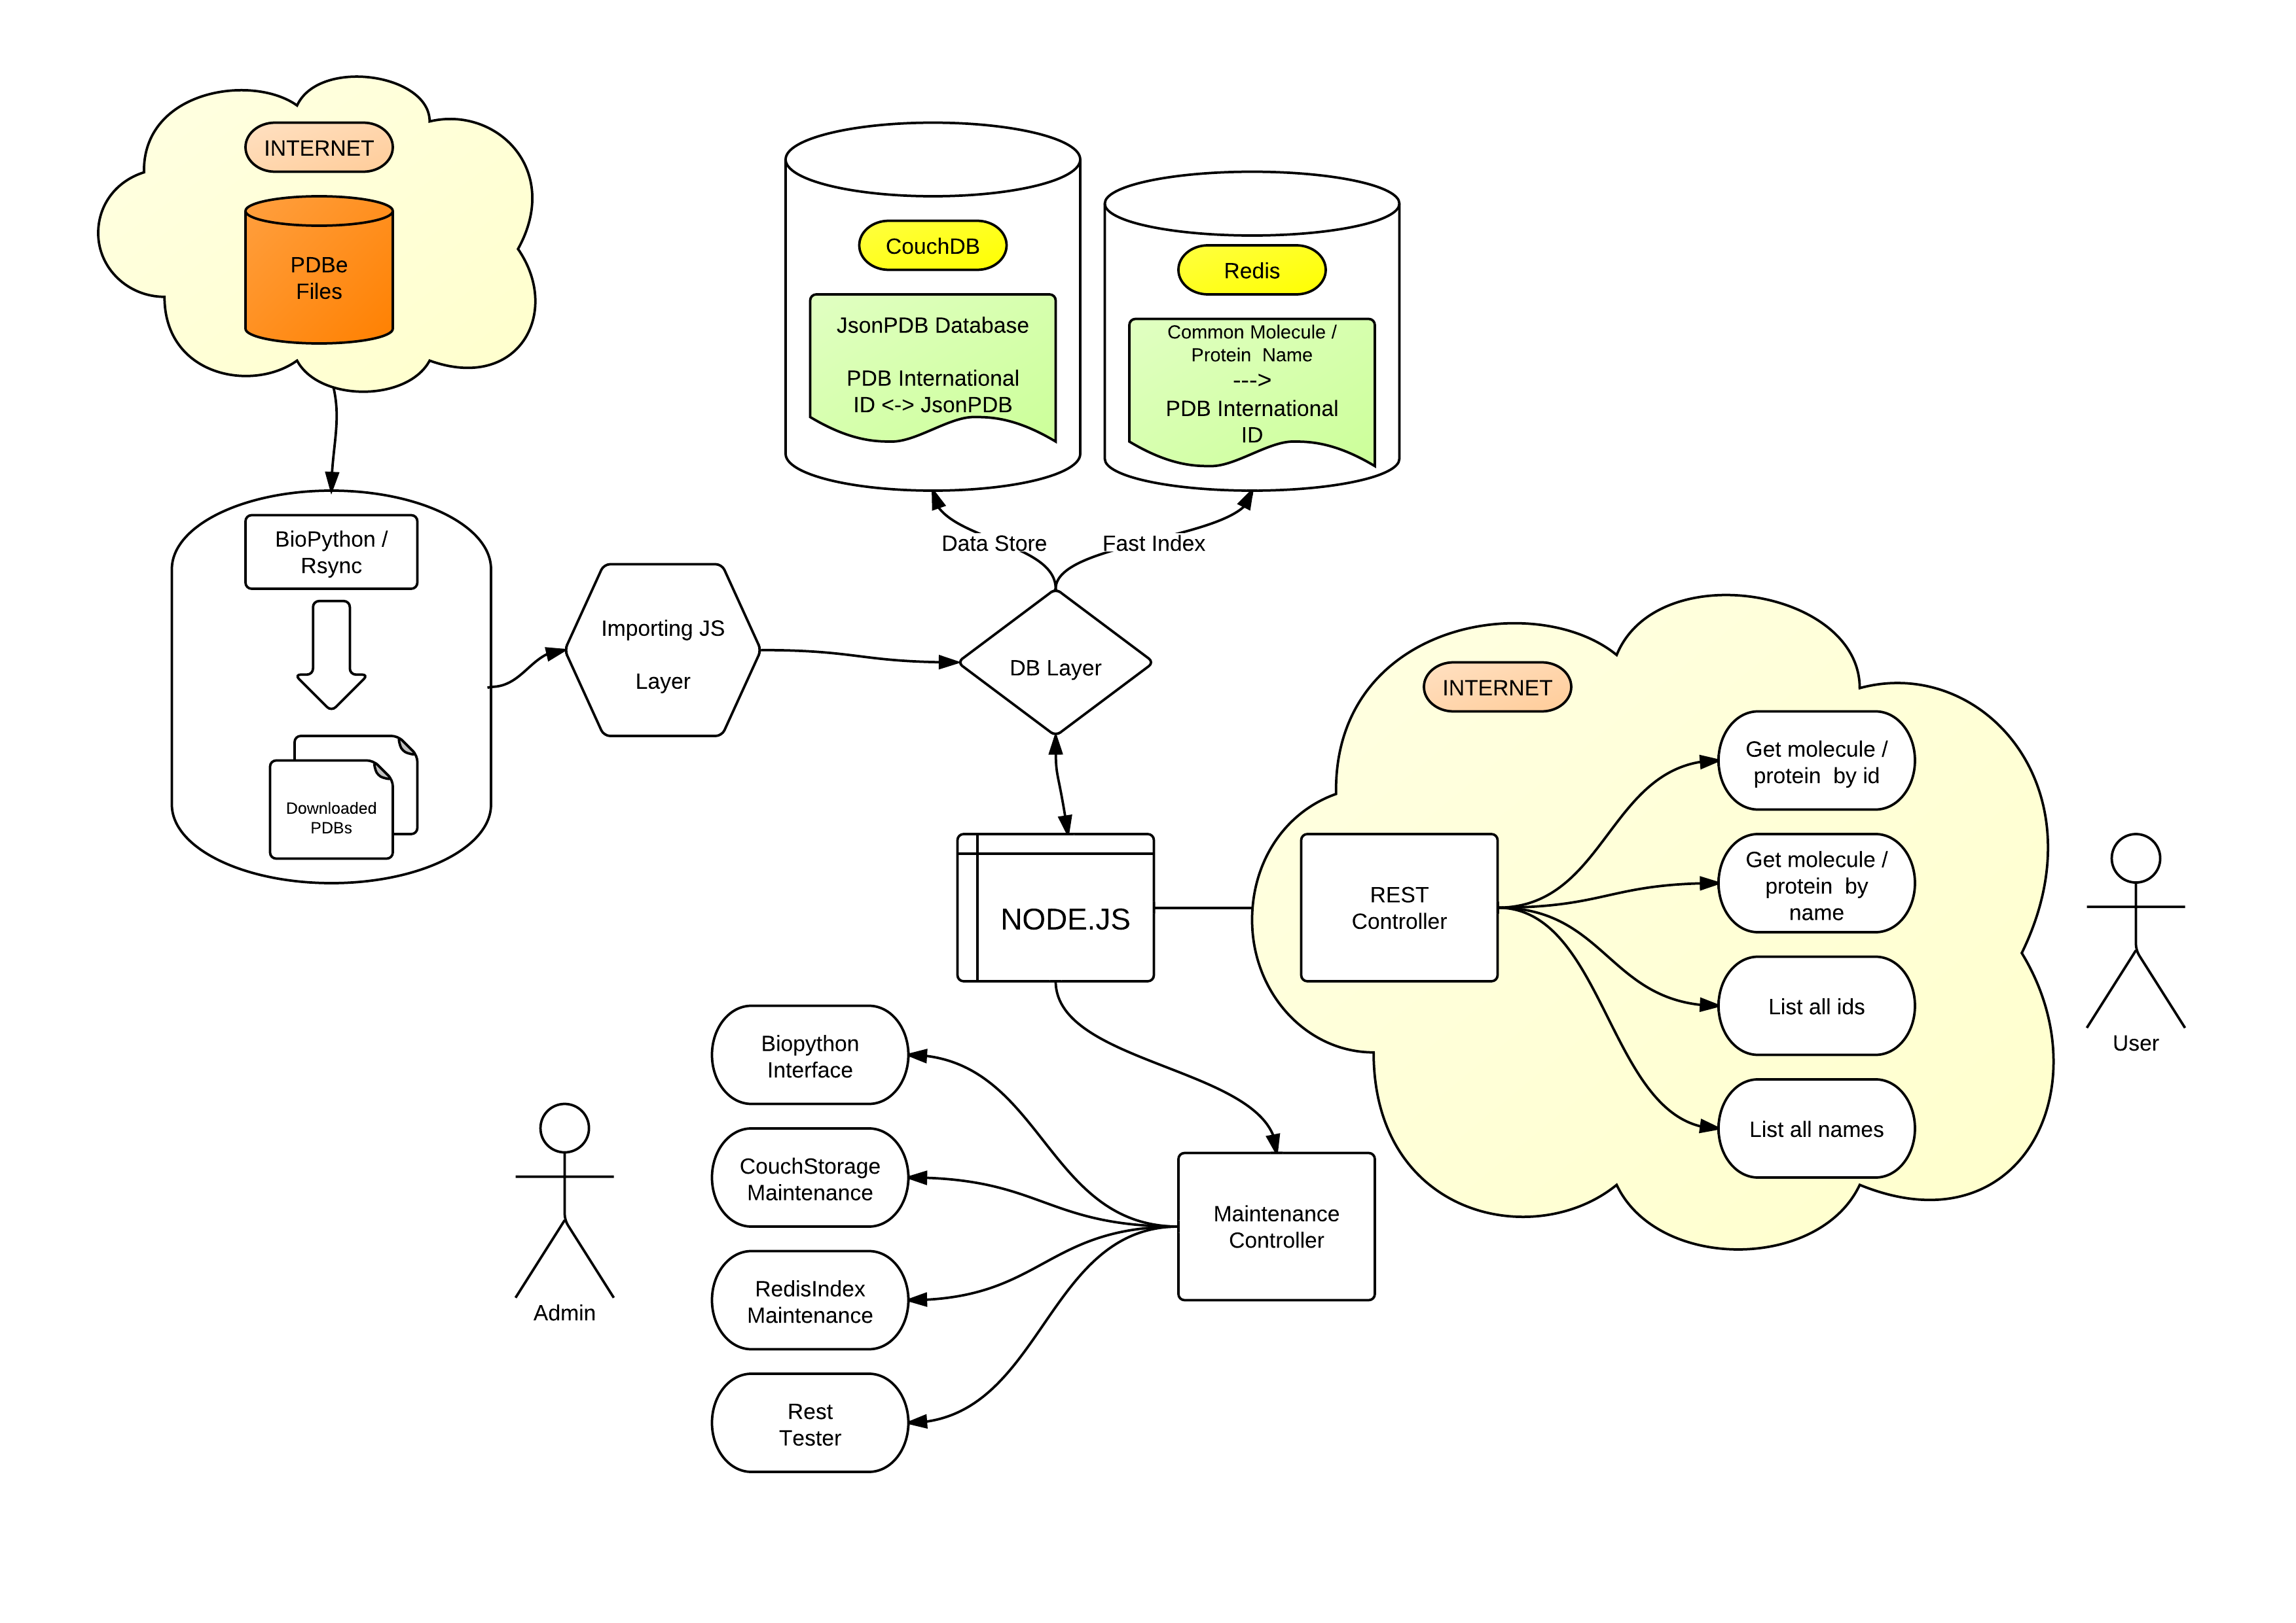
webPDB structure

Slide 3
Where were we?
Currently installed on a testing machine in the MAIS lab
ZFS
Installed as user space module, serving as storage space for CouchDB
PDB to JSON parser
Currently extracting all the necessary information from a PDB entity file. Very flat structure.
Ironing out the last bugs.
Work in progress for the monomers section (different standard used)
Background importer
Working nicely, can import thousand of proteins into CouchDB in minutes.
CouchDB api for retrieval and insertion
Currently in stable version
Can be easily modified to allow custom query through MapReduce
REST service
Test in progress
Administration Interface
Work in Progress

Slide 4
Where we are now
Moved the instance to Apple Storage Server
Using as CouchDB / Node.js server the PLM21 machine
PDB to JSON parser
Less flat structure done
Monomers dataset fully integrated
CouchDB api for retrieval and insertion
Now having some complex queries (like retrieve of proteins with some aminoacids in it)
REST service
Exporting almost every query created
Administration Interface
In staging area, to be added before delivery

Slide 5



Slide 6
What’s next
Final review of the DB interface
Using other native cradle interface for better usage of CouchDB native caching
Moving CouchDB on a native Linux machine
Some Mac Os X related bugs makes the installation / operation unstable under some circumstances
PDB to JSON parser
Total integration with BioPython module (now limited to MODEL section)
HTML service
Nice HTML / CSS interface
Administration Interface
Finally included
Used to do maintenance on the dataset
Documentation
Publishing ☺
Final integration with WebMol project
REST service is ready to accept AJAX requests from other domains
Whatever is missing ☺

Slide 7


