Slide 1
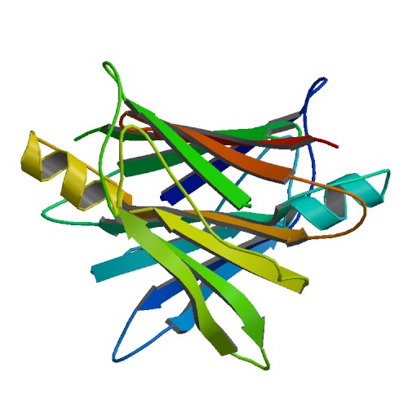


webPDB
A fast storage and retrieval web-service for proteins
by
Conte, Furiani, Nardini, Pasquantonio, Ungania

Slide 2
Why webPDB?
Rapid lookup of protein data
JSON slim format
Maintenable infrastructure

Slide 3
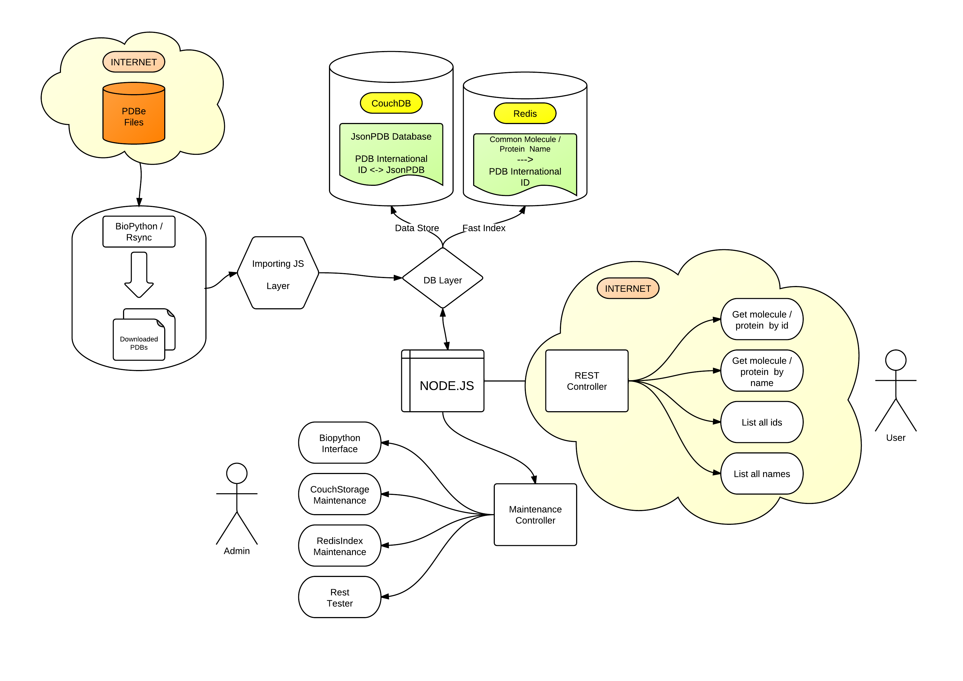
webPDB structure

Slide 4
Issues
A file system with high storage capacity and data integrity for the database storage files
A fast scalable database with document storage, ACID semantic, eventual consistency, MapReduce support, incremental replication and fault tolerance
A light weight format to store and distribute protein data
A scalable software system, event driven, with minimal overhead and maximum scalabilty for the deploy of a REST web service

Slide 5
Solutions
ZFS
An open source file system supported by NIX operating systems
Working as user space module (kernel module is still bugged)
CouchDB
NoSQL document storage with multi version concurrency control
Extremely fast and scalable
Document storage is done in JSON
JSON
Light weight text-based open standard designed for human readable data interchange
Derived from JavaScript language
Node.js
Scalable software system for writing Internet applications
Use JavaScript language and V8 Google JavaScript engine (CommonJS compliant)
Extremely modular

Slide 6
Current status
Currently installed on a testing machine in the MAIS lab
ZFS
Installed as user space module, serving as storage space for CouchDB
PDB to JSON parser
Currently extracting all the necessary information from a PDB entity file. Very flat structure.
Ironing out the last bugs.
Work in progress for the monomers section (different standard used)
Background importer
Working nicely, can import thousand of proteins into CouchDB in minutes.
CouchDB api for retrieval and insertion
Currently in stable version
Can be easily modified to allow custom query through MapReduce
REST service
Test in progress
Administration Interface
Work in Progress

Slide 7
What’s next?
Moving the instance on the Apple Storage Server
PDB to JSON parser
Less flat structure to be used easily with map-like JavaScript operators
Monomers
CouchDB api for retrieval and insertion
More complex queries
Secondary query cache
Use a RAM Key-Value storage like Redis to cache query results
REST service
Exporting interface for user-defined complex queries
Administration Interface
Easily administrate the whole system through a nice HTML5 interface

Slide 8


