Slide 1
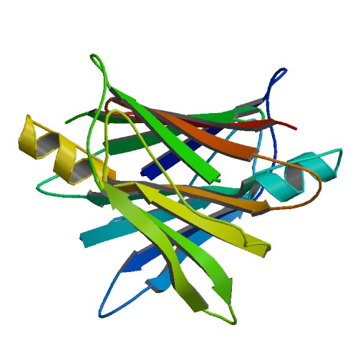


webPDB
A fast storage and retrieval web-service for proteins

Slide 2
Why webPDB?
Rapid lookup of protein data
JSON slim format
Maintenable infrastructure

Slide 3
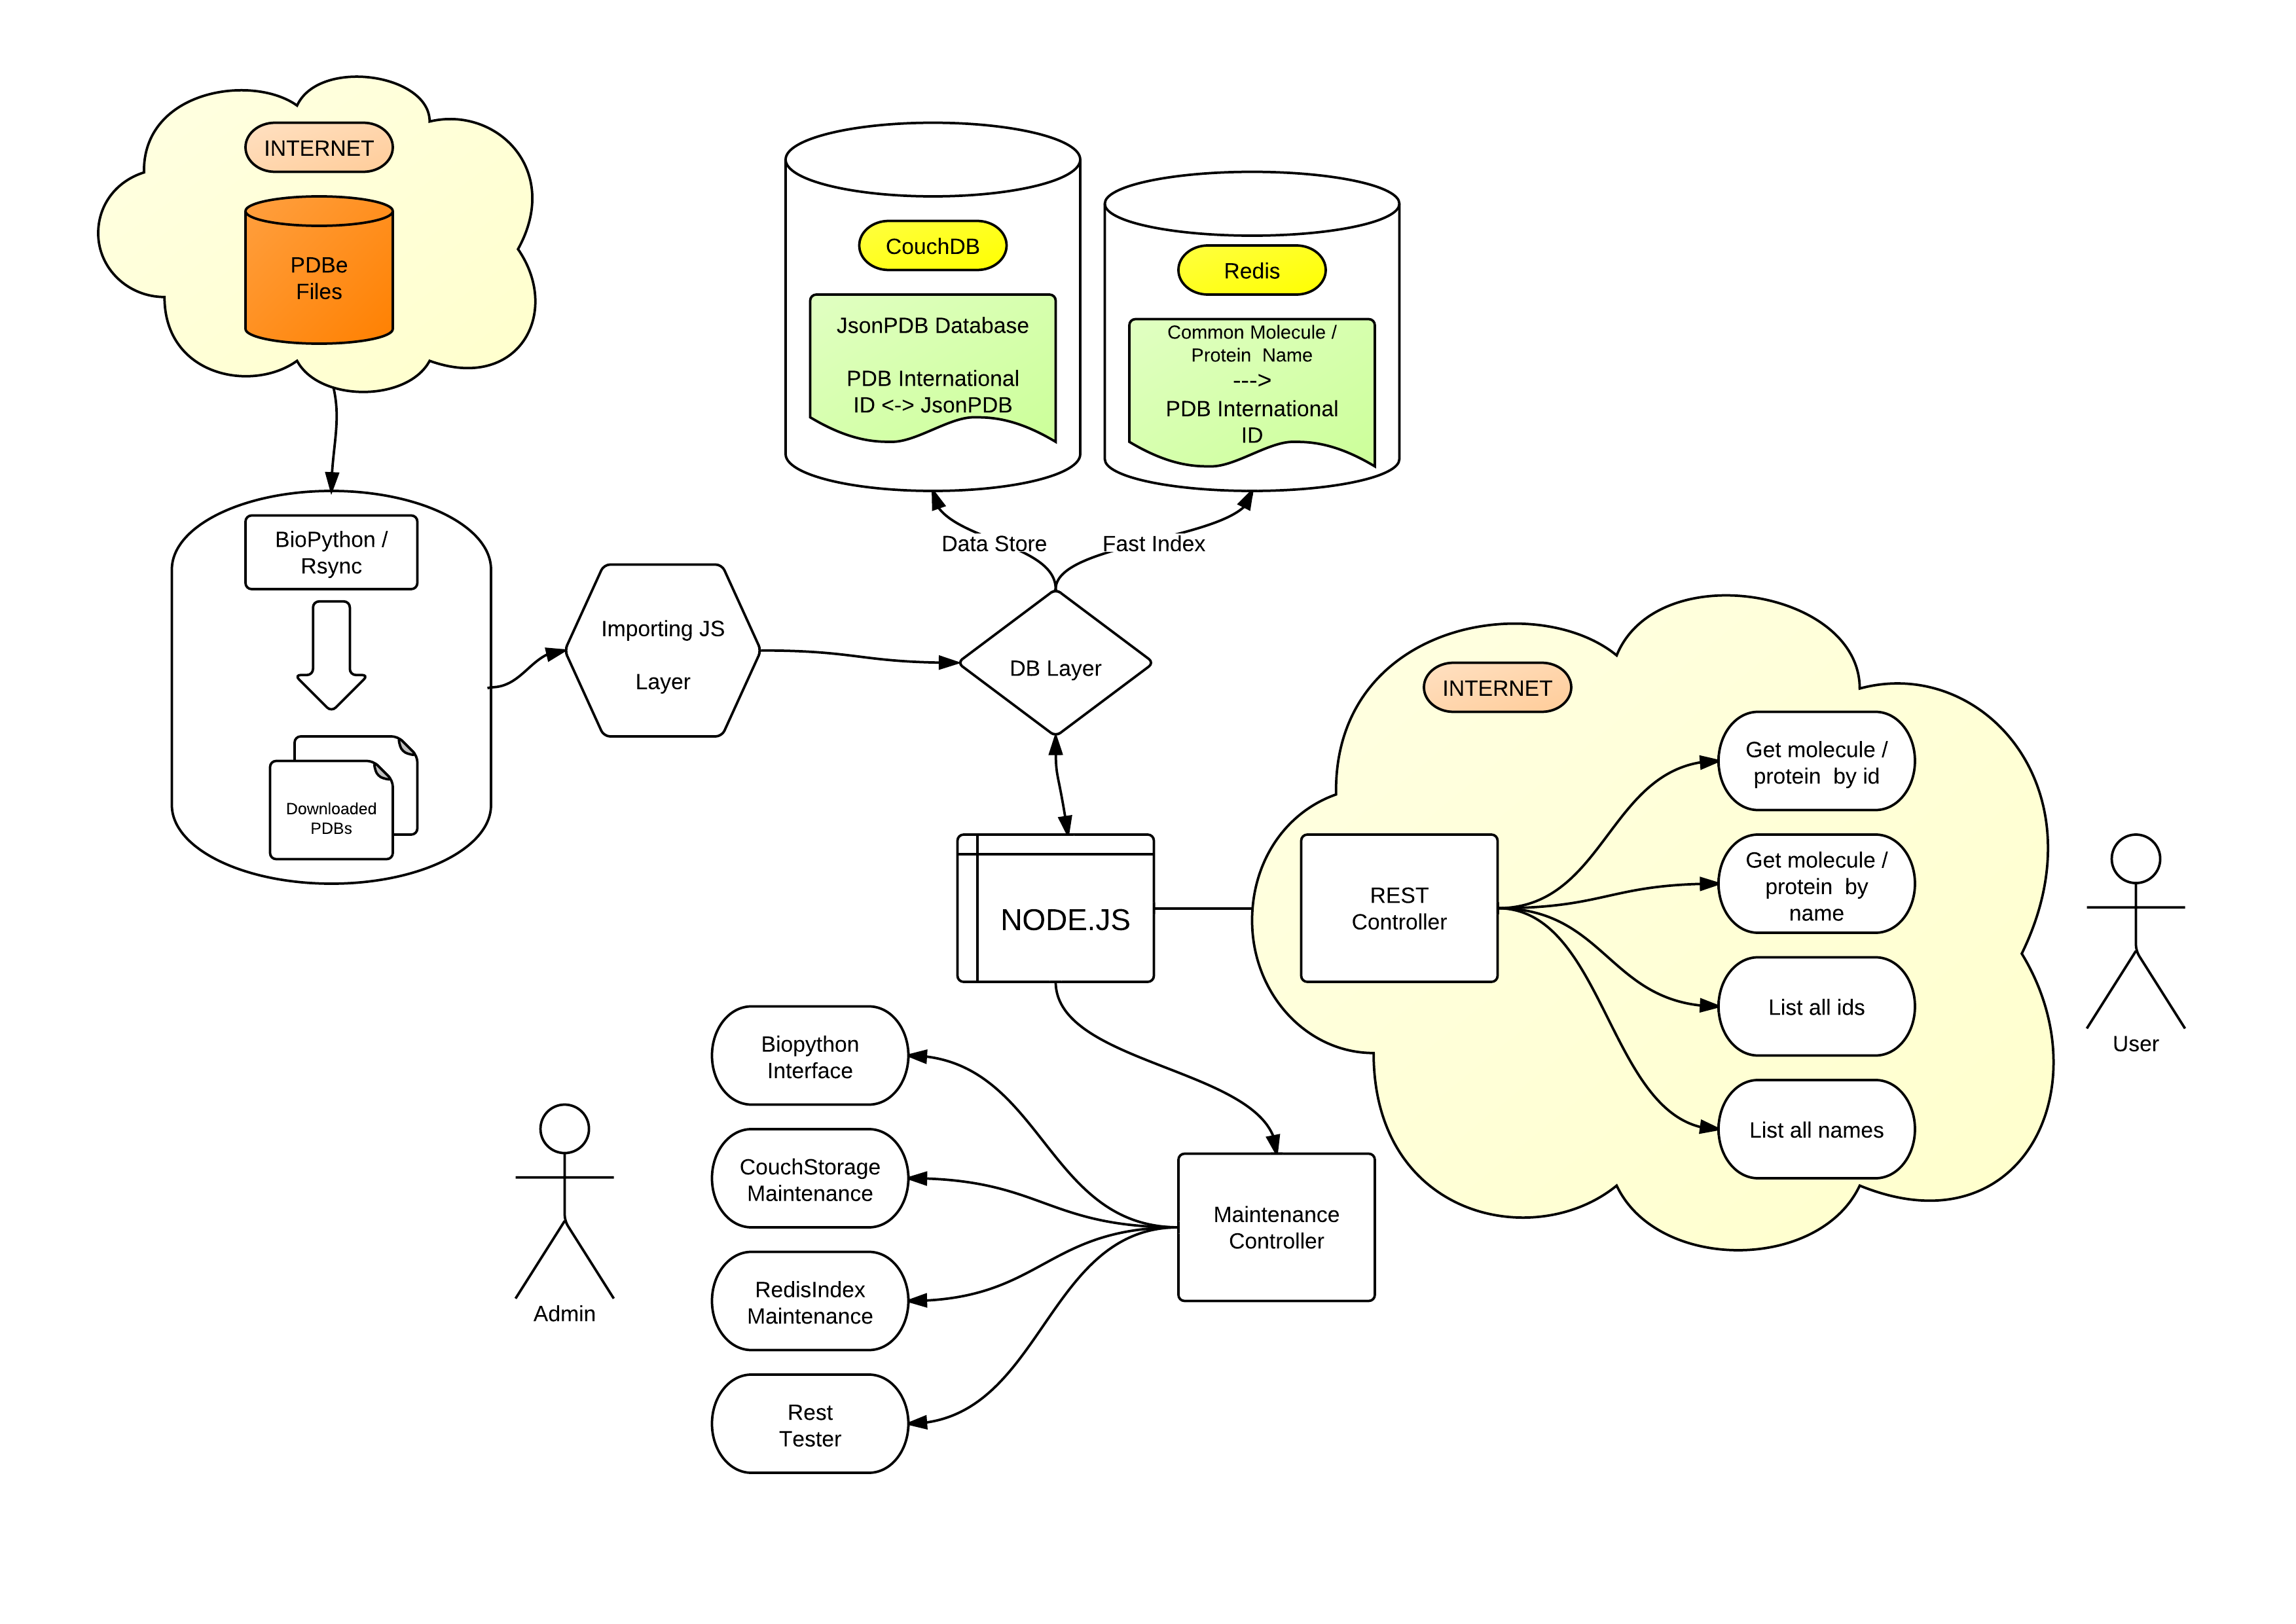
webPDB structure

Slide 4
Issues
File system with high storage capacity and data integrity for the database files
A fast scalable database with document storage, ACID semantic, eventual consistency, MapReduce support, incremental replication and fault tolerance
A light weight format to store and distribute protein data
A scalable software system, event driven, with minimal overhead and maximum scalabilty for the deploy of a REST web service

Slide 5
Solutions
ZFS
An open source file system supported by NIX operating systems
Working as user space module (kernel module is still bugged)
CouchDB
NoSQL document storage with multiversion concurrency control
Extremely fast and scalable
Document storage is done in JSON
JSON
Light weight text-based open standard designed for human readable data interchange
Derived from JavaScript language
Node.js
Scalable software system for writing Internet applications
Use JavaScript language and V8 Google JavaScript engine (CommonJS compliant)
Extremely modular

