Slide 1
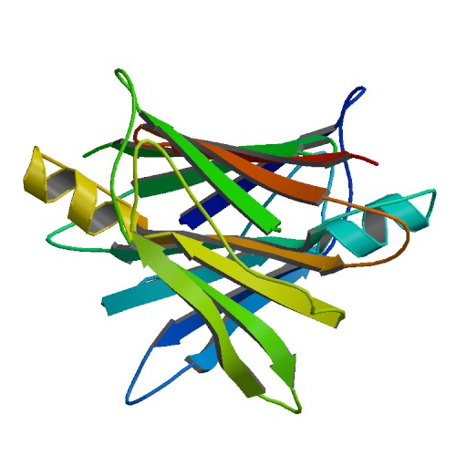


webPDB
A fast storage and retrieval web-service for proteins
by
Conte, Furiani, Nardini, Pasquantonio, Ungania

Slide 2
Why webPDB?
Rapid lookup of protein data
JSON slim format
Maintainable infrastructure

Slide 3
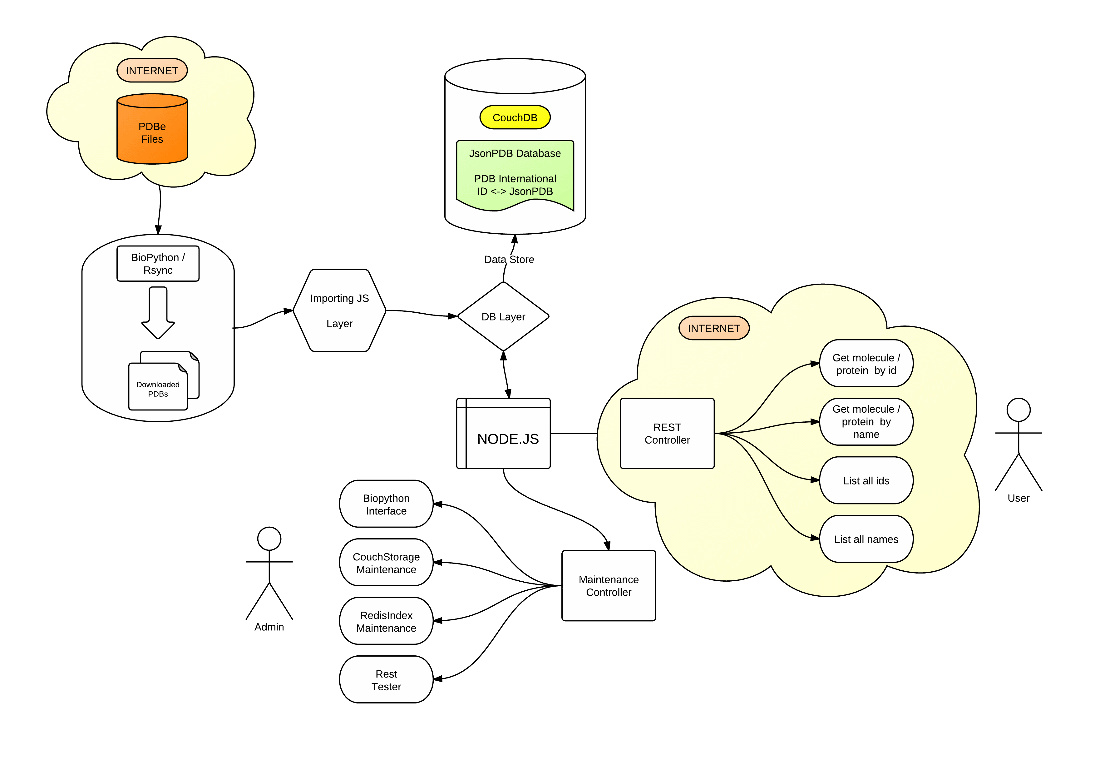
webPDB structure

Slide 4
Issues
A file system with high storage capacity and data integrity for the database storage files
A fast scalable database with document storage, ACID semantic, eventual consistency, MapReduce support, incremental replication and fault tolerance
A light weight format to store and distribute protein data
A scalable software system, event driven, with minimal overhead and maximum scalabilty for the deploy of a REST web service

Slide 5
Solutions
ZFS
An open source file system supported by NIX operating systems
Working as user space module (kernel module is still bugged)
CouchDB
NoSQL document storage with multi version concurrency control
Extremely fast and scalable
Document storage is done in JSON
JSON
Light weight text-based open standard designed for human readable data interchange
Derived from JavaScript language
Node.js
Scalable software system for writing Internet applications
Use JavaScript language and V8 Google JavaScript engine (CommonJS compliant)
Extremely modular

Slide 6
ZFS
ZFS is a combined file system and logical volume manager designed by Sun Microsystems.
Features are:
data integrity verification against data corruption modes
support for high storage capacities
snapshots and copy-on-write clones
continuous integrity checking and automatic repair
RAID-Z
Unfortunately, known problems on Linux as kernel module
Working as userland module, not as good as kernel module (at least 50% performance hit)

Slide 7
PDB to JSON parser
PDB is a text file representing a protein
Need to translate it in a more usable format by an automated API and elaboration system
JSON (Java Script Object Notation)
Lightweight and fairly descriptive
Need to define a coherent and usable structure

Slide 8
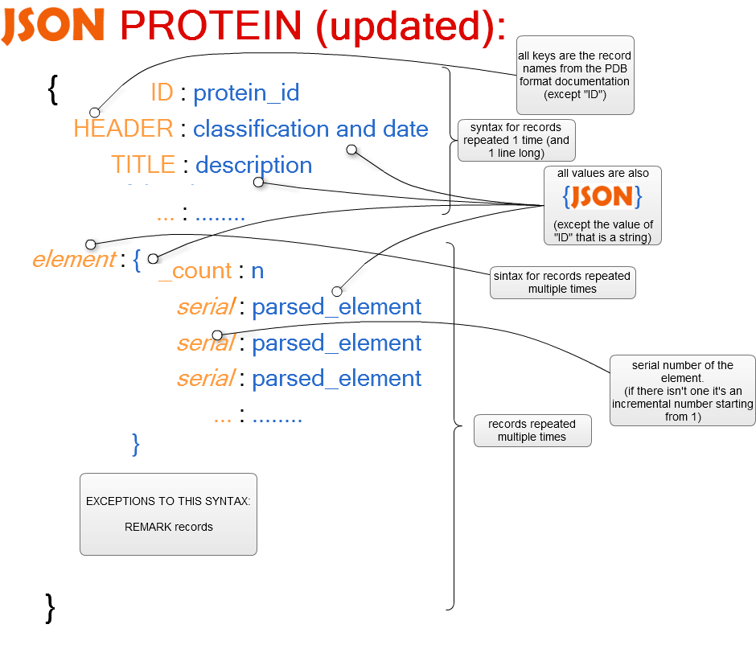
PDB to JSON parser

Slide 9
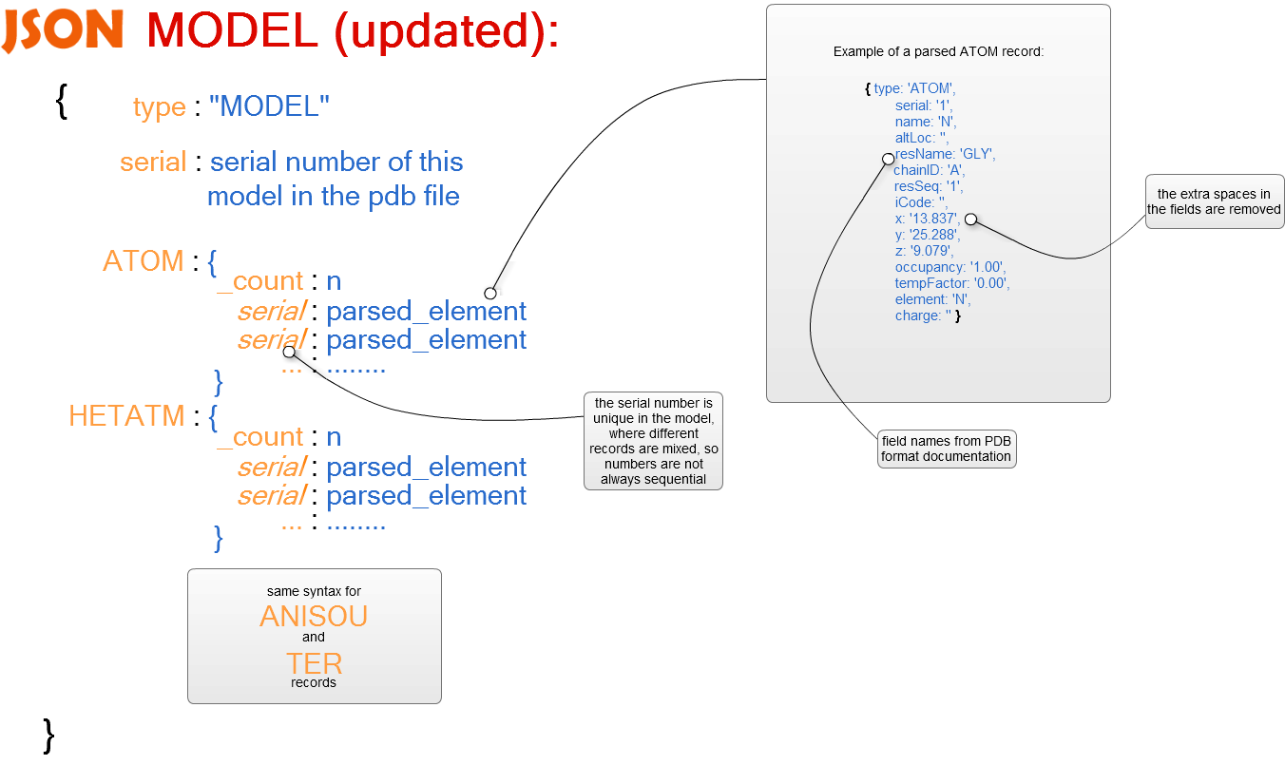
PDB to JSON parser

Slide 10
Background importer
We’ve a lot of PDBs
An automated system that is able to read asynchronously a lot of them and write the parsed JSON into the DB
Piping through BioPython PDB «spellchecker»
Maximize throughput
Node.js async driven IO-model

Slide 11
Background importer
Code for importing in N-batches (N is calculated upon system capacity)
var mmf_fileNamesRead = function(fileList) {
asyncMod.forEachLimit(fileList, BATCH_LIMIT, mmf_fileStartRead, function(err) {
console.log("Iterated through " + fileList.length + " in batches of " + BATCH_LIMIT );
if (typeof err !== "undefined") {
console.log("With errors: " + err);
}
});
};
Bridge between PDB parser and DB
var mmf_gen_fileDataRead = function(cbDone) {
return (function(status, data, filename) {
if ( status === true ) {
var fileID = mmf_fixName_fromFile(filename);
var pdbImported = parsePdb.parsePDB(status, data, fileID);
insertDB.insert(pdbImported.ID, pdbImported, mmf_gen_fileDataInserted(cbDone), m_Database_Name);
} else {
console.log("Reading data for fileID " + filename + " has failed.");
}
});
};

Slide 12
CouchDB
NoSQL document storage
Efficient key retrieval document
MapReduce API for complex queries
Incremental cache update for same queries («view»)
JavaScript interface

Slide 13
Database APIs for REST interface
Layer to CouchDB for insertion and retrieval
Insertion
Saving converted PDB into Couch with special ID to optimize retrieval and used space
Asynchronous
Retrieval I
Simple retrieval with document id
Extremely fast

Slide 14
Database APIs for REST interface
Retrieval II
Using MapReduce system
Dynamic generation of Map functions
Retrieves a list of document ID according to query
If required, uses Reduce functions
Good usage of «view» mechanism for caching results of same queries
Optionally, return a list of documents by using the fast retrieval by document ID

Slide 15
REST interface
Using express module of node.js
Completely async management of HTTP GET requests
Classical REST (read-only) implementation
GET request to /rest/protein/id/:someid gets you the protein with ID :someid
GET request to /rest/protein/name/:somename gets you a list of proteins containing that name
GET request to /rest/protein/byamino/all/:list gets you a list of proteins that contains that exact sequence of amino acids
Much more in documentation

Slide 16
Admin interface
Using express module of node.js
Nice web interface
GUI for routine operations
Start importing of data
Database maintenance
Query interface

Slide 17



Slide 18
Conclusions
Project is fully working
It can be easily extended to work on more data or different data because it’s fully modular
Some bugs in recent Couch DB version made us wrote code that could be trimmed down in the future
Interface CSS could be better if a proper designer could work on it

Slide 19


