Slide 1
Microsoft Graph, Graph, Graph
Overview of the Microsoft Graph
Notes:
Preparations:
Ngrok
Running EventManagement web app
Browser with the following tabs:
https://developer.microsoft.com/en-us/graph
https://graph4.azurewebsites.net/api/ExcelBinding?workbook=graphtest/test.xlsx&table=Table1
https://localhost:44356/
https://portal.azure.com/
https://outlook.office.com/owa/
https://m365x724792.sharepoint.com/SitePages/Graph-API-demo.aspx

Slide 2

Who am I?
Carl in ‘t Veld
Just a damn good developer
MCSD App developer
Owns the Microsoft Graph @Capgemini
Capgemini Netherlands
@cveld
Notes:
Carl

Slide 3
Agenda
Introduction to the Microsoft Graph
Web App
Azure Functions
SharePoint Framework
Authentication
SDK
Custom data
User consent
WebHooks
OData

Slide 4
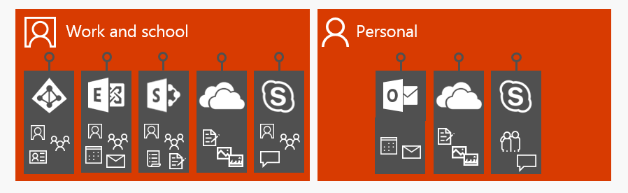
Before Microsoft Graph
Each service has its own set of APIs, characteristics, data model, and authentication
Separate authentication stack for work and personal accounts
High learning curve - not always compatible with non Microsoft stack
Notes:
D

Slide 5
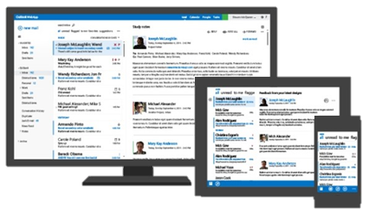
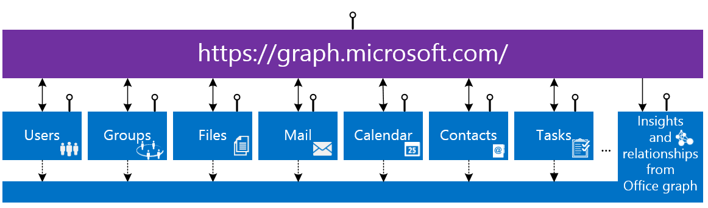
Single endpoint for Office 365 Services
Notes:
D

Slide 6



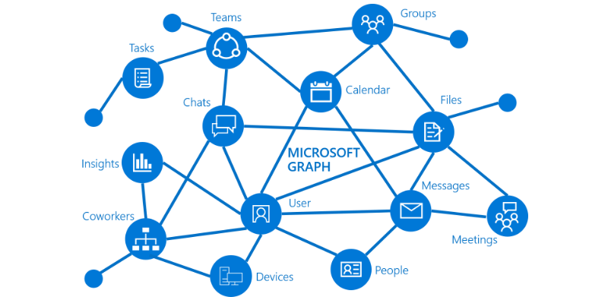




Graph API integrates everywhere
Flow
Azure Active Directory
Azure Functions
Power Apps
Event Grid
Logic Apps
Web Apps

Slide 7
Unified API Style
DEMO
https://graph.microsoft.com
Operation Service Endpoint
GET my profile https://graph.microsoft.com/v1.0/me
GET my files https://graph.microsoft.com/v1.0/drive/root/children
GET my photo https://graph.microsoft.com/v1.0/photo/$value
GET my mail https://graph.microsoft.com/v1.0/me/messages
GET my calendar https://graph.microsoft.com/v1.0/me/calendar
GET my manager https://graph.microsoft.com/v1.0/me/manager
GET group conversations https://graph.microsoft.com/v1.0/groups/<id>/conversations
GET files trending around me https://graph.microsoft.com/v1.0/me/insights/trending
Notes:
Graph Explorer: https://developer.microsoft.com/en-us/graph/graph-explorer

Slide 8
What has become GA over the last year?
Beta
Azure Active Directory
Outlook mail, Calendar and Contacts
Office 365 Groups and Conversations
OneDrive Drives and Files
WebHooks for Outlook, Groups, User, OneDrive data
SharePoint & LiveID profiles
Office 365 Reports
Teams
Extensions
Excel API
FindMeetingTime
Planner
Extensions
Delta Queries
Sites (SharePoint)
InTune
Project Rome
PDF conversion
Application Management
Thumbnails
https://developer.microsoft.com/en-us/graph/docs/concepts/changelog
Notes:
D

Slide 9
Authentication
ADAL v1.0
MSAL v2.0
Authentication library to deal with Azure Active Directory authentication flow
Support for Work and School accounts via Azure Active Directory
Full set of SDKs available
Supports Office 365 Services
User gives consent for all permissions at first start
Unified authentication library to deal with authentication across the different identity platforms provided by Microsoft
Support for Work, School and Personal accounts – No Azure requirement
User gives consent when the applications needs it

Slide 10
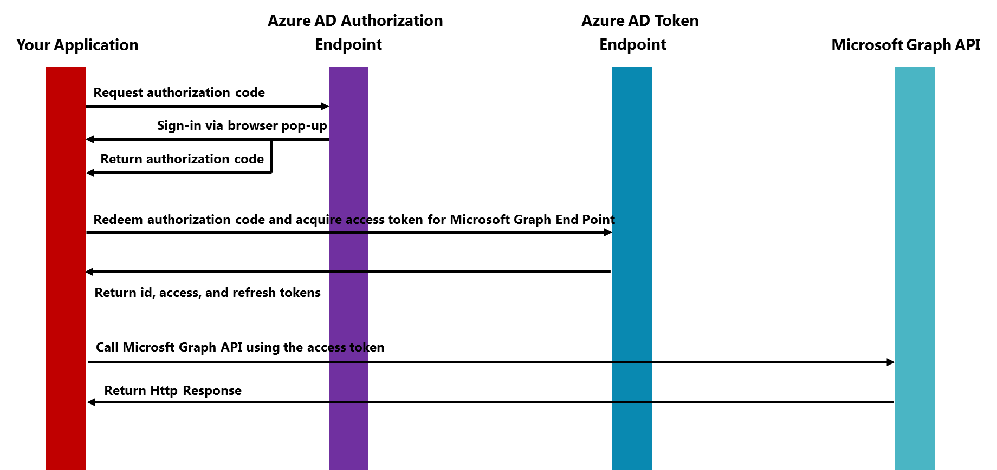
Authentication flow for Microsoft Graph
Notes:
C

Slide 11
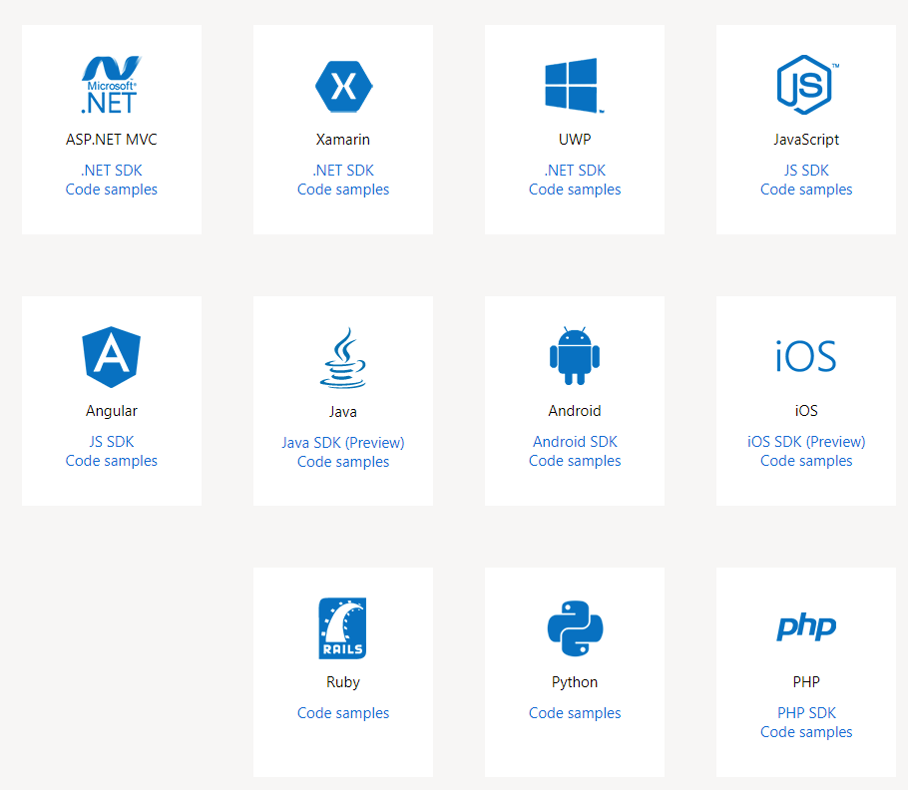
Microsoft Graph API SDK
DEMO
Notes:
Resultaat:
https://github.com/microsoftgraph/aspnet-connect-sample
Zie web.config en HomeController
https://github.com/SharePoint/PnP/tree/master/Samples/MicrosoftGraph.Office365.DotNetSDK

Slide 12
Extensions
Add custom data to the Microsoft Graph entities
Demo: Event Manager
Notes:
C

Slide 13
Type of Extensions
Open Extensions (aka Office 365 data extensions):
Untyped data that is scoped to the tenant
extensionName property should be unique within the tenant
Naming convention: Com.Capgemini.ManagedEvent for the Capgemini.Com tenant
Schema Extensions
Strongly typed data – define your own schema extension definition
Schema extension definition should have a unique name for its id:
By using the an existing vanity domain that is verified with your tenant (e.g. capgemini.com) for capgemini_ManagedEvent
By using a name without a domain , e.g. ManagedEvent. The id will be based on the schema name and prefixed with 8 random characters. E.g. extabcdefgh_ManagedEvent
Notes:
D

Slide 14
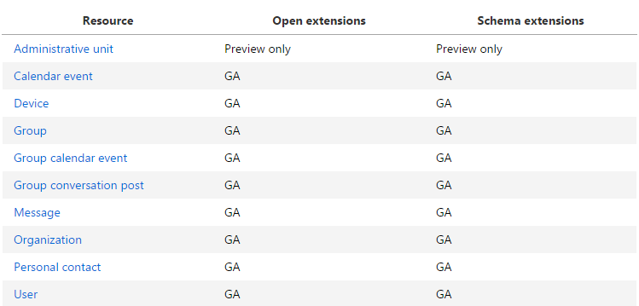
Supported resources for Extensions
When using personal accounts (MSAL) you are limited to the event, post, group, message, contact, and user resources
Notes:
C

Slide 15
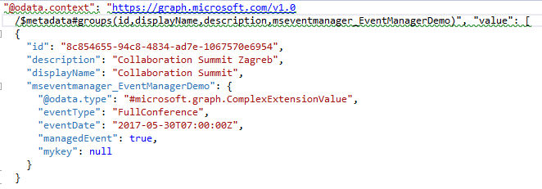
Extensions
DEMO
Add Custom Properties to Microsoft Graph Resources without requiring an external data source
MS Graph Group Data
Custom Extension Data
Notes:
https://eventmanagerdemo20180418083443.azurewebsites.net/
EventManager tab

Slide 16
Azure Functions
What are Azure Functions
Graph bindings preview
Demo: Process excelsheet

Slide 17
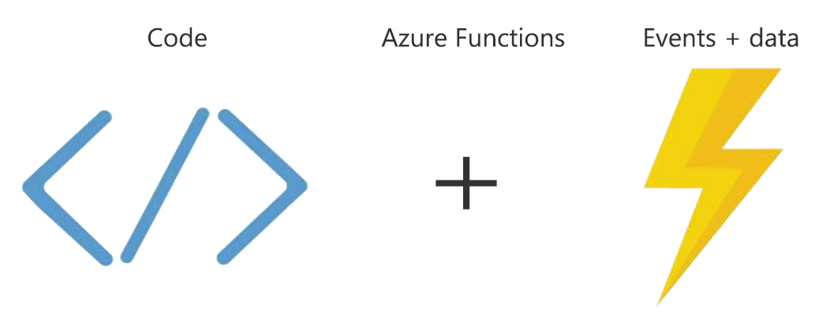
Introducing Functions

Slide 18
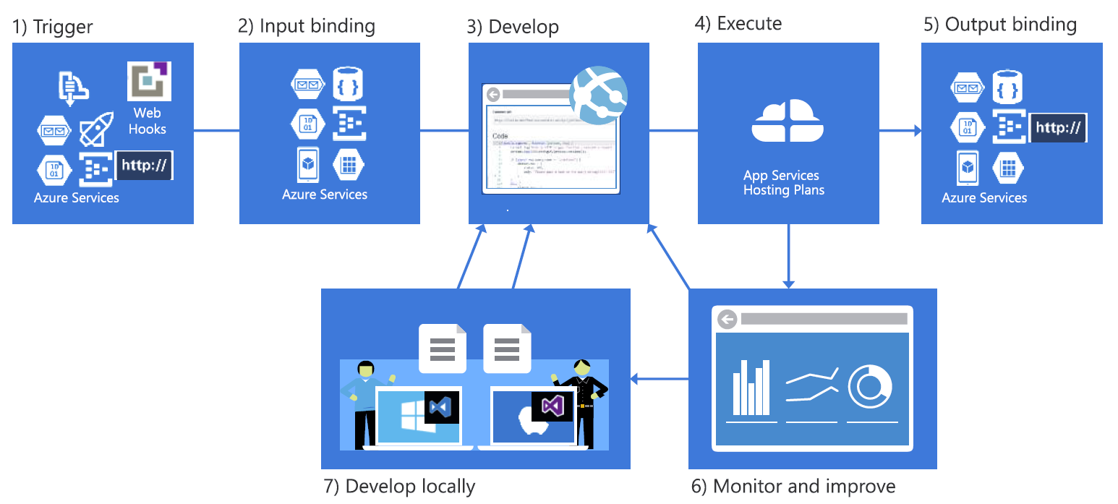
Seamless development experience

Slide 19
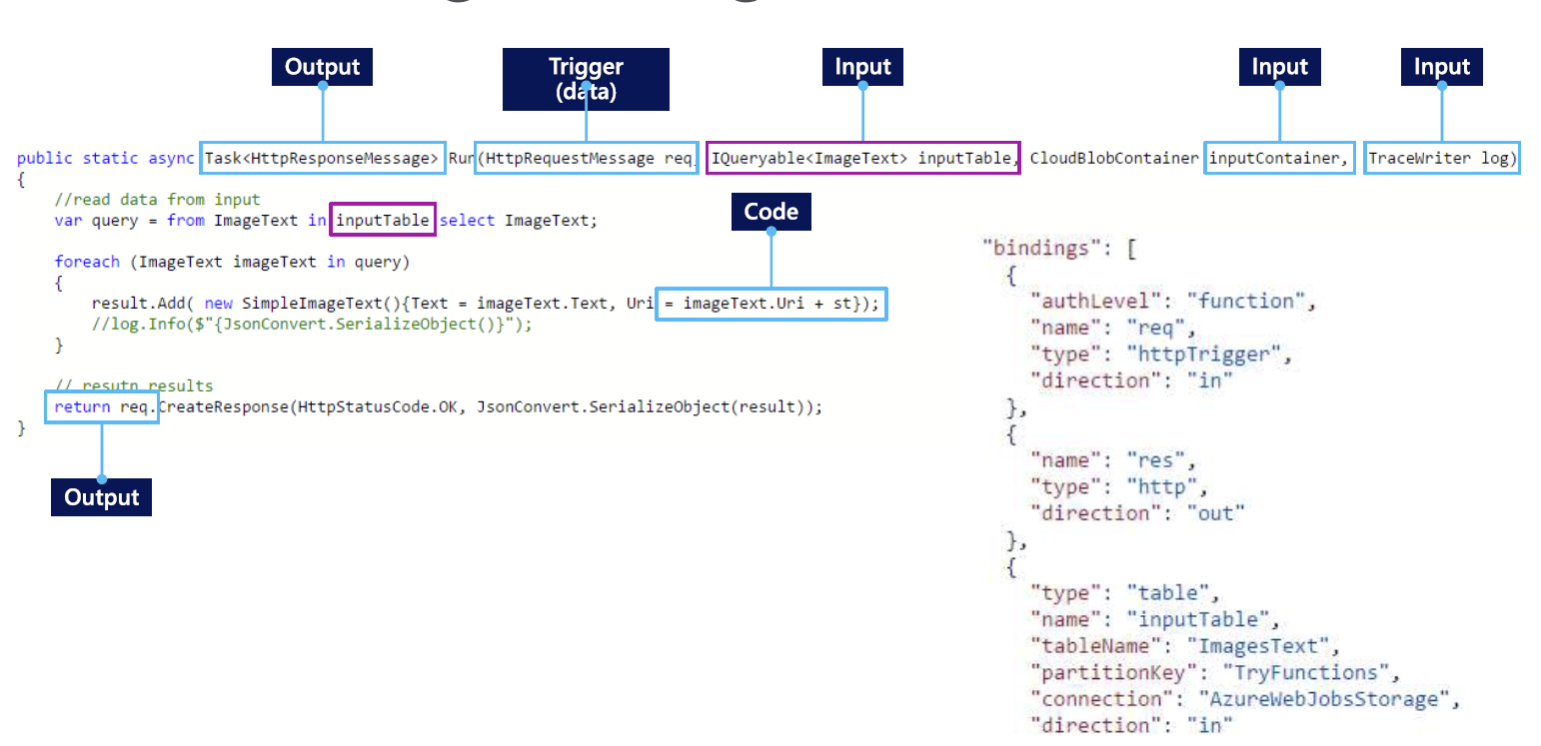
Functions Programming Model

Slide 20

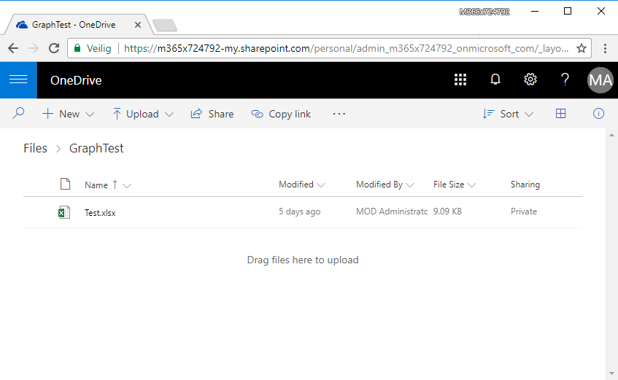
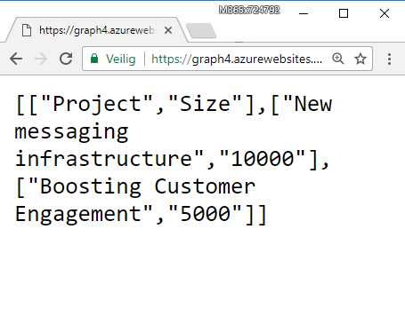
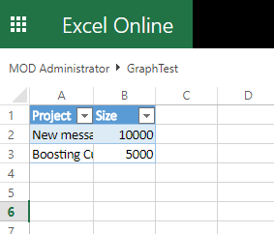
Demo: Excel processing
Notes:
https://graph4.azurewebsites.net/.auth/login/aad
https://graph4.azurewebsites.net/api/ExcelBinding?workbook=graphtest/test.xlsx&table=Table1
Graph bindings: available in the v2 preview

Slide 21
Webhooks
What are webhooks
Demo: Within a Web App
Demo: Within an Azure Function
Notes:
C

Slide 22
Webhooks
Microsoft Graph REST API clients can subscribe to changes on the following resources:
Messages
Events
Contacts
Group conversations
Drive root items
After Microsoft Graph accepts the subscription request, it pushes notifications to the URL specified in the subscription.
The app then takes action according to its business logic. For example, it fetches more data, updates cache and views, etc.
Notes:
D

Slide 23
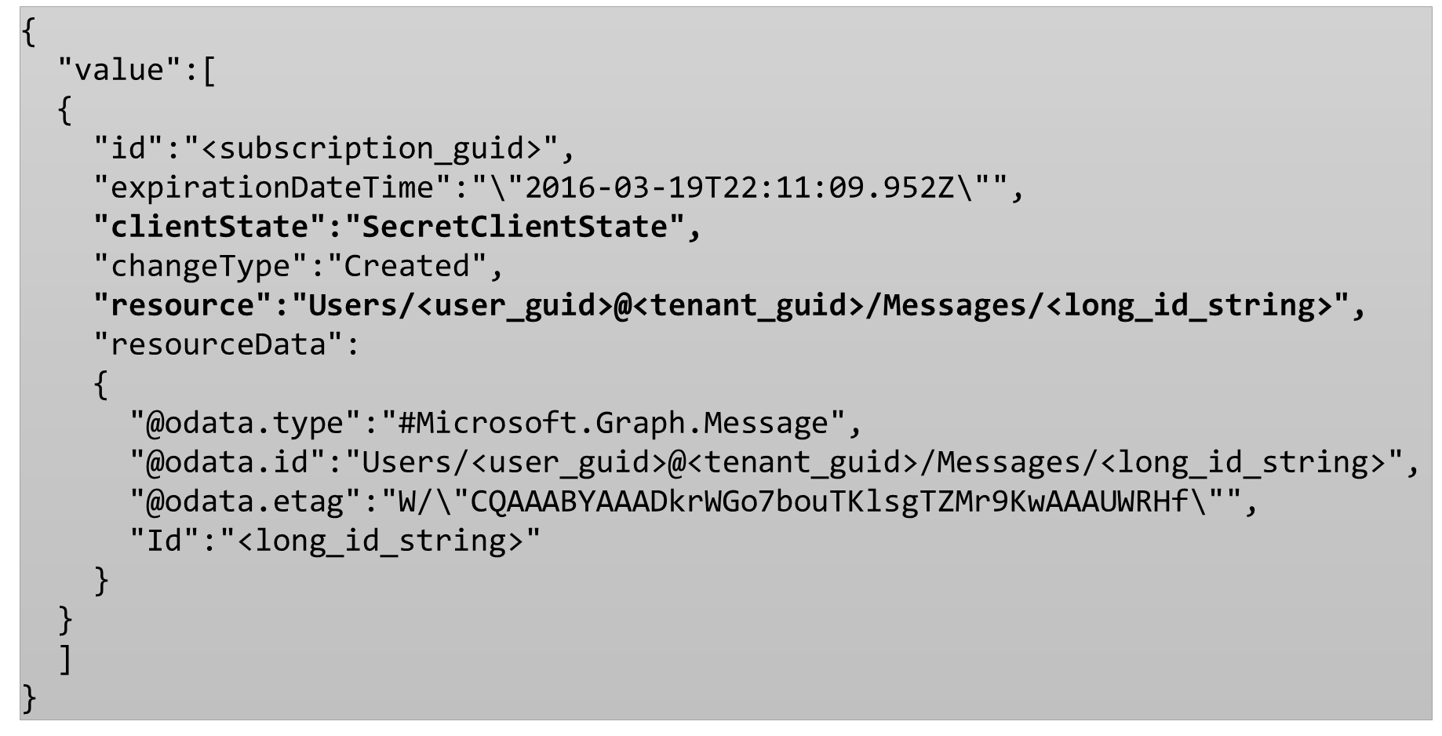
Example Notification API
Notes:
D

Slide 24
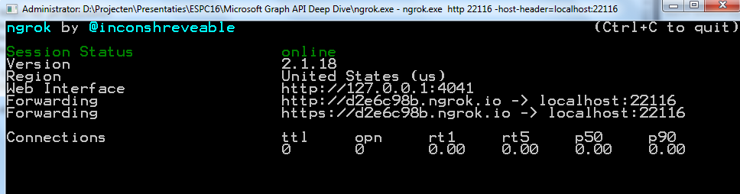
Webhooked localhost web app
DEMO
Webhook requires a public accessible endpoint for sending the notifications
During development, your endpoint is running on https://localhost:[portnumber]
Use NGROK to:
Create a public accessible endpoint
Tunnel the request from the public endpoint to https://localhost:[portnumber]
Notes:
https://eventmanagerdemo20180418083443.azurewebsites.net/
Subscription tab

Slide 25
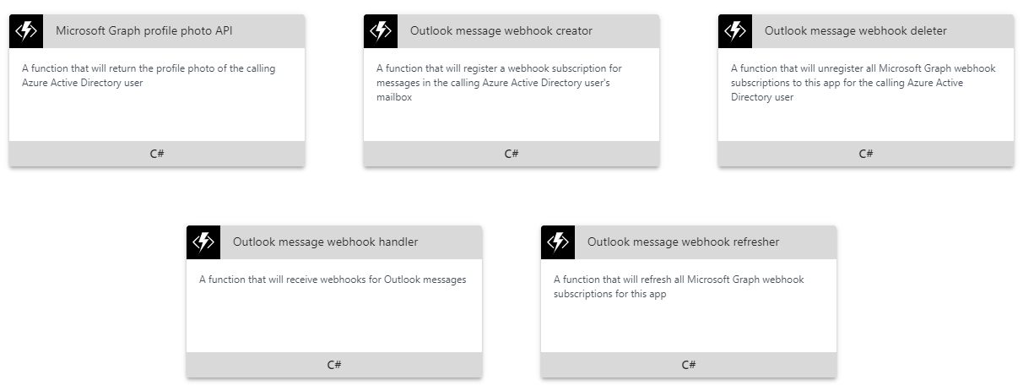
Webhooked Function

Slide 26
SharePoint Framework
SharePoint Framework 1.4.1 comes with MsGraphClient preview
Notes:
C

Slide 27
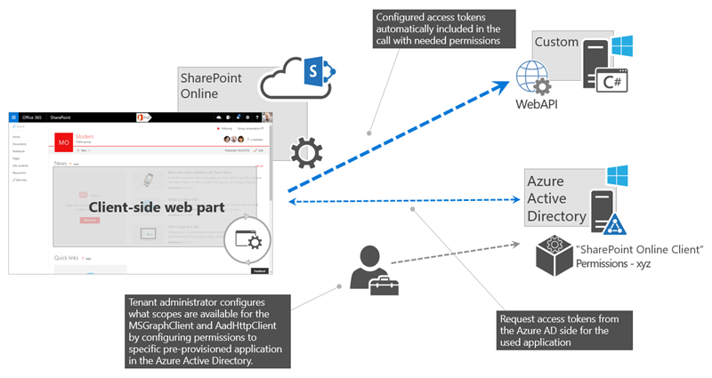
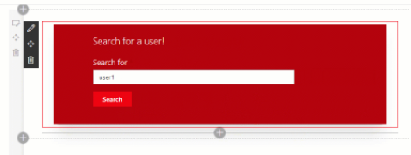
SharePoint Framework
DEMO
https://docs.microsoft.com/en-us/sharepoint/dev/spfx/use-aad-tutorial
Notes:
https://m365x724792.sharepoint.com/SitePages/Graph-API-demo.aspx
Available through MsGraphClient SharePoint Framework 1.4.1. Preview
Notes:
After the package has been added to the App collection, an Admin needs to approve the requested permissions through the SharePoint admin portal
Permissions are granted to a tenant wide app principal
Popup blocker must be disabled

Slide 28
Thanks for attending

