Slide 1

CVPR 2015 Awards

Slide 2
CVPR 2015 Organizing Team
General Chairs: Horst Bischof, David Forsyth, Cordelia Schmid, Stan Sclaroff
Area Chairs
Workflow and CMT: Cheni Chadowitz and Joseph Lim
Publications: Eric Mortensen, Sanja Fidler
Local Arrangements: Mike Jones
Website: Gary B. Huang
Finance: Terry Boult, Greg Mori
Logistics Advisor: Ginger Boult
Workshops: Alex Berg, Tamara Berg
Tutorials: Deva Ramanan, Octavia Camps
Corporate Relations: Fatih Porikli
Publicity: Kristin Dana
Video Proceedings: Nathan Jacobs
Demos/Exhibitions: Kate Saenko, Bruce A. Maxwell
Doctoral Consortium: Adriana Kovashka, Christoph Lampert
Student Activities: Devi Parikh, James Hays
Conference Organizer: Nicole Finn
CVF Liaison: Walter Scheirer

Slide 3

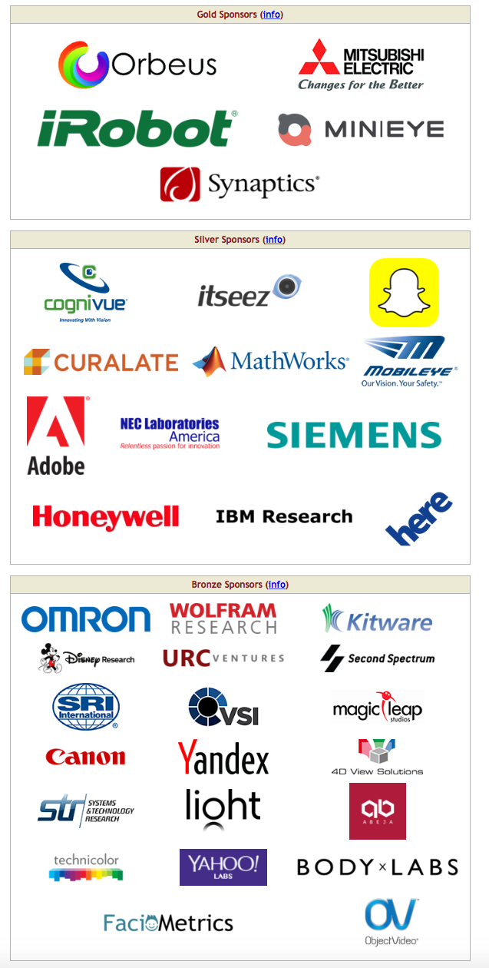

Special thanks to:
Our 51 corporate donors
&
NSF

Slide 4
Outstanding reviewer awards
Tal Arbel
Dan Banica
Adrien Bartoli
Dhruv Batra
Ismail Ben Ayed
Rodrigo Benenson
Ohad Ben-Shahar
Joan Bruna
Ayan Chakrabarti
David Crandall
Francisco Estrada
Bin Fan
Sanja Fidler
Alexander Fix
Boris Flach
Francois Fleuret
Wolfgang Forstner
Friedrich Fraundorfer
Adrien Gaidon
Ross Girshick
Albert Gordo
Bharath Hariharan
Tal Hassner
Soren Hauberg
Kaiming He
Adrian Hilton
Jeremy Jancsary
C. V. Jawahar
Joerg Kappes
Andrej Karpathy
Piotr Koniusz
Adriana Kovashka
Jean-Francois Lalonde
Yong Jae Lee
Stephen Lin
Michael Maire
Subhransu Maji
Tim Marks
Stefan Mathe
Richard Newcombe
Takayuki Okatani
Chris Pal
Vishal Patel
Marco Pedersoli
Leonid Pishchulin
Jerry Prince
Ian Reid
Hayko Riemenschneider
Emanuele Rodola
Jose Rodriguez-Serrano
Marcus Rohrbach
Stefan Roth
Olga Russakovsky
Torsten Sattler
Bogdan Savchynskyy
Walter Scheirer
Falk Schubert
Samuel Schulter
Pradeep Sen
Lavanya Sharan
Alexander Shekhovtsov
Abhinav Shrivastava
Cees Snoek
Anuj Srivastava
Michael Stark
Joost van de Weijer
Jan van Gemert
Rene Vidal
Carl Vondrick
Lei Wang
David Wipf
Paul Wohlhart
Dijia Wu
Stefanos Zafeiriou

Slide 5
TC Award Process
Overseen by the PAMI-TC Awards Committee
David Forsyth, Bill Freeman, Richard Hartley, Jitendra Malik, Cordelia Schmid, Andrew Zisserman
Decide policy, select the group that chooses the winners of each award
Prizes come with a plaque plus $3,000
Process, including conflicts policy, described at
http://www.computer.org/portal/web/tcpami/Award-Committee

Slide 6
Longuet-Higgins Prize
Recognizes a CVPR paper from 10 years ago that has had significant impact
Prize committee:
David Forsyth, William T. Freeman, Jitendra Malik (chair), Cordelia Schmid

Slide 7
2015 Longuet-Higgins Prize
Histograms of oriented gradients for human detection
Navneet Dalal and Bill Triggs
A non-local algorithm for image denoising
Antoni Buades, Bartomeu Coll, and Jean-Michel Morel
Sponsored by Microsoft Research

Slide 8
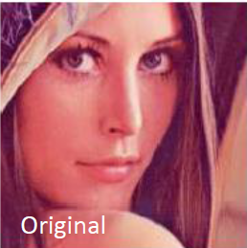
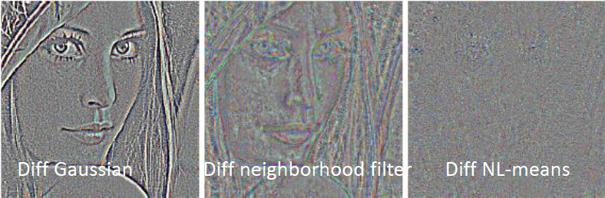
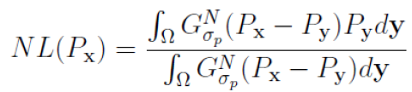

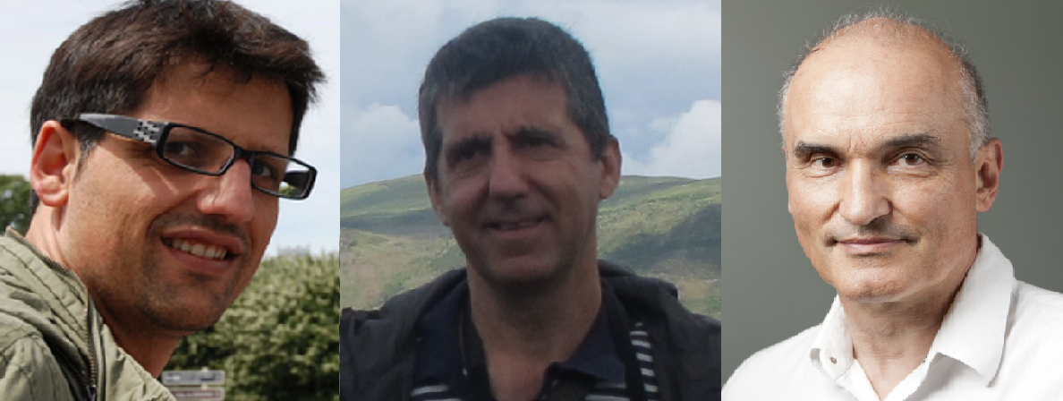
Thank you very much for the great honour
This prize was totally unexpected! This is why we are not here in person ☺☺☺
We hope to be back soon for new adventures!
Toni Tomeu Jean-Michel

Slide 9
PAMI Young Researcher Award
Eligible if Ph.D. awarded on January 1, 2008 or later
Nomination process, including 2 letters of reference
NSF definition of conflicts of interest with candidates
Award committee:
Bill Freeman, David Kriegman, Maja Pantic, Cordelia Schmid (chair), Tinne Tuytelaars

Slide 10
2015 PAMI Young Researcher Award
John Wright
Sponsored by Elsevier's Image and Vision Computing Journal

Slide 11
Best paper prizes
Prize committee
Kobus Barnard, Horst Bischof, Pedro Felzenszwalb, David Forsyth, Svetlana Lazebnik, Jiri Matas (chair)

Slide 12
2015 CVPR Best Student Paper
Category-Specific Object Reconstruction from a Single Image
Abhishek Kar, Shubham Tulsiani, João Carreira, Jitendra Malik
Sponsored by Google
Hardware prize sponsored by NVIDIA

Slide 13
Honorable mention
Efficient Globally Optimal Consensus Maximisation with Tree Search
Tat-Jun Chin, Pulak Purkait, Anders Eriksson, David Suter
Sponsored by SenseTime
Hardware prize sponsored by NVIDIA

Slide 14
Honorable mention
Fully Convolutional Networks for Semantic Segmentation
Jonathan Long, Evan Shelhamer, Trevor Darrell
Sponsored by Intel
Hardware prize sponsored by NVIDIA

Slide 15
Honorable mention
Picture: A Probabilistic Programming Language for Scene Perception
Tejas D Kulkarni, Pushmeet Kohli, Joshua B Tenenbaum and Vikash Mansinghka
Sponsored by Cognex
Hardware prize sponsored by NVIDIA

Slide 16
2015 CVPR Best Paper Award
DynamicFusion: Reconstruction and Tracking of Non-rigid Scenes in Real-Time
Richard A. Newcombe, Dieter Fox,
Steven M. Seitz
Sponsored by Megvii
Hardware prize sponsored by NVIDIA

