Slide 1
Student Details
Name : Talluri Triveni
College : ADITYA COLLEGE OF ENGINEERING,SUREMPALEM
University : JNTUK

Slide 2
PROJECT TITLE/Problem Statement
Employee burn out analysis

Slide 3
AGENDA
Project overview
WHO ARE THE END USERS of this project
YOUR SOLUTION AND ITS VALUE PROPOSITION
How did you customize the project and make it your own
MODELLING
Results
links

Slide 4
PROJECT OVERVIEW
Employee burnout is a state of physical, emotional and mental exhaustion caused by excessive and prolonged stress. It can have serious consequences on an individual's well-being and can lead to decreased productivity and job performance. In today's fast-paced and constantly connected world, it is increasingly important to recognize and address the signs of burnout in order to maintain the health and well-being of employees.we will be exploring the use of regression techniques to predict employee burnout. By analyzing a dataset containing various factors that may contribute to burnout such as workload, mental fatigue job and work-life balance, we can develop a model to identify individuals who may be at risk of burnout. By proactively addressing these risk factors, organizations can help prevent burnout and promote the well-being of their employees.

Slide 5
WHO ARE THE END USERS of this project?
The end users of a project can vary depending on its nature. Typically, they are the individuals or groups who directly interact with or benefit from the project's outputs or outcomes. For example:
1. Consumers: If the project involves a product or service, consumers are the end users who use or consume it.
2. Clients or Customers: In business orservice-oriented projects, these are the entities paying for or receiving the service.
3.Employees or Team Members: Internal projects often benefit employees who use new systems or tools developed by the project.
4. Stakeholders: These can include investors, regulatory bodies, or community members who have a vested interest in the project's success.
5. General Public: Some projects, especially public infrastructure or government initiatives, aim to benefit the broader public.

Slide 6
YOUR SOLUTION AND ITS VALUE PROPOSITION
Sure, I understand now. When talking about a "solution and its value propositions," we're typically discussing a product or service and the unique benefits it offers to customers. Here's how it breaks down:
1. Solution: This refers to the product, service, or offering that solves a particular problem or fulfills a need for customers.
2. Value Propositions: These are the unique benefits or advantages that the solution provides to its users. They can include things like cost savings, improved efficiency, better performance, enhanced user experience, environmental sustainability, etc.
For example, let's say we have a new software tool designed to streamline project management:- Solution: Project management software.- Value Propositions: Increased productivity through better task organization, real-time collaboration features for remote teams, customizable reporting for stakeholders, and automated scheduling to save time.The value propositions highlight why customers should choose this particular solution over others—it's about communicating the unique benefits and advantages that address their specific needs or pain points.

Slide 7
How did you customize the project and make it your own
Customizing a project typically involves tailoring it to specific requirements or preferences, which can be achieved through several
steps:1. Understanding Requirements: Begin by clearly defining the project's objectives, scope, and desired outcomes. This involves gathering input from stakeholders and understanding their expectations.
2. Designing Solutions: Based on the requirements, brainstorm and design solutions that align with the project goals. This may involve creating prototypes, mockups, or detailed plans to visualize the final product.
3. Implementing Customization: Execute the customization by integrating tailored features, functionalities, or designs into the project. This could involve coding, configuration, or adjustments to existing systems.
4. Testing and Iteration: Test the customized elements to ensure they meet quality standards and fulfill the project requirements. Iteratively refine and adjust as necessary based on feedback and testing results.
5. Deployment and Feedback: Once satisfied with the customization, deploy the project for use. Gather feedback from users and stakeholders to assess its effectiveness and make further improvements if needed.
6. Documentation and Maintenance: Document all customization processes, configurations, and decisions for future reference. Establish a maintenance plan to support ongoing updates and enhancements.By following these steps, you can effectively customize a project to meet specific needs and make it your own, ensuring it aligns closely with desired outcomes and delivers value to stakeholders.

Slide 8
MODELLING
Modeling data involves structuring and organizing data in a way that facilitates analysis, interpretation, and decision-making. Here are the key steps involved in data modeling:
1. Understand Requirements: Start by understanding the business requirements and objectives that the data model needs to support. This involves gathering input from stakeholders to determine what questions the data should answer and what insights are needed.
2. Conceptual Data Modeling: Create a high-level conceptual model that represents the entities (objects or things) and their relationships. This helps to establish the scope and boundaries of the data model without delving into technical details.
3. Logical Data Modeling: Develop a logical data model that defines the structure, relationships, and attributes of the data entities. This model is more detailed and translates the conceptual model into a format that can be implemented in a database or data system.
4. Normalization: Normalize the data model to reduce redundancy and improve data integrity. This involves organizing data attributes into logical groupings to minimize data duplication and improve efficiency.
5. Physical Data Modeling: Design the physical implementation of the data model, including specific database schemas, tables, columns, and constraints. Consider performance optimization and storage considerations at this stage.
6. Data Integration: Ensure that the data model integrates seamlessly with existing data sources and systems. This may involve data migration, transformation, or integration processes to ensure consistency and accuracy across different data sources.
7. Validation and Testing: Validate the data model through testing and validation processes to ensure it accurately represents the business requirements and supports the desired analyses and reporting.
8. Documentation**: Document the data model comprehensively, including its structure, relationships, definitions, and any assumptions or constraints. This documentation serves as a reference for stakeholders and future development efforts.Data modeling is crucial for organizing and structuring data effectively, enabling organizations to derive meaningful insights, make informed decisions, and optimize business processes.

Slide 9
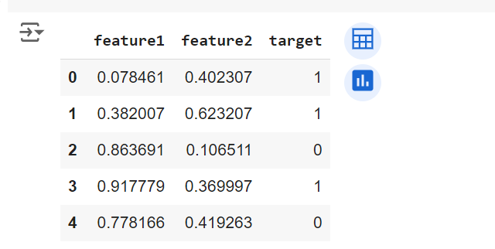
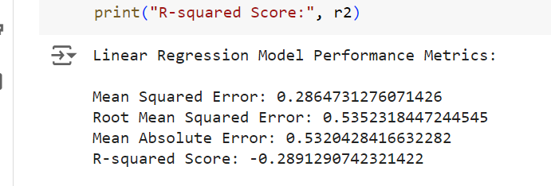
Results

Slide 10
links
cvfgrty/AIppt (github.com)

