Slide 1

Baseball Performance Relationships to Hall of Fame Summer 2020
Conrad Ibanez

Slide 2
Dataset
Kaggle-https://www.kaggle.com/open-source-sports/baseball-databank.
This dataset is a collection of historical baseball data from 1871 to 2015. It contains 20 files, and the main tables include a master table for player and biographical info, batting statistics, pitching statistics, and fielding statistics. There are also tables that contain information for player salaries, awards, All-Star appearances, and Hall of Fame votes.

Slide 3
Statistical Questions
Can we mine frequent patterns in player performance data and associate them to rewards data?
For example, do certain player statistical performance data lead to certain accolades such as All-Star or Hall of Fame selections or even large monetary contracts?
If so, then we can apply techniques to classify or predict certain associations such as clustering or machine learning.
This project has focused on Player Batting data and Hall of Fame data.

Slide 4
Hypothesis
Players who perform well and have high performance metrics are elected to the Hall of Fame.

Slide 5
Variables
AB: At-Bats
H: Hits
HR: Homeruns
RBI: Runs Batted In
R: Run
2B: Double
3B: Triple

Slide 6
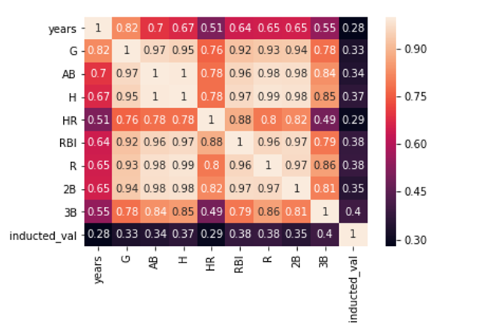
Correlation Heatmap
0.98 or higher correlation
AB-> R, 2B
H-> R, 2B
R-> H, AB,
2B-> H, AB,
Metrics in Focus
AB, H, HR, RBI

Slide 7
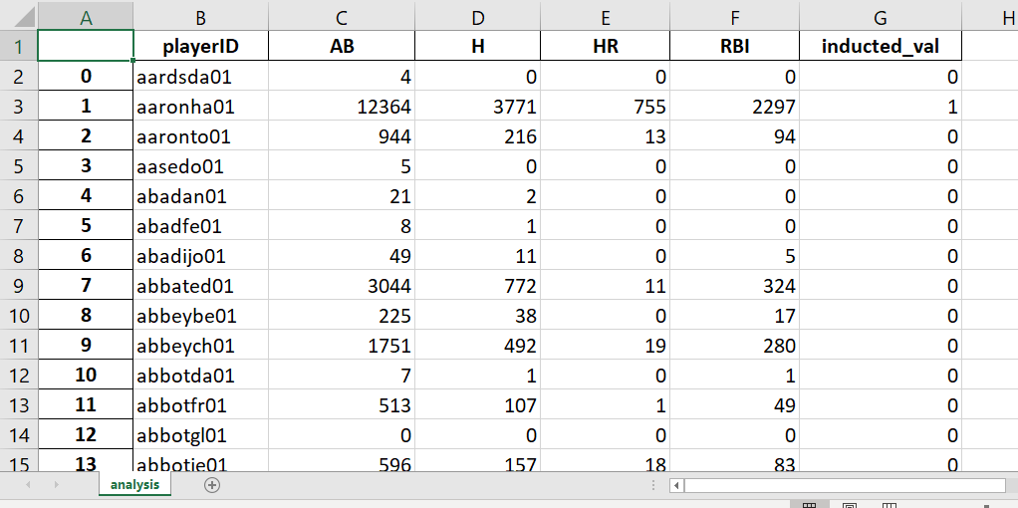
Dataset

Slide 8
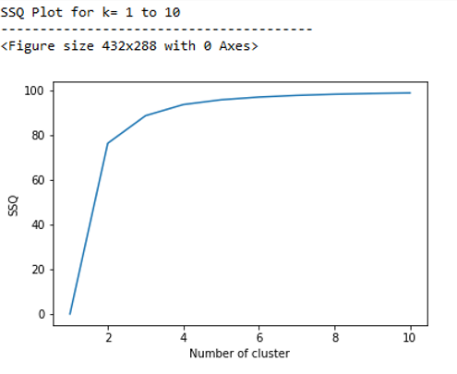
Choosing k with SSQ

Slide 9
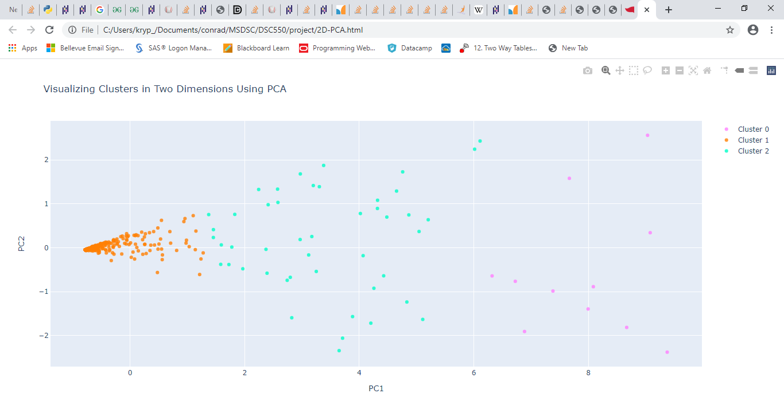

Slide 10
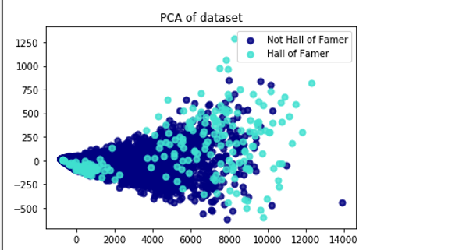
Principal Component Analysis (PCA)- identifies the combination of attributes (principal components, or directions in the feature space) that account for the most variance in the data.
Reference: https://scikit-learn.org/stable/auto_examples/decomposition/plot_pca_vs_lda.html#sphx-glr-auto-examples-decomposition-plot-pca-vs-lda-py

Slide 11
Issues Distorting Learning/Insights
Unexpected Min Values on performance data for Hall of Famers
Unexpected Max Values on performance data for non-Hall of Famers
Impacts of player roles/positions
Impacts of Subjectivity vs. Objectivity

Slide 12
Results:
There is a relationship between player performance metrics and whether the player is elected into the Hall of Fame.
However, the strength of that relationship is somewhat distorted.
Other factors such as player position and subjective views on the players have some impact on the Hall of Fame status for a player.

