Slide 1

Covid-19 Data
Conrad V. Ibanez
Bellevue University - DSC 680
Spring 2021

Slide 2
Objectives
To analyze Covid-19 data and provide visualizations to compare different attributes
Cases and Deaths
Testing
Vaccinations
Cases & Deaths
https://data.cdc.gov/Case-Surveillance/United-States-COVID-19-Cases-and-Deaths-by-State-o/9mfq-cb36
Covid-19 Testing Data
https://healthdata.gov/dataset/COVID-19-Diagnostic-Laboratory-Testing-PCR-Testing/j8mb-icvb
Vaccinations
https://data.cdc.gov/Vaccinations/COVID-19-Vaccinations-in-the-United-States-Jurisdi/unsk-b7fc

Slide 3
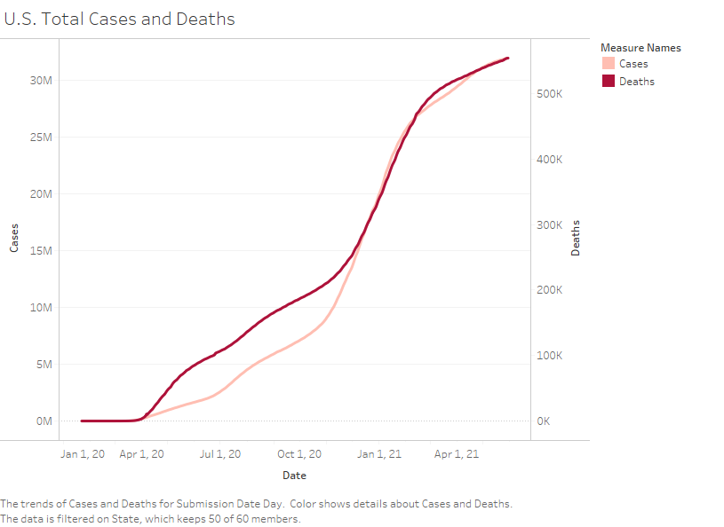
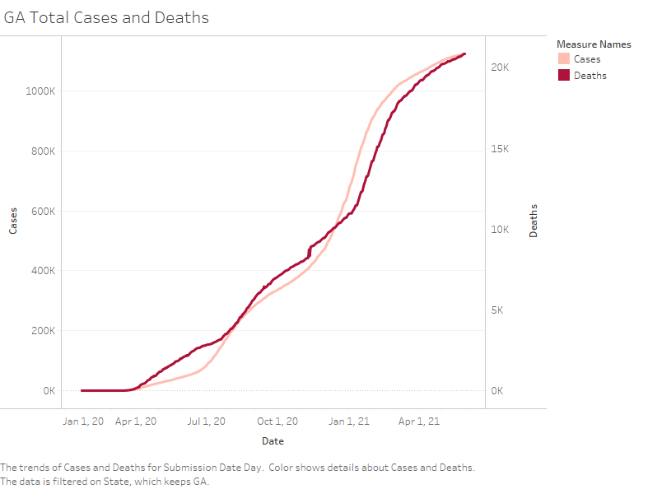
Total Cases & Deaths

Slide 4
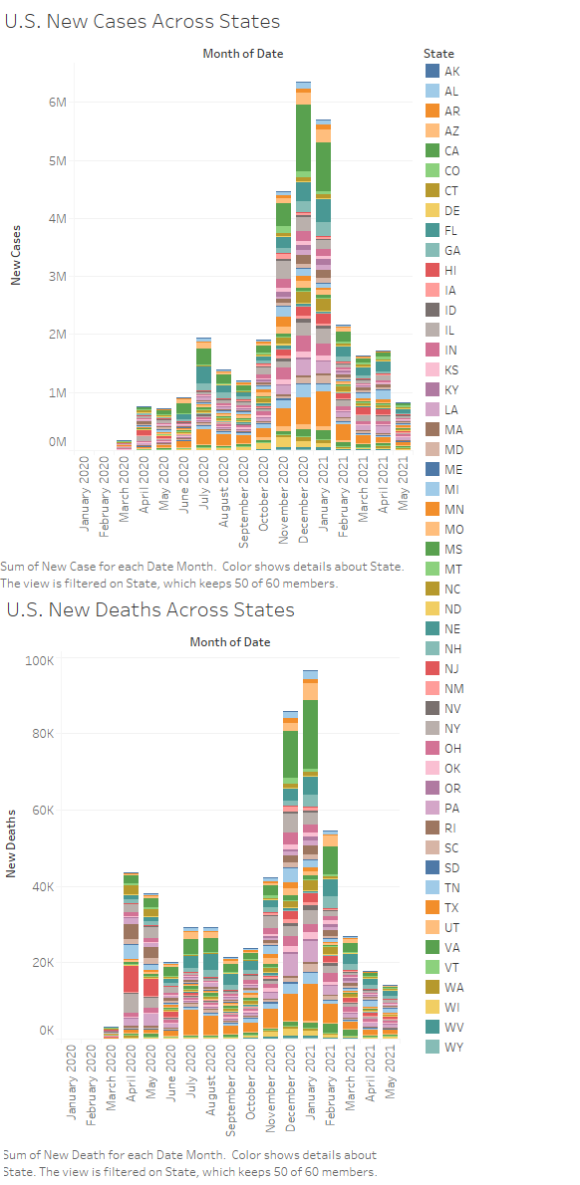
New Cases & Deaths

Slide 5
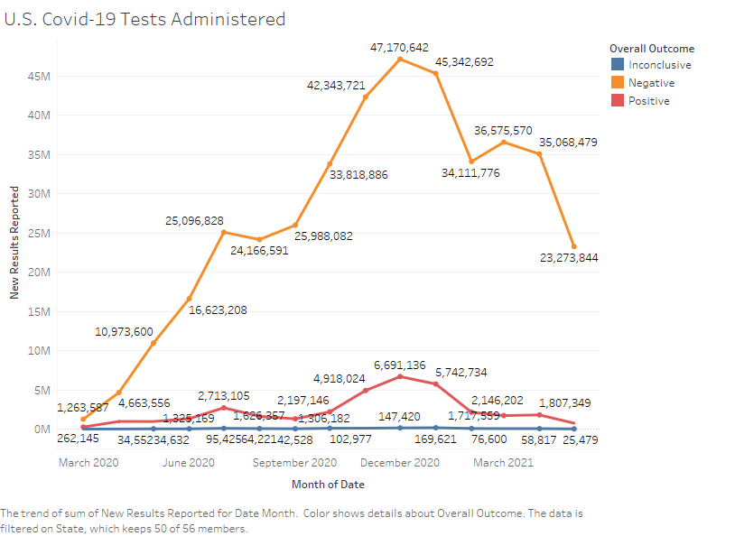
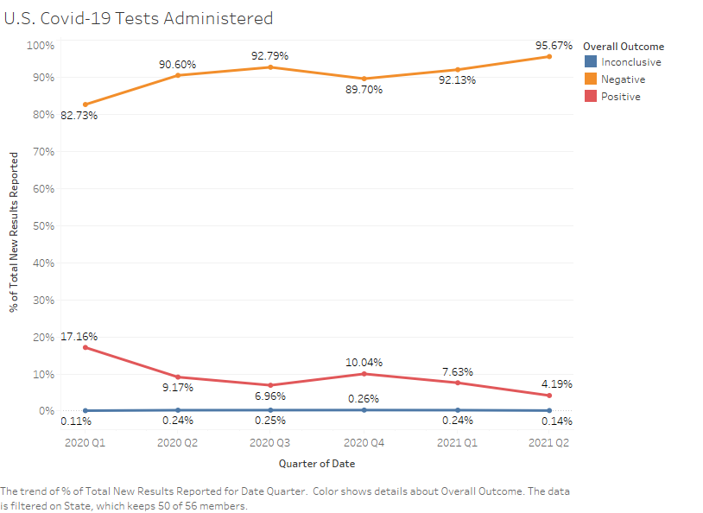
U.S. Covid-19 Testing & Results

Slide 6
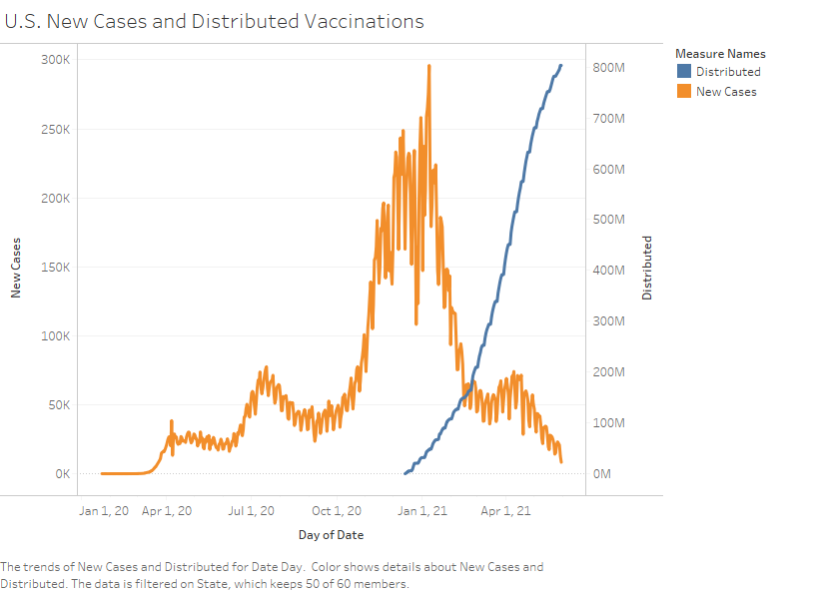
Affects of Vaccinations in U.S.

Slide 7
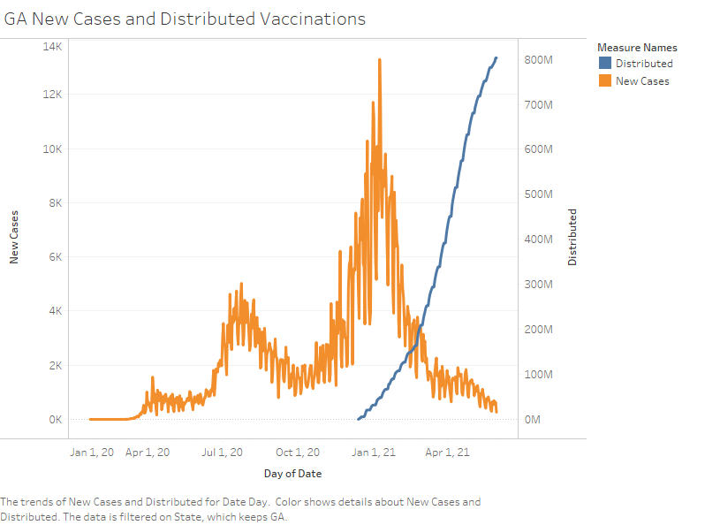
Affects of Vaccinations in Georgia (GA)

Slide 8
CONCLUSION
The Covid-19 pandemic has led to many infections and deaths across the country.
Testing efforts ramped up quickly, but the percentage of positive test results stayed relatively consistent.
Vaccines have greatly reduced the number of infections, and therefore deaths in the country.
Although the vaccines that are available are very effective, we must remain vigilant and follow the guidelines of the CDC.

