Slide 1

DSC 530 Exploratory Data Analysis Final Project-Winter 2019
Conrad Ibanez

Slide 2
Data Set
https://www.kaggle.com/usdot/flight-delays
Context Description from Kaggle:
The U.S. Department of Transportation's (DOT) Bureau of Transportation Statistics tracks the on-time performance of domestic flights operated by large air carriers. Summary information on the number of on-time, delayed, canceled, and diverted flights is published in DOT's monthly Air Travel Consumer Report and in this dataset of 2015 flight delays and cancellations.

Slide 3
Statistical Questions
Which airline was the best in terms of different metrics such as delays or cancellations?
Which airport was the best?
Is there a relationship between airline and airport for such metrics?
Is there a time (ex. day of the week) where travelling is the best?
Are there variables that can be represented by certain distributions? For example, do any variables follow the Pareto distribution or 80/20 rule?
Are there certain flights or airports that are responsible for most of the delays?

Slide 4
Hypothesis
Airlines that are rated the best by travelers also perform the best.
Airports that are rated the best by travelers also perform the best.
Is there a relationship between airline and airport for such metrics?
Mondays and Thursday are the worst days for travelling.
Certain flights or airports are responsible for most of the delays.

Slide 5
Variables
DAY_OF_WEEK - Integer 1 - 7 corresponding to the day of the week. 1 is Monday and 7 is Sunday.
AIRLINE - Letter code corresponding to the airline for the flight.
ORIGIN_AIRPORT - Airport code corresponding to the flight's origin airport.
DESTINATION_AIRPORT - Airport code corresponding to the flight's destination airport.
DEPARTURE_DELAY - Integer value corresponding to the departure delay for the flight. Computed from SCHEDULED_DEPARTURE and DEPARTURE_TIME.
ARRIVAL_DELAY - Integer value corresponding to the arrival delay for the flight. Computed from SCHEDULED_ARRIVAL and ARRIVAL_TIME.

Slide 6
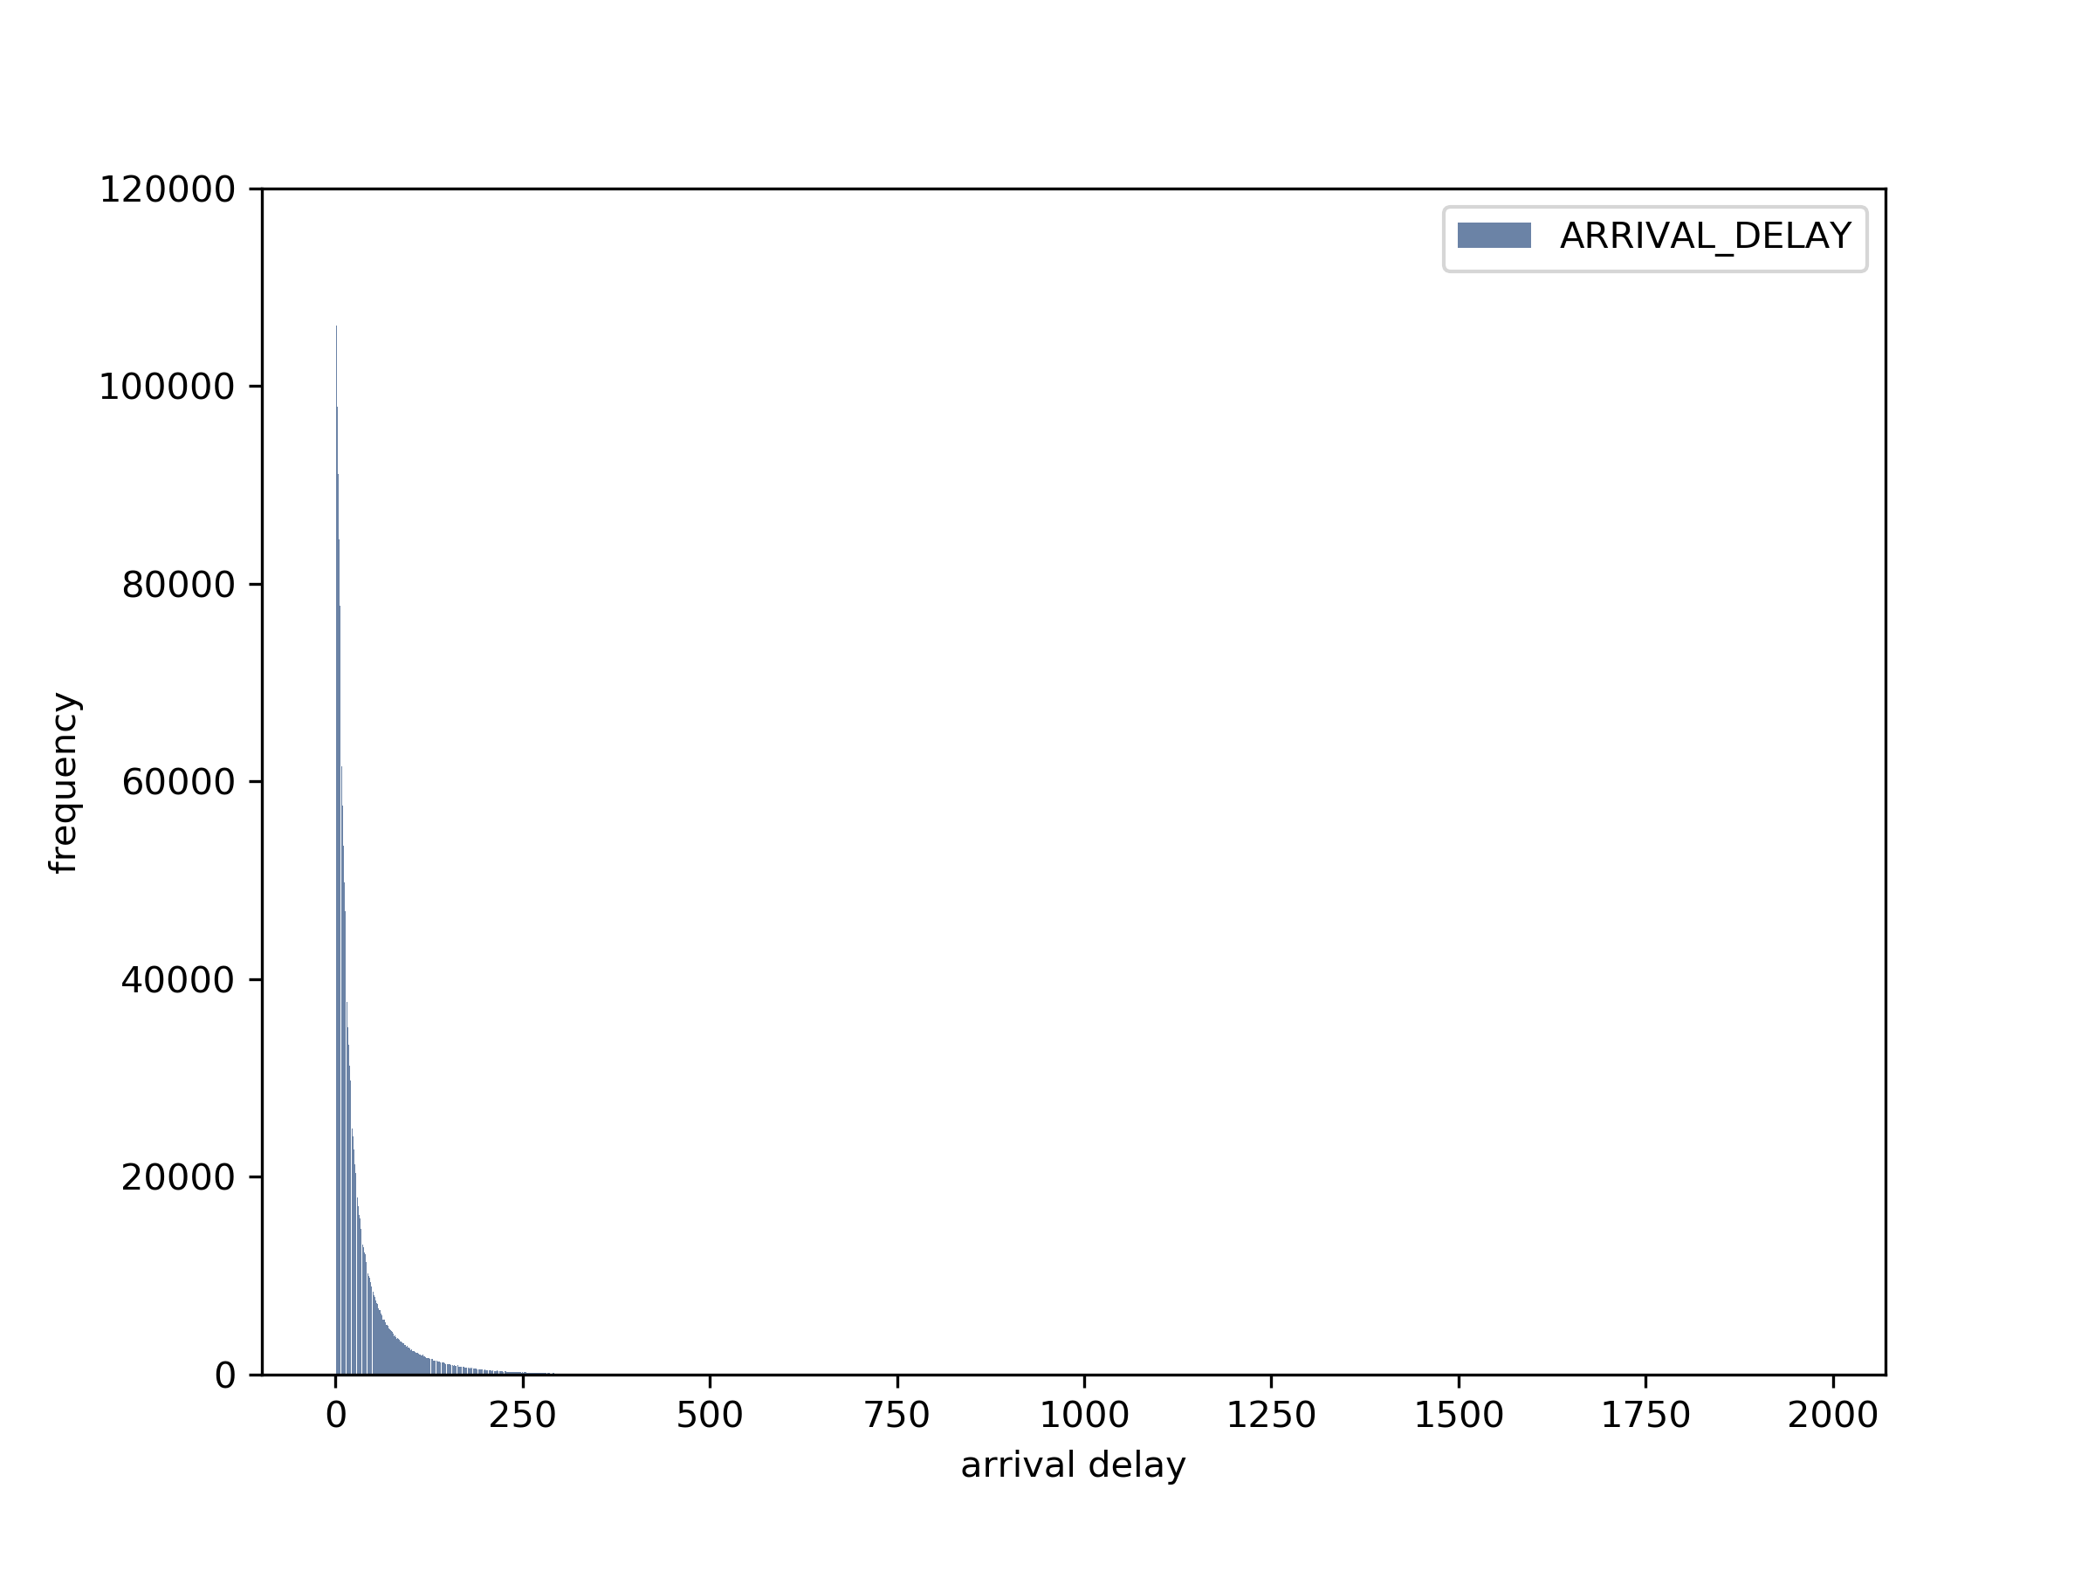
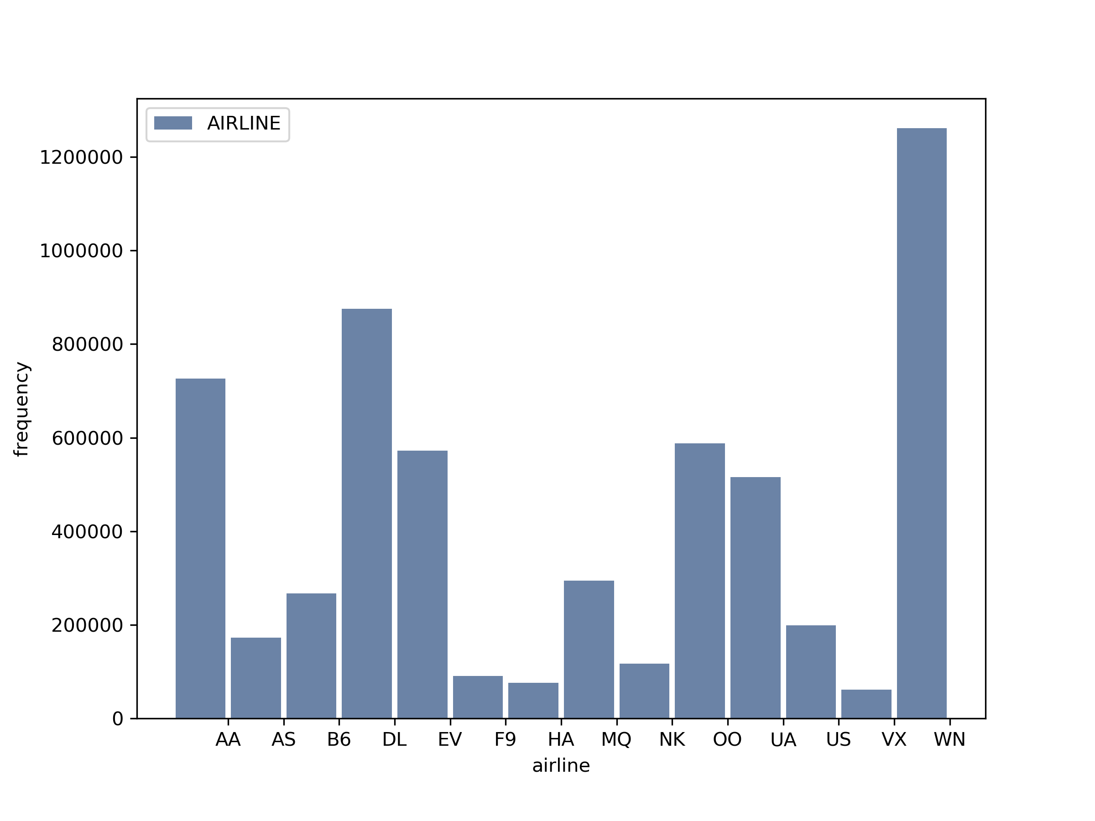
Output Examples- Histogram

Slide 7
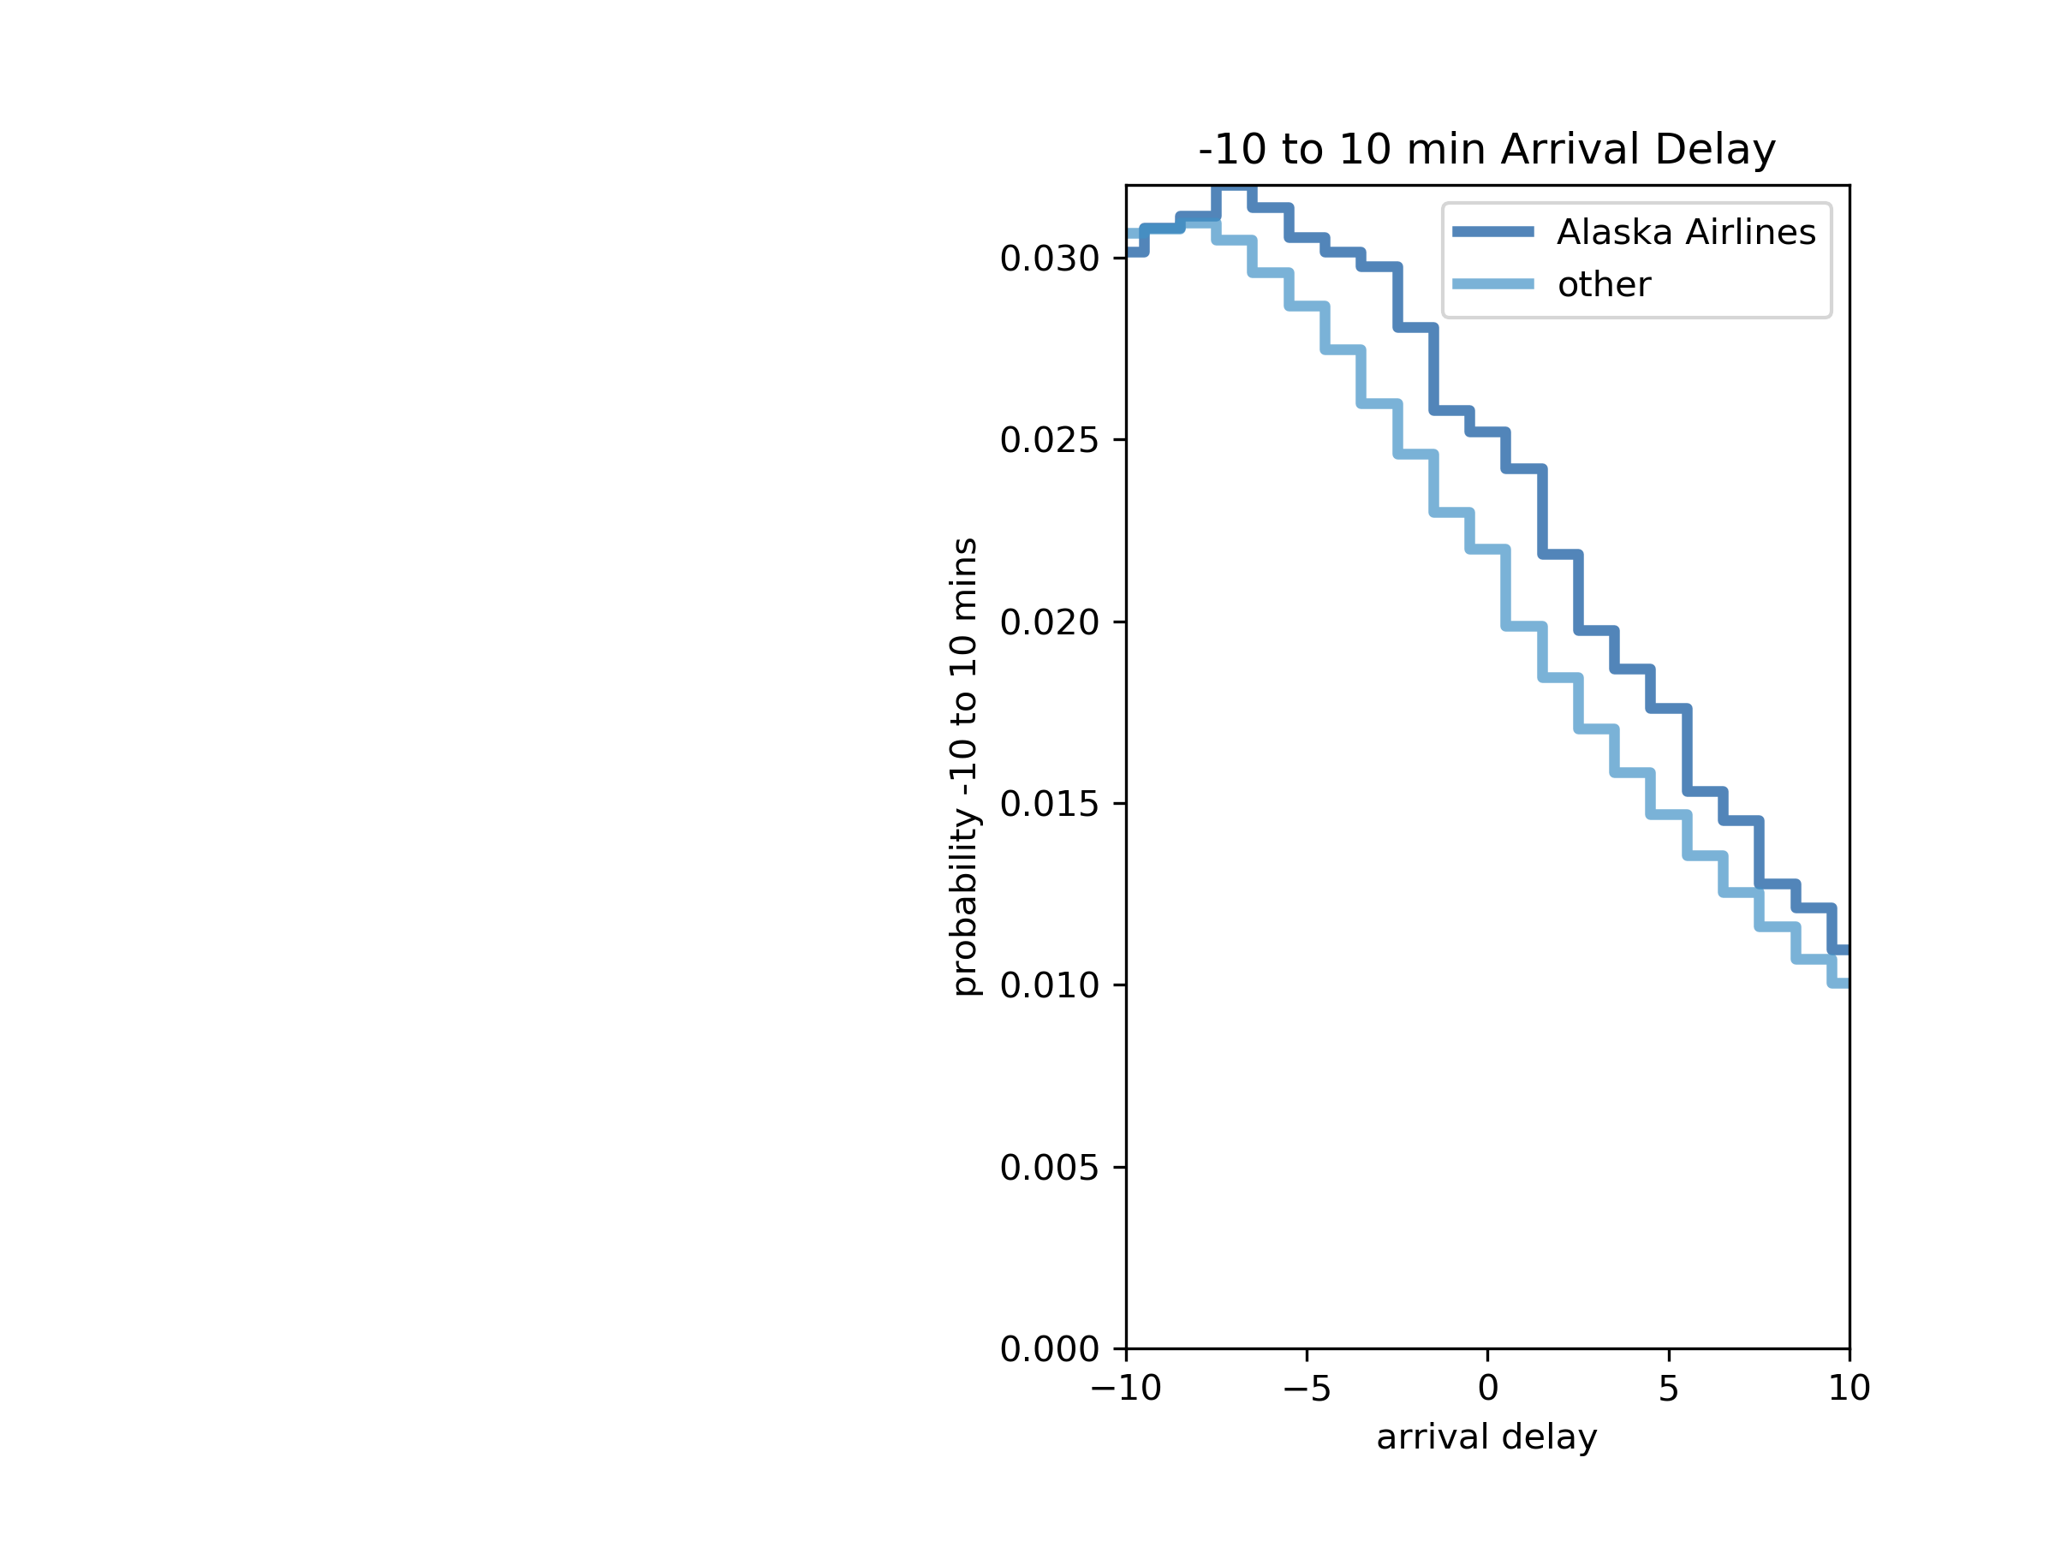
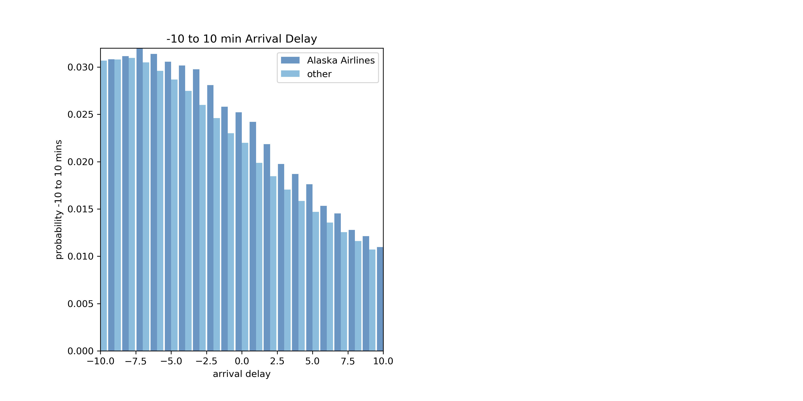
Probability Mass Functions

Slide 8
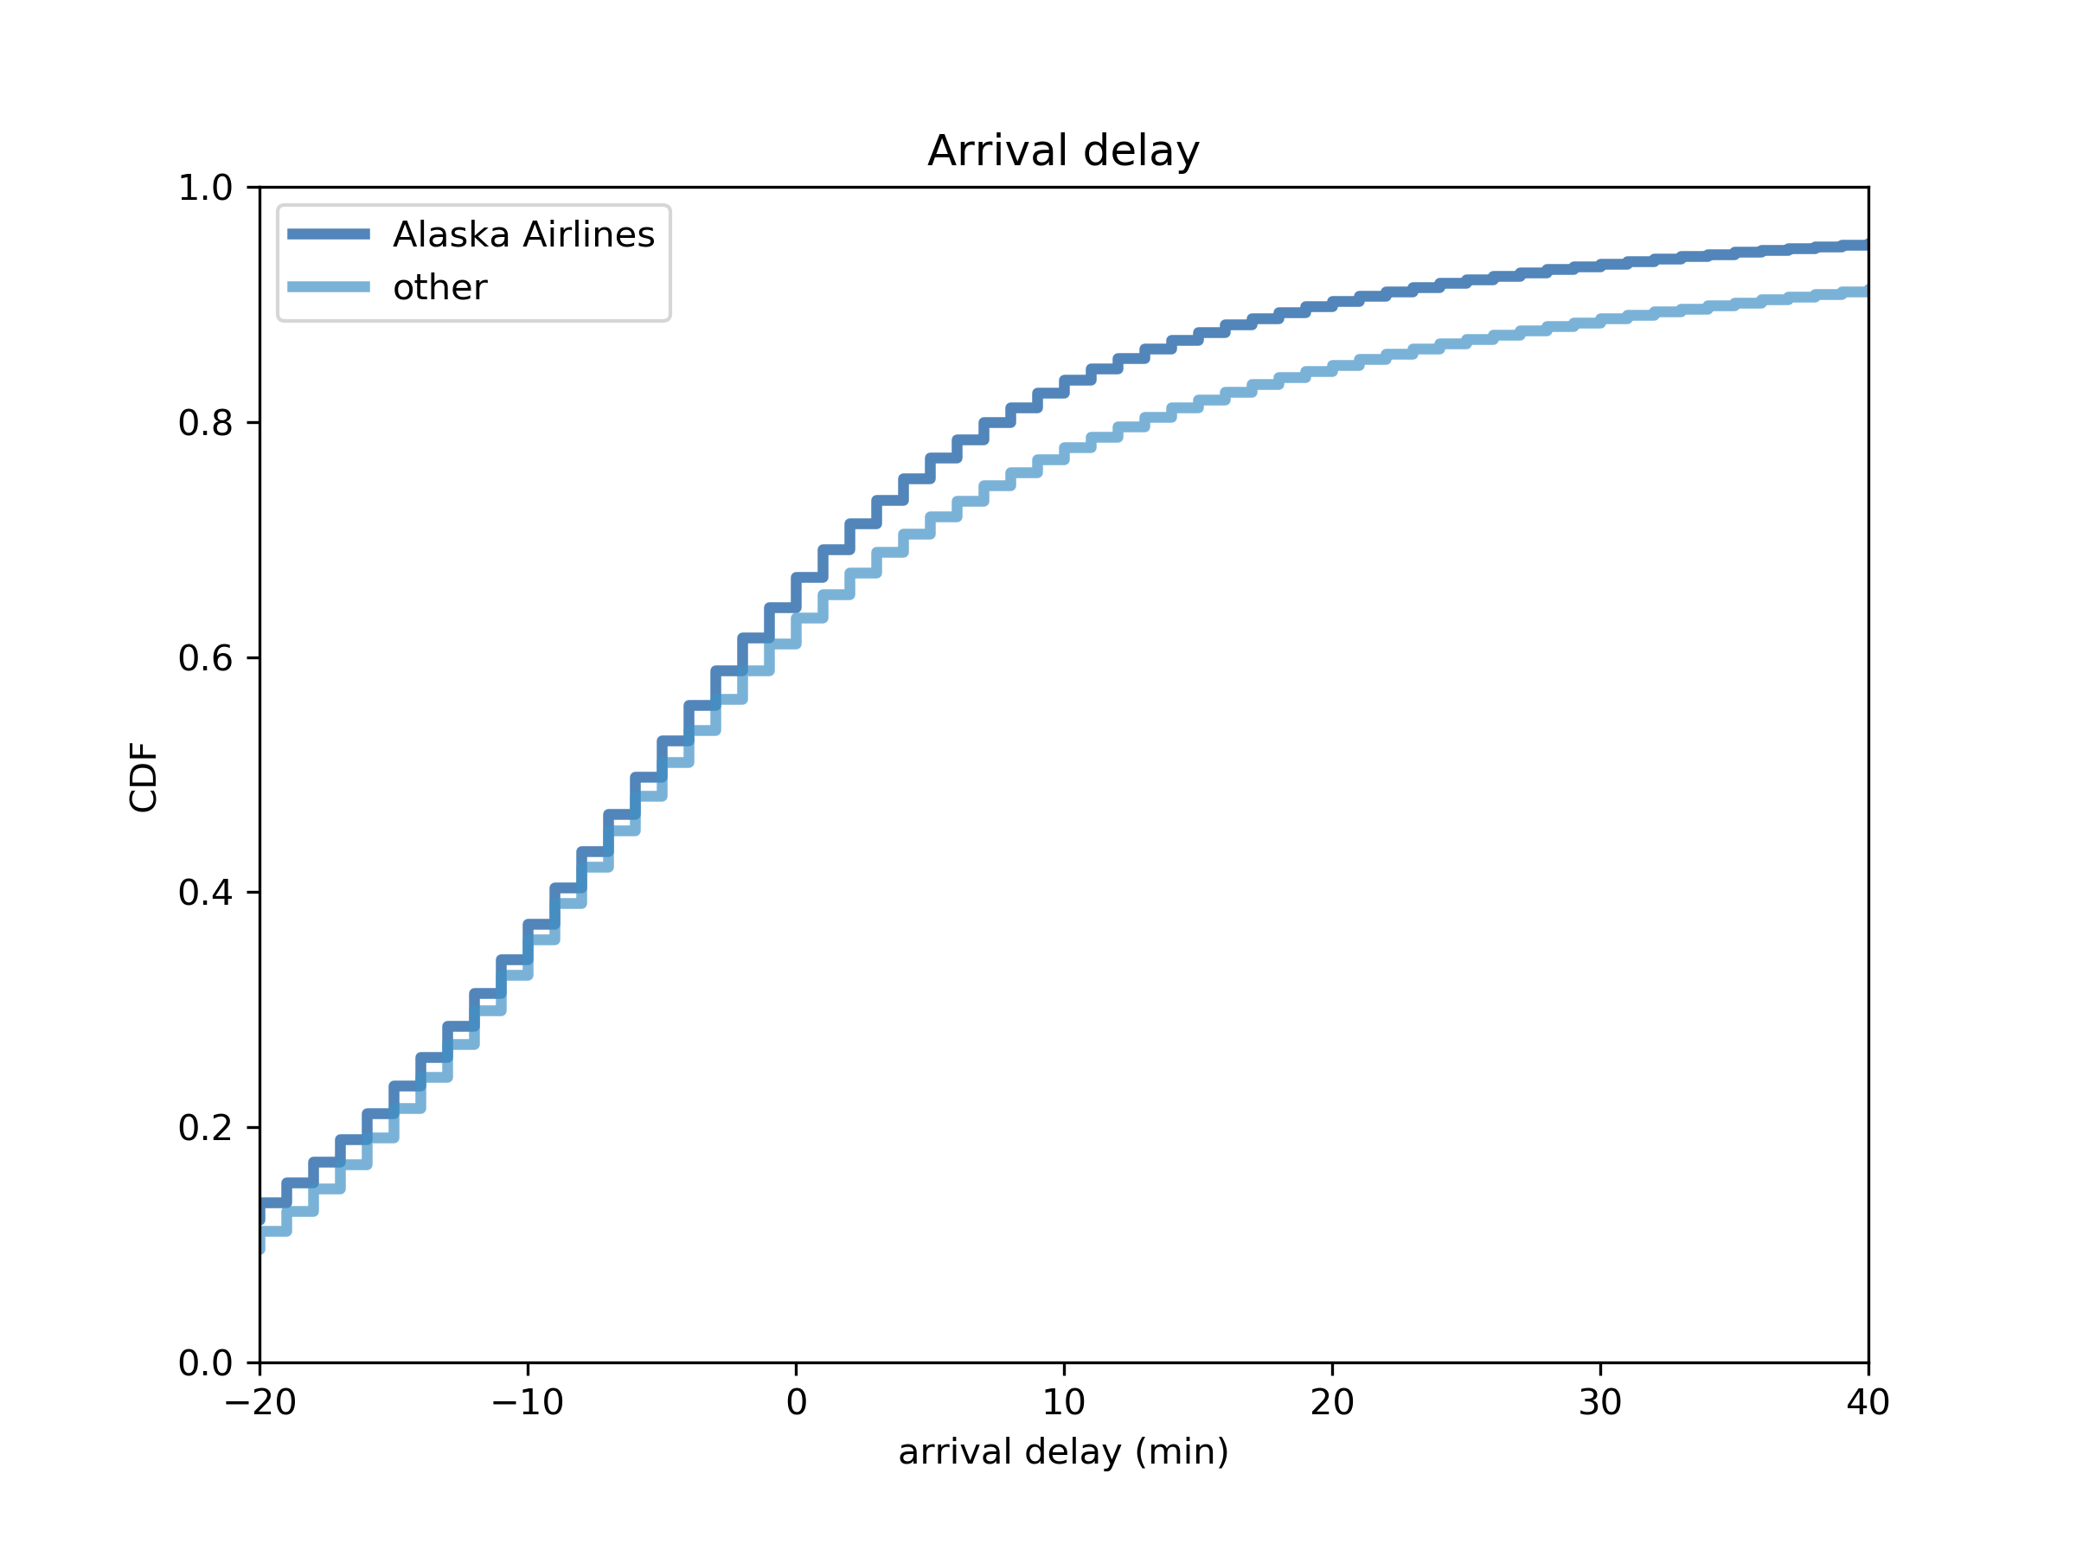
Cummulative Distribution Functions

Slide 9
EDA Results:
My initial hypothesis questions were very subjective in nature. I had to come up with an approach to use the data to show objectivity and to define the meaning of “best” or “worst”.
Histograms for all the variables mentioned were created. The airline histogram indicated that SouthWest Airlines had the most flights by far, but I question that because I have not heard it mentioned as the biggest U.S. airline. The histogram for day shows that Thursday has the most flights, and Saturday has the fewest. The histograms for both departure and arrival delays show that most flights did not suffer long delays.
Probability Mass Functions (PMFs) for airlines were skewed to left and showed that airline data for the most part had arrival delays that were closer to zero or negative. The PMF for Alaska Airlines which is top ranked according to J.D. Power versus other airlines had lower probability as the arrival delay time increased. PMFs for airports showed similar characteristics where arrival delays were closer to zero or negative. For J.D. Power’s top-rated large airport, Detroit Metropolitan Airport, had lower probability compared to other airports as the arrival delay time increased.
The Cumulative Distribution Function (CDF) supports why travelers rate Alaska airlines higher as arrival delay of 10 minutes or less is expected over 80% of the time.
For linear regression, it showed a direct relationship between departure delay and arrival delay. This makes absolute sense since a plane that takes off later will likely arrive delayed as well. I am not sure if variables like these can be considered independent from each other.

