Slide 1

Southwest Airlines
Executive Summary
Conrad V. Ibanez
Hypothetical Project
Analyzing Airline Safety
January 24, 2021

Slide 2
Objectives
Due to recent unfortunate airline crashes, the media has been promoting statistics stating air is no longer a safe way to travel. The news and media outlets have been bombarding the public with reports and figures about the trends of airline safety and that things are not looking good. What was previously thought as the safest way to travel, especially when compared to automobiles, is now being presented as one of the most dangerous to the public.
In this executive summary, we present findings on the airline industry and our company. We analyzed data related to some of these claims and address the following topics:
U.S. Airline Safety
U.S. Auto Safety
Incidents and Fatalities
Passenger Metrics
Revenue

Slide 3
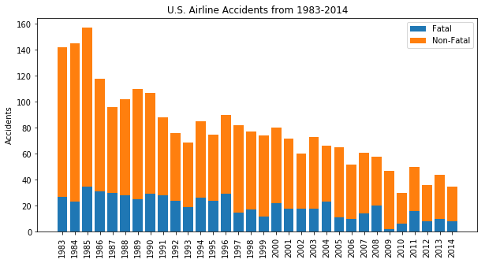
U.S. Airline Safety
Total Number of Accidents has declined since 1983
Fatal accidents remain low compared to total number of accidents

Slide 4
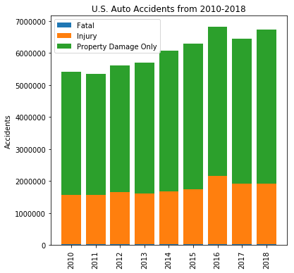
U.S. Auto Safety
Over 5 million auto accidents yearly since 2010
# Fatal U.S. auto accidents is low compared to total number of accidents

Slide 5
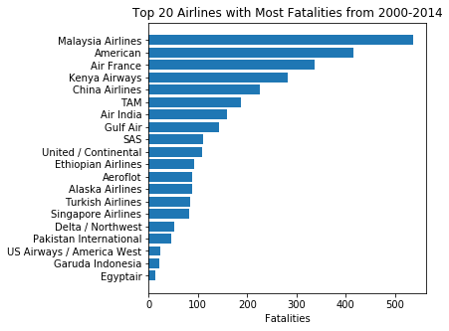
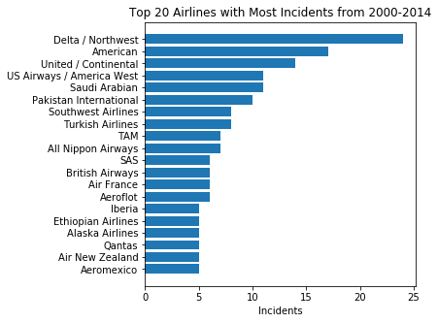
Incidents and Fatalities
No Fatalities for Southwest Airlines from 2000 - 2014
8 Incidents during same time period

Slide 6
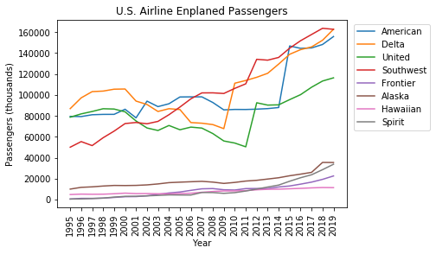
Passenger Metrics
# of Enplaned Passengers has gradually increased for the largest U.S. Airlines
Southwest has led the U.S. airline industry based on Enplaned Passengers in recent years

Slide 7
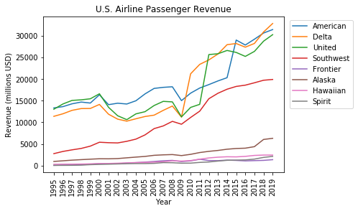
Revenue
Revenue has increased for the largest U.S. airlines including Southwest

Slide 8
CONCLUSION
U.S. Airlines remain safe based on metrics for accidents
U.S. Auto Safety metrics show over 5 million yearly accidents occurring since 2010
Southwest has a good airline safety track record
Southwest has experienced significant growth for enplaned passengers
Revenue indicates a growing and healthy airline industry in the U.S.

