Slide 1

Twitter Sentiment Analysis
Conrad V. Ibanez
Bellevue University - DSC 680
Spring 2021

Slide 2
Objectives
Perform sentiment analysis using Twitter data
Dataset
https://www.kaggle.com/c/tweet-sentiment-extraction/data.
Tweet Sentiment Extraction dataset that was used as part of a Kaggle competition in 2020 that included over 2,000 teams and 37,000 entries. The dataset includes three csv files: a train file, a test file, and a sample submission file.

Slide 3
Methods
Methods
Sentiment analysis utilizes natural language processing (NLP)
Natural Language Toolkit (NLTK) package
NLTK includes classes and functions that lemmatizes or groups together different forms of the same word.
WordNet as the lexical database for the English language.

Slide 4
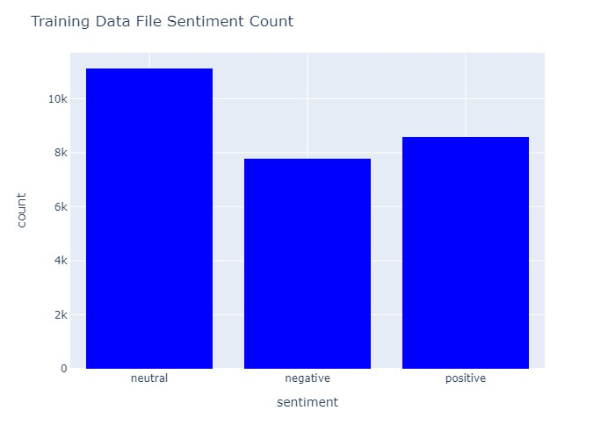
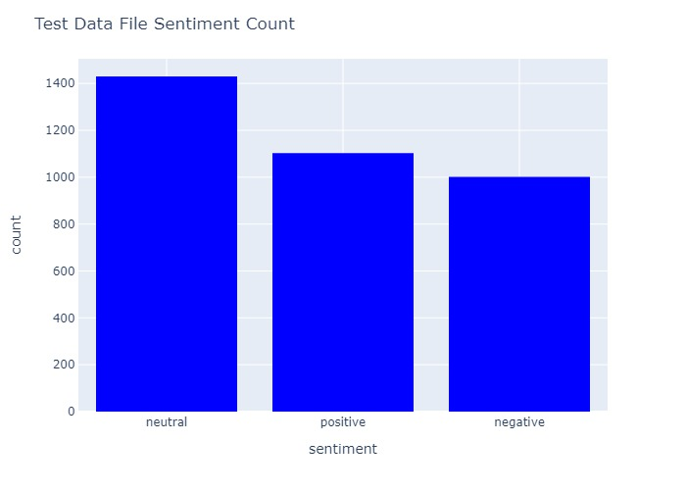
Data

Slide 5
Sentiment Analysis
Positive
[('good', 950), ('love', 795), ('happy', 733), ('day', 476), ('thanks', 438), ('great', 370), ('fun', 287), ('nice', 268), ('hope', 247), ('awesome', 234)]
Negative
[('miss', 525), ('sad', 347), ('sorry', 294), ('bad', 294), ('..', 265), ('hate', 248), ('...', 230), ('feel', 219), ('get', 219), ('suck', 208)]
Neutral
[('...', 1392), ('get', 1239), ('go', 1147), ('..', 638), ('day', 629), ('work', 625), ('like', 462), ('lol', 462), ('time', 458), ('know', 442)]

Slide 6
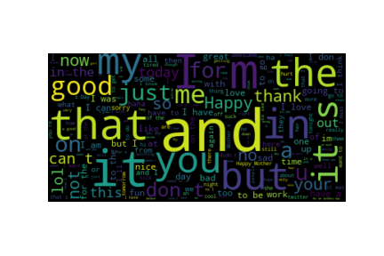
WordClouds

Slide 7
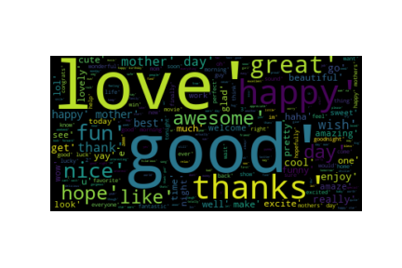
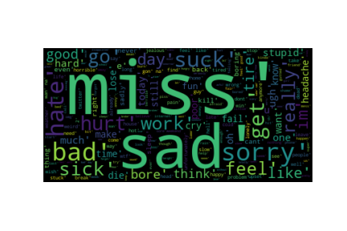
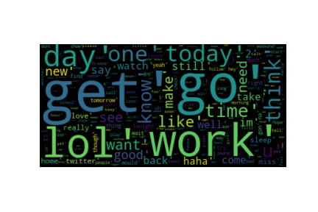
WordClouds

Slide 8
Informative words from the dataset and the ratio among different sentiments
sad = True negati : positi = 151.5 : 1.0
thank = True positi : negati = 109.1 : 1.0
hate = True negati : positi = 105.2 : 1.0
suck = True negati : positi = 92.0 : 1.0
awesome = True positi : negati = 84.0 : 1.0
http = True neutra : positi = 76.0 : 1.0
stupid = True negati : positi = 65.8 : 1.0
fail = True negati : positi = 51.1 : 1.0
beautiful = True positi : negati = 46.2 : 1.0
till = True neutra : positi = 44.0 : 1.0
amazing = True positi : negati = 42.6 : 1.0
thanks = True positi : negati = 41.7 : 1.0
sick = True negati : positi = 40.8 : 1.0
love = True positi : negati = 40.5 : 1.0
hour = True neutra : positi = 35.4 : 1.0
hurt = True negati : positi = 34.6 : 1.0
poor = True negati : positi = 33.7 : 1.0
close = True neutra : positi = 33.2 : 1.0
lose = True negati : positi = 32.9 : 1.0
mother = True positi : negati = 32.6 : 1.0

Slide 9
Results
NaiveBayesClassifier was used to train on the training dataset which contained over 5,000 rows.
71% accuracy- training dataset was split into 80/20 train and test sets.
78% - full training set and the full testing set from the files
When creating predicted attribute for the test file, only 47% accuracy was achieved.

Slide 10
Sample incorrect predictions
Error: Actual= negative Predicted= neutral tweet= its at 3 am, im very tired but i can`t sleep but i try it
Error: Actual= positive Predicted= neutral tweet= All alone in this old house again. Thanks for the net which keeps me alive and kicking! Whoever invented the net, i wanna kiss your hair!
Error: Actual= negative Predicted= neutral tweet= I know what you mean. My little dog is sinking into depression... he wants to move someplace tropical
Error: Actual= positive Predicted= neutral tweet= _sutra what is your next youtube video gonna be about? I love your videos!
Error: Actual= positive Predicted= neutral tweet= http://twitpic.com/4woj2 - omgssh ang cute ng bby.!

Slide 11
CONCLUSION
Sentiment analysis can be leveraged in many ways and in many real-world applications.
Predicting sentiment at a high accuracy can be challenging.

