Slide 1
Lexicografie computationala
Curs 3
Nov., 2009
Anca Dinu
University of Bucharest

Slide 2
Introduction
2 problems with assuming a fixed number of "bounded” word senses for lexical items :
In the case of automated sense selection, the search process becomes computationally undesirable, particularly when it has to account for longer phrases made up of individually ambiguous words.
The assumption that an exhaustive listing can be assigned to the different uses of a word lacks the explanatory power necessary for making generalizations and/or predictions about words used in a novel way.

Slide 3
Introduction
What a lexical item (word) listed in a machine readable dictionary should look like (form, kind of information)?
We will take first the example of decomposing the meaning of the verb, for it is the most intuitive. What kind of arguments a verbs selects and features should have these arguments?
Nouns, adjectives, determiners, adverbs etc may be treated in a similar manner.

Slide 4
Predicative decomposition
The predicative complex that makes up a verb’s meaning includes (but is not limited to):
a. Specific properties of the participants of the event;
b. Change of being, state, location, relation;
c. Causation and agency;
d. Manner and means of an activity;
e. Temporal and spatial constraints;
f. Intentionality of the actor;
g. Instrumental information;
h. Psychological state of the participants.

Slide 5

Predicative decomposition
A predicative expression such as a verb has both a argument list and a body:
Questions:
If the semantics of a predicate can convey any or all of the components of meaning mentioned above, then how are they represented, if at all, in the semantic form adopted for the lexical representation of this predicate?
How explicit is the predicative decomposition and how many arguments has the predicate?

Slide 6
Predicative decomposition
We will consider four possible strategies for reconfiguring the args-body structure of a predicate:
1. atomic predication: do nothing (ATOMIC DECOMPOSITION):
P(x1,…,xn)
2. add arguments (PARAMETRIC DECOMPOSITION ):
P(x1,…,xn) P(x1,…,xn, xn+1,…xm)
3. split the predicate:
Px1,…,xn P1(x1,…,xn), P2(x1,…,xn)
4. add and split:
P(x1) P1(x1,…,xn, xn+1,…xm),P2(x1,…,xn, xn+1,…xm)

Slide 7
ATOMIC DECOMPOSITION
ATOMIC DECOMPOSITION: The expression has a simple atomic body, Φ, and a parameter list matching the arguments in syntax.
λxn . . . x1 [Φ]
Examples:
1. λ x[die(x)]
The flower died.
2. λ yx [hit(x, y)]
The car hit the wall.

Slide 8
PARAMETRIC DECOMPOSITION
PARAMETRIC DECOMPOSITION: The expression has a simple atomic body, Φ, but the parameter list adds additional arguments for interpretation in the model:
λ xm . . . xn+1xn . . . x1[Φ]
Examples:
λ yxe[kill(e, x, y)]: (Davidson, 1967)
The gardner killed the flower.

Slide 9
PARAMETRIC DECOMPOSITION
In this manner, Davidson is able to capture the appropriate entailments between propositions involving action and event. For example, to capture the entailments between (b-d) and (a) below:
a. Mary ate the soup.
b. Mary ate the soup with a spoon.
c. Mary ate the soup with a spoon in the kitchen.
d. Mary ate the soup with a spoon in the kitchen at 3:00pm.

Slide 10

PARAMETRIC DECOMPOSITION
In this example, each more specifically described event entails the one above it by:
a. e[eat(e,m, the-soup)]
b. e[eat(e,m, the-soup) ^ with(e, a spoon)]
c. e[eat(e, m, the-soup) ^ with(e, a spoon) ^ in(e, the kitchen)]
d. e[eat(e, m, the-soup) ^ with(e, a-spoon) ^ in(e, the kitchen) ^ at(e, 3:00pm)]

Slide 11
PARAMETRIC DECOMPOSITION
Parametric decomposition not only adds event variables, but also other arguments as well. Hobbs et al. (1993), for example, models verbs of changeof-location such as come and go as directly selecting for the “source” and “goal” location arguments, for example:
1. λ l2l1xe[go(e, l1, l2, x)] (Hobbs, 1993)
Nicholas went to China.
2. λ t2t1lyx[teach(x, y, t1, t2, l)]: (TimeML’07)
Graham taught for an hour in Boston.

Slide 12
PARAMETRIC DECOMPOSITION
Parametric decomposition adds logical parameters to the body of the expression without enriching the “descriptive content” of the predicate itself.
One-to-one correspondence from the semantic representation to syntactic expression of an argument is not explicitly maintained.
Parametric decomposition requires both argument identification and argument reduction in the mapping to syntax (something has to ensure that an argument may be elided or must be expressed).

Slide 13
SIMPLE PREDICATIVE DECOMPOSITION
SIMPLE PREDICATIVE DECOMPOSITION: The expression Φ has a complex expression of subpredicates, Φ 1, . . . Φ k, over the parameter list:
λ x [Φ 1, . . . Φ k]
Examples:
λ x[alive(x) ^ Become(¬alive(x))]
The flower died.
Bachelor: λ x[male(x) ^ person(x) ^ adult(x) ^ ¬married(x)]

Slide 14
FULL PREDICATIVE DECOMPOSITION
FULL PREDICATIVE DECOMPOSITION: The expression has a complex expression of subpredicates, Φ 1, . . . Φ k , while also adding additional arguments to the parameter list, binding into the subpredicates:
λ xm . . . xn+1xn . . . x1 [Φ 1, . . . Φ k]
Examples:
kill: λ y, x, e1, e2[act(e1, x, y) ^ ¬dead(e1, y) ^ dead(e2, y) ^ e1 < e2]

Slide 15

Argument Typing as Abstracting from the Predicate
Richer typing for arguments:
Identifies predicates in the body of the expression that are characteristic functions of an argument;
Pulls this subset of predicates out of the body, and creates a pretest to the expression, in the form of argument typing.
σ and τ have now become reified as types on the arguments (involves ontologies and inheritance).

Slide 16
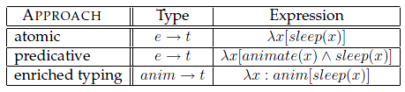
Argument Typing as Abstracting from the Predicate
Example: Verbs like sleep, die, dream select for animate subjects.
Types for the verb sleep:
I omitted the parametric approach involving events, locations, times, etc, for simplicity.

Slide 17
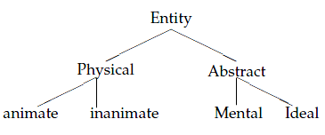
Argument Typing as Abstracting from the Predicate
Under such an interpretation, the expression makes reference to a type lattice of expanded types, such as that shown below (cf. Copestake and Briscoe, 1992, Pustejovsky and Boguraev, 1993).

Slide 18
Argument Typing as Abstracting from the Predicate
The “Fail Early” Strategy of Selection:
Argument typing can be viewed as pretest for performing the action in the predicate.
If the argument condition (i.e., its type) is not satisfied, the predicate either:
fails to be interpreted (strong selection);
coerces its argument according to a given set of strategies.

Slide 19
Generative Lexicon GL(Pustejovsky 1993, 1995, 2005, 2007)
It is a Full Parametric Decomposition Theory.
Employs the computational efficiency of pretest argument typing.
Composition is taken care of by means of typing and selection mechanisms (compositional rules applied to typed arguments).

Slide 20
GL’s Theoretical Starting Points:
The human conceptual apparatus (i.e. the ability to categorize and represent the world) is one of generative categorization and compositional thought (as opposed to extensional).
The human linguistic capacity reflects our ability to categorize and represent the world in the particular ways we do.
Therefore, language is a natural manifestation of our generative construction of the world through the categories it employs.

Slide 21
The structure of GL
Lexical Data Structures:
LEXICAL TYPING STRUCTURE: giving an explicit type for a word positioned within a type system for the language;
ARGUMENT STRUCTURE: specifying the number and nature of the arguments to a predicate;
EVENT STRUCTURE: defining the event type of the
expression and any subeventual structure;
QUALIA STRUCTURE: a structural differentiation of the predicative force for a lexical item.

Slide 22
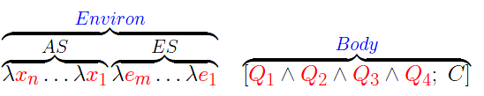
The structure of GL
Argument and Body in Generative Lexicon
AS: Argument Structure
ES: Event Structure
Qi: Qualia Structure
C: Constraints

Slide 23
The structure of GL
Qualia Structure:
Formal: the basic category which distinguishes it within a larger domain;
Constitutive: the relation between an object and its constituent parts;
Telic: its purpose and function, if any;
Agentive: factors involved in its origin or “bringing it about”.

Slide 24
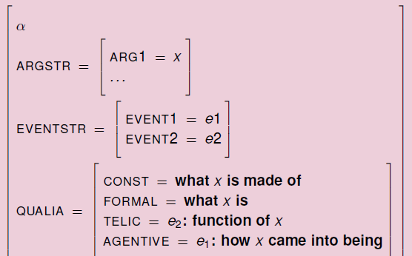
The structure of GL

Slide 25
Motivating the qualia
There is no way selection based on pure syntactic argument typing can rule out constructions like (*):
The man / *the rock died.
John forced / *convinced the door to open.
John forced / convinced the guest to leave.
John poured milk into / * on his coffee.
John poured water into / on the bowl.

Slide 26
Motivating the qualia
John crossed the lake / *the ladder.
John climbed *the ocean / the building. Mary behaved *(well).
John performed *(admirably).
John performed his piece yesterday.
The crowd / *the man assembled.
John began writing his thesis. / *John began a tiger.
c. John finished his thesis. / *John finished the tree.

Slide 27
Types in Generative Lexicon (Pustejovsky 2001, 2007, Asher and Pustejovsky 2006):
The Type Composition Language:
a. e is the type of entities; t is the type of truth values. (σ and τ, range over simple types and subtypes from the ontology of e.)
b. If σ and τ are types, then so is σ -> τ ;
c. If σ and τ are types, then so is σ • τ ;
d. If σ and τ are types, then so is σ ʘQ τ , for Q = const(C), telic(T), or agentive(A).

Slide 28
The structure of GL
Compositional Rules:
Type Selection: Exact match of the type
Type Accommodation: The type is inherited
Type Coercion: Type selected must be satisfied

Slide 29
Types of Expressions in Language:
Following Pustejovsky (2001), we will separate the domain of individuals (type e) into three distinct type levels:
Natural Types: atomic concepts of formal, constitutive and agentive;
Artifactual Types: Adds concepts of telic;
Complex Types: Cartesian types formed from both Natural and Artifactual types.

Slide 30
Examples
Level of Types in the Major Categories
1. Noun
N: rock, water, woman, tiger, tree
F: knife, beer, husband, dancer
C: book, lunch, university, temperature
2. Verb
N: fall, walk, rain, put, have
F: donate, spoil, quench
C: read, perform

Slide 31
Examples
3. Adjective
N: red, large, flat
F: useful, good, effective
C: rising

Slide 32
More about Qualia structure and selectional mechanisms next lecture

