Slide 1
Lexicografie computationala
Curs 4
Nov., 2009
Anca Dinu
University of Bucharest

Slide 2
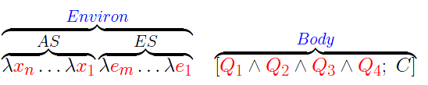
Recap. The structure of GL
Argument and Body in Generative Lexicon
AS: Argument Structure
ES: Event Structure
Qi: Qualia Structure
C: Constraints

Slide 3
Recap. The structure of GL
Qualia Structure:
Formal: the basic category which distinguishes it within a larger domain;
Constitutive: the relation between an object and its constituent parts;
Telic: its purpose and function, if any;
Agentive: factors involved in its origin or “bringing it about”.

Slide 4
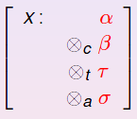
Representing the type structure
Assume that the FORMAL role is always present in the qualia, and hence will be considered the head type: [FORMAL = α] is simply written α.
Each additional quale value will be introduced by operator, subscripted accordingly; e.g., [CONSTITUTIVE = β] can be expressed as c β, [TELIC = τ] as T τ, [AGENTIVE = σ] as A σ.
The feature structure can be represented as or written linearly, as α C β T τ A σ.

Slide 5
Types in Generative Lexicon (Pustejovsky 2001, 2007, Asher and Pustejovsky 2006):
The Type Composition Language:
a. e is the type of entities; t is the type of truth values. (σ and τ, range over simple types and subtypes from the ontology of e.)
b. If σ and τ are types, then so is σ -> τ ;
c. If σ and τ are types, then so is σ • τ ;
d. If σ and τ are types, then so is σ Q τ , for Q = const(C), telic(T), or agentive(A).

Slide 6
Types of Expressions in Language:
Following Pustejovsky (2001), we separate the domain of individuals (type e) into three distinct type levels:
Natural Types: atomic concepts of formal and/or constitutive: eN; These will be our atomic types, from which we will construct artifactual types ( -types) and complex types (•-types).
Artifactual Types: Adds concepts of telic and/or agentive: eA;
Complex Types: Cartesian types formed from both Natural and Artifactual types: eC.

Slide 7
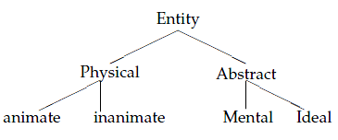
Natural Entity Types
Natural types N contain entities formed from the application of the FORMAL and/or CONST qualia roles: structured as a semi-lattice, (eN; ≤) of the form:
Examples: human, stick, lion, pebble, water, sky, rock: eN.

Slide 8
Natural Predicate Types
Predicates formed with Natural Entities as arguments:
fall: eN -> t
touch: eN -> (eN -> t)
be under: eN -> (eN -> t)
1. λ x :eN [fall(x)]
2. λ y:eN x:eN [touch(x,y)]
3. λ y:eN x:eN [be-under(x,y)]

Slide 9
Artifactual Entity Types
Artifactual types A contain entities formed from the Naturals by adding the agentive or telic qualia roles:
Artifactual Entity x : (eN a σ) t τ (x exists because of event σ for the purpose τ)
Examples:
beer: (liquid a brew) t drink
knife: (phys a make) t cut
house: (phys a build) t live in

Slide 10
Artifactual Predicate Types
Predicates formed with Artifactual Entities as arguments.
Examples:
spoil: eA -> t λ x: eA [spoil(x)]
fix: eA -> (eN -> t) λ y: eA x: eN[fix(x,y)]
The beer spoiled.
Mary fixed the watch.

Slide 11
Complex Entity Types
Complex Types C contain entities formed from the Naturals and Artifactuals by • product type between the entities (λx : ei • ej, for i, j of any level).
Examples:
book, record, DVD: phys • info;
construction, examination: event • event;
door, window: phys • aperture.

Slide 12
Motivating the complex type
A word or phrase that has the ability to appear in contexts that are contradictory in type specification, is a dot object (has a complex type).
Examples:
1 a. Mary doesn’t believe the book.
1 b. John sold his book to Mary.
2 a. The exam started at noon.
2 b. The students could not understand the exam.

Slide 13
Dot Object Inventory
Act•Proposition: promise, allegation, lie
I doubt John’s promise of marriage.
John’s promise of marriage happened while we were in Prague.
State•Proposition: belief
Nothing can shake John’s belief.
John’s belief is obviously false.
Attribute•Value: temperature, weight, height, tension
a. The temperature is rising.
b. The temperature is 23.

Slide 14
Dot Object Inventory
Event•Information: lecture, play, seminar, exam, quiz, test
a. My lecture lasted an hour.
b. Nobody understood my lecture.
Event•Human: appointment
a. You missed your last appointment.
b. Your next appointment is a Serbian student.
Event•Music: sonata, symphony, song, performance, concert
a. Mary couldn’t hear the concert.
b. The rain started during the concert.

Slide 15
Dot Object Inventory
Event•Physical: lunch, breakfast, dinner, tea
a. My lunch lasted too long today.
b. I pack my lunch on Thursdays.
Information•Physical: book, cd, dvd, dictionary, diary, mail, email, mail, letter
a. Mary burned my book on Darwin.
b. Mary believes all of Chomsky’s books.

Slide 16
Dot Object Inventory
Organization•(Information•Physical): magazine, newspaper, journal
a. The magazine fired its editor.
b. The cup is on top of the magazine.
c. I disagreed with the magazine.

Slide 17
Dot Object Inventory
Process•Result: construction, depiction, imitation, portrayal, reference, rendering, decoration, display, documentation, drawing, enclosure, entry, instruction, design, invention, music, obstruction, pattern, simulation, illustration, agreement, approval, recognition, damage, compensation, contribution, disbursal, disbursement, discount, donation, acquisition, deduction, endowment, gift, categorization, classification, grouping
a. Linnaeus’s classification of the species took 25 years.
b. Linnaeus’s classification contains 12,100 species.

Slide 18
Complex Predicate Types
Predicates formed with Complex Entity Types as arguments:
Example:
read: phys • info -> (eN -> t)
Expressed as typed arguments in a λ-expression:
λy : phys • info x: eN[read(x,y)]
Mary read the book.

Slide 19
Compositional Rules in GL:
Compositional Rules:
Type Selection: Exact match of the type
Type Accommodation: The type is inherited
Type Coercion: Type selected must be satisfied

Slide 20
Defining Compositional Rules
For a predicate selecting an argument of type σ, [ ]σ F, the following operations are possible:
a. PURE SELECTION: The type a function requires of its argument, A, is directly satisfied by that argument’s typing: [ Aα]α F
b. ACCOMMODATION: The type a function requires is inherited through the type of the argument: [ Aβ]α F, where α ∩ β ≠ Φ.
c. COERCION: The type a function requires is imposed on the argument type. This is accomplished by either:

Slide 21
Defining Compositional Rules
i. Exploitation: selecting part of the argument’s type structure to satisfy the function’s typing: [ Aαʘσ ]β F, α ≤ β
ii. Introduction: wrapping the argument with the type the function requires: [ Aα ]βʘσ F, α ≤ β
(where ʘ represents the disjunction of the two constructors, and •):

Slide 22
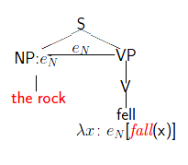
Pure Selection: Natural Type
The rock fell.

Slide 23
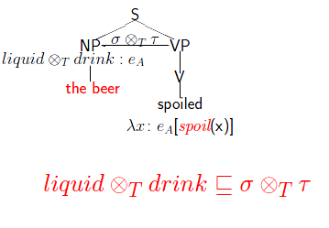
Pure Selection: Artifactual Type
The beer spoiled.

Slide 24
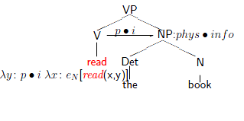
Pure Selection: Complex Type
John read the book.

Slide 25
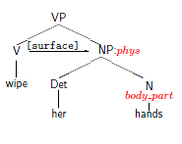
Type Accommodation: Natural Types
Accommodation: If α is of type σ, and β is of type τ -> t, then, if σ ∩ τ ≠ Φ, then Acc(β, α) is of type σ ∩ τ -> t.
Mary wiped her hands.

Slide 26
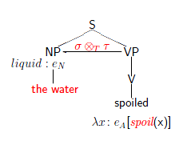
Type Coercion: Natural to Artifactual Introduction
The water spoiled.

Slide 27
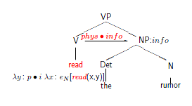
Type Coercion: Natural to Complex Introduction
John read the rumor.

Slide 28
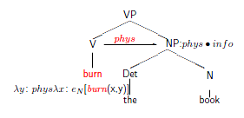
Type Coercion: Complex Exploitation
The police burned the book.

Slide 29
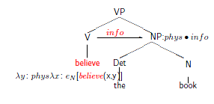
Type Coercion: Complex Exploitation
Mary believes the book.

Slide 30
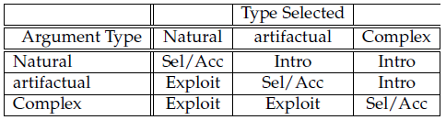
What operations are available in which selectional contexts.

