Slide 1
Lecture 26
May 18, 2000

Slide 2
Exam Review
How to use classes and objects.
How to use particular classes
  Primarily GUI-related
    Listeners and Adapters
    Menus
    Visible Components
    Layout Managers
And …

Slide 3
Code Review
Class JOptionPane
  showMessageDialog()
  showOptionDialog()
Editor Structure
  Keep track of need to save changes
    Use boolean variable isModified
  Using Getters and setters for ID3V1_Tag
File I/O Operations

Slide 4
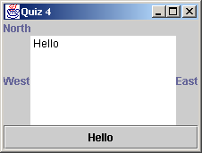
Quiz 4
Write this application:
[ Solution ]

