Slide 1
CS-341 Lecture 5
February 16, 2001
Dr. Vickery

Slide 2
Compression Concepts
Saves disk space
Reduces demands on bandwith.
  Capacity of a channel, such as a network connection.
  Measured in bits per second. (Transmission rate)
Lossless (Zip)
  Eliminate redundant information.
    Sequence of identical values replaced by the value and a repeat count.
    Record differences between successive frames instead of entire frames.
Lossy (MP3)
  Reduce bits per sample, and/or sampling rate.

Slide 3
Encoding Numbers
Fixed Point
  Integers
    Unsigned
    Signed
  Fractions
Floating Point
  IEEE-754

Slide 4
Fixed Point
Integer is a special case, where the binary point is at the right end. But there can be fractions.
  0101.1010 = 2² + 2⁰ + 2⁻¹ + 2⁻³
  Equals 4 + 1 + 0.5 + 0.125
  Equals 5 + 5/8
  Equals 5 + 10/16
… + 2³b₃ + 2²b₂ + 2¹b₁ + 2⁰b₀ + 2⁻¹b₋₁ + 2⁻²b₋₂ + 2⁻³b₋₃ +…

Slide 5
Integers
Unsigned – piece of cake
  Values from 0 to 2^{n}-1 for n-bit numbers.
Four Ways to Encode Signed Values
  Sign-magnitude
    Easy for people, rotten for logic circuits
  Biased
    Good for comparing values
    Used for floating-point exponents
  One’s Complement
    Two zeros
    Requires end-around carry step for addition
    Stepping stone to two’s complement
  Two’s Complement …

Slide 6
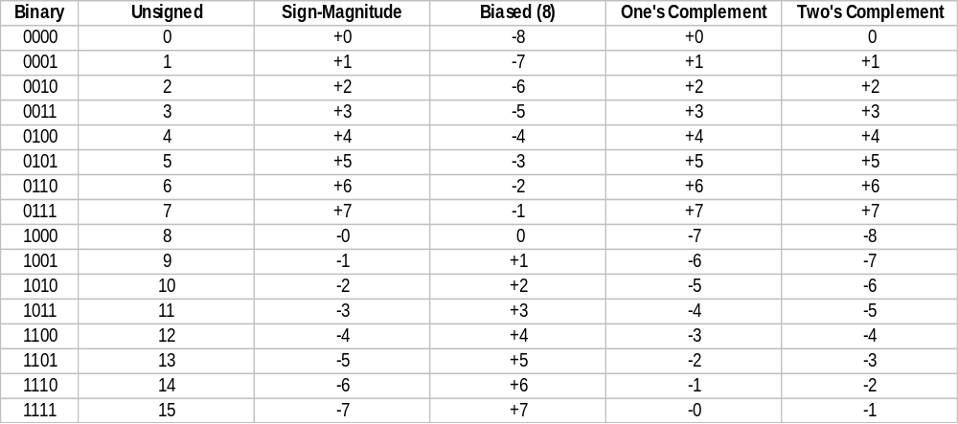
Assigning Numeric Values to 4-bit Numbers

Slide 7
Homework Due Feb. 23
Exercises 1-14 at the end of Appendix A

