Slide 1
CS-341 Lecture 6
February 20, 2001
Dr. Vickery

Slide 2
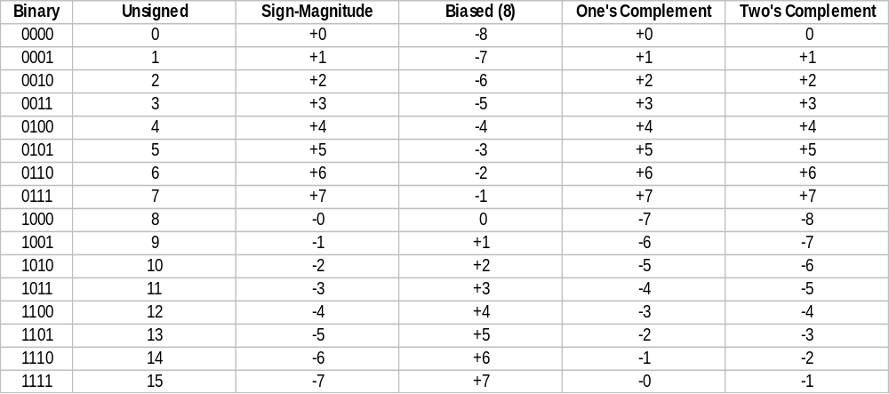
Assigning Numeric Values to 4-bit Numbers

Slide 3
Two’s Complement Encoding
Using n bits to represent values, the range is –2^{n-1} to +2^{n-1}-1
Consider the leftmost bit to have a negative weight.
  Useful when changing word size: sign extension.
  Also makes it easy to evaluate numbers.
Negate by subtracting from zero
  Equivalent to “flip bits and add 1”
Subtract by negating subtrahend and adding
Carry is normal and usually ignored.
Overflow is when correct value cannot be represented in n bits.

Slide 4
The Leftmost Bit Has a Negative Weight
1101 = -2³ + 2² + 2⁰
  = -8 + 4 + 1
  = -3
11101 = -2⁴ + 2³ + 2² + 2⁰
  = -16 + 8 + 4 + 1
  = -3
  Because -8 ≡ -16 + 8

Slide 5
Sign Extension
1111 1111 1111 1111 1111 1111 1111 1001₂
  Same as 1001₂ (-7)
BUT:
1011 1111 1111 1111 1111 1111 1111 1001₂
  Equals -2³¹ + 2²⁹ + 2²⁸ + 2²⁷ + 2²⁶ + 2²⁵ + …

Slide 6
Negate by Subtracting from Zero
(0 - X) = -X
In n bits, zero is the same as 2^{n}
  For example, 2⁴ is 10000₂
For any n 2^{n}-1 is n-many ones.
  For example, 2⁴-1 is 15, which is 1111₂
If you subtract from 2^{n}-1, there will never be any borrows.
  Only two cases: 1-0 is 1 and 1-1 is 0

Slide 7
Two’s Complement Negation
When using two’s complement encoding for numbers, “taking the two’s complement” means to negate the value of a number.
Subtract from zero, which is the same as subtracting from 2^{n}-1 and adding 1, which is the same as flipping the bits and adding 1.
  Positive numbers become negative
  Negative numbers become positive
  Zero becomes zero
  But -2^{n-1} becomes … -2^{n-1}

Slide 8
Two’s Complement Subtraction
Negate the minuend (second operand), and add.
  X-Y = X+(-Y)
ALU design: just one circuit for adding, plus a small amount of logic for negating the minuend instead of a whole other circuit for subtracting.
  Simpler to design and faster execution.
A carry out of the leftmost position is normal, and may be ignored.
  May be used for multiple-precision arithmetic.

Slide 9
Two’s Complement Overflow
If the result of an addition is bigger than +2^{n-1}-1 or less than -2^{n-1}, the correct answer cannot be represented with n bits, and overflow has occurred.
Carry into the leftmost position will be unequal to the carry out of the leftmost position iff overflow occurs.
  Adding a positive value to a negative value cannot overflow.
  Add two positives: sign bit of 1 indicates overflow
  Add two negatives: sign bit of 0 indicates overflow

Slide 10
Floating-Point Encoding
Real numbers: range from -∞ to +∞
  Infinitely many values between any two points on the number line.
Many schemes, but virtually all computers now use IEEE-754 encoding.
All schemes based on scientific notation
  Signed fraction *base^{Signed exponent}
  The base doesn’t have to be encoded
    It’s always base two for IEEE-754

Slide 11
IEEE-754 Encoding
Two formats, using 32 and 64 bits
  Correspond to Java’s float and double data types.
    Sign of fraction: 1 bit
    Signed exponent: 8 bits (biased-127) or 11 bits (biased-1023) for 32 and 64-bit formats.
    Value of fraction: 23 or 52 bits for 32 and 64-bit formats.

