Slide 1
CS-341 Lecture 12
March 16, 2000

Slide 2
Types of Gates
Buffer, Inverter
  One input, one output
  Buffers are useful when you need a restorer, but no combiner.
AND, OR, XOR
  Two or more inputs, one output.
  XOR can be constructed from AND, OR, and Inverters.
NAND, NOR, XNOR
  Two or more inputs, one output.
  NAND and NOR are universal; all of the other gate types can be built using any one of these types.

Slide 3
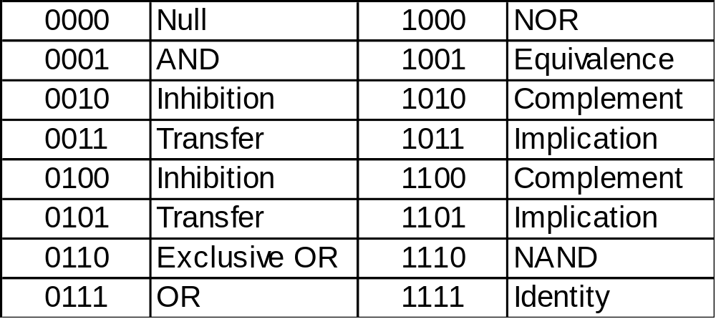
Boolean Functions
Sixteen functions of two variables.
  Each 4-bit number corresponds to the output column of a truth table of two variables

Slide 4
Homework 6
Exercises 1-6 at the end of Chapter 3.
Due Tuesday, March 20.

