Slide 1
CS-341 Lecture 13
March 20, 2001

Slide 2
Universal Operators
NAND and NOR
  But not XNOR!
Construct AND-OR from NAND
  AND-OR is universal
  Sum of Products is universal
    “Disjunctive Normal Form”

Slide 3
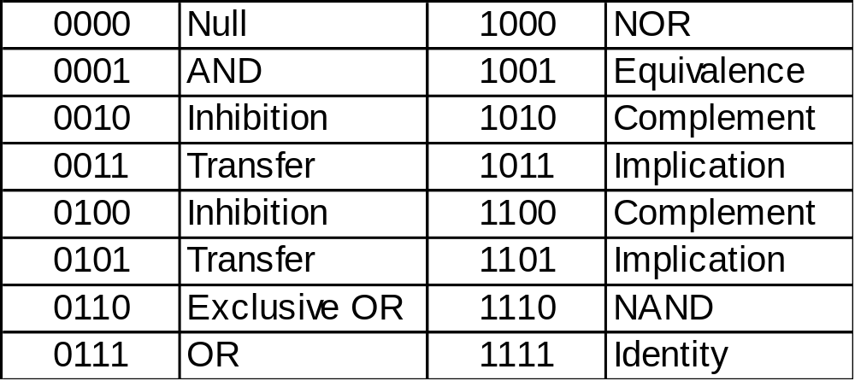
Boolean Functions
Sixteen functions of two variables.
  Each 4-bit number corresponds to the output column of a truth table of two variables.

Slide 4
Properties of Gates
Propagation Delay
  The time it takes for the output of a gate to change state in response to a change in the input(s).
  Typical value: 1 nanosecond.
Fan-in
  The number of wires going into a gate
Fan-out
  The number of inputs to which the output of a gate can be connected without overloading the ability of the restorer to generate logically valid voltages.
  Can be determined only by reading the manufacturer’s “data sheet” for the gate.
  Circuits that violate the fan-out limits produce undefined values.

Slide 5
Logic Networks
“When one gate is not enough.”
A combinational logic network is a mechanism for producing a boolean output value based on the values of a set of boolean input variables.
A combinational logic network may be completely specified in any of three equivalent representations:
  A boolean equation.
    Y = f(a, b, c)
  A truth table showing the output value for every combination of input values.
  An electronic circuit constructed from gates.
    This representation is the ultimate goal in logic design.

Slide 6
Complex Networks
If two combinational networks have input variables in common, it is more efficient to merge them into a single network with multiple outputs.
  Still need a separate function for each output.
  Truth table has multiple columns on the right side, one for each output.
  One gate might be part of more than one output’s network, reducing the cost of the circuit.

Slide 7
Sequential Networks
The values of the output variables are called the state of a network.
The state of a combinational network can always be determined if you know the values of the input variables.
If you want to store information, you need another type of network, one where the state can be saved after the input variables change values.
  Flip-flops
  Later …

Slide 8
Simplifying Networks
Minimization
Algebraic
  Pair terms that differ in exactly one literal, which must be the same variable in its asserted and complemented form (such as x’).
  x•1 = x
  x+x’= 1
  So, x •(y+y’) = x
Karnaugh Map
  Same idea as algebraic, except works from truth table.
  Arrange truth table so rows that differ in one literal are adjacent to each other.
  Adjacent minterms that number a power of two can be combined into one simpler term.

