Slide 1
CS-341 Lecture 18
April 6, 2001

Slide 2
Administrivia
Second Exam will be April 24.
Homework
  Understand and be able to reproduce Figure 3-19 on page 138.
  Read through page 154.
  Try problems 14-18 at the end of Chapter 3.
    Will not be collected.

Slide 3
Parallel ALU Design
Parallel 1-bit ALUs
  Three data inputs (A, B, C_{in}) like full adder.
  Control inputs
    INV A
    ENA, ENB
    F₀ and F₁
      00 AND
      01 Not B
      10 OR
      11 Add/Sub
    INC = C_{in} of rightmost unit
  Outputs: result and carry out

Slide 4
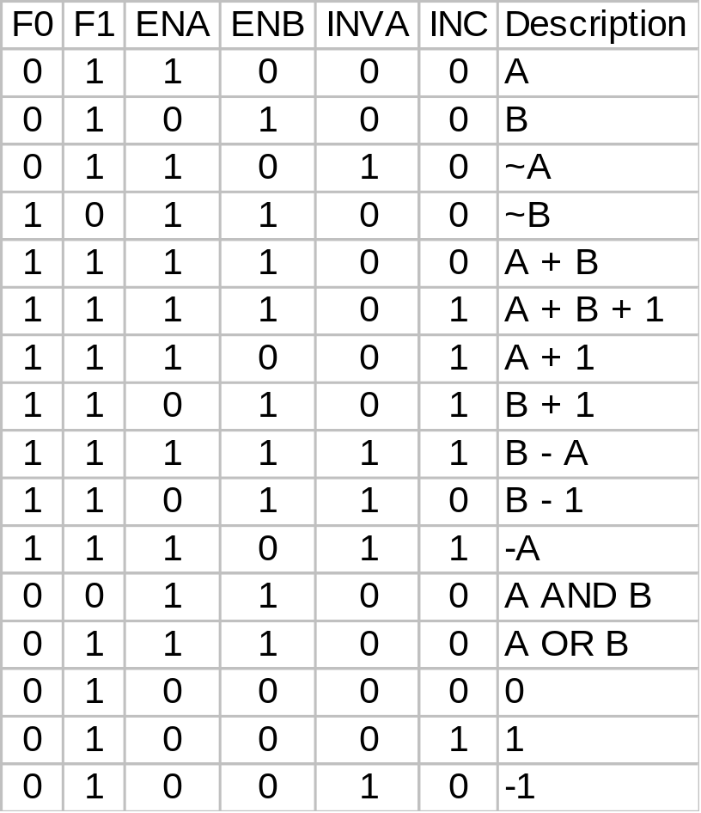
Combinations of ALU Controls
(Table 4-2; page 206)

