Slide 1
CS-341 Lecture 19
April 17, 2001

Slide 2
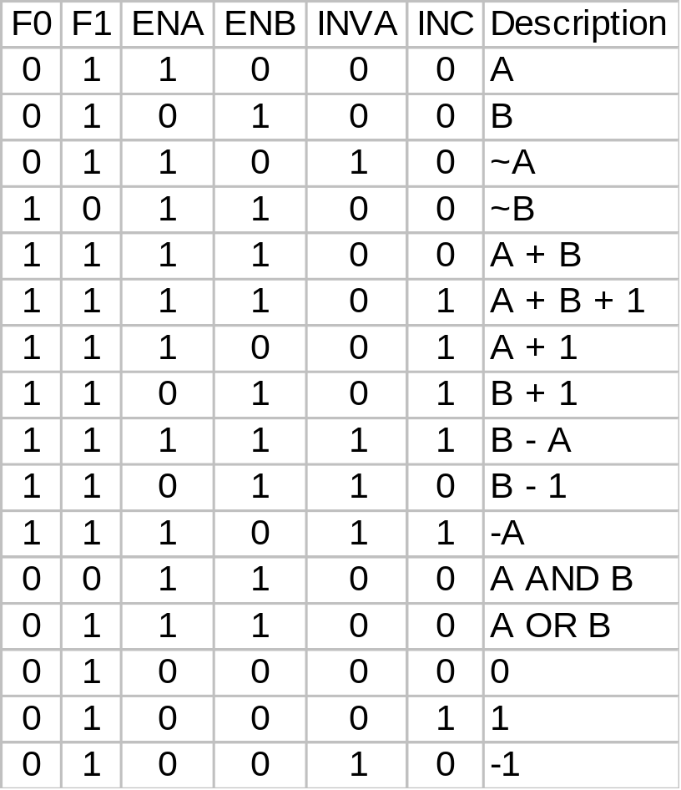
Combinations of ALU Controls
(Table 4-2; page 206)

Slide 3
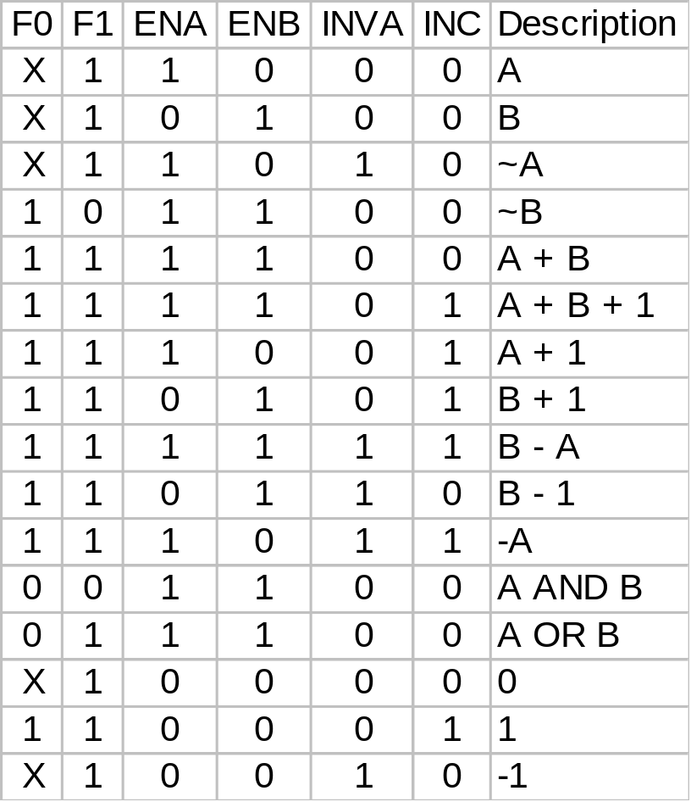
Updated Version of Table 4-2
Add and OR are the same when INC is zero.
When doing OR, INC can be X.
There was an error in the line to produce +1.
X means “don’t care”
(Whether it is zero or
one doesn’t affect the
result.)

