Slide 1
The Persistent Java Virtual Machine
(PJVM)
Christopher Vickery
Eric Shamow
Computer Science Department
Queens College of CUNY

Slide 2
Golub’s Law:
A carelessly planned project takes three times longer
to complete than expected.
A carefully planned project will take only twice as long.

Slide 3
Topics
Project Origins and Goals
Other Persistent Java Virtual Machines
JNI and Reflection Mechanisms
PJVM Structure and Implementation
PJVM Features
Current Status (Demonstration)
Future Plans

Slide 4
Project Origins and Goals
Overhead of Running Java Applications
For each application:
  Load program to implement the JVM (java.exe)
  Load and link system classes
  Load and link first application class
  Load and link other application classes
Looking for a way to do steps 1-2 just once during a development session
Evolving Into:
  Development tool for experienced programmers
  Learning tool for students

Slide 5
Other Persistent Java Virtual Machines
Web browsers include a JVM
  Instantiated the first time an applet is encountered
  The JVM persists for the lifetime of the browser session
  No way to reload a class except to exit and restart the browser
    Efficient once applet is deployed, but awkward during development

Slide 6
Resources Used for PJVM
Java Native Interface (JNI)
  Allows Java code to call C/C++ (native) code for performance-critical operations
  Also lets C/C++ code create JVMs
Reflection Mechanism
  Java classes that provide methods for examining classes, methods, and objects
Classloaders
  Gives control over loading classes into a JVM dynamically

Slide 7
PJVM Structure and Implementation
Server
  Creates and destroys JVMs
  Accepts requests to load classes, instantiate them, and to invoke methods.
Manager(s)
  Acts as liaison between Server and Clients
  Provides isolation among users sharing a server
  Manages networked interfaces between clients and a server
User Interface (clients)
  Written as C commands to make server requests and queries
  Java GUI manages housekeeping across requests

Slide 8
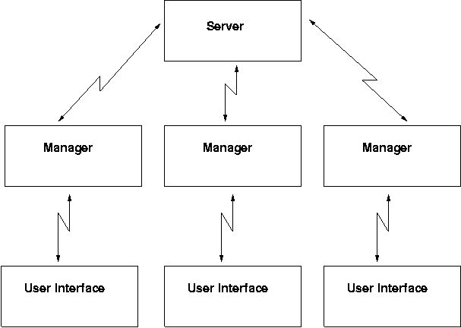
PJVM Structure

Slide 9
Server – Manager – Client Interactions
Request/Delete
Server
Manager
Port
JVM₀
Load
Instantiate
Invoke
JVM₁
Clients
JVM₂

Slide 10
PJVM Features
Instantiate Single/Multiple JVMs
  List JVMs
Load local/remote classes into specified JVMs
  List loaded classes for each JVM
  List constructors/methods for each loaded class
  Load multiple versions of a class
Invoke constructors, static, and instance methods
  Using primitives as parameters
  Using references to objects as parameters
  Using values returned by other methods as parameters
Delete JVMs from Memory

Slide 11
Current Status (Demonstration)
GUI, Manager, and Server all running on the same Linux machine

Slide 12
Future Plans
Current source code available here
Full network implementation so that GUI clients run on user’s local machine
  Server may run remotely
  Manager runs locally
Display more information
  Memory utilization
  Class file timestamps and dependencies
  Class files loaded by system classloader
  Objects not created by PJVM clients
Debugging support
  Single-step, breakpoints, etc.
Port to other platforms
  NT, OS X

