Slide 1
Web Design As a Lead-in To Computer Science For Non-majors
Christopher Vickery
Queens College
CUNY Discipline Council
November 10, 2006

Slide 2
Overview
The Context and the Problem
The CIT Minor
The Web Programming Course
Teaching Web Programming With “Computer Science Integrity”

Slide 3
The Context and the Problem
Computer Science Department
Liberal Arts College
ACM 2005: CS – CE – SE – IT – IS
  CS stresses principles, but includes practical applications.
  Others stress practical applications, with theoretical foundations secondary.
Most students want jobs: skills not theory
  Number of majors tracks perceived employability.

Slide 4
The CIT Minor
“IT in a Computer Science Department”
Courses are largely independent of the major rather than a subset.
  There is also a CS Minor.
  (Cross-disciplinary minors are in the works.)

Slide 5
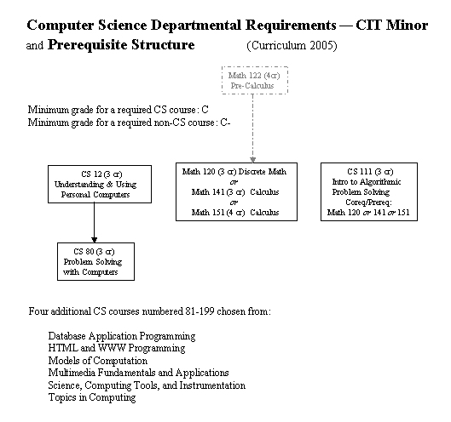
CIT Minor Course Structure

Slide 6
The Web Programming Course
Text
  Holzschlag, Spring Into HTML and CSS
Syllabus Topics (if only …)
  HTML
  CSS
  Image preparation
  JavaScript
    DOM Manipulation
    AJAX
  PHP
  Server Management

Slide 7
Teaching Web Programming with
“Computer Science Integrity”
Provide Accurate Models
Use Proper Terminology
Expose Full Scope of Development Environment
Clarify Relevance
Stress Development Best Practices
Adhere to Standards

Slide 8
Provide Accurate Models
File system structure and nomenclature
Sequence of events
  Browser Request
  Web Server
  Server-side scripting / database
  Server Reply, Browser 2ª requests
  Client-side scripting
DOM Tree
JavaScript Event management

Slide 9
Use Proper Terminology
File system
Web site, Configuration Files
JavaScript
  Statements, expressions, objects
  Lists -> Arrays -> Collections
  Scope of variables
Rendering Engines
Namespaces

Slide 10
Expose Full Scope of Development Environment
Server Configuration
  DocumentRoot
  Authentication
  Development, Testing, Deployment servers.
Dreamweaver
  Templates
  Rendering engine
  Relate to client and server-side scripting

Slide 11
Clarify Relevance
Why Apache
Why Dreamweaver
Why XHTML
Why CSS
Why JavaScript
  Windows Scripting example
  Photoshop Actions

Slide 12
Stress Development Best Practices
Separation of Content, Presentation, and Behavior into separate files from the beginning
Coding Example: Alternate background colors of table rows
  CSS
  JavaScript
    Pros and Cons of alternative approaches
    What needs to be documented

Slide 13
Adhere to Standards
Downplay browser-specific issues
  But acknowledge that even producers of non-standard browsers recognize the importance of standards support.
Current topics: Tim Berners-Lee on the future of HTML.
Require validation of all code from Day 1

Slide 14
Conclusion
Provide a very practical, very how-to course.
Teach programming best practices rather than cookbook techniques.
Explicitly state CS principles being brought to bear.
  Cite CS as the source of models and rationale for practical issues.

