Slide 1

Model Evaluation in Machine Learning
Advanced CS
Intro to Artificial Intelligence
Ms. Villanueva

Slide 2

Puzzle Time (Allergy season)
Five friends (Allegra, Ben, Clara, Flora and Zach) are each allergic to something different: pollen, shellfish, bee stings, cats or nuts.
Allegra has a food allergy
Ben can play with his kitten for hours without issue (or medicine).
Clara’s allergy is not related to animals.
Flora has seasonal allergies.
Can you figure out who is allergic to what?
Notes:
Allegra is allergic to shellfish, Ben to bee stings, Clara to nuts, Flora to pollen and Zach to cats.

Slide 3
Allegra is allergic to shellfish, Ben to bee stings, Clara to nuts, Flora to pollen and Zach to cats.

Slide 4
Model Evaluation
Model Evaluation
Mean Absolute Error (MAE)
and Model Evals
The central question of this lesson is simple: when two models make predictions, how do we decide which one is actually better? In machine learning, evaluation is not an afterthought. It is the part that tells us whether our model learned a useful pattern or just got lucky.
🍎 150g
🍊 130g
🍎 160g
🍊 140g
Model
Good Model?
Bad Model?
Food for thought : “A good model is not the one that looks smartest on old data. It is the one that still works on new data.”
1
Notes:
Open by framing evaluation as the answer to a practical question: which model should we trust? Connect to the fruit example immediately, because it is concrete and low-stakes. Emphasize that the lesson is not only about code or formulas. It is about designing an honest experiment. If the experiment is unfair, even a perfect-looking number tells us nothing useful.
[Sources]
- Uploaded lecture PDF: 21.Methodology1.annotated.pdf, pages 1 to 3, introducing model evaluation and the question of which model is best.
- Kaggle Learn notebook: “Model Validation” by Dan Becker, for the train/test and MAE workflow.

Slide 5
Comparing models starts with an experiment
Model Evaluation
Model A
Let’s say we train model A, train model B, compute an error score for both, and choose the model with the lower error. That sounds straightforward, and it is. The catch is that the result only means something if the error was measured on the right data.
Error = 12 g
So the real question is not just “which error is lower?” It is also “where did that number come from?” If it comes from the training data, we may simply be rewarding memorization.
Model B
Error = 8 g
At first glance, B wins because its error is lower.
Key question: On which data do we compute the error?
2
Notes:
The lecture makes this move very early: comparing models is easy in principle, but only if we trust the measurement. Use this slide to slow students down. They will naturally focus on the numbers. Push them to inspect the experiment that produced the numbers. That habit is the foundation of model evaluation and of scientific thinking more broadly.

Slide 6
Never judge performance on the training data
Model Evaluation
Training data
If we test on the same examples we used for learning, the model may look brilliant simply because it remembers them.
It’s like giving students the answer key, then acting surprised when they score 100%.
Fruit | Actual | Predicted
🍎 | 150g | 150g
🍊 | 130g | 130g
🍎 | 160g | 160g
🍊 | 140g | 140g
This problem is called overfitting. The model fits the training examples so closely that the score becomes an illusion. What we really care about is whether the model will work on examples it has never seen before.
Result: 0 error, but this proves almost nothing.
3
Notes:
This slide should feel like a warning sign. The phrase “never judge performance on the training data” appears explicitly in the lecture, and it is worth treating as a rule, not merely a suggestion. Give students the test analogy: a student who memorized yesterday’s worksheet may look strong until the quiz changes. The same thing happens with models.
[Sources]
- Uploaded lecture PDF: page 3, “Never judge your performance on the training data.”
- Uploaded lecture PDF: page 2, discussion of overfitting when evaluating on training data.

Slide 7
The fix: split the original dataset into train and test
Model Evaluation
Training data
Test data
This is where the test set. We deliberately withhold some data so the model cannot practice on it. Then we evaluate on that hidden portion at the end. This gives us a far more honest estimate of what will happen in the future.
Why this works:
• Training data teaches the model.
• Test data checks whether the model can generalize.
• The test set should be large enough to give a stable estimate of performance.
Evaluation is a simulation of real use: “Here is new data. How well does the model do now?”
5
Notes:
You should test a model against a different set of examples than those used to train the model. As you'll learn a little later, testing on different examples is stronger proof of your model's fitness than testing on the same set of examples. Where do you get those different examples? Traditionally in machine learning, you get those different examples by splitting the original dataset. You might assume, therefore, that you should split the original dataset into two subsets:
A training set that the model trains on.
A test set for evaluation of the trained model.

Slide 8
Mean Absolute Error: a metric students can interpret
Model Evaluation
Mean Absolute Error (MAE)
For regression problems like predicting house price or fruit weight, accuracy is not the right idea. We need a metric that measures distance between the real value and the prediction. MAE takes the absolute error for each example and then averages those errors.
MAE = average of |actual − predicted|
Interpretation: on average, how far off are our predictions?
The word absolute matters. If one prediction is 10 grams too high and another is 10 grams too low, those should not cancel each other out. Both are mistakes, so MAE counts them both.
When you need a clear way to measure how accurate your predictions are, mean absolute error is a good place to start. It tells you, on average, how far off your model’s predictions are from the actual values without worrying about whether these predictions were too high or too low.
“Our model is off by about 12 grams per fruit on average.”
6
Notes:
Explain MAE as a language bridge between mathematics and intuition. Students do not need to love the formula if they can interpret the sentence it produces. In a fruit example, “off by 12 grams on average” is immediately meaningful. Also emphasize why the absolute value bars are there: they stop positive and negative mistakes from masking each other.
[Sources]
- Kaggle Learn notebook: “Model Validation,” which introduces MAE for model quality.
- General regression-evaluation framing aligned with the uploaded lecture PDF, which later discusses error metrics for regression.

Slide 9
Worked fruit example: calculating MAE
Model Evaluation
Fruit | Actual | Predicted | Absolute error
🍎 | 150 g | 140 g | 10 g
🍊 | 130 g | 150 g | 20 g
🍎 | 160 g | 155 g | 5 g
The interpretive punchline is the most important part: this model misses by about 11.7 grams per fruit.
MAE = (10 + 20 + 5) / 3 = 11.67 g
Student check: lower MAE means predictions are, on average, closer to the truth.
7
Notes:
Work this one slowly. Invite students to compute the three errors before you reveal the average. Stress that MAE is not a percentage. It uses the original unit of the target, which makes it unusually readable for beginners. You can also connect it back to the question “How wrong are we?” instead of introducing it as just another function to memorize.
[Sources]
- Kaggle Learn notebook: “Model Validation,” use of MAE as the quality metric.
- Fruit example and worked values created for classroom illustration.

Slide 10
From concept to code: the honest evaluation loop
Model Evaluation
1 from sklearn.model_selection import train_test_split
2 from sklearn.metrics import mean_absolute_error
3 from sklearn.tree import DecisionTreeRegressor
4
5 train_X, val_X, train_y, val_y = train_test_split(X, y, random_state=1)
6 model = DecisionTreeRegressor(random_state=1)
7 model.fit(train_X, train_y)
8 preds = model.predict(val_X)
9 mae = mean_absolute_error(val_y, preds)
The code is short because the ideas are doing the heavy lifting. split the data, fit the model on the training portion, predict on the held-out portion, then compare predictions to the true answers with MAE. Every line corresponds to a decision we already justified conceptually.
What each line means:
• train_test_split creates an honest test.
• fit means “learn from examples.”
• predict means “guess on unseen inputs.”
• mean_absolute_error asks “how wrong were those guesses?”
You can read the code as a sentence: split → learn → predict → measure.
8
Notes:
Scikit-learn splits data primarily through the train_test_split function from the sklearn.model_selection module. This utility divides your dataset into a training set for fitting the model and a testing set for unbiased performance evaluation.

Slide 11
Random_State=0 vs 1
Where the number generator is started is known as the seed. When you specify the random_state parameter, you are just setting the random seed for the random number generator.
To make this a bit more concrete, suppose you set random_seed = 0. The random number generator might then produce the sequence of integers
0, 19, 11, 2, 34, 5, 23, 24, 0, 1, 89, …
and by fixing random_state=0, you will always see this sequence each time you call your train_test_split function. On the other hand, maybe random_state=1 produces the following sequence of integers:
91, 18, 11, 34, 34, 5, 19, 18, 0, 0, 1, …
Even though this is different from the random_state=0, the point is you will always see these random numbers popping up when you set random_state = 1.

Slide 12
A deeper trap: trying many models can fool us
Model Evaluation
Same test set
Even after we hide a test set, we can still misuse it. If we try many hyperparameter values, compare all of them on the same test set, and then choose the winner, we start overfitting our choice to the test data.
Model | MAE on test set
k = 1 | 9
k = 2 | 12
k = 3 | 10
k = 4 | 15
k = 5 | 11
In other words, we did not necessarily find the truly best model. We may have found the model that got lucky on this particular sample. This is where we use k-nearest neighbors as the example (that’s another lesson lol).
If we pick k = 1 only because it won this one contest, the “best” score may just be luck.
9
Notes:
Pause here. This is the concept that usually surprises students and many adults too. They think hiding a test set solves everything. Explain that if the test set becomes part of the model-selection process, it is no longer a neutral judge. The uploaded lecture describes this as overfitting again, specifically overfitting the hyperparameter choice to the test data.
[Sources]
- Uploaded lecture PDF: pages 3 to 6, the kNN example showing that repeated testing on the same test set can lead to selecting a lucky model.

Slide 13
The modern recipe: train, validation, test
Model Evaluation
Train
Validation
Test
Train
Use this data to fit candidate models.
Validation
Use this data to compare models and choose settings such as tree depth or k.
Test
Use this only once, at the very end, for the final honest score.
Short rule: validation is for choosing; test is for reporting.
10

Slide 14
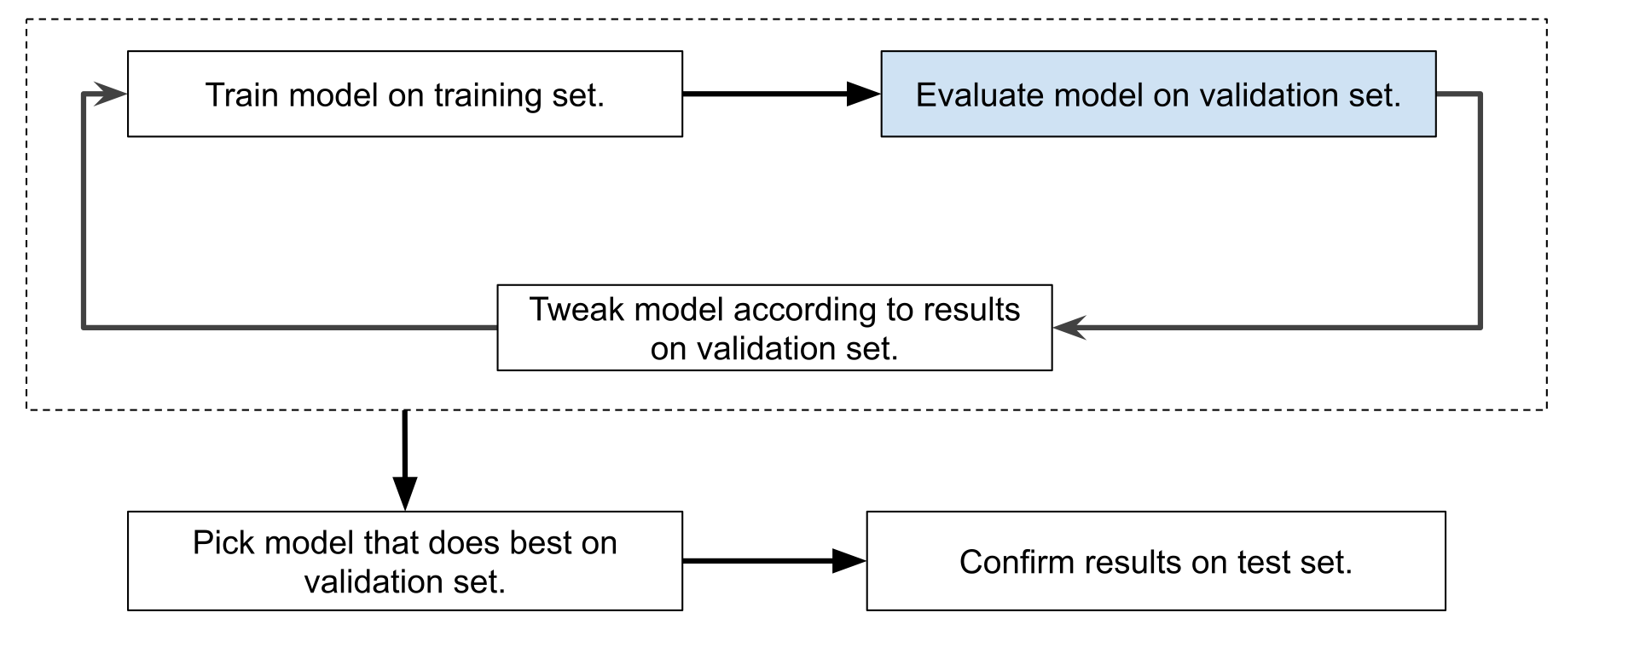
The modern recipe: train, validation, test
Model Evaluation
Train
Validation
Test
Short rule: validation is for choosing; test is for reporting.
10

Slide 15
When data is limited: cross-validation
Model Evaluation
If your training data is small, splitting off a large validation set can feel expensive. Cross-validation is a way to reuse the training data more efficiently. We rotate which chunk acts as validation, train several times, and average the validation scores.
train
train
val
train
train
The big idea is not “more math.” It is “more stable evidence.” Every chunk gets a turn as validation, so our choice of model depends less on one lucky split. After selecting settings this way, we still keep a final test set for the very end.
Fold 1 Fold 2 Fold 3 Fold 4 Fold 5
Cross-validation helps when data is scarce, but it does not replace the final test set.
11
Notes:
You do not need to go deep here unless your students are ready. The key message is that cross-validation is a practical answer to the question “How can I choose a model when I do not have much training data?” Emphasize that it is still part of the model-selection phase. The final test set remains untouched.
[Sources]
- Uploaded lecture PDF: page 9, cross-validation overview and averaging over folds.

Slide 16
Takeaways
Model Evaluation
1
A model should be judged on new data, not the training set.
2
For regression, MAE answers: “How wrong are we on average?”
3
If we try many models, we need a validation set so the test set stays honest.
4
Evaluation is a simulation of real life: how will this model behave in the future?
Closing line: “A good model does not remember apples. It understands fruit.”
12
Notes:
Use the final slide to restate the lesson in ordinary language. If students can paraphrase these four ideas, they understand the heart of model evaluation. You can also end by asking them to explain why a low training error is not enough, or to interpret an MAE score aloud in units.
[Sources]
- Summary synthesized from the uploaded lecture PDF pages 2 to 10 and the Kaggle “Model Validation” workflow.

