Slide 1
Eco-Sweep Robot: Components & Design
How each part works together for the most optimal design

Slide 2
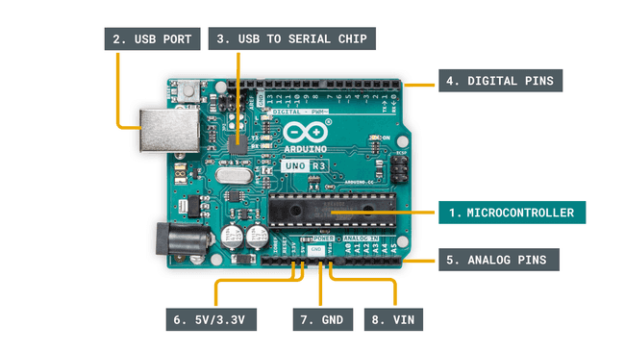
Arduino Uno Anatomy
Notes:
ATmega328P microcontroller with an 8-bit processor
An Arduino is an open-source electronic development platform consisting of a programmable circuit board and software to write code,
making it easy to build devices that interact with the real world. It simplifies electronics for beginners by providing a standardized,
accessible package that can be programmed directly via USB, using a simplified C++ language to control inputs and outputs

Slide 3
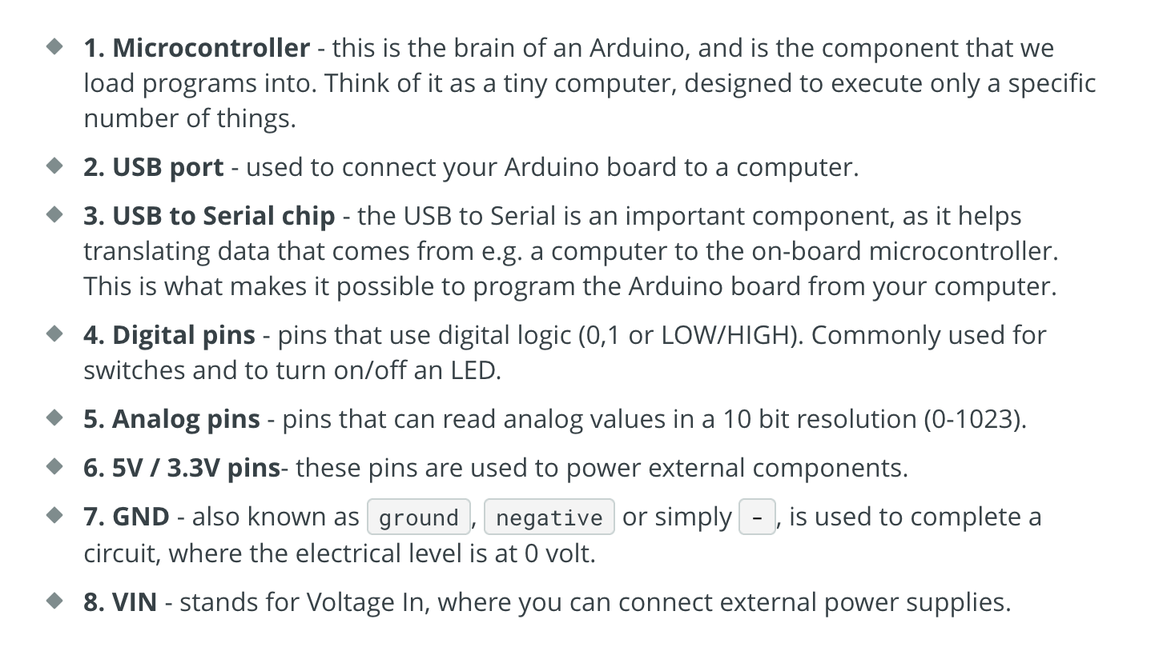
Components

Slide 4
Arduino Programming
-- The program that is loaded to the microcontroller will start execution as soon as it is powered. Every program has a function called "loop”. Examples:
- Read a sensor.
- Turn on a light.
- Check whether a condition is met.
- All of the above.

Slide 5
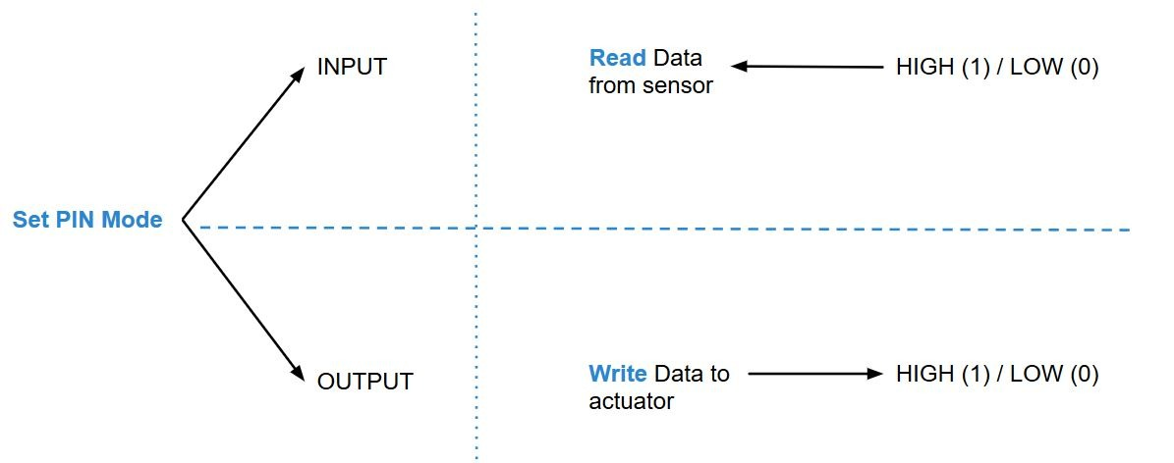
Arduino PINS
In Arduino, HIGH and LOW are keywords representing the two possible logic states of a digital pin, analogous to 1 and 0, or true and false. When a digital pin is set to HIGH using digitalWrite(), it outputs the board's voltage (e.g., 5V on a 5V board), while LOW sets it to 0V (ground). The digitalRead() function interprets an incoming voltage: a voltage below a certain threshold (e.g., ~1.5V) is read as LOW, a

Slide 6
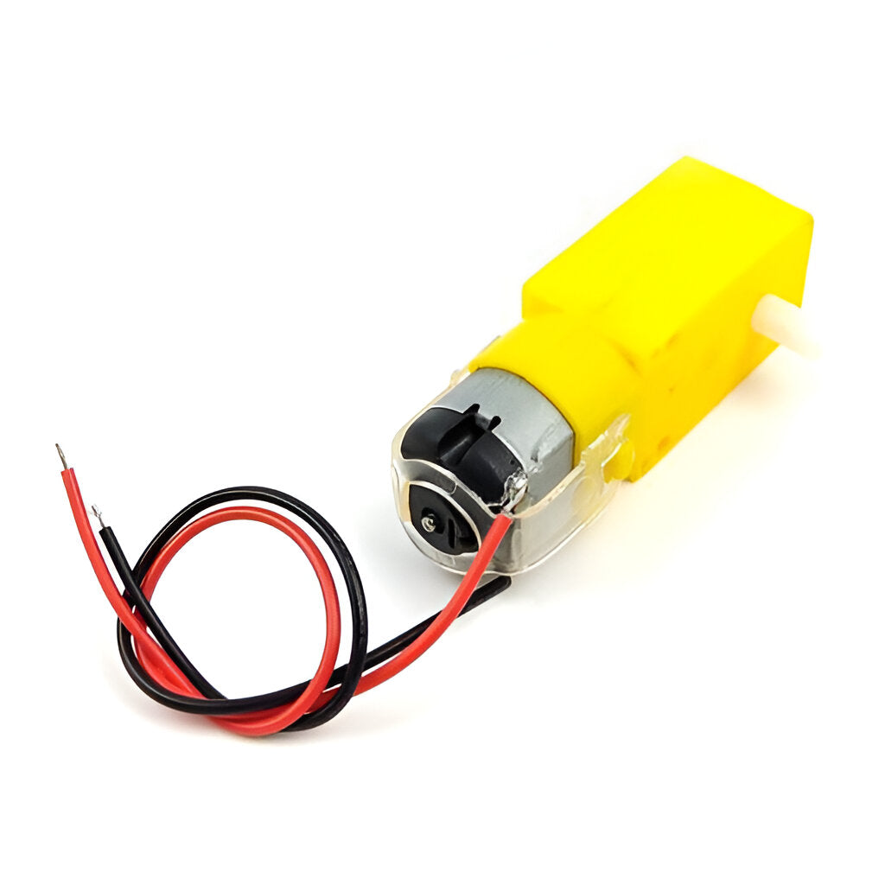
DC Gear Motors + Wheels
Provide movement. Two motors drive the robot in differential steering (tank-style turns).
Electric motors that run on direct current are known as direct-current (DC) motors.
These motors can convert electrical energy into mechanical energy by combining magnetic fields and currents

Slide 7
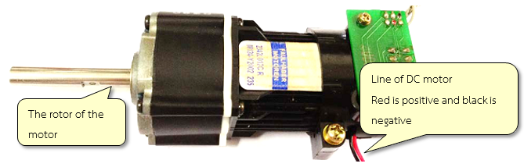
There are two lines of the motor i.e. black (negative polarity) and red (positive polarity). Rotation of the motor is based on the application of the voltage polarity applied to the lines of the motor. Motor can rotate in clock and anti-clock wise direction. The speed of the motor can be decreased by controlling the voltage of the power supply. The DC motor is cheap and easy to use. Use of DC motor is widely found in daily use items such as small toys, electric bikes, robotic arms and industrial projects etc.
Notes:
DC motor is a device that converts electrical energy into mechanical energy. DC motor structure consists of two main parts: a permanent magnet and a coil. There is also a brush which is connected to an external electric power to the coils of the motor. When coil is powered on, there is a magnetic field around the coil.

Slide 8
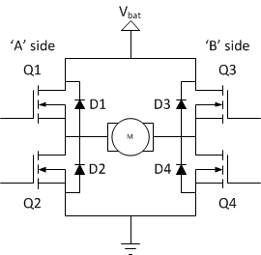
H-Bridge
An H-bridge circuit is a simple DC motor driver configuration which allows us to control both the rotational speed and direction of such electric motors by using a fixed DC voltage or by pulse width modulation (PWM).

Slide 9
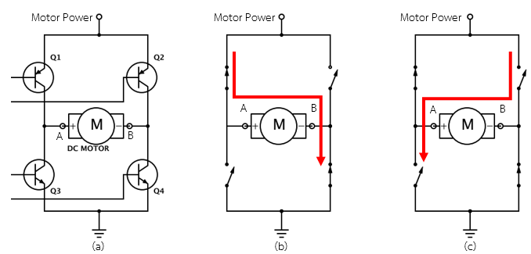
DC Motors (How they work)
Notes:
DC motor drive current is mostly an H-Bridge circuit which consists of a transistor which acts as a switch of 4 units (Q1 to Q4) via a dedicated DC motor.
Figure shows the position of the transistors in the H-bridge which are responsible for controlling the current in the motor.
When sending the control signal to Q1 and Q4, Q2 and Q3 will be disabled and the current will flow from A to B which will enable the motor to rotate in one direction.
When the control signal is sent to Q2 and Q3, Q1 and Q4 transistors will be disabled and current will flow from B to A and the motor will rotate in reverse directions.

Slide 10
ENABLE in H-Bridge
In the context of an H-bridge, EN most likely refers to the Enable input or function, which controls whether the H-bridge circuit is active and can receive control signals to drive the motor, or is disabled to a safe state like high-impedance or coasting

Slide 11
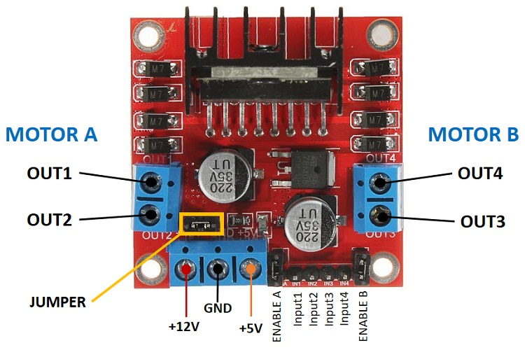
L298N Motor Driver (H-Bridge)
Controls the DC motors. Takes commands from Arduino to drive wheels forward, backward, or turn.

Slide 12
PMW (Pulse Width Modulation)
PWM allows you to simulate an analog output by rapidly switching the pin between HIGH and LOW states. The duration of the HIGH state (the "pulse width") within a cycle determines the average voltage, which can be used to dim an LED or control a servo motor.
Notes:
Pulse Width Modulation, is a technique for controlling the average power delivered to a device by rapidly switching the power on and off.

Slide 14
Caster Wheel (optional)
Provides stability as the third wheel, allowing smooth turning.

Slide 15
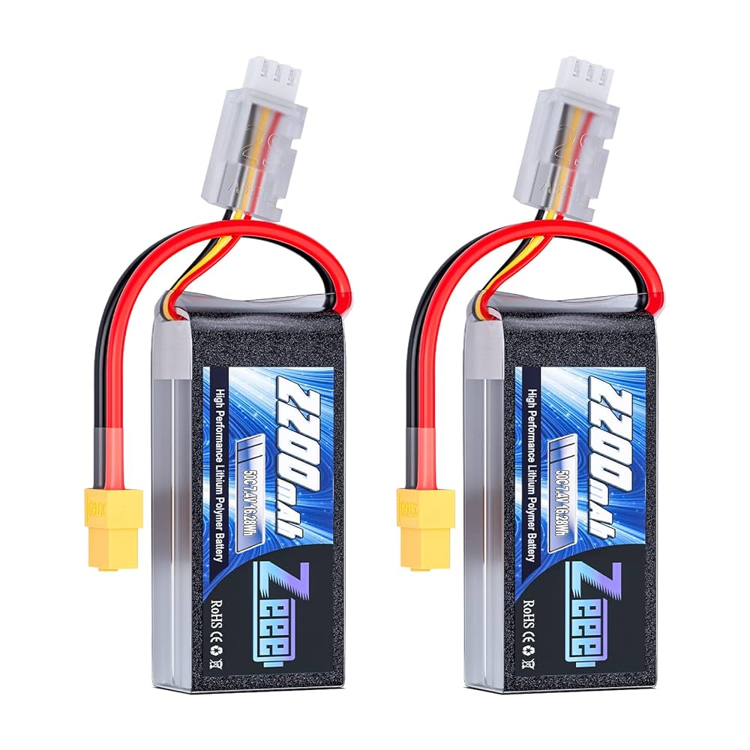
7.4V Battery Pack
Powers the entire system – BUT WE NEED TO POWER DOWN!
DON’T PLUG THE BATTERY INTO THE ARDUINO --- YOU WILL FRY THE ARDUINO!!!!!!!!

Slide 16
Battery Setup
Battery Pack to Power Switch
Use a matching connector or adapter (e.g., JST male ↔ JST female pigtail).
Switch goes in-line on the positive wire so you can turn the whole robot on/off. From the switch, the positive/negative split into two paths:
a) Motor Power Path
Battery to Motor Driver (L298N or TB6612) VIN and GND screw terminals.
This powers the DC motors at 7.4 V.
b) Logic Power Path
Battery to Buck Converter input (VIN+ / VIN–).
Buck Converter output (+5 V / GND) to Arduino 5V pin + sensors + servo.
Common Ground Rule
Connect all grounds (battery – , motor driver GND, Arduino GND, buck GND) together.
This makes sure signals flow correctly.

Slide 17
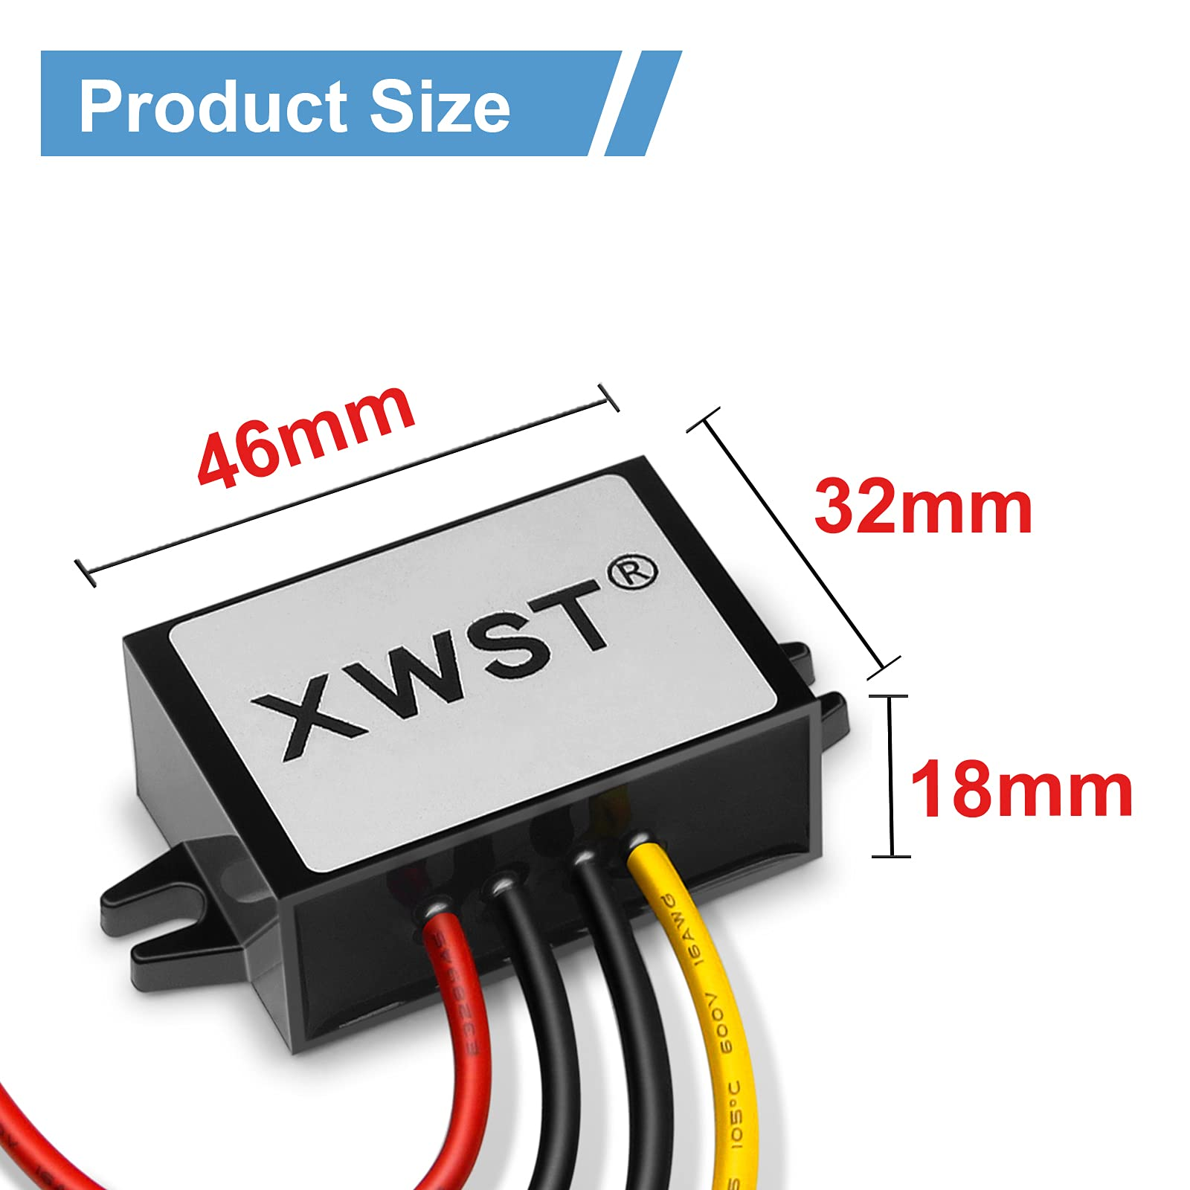
DC-DC Buck Converter
What is a DC-DC Buck Converter?
It’s a small electronic module that takes a higher DC voltage and steps it down to a lower DC voltage.
“Buck” = step-down.
Example: If your battery is 7.4 V (from a Li-ion pack), but your Arduino, sensors, and servo need 5 V, the buck converter lowers it safely.
. LM2596 buck converter is the way

Slide 18
Power Switch
Turns the robot on/off safely. Rated to handle motor current.

Slide 19
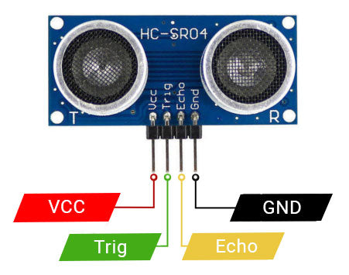
Ultrasonic Sensor
Detects obstacles/trash by sending sound waves and measuring echo time.

Slide 20
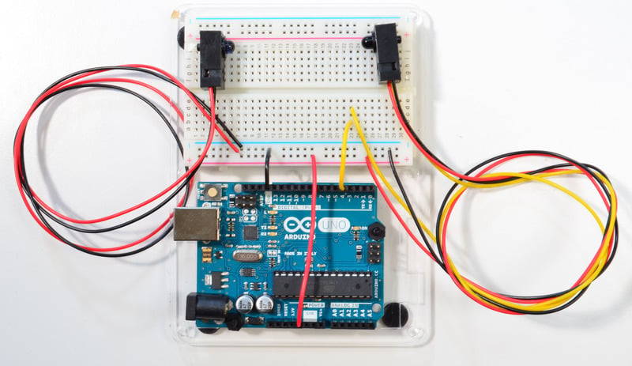
Break-beam Sensor
Placed in scoop; detects when trash is collected.

Slide 21
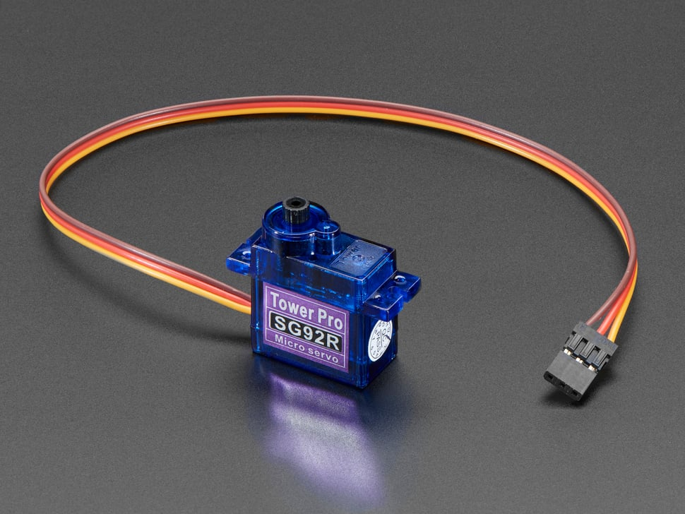
Micro Servo
Opens/closes the scoop gate for dumping trash.

Slide 22
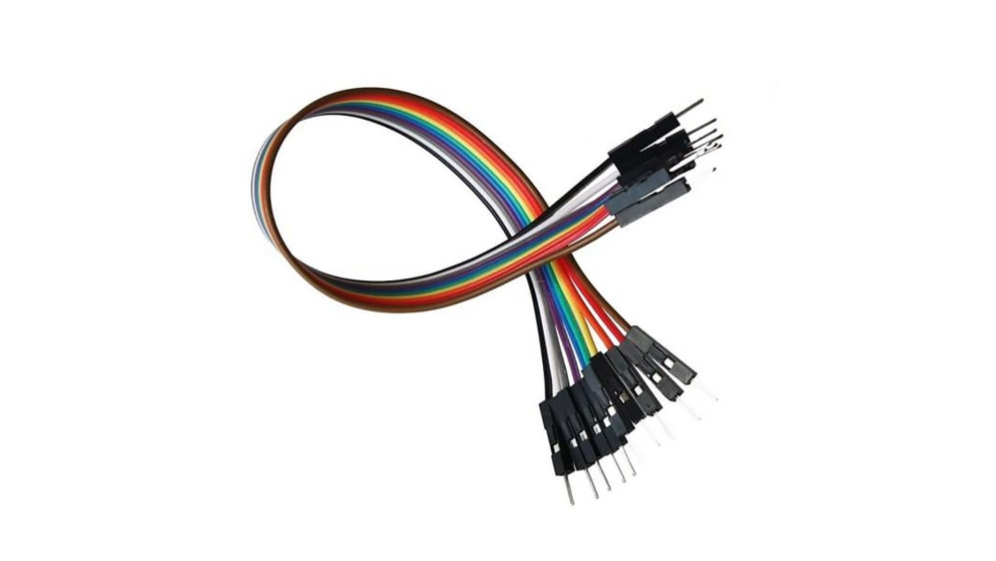
Jumper Wires
Arduino to Motor Driver: connect digital pins (IN1, IN2, ENA, etc.) using M–M wires into breadboard or headers.
Arduino to Ultrasonic Sensor: the HC-SR04 has male pins, so you’ll use M–F wires (female side to sensor, male to Arduino pins).
Arduino to Line Sensors: most line sensor modules have male header pins → use M–F.
Arduino to Servo: servo plug is female → use M–M into Arduino header.
Breadboard Connections: linking VCC and GND rails with M–M wires.

Slide 23
Chassis (Wooden Box)
Holds all components together. Motors mounted on sides, electronics inside, scoop at the front.

Slide 24
Scoop & Hinges
Collects trash items. Hinges/servo allow dumping mechanism.

Slide 25
Zip Ties, Screws, Brackets
Mechanical support for mounting components securely.

Slide 26
Most Optimal Design Layout
Place DC motors + wheels on the left/right sides of the wooden box
Position scoop at the front with servo-controlled gate
Ultrasonic sensor mounted above scoop facing forward
Battery pack centered inside for stability
Arduino and motor driver mounted inside on top panel
Wires tied with zip ties for safety

