Slide 1

Deep Learning-Based
Eye Tracking Analysis
for Autism Spectrum Disorder
Notes:
Credit picture : Unsplash

Slide 2
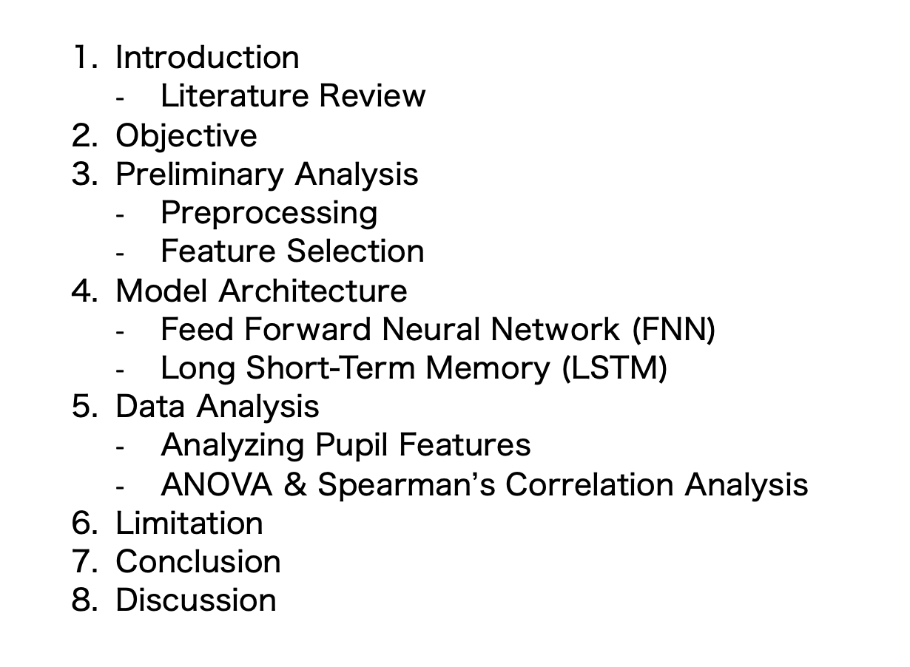
Table of contents

Slide 3
01
Introduction

Slide 4

Introduction
Importance
Understanding gaze behavior in children with ASD is
crucial for developing effective interventions and
improving their social interactions and communication
skills. [1][2]
The short- and long-term effects of atypical
gaze behavior in individuals with ASD underscores the
significance of studying this unique behavior in the
everyday environments they encounter.

Slide 5
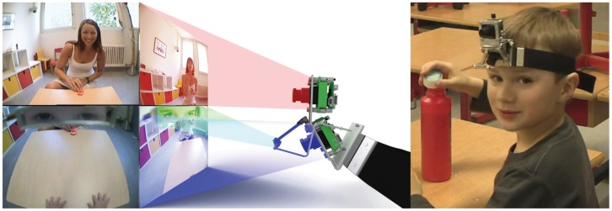
Literature Review
In a pioneering study, Noris et al. (2011) examined the gaze behavior of children aged 3-9 with ASD during a dyadic interaction in a natural setting. Participants wore a head-mounted ’WearCam’ to record their field of view and gaze direction.
The study found that compared to typically developing (TD) controls, children with ASD exhibited more downward looks and explored their lateral field of view more extensively
The WearCam device. (figure 1 from Noris et. Al) Left: Schematic view of the images recorded by the WearCam, highlighted are the interaction zone (top), the eyes reflected by the eye-mirror (middle) and the manipulation zone (bottom). Software for automatic monitoring of the child's gaze and detection of human faces in the camera images is used to quantify, among other factors, the frequency and length of time during which the child looks at human faces. Right: The WearCam worn by a typically developing child

Slide 6
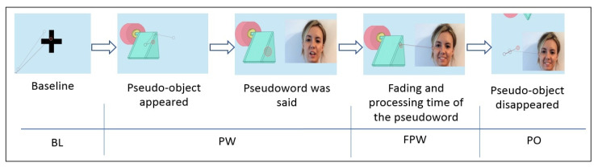
Literature Review
A study by Camero et al. shared a similar goal to ours, aiming to investigate whether measurements of gaze following and pupillary dilation during
a linguistic interaction task could serve as potential objective biomarkers for early ASD diagnosis [3]
The results showed significant differences in the duration of gaze fixation on the human face and the object, as well as in the frequency of gazes.
Pupil dilation in children with a higher likelihood of ASD remained consistent throughout the task, whereas NT participants showed increased dilation upon hearing the pseudoword

Slide 7
02
Objective

Slide 8
Objectives
Data Exploration
Model
Objective 1: Explore Patterns and Correlations
Our objective is to analyze the eye tracking data to identify patterns and correlations that could help differentiate between individuals with Autism Spectrum Disorder (ASD) and neurotypical individuals.
We aim to elucidate differences in eye behavior between these two groups, potentially uncovering unique characteristics associated with ASD.
Objective 2: Model Development for Classification
Train and develop a deep learning model using the selected features from our data.
The model will be designed to classify individuals as either having ASD or being neurotypical based on their eye behavior.

Slide 9
03
Preliminary Analysis

Slide 10
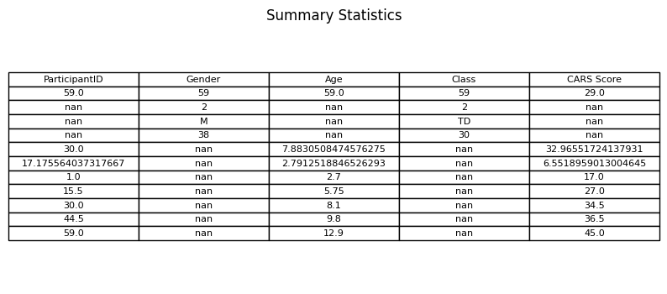
Preliminary Analysis - Metadata
Data was collected from 59 participants, consisting of 38 males and 21 females, with ages ranging from 2.7 to 12.9 years old. Of these participants, 30 were classified as typically developing (TD) and 29 as having Autism Spectrum Disorder (ASD).
The mean age of the participants was 7.88 years, with a standard deviation of 2.79. The CARS (Childhood Autism Rating Scale) scores for the ASD group ranged from 17 to 45, with a mean of 32.97 and a standard deviation of 6.55.

Slide 11
Preliminary Analysis - Preprocessing
X_train shape: (330793, 14), y_train shape: (330793,)
X_val shape: (82699, 14), y_val shape: (82699,)
Mapping of numeric labels to original labels:
Numeric Label: 0, Original Label: 0
Numeric Label: 1, Original Label: 1
Number of classes: 2
The RandomOverSampler is used to create a balanced dataset by randomly duplicating samples from the minority class until it matches the number of samples in the majority class.
Before Class Distribution:
Other 1839451
Neurotypical 225675
ASD 187817
Name: Participant Group, dtype: int64
After Class Distribution:
Balanced Class Distribution (filtering only ASD Ä& NT):
Class 0: 218024 samples
Class 1: 225675 samples
Dataset divided into three subsets based on participant groups.
The first subset: participants with IDs ranging from 1 to 29, representing individuals with Autism Spectrum Disorder (ASD).
The second subset, participants with IDs ranging from 30 to 59, representing typically developing (TD) individuals (Neurotypical)
The third subset, contained data from participants labeled as ’Unidentified(Pos)’, whose group classification was unspecified.

Slide 12
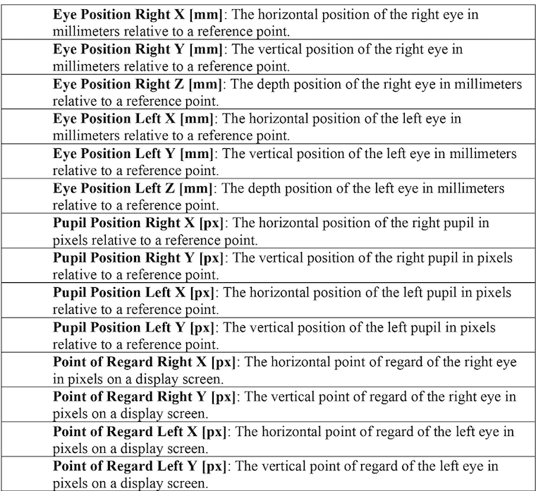
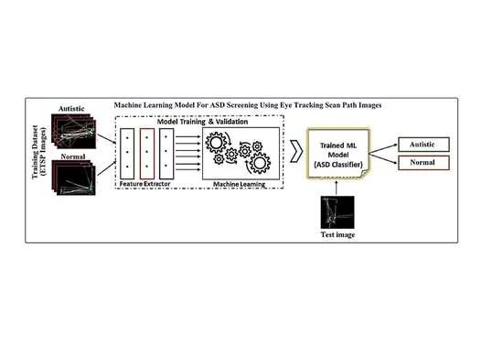
Preliminary Analysis - Feature Selection

Slide 13
04
Model Architecture

Slide 14
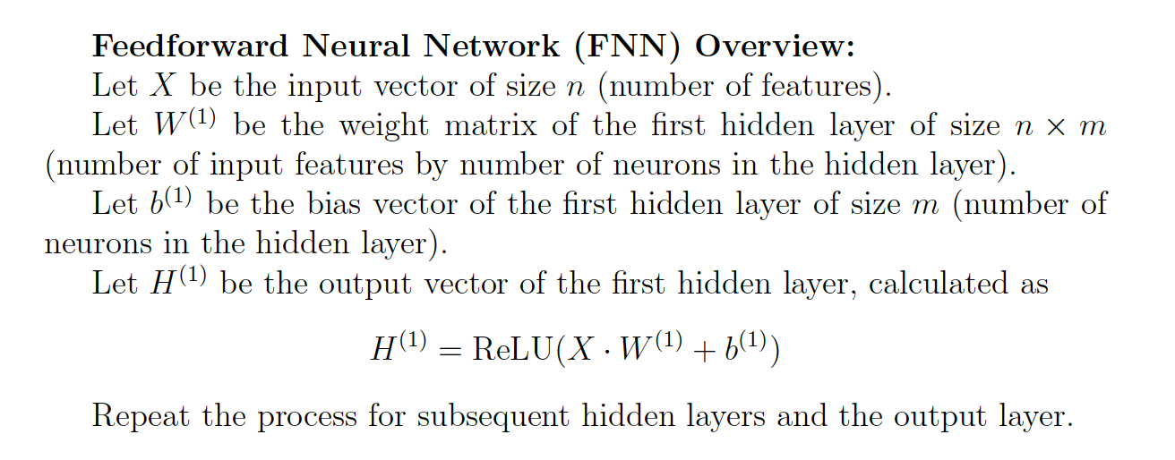
Model Architecture
Feed Forward Neural Network (FNN) Model Architecture

Slide 15
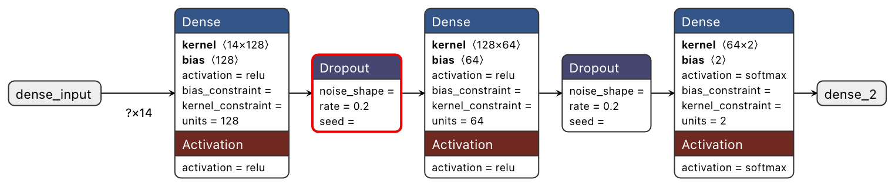
Model Architecture
Feed Forward Neural Network (FNN) Model Architecture

Slide 16
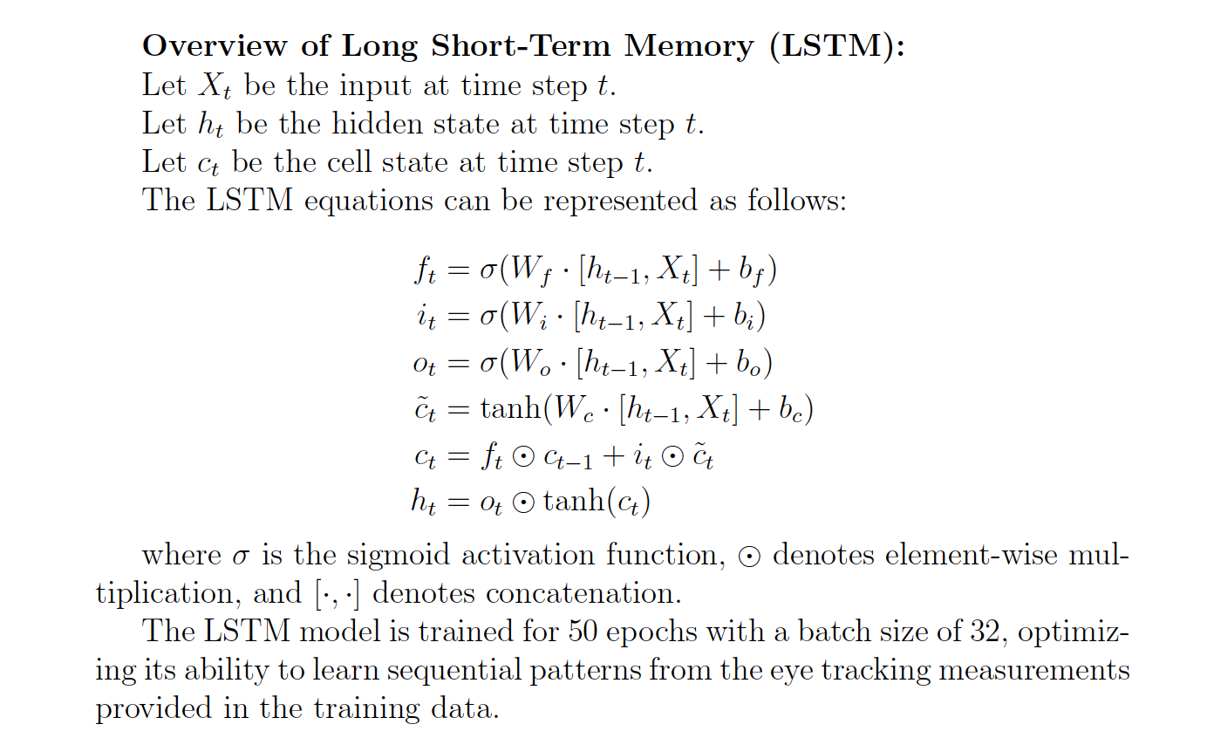
Model Architecture
Long Short Term Memory (LSTM) Model Architecture

Slide 17
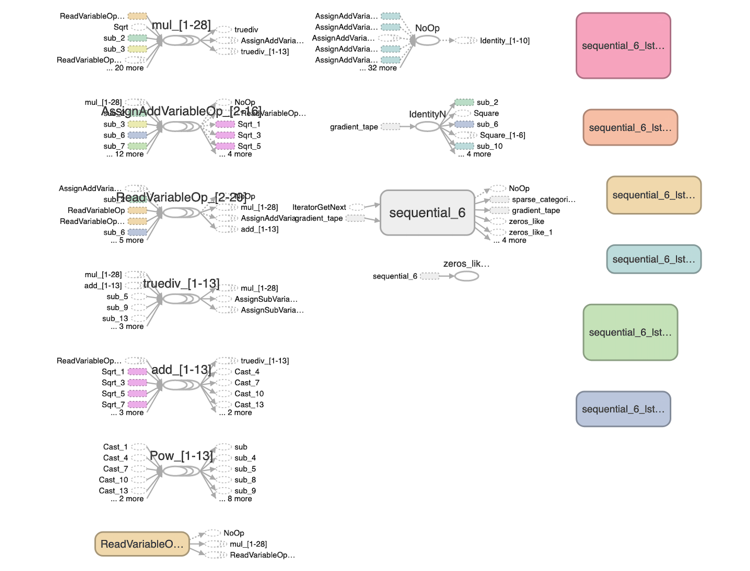
Model Architecture
Long Short Term Memory (LSTM) Model Architecture
LSTM is particularly useful due to its ability to capture dependencies and patterns over time. Unlike a Sequential feedforward neural network, which processes each input independently, an LSTM maintains an internal state that allows it to remember information from previous time steps

Slide 18
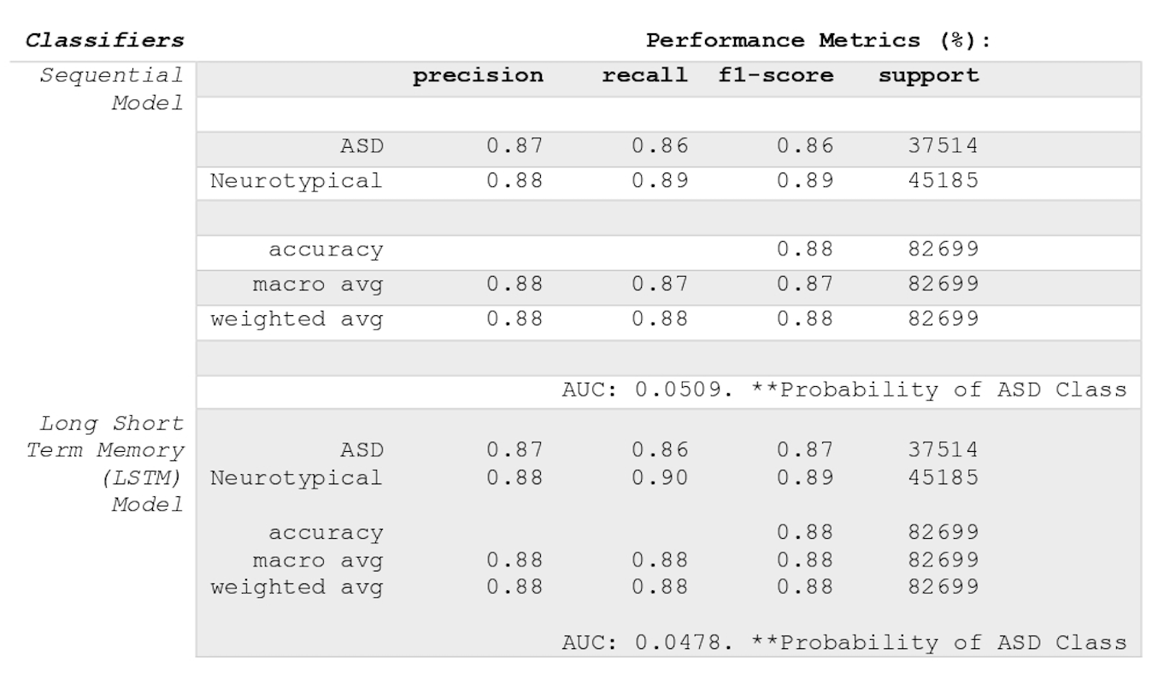
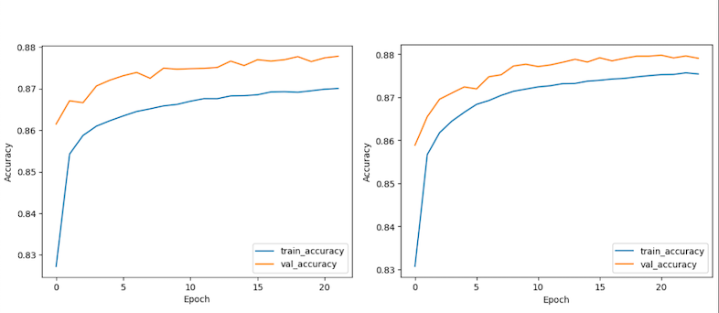
Model Architecture
Results
Both models demonstrate high precision, recall, and F1-scores for the ’ASD’ class, indicating that they are effective at correctly identifying individuals with ASD.
However, the AUC values for both models suggest that they perform only slightly better than random chance in distinguishing between ’ASD’ and ’Neurotypical’ samples based on the probability of the ’ASD’
class.

Slide 19
05
Data Analysis

Slide 20
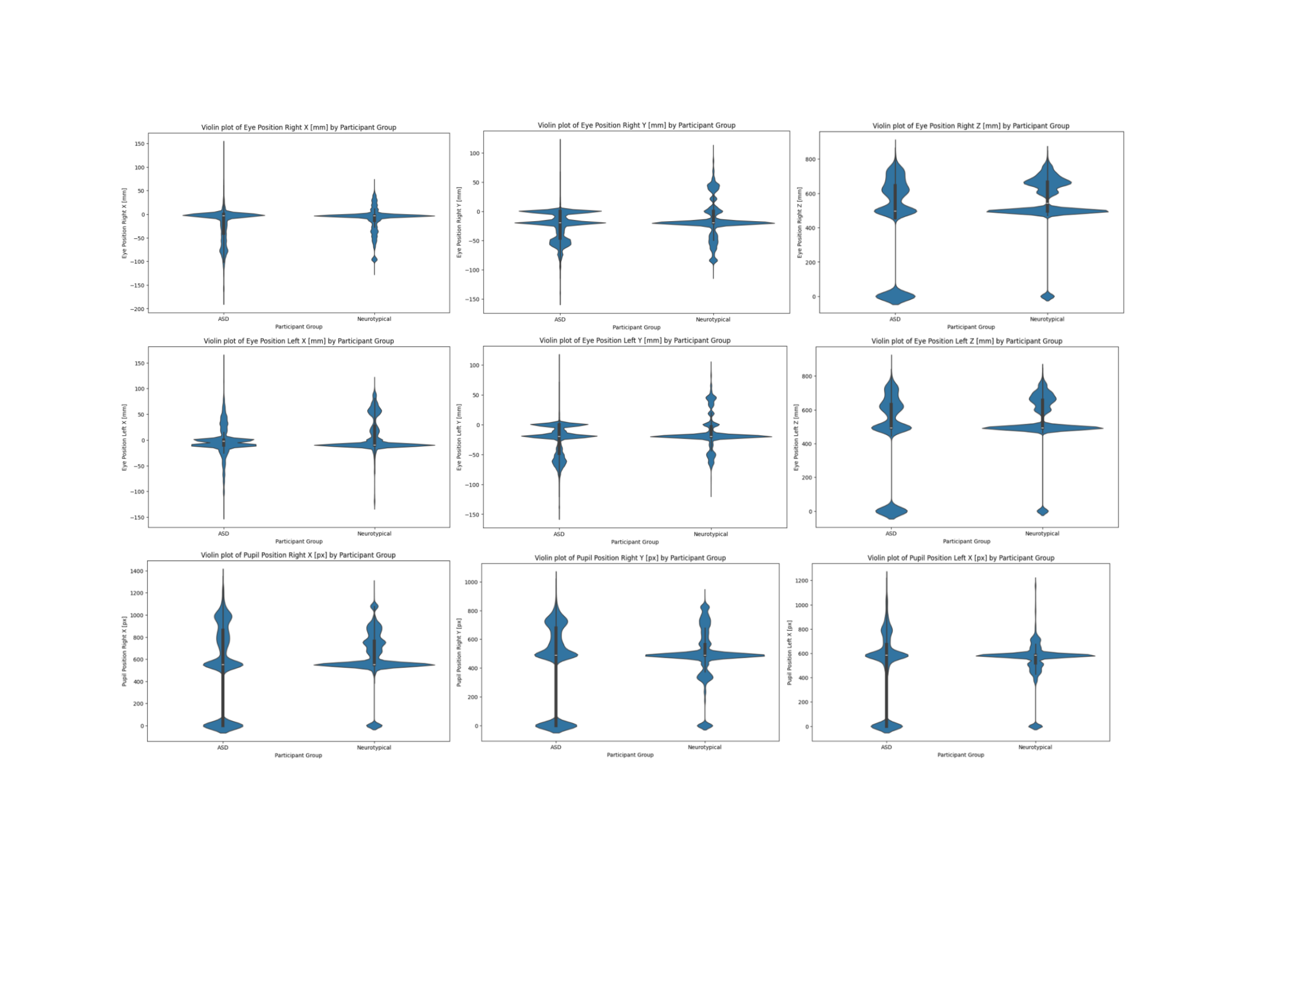
Data Analysis - ANOVA test
Neurotypical individuals, and participants labeled as Unidentified(Pos) revealed statistically significant differences in several key metrics.
For ’Eye Position Left X [mm]’, ’Eye Position Left Y [mm]’, ’Eye Position Left Z [mm]’, ’Pupil Position Left X [px]’, ’Pupil Position Left Y [px]’, ’Point of Regard Left X [px]’, and ’Point of Regard Left Y [px]’, the F-statistics were 18134.17, 13128.42, 12140.71, 149476.12, 880.72, 16103.98, and 13048.19, respectively, all with p-values below 0.001.

Slide 21
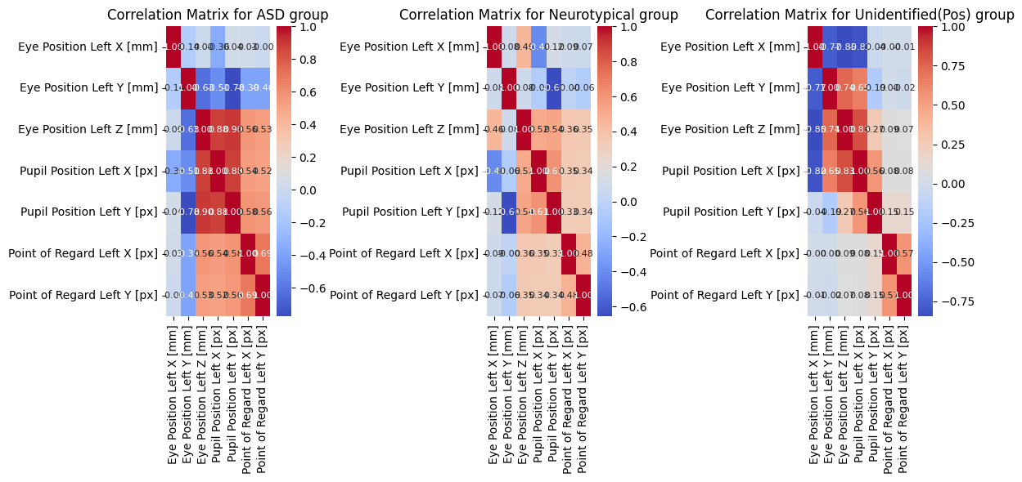
Data Analysis - Spearman’s Correlation
In the ASD group, strong negative correlations were observed between eye position and pupil position, with coefficients ranging from -0.776 to -0.358. This suggests that as the eye position on the left increases, the left pupil position tends to decrease significantly.
In contrast, the neurotypical group displayed weaker correlations, with coefficients ranging from -0.657 to -0.412, indicating a less pronounced relationship between these variables.

Slide 22
06
Limitations

Slide 23
Limitations
Sample Size
Missing Data / Sample Bias
For each group may affect the generalizability of the findings, especially for the Unidentified(Pos) group, which might be relatively small compared to the ASD and Neurotypical groups.
Measurement errors, such as inaccuracies in data collection or entry, could introduce noise and affect the accuracy of the correlation estimates.
The dataset that was download had missing gaze vector data in every CSV file along with other missing values
Analysis
The use of ANOVA does not account for potential confounding variables that could influence the results.
Notes:
Future research could benefit from larger and more diverse samples, longitudinal designs, and multivariate analyses to better understand the complexities of
eye tracking data in the context of Autism spectrum disorders.

Slide 24
Conclusion
Model Success
ANOVA Analysis
Correlations
The Sequential FNN & LSTM model achieved high accuracy for both the training and validation datasets, indicating its ability to generalize well to unseen data.
The ANOVA tests conducted on various eye tracking measurements revealed significant differences between individuals with ASD, neurotypical individuals, and those labeled as Unidentified(Pos).
The relationship between
different eye. tracking metrics,
with strong negative
correlations observed
in the ASD group compared to
weaker correlations in the
Neurotypical group.

Slide 25
Discussion
Open for questions & thoughts

Slide 26
Thanks

