Slide 1
ARIMA
ARIMA stands for Auto regressive integrated moving average models
Correlation between values of time series in neighboring periods is called Autocorrelation.
The data should be stationary.
To build an ARIMA model we need to define its components (p,d,q)
P - Autoregressive components. D- Differencing, Q- Moving Average

Slide 2
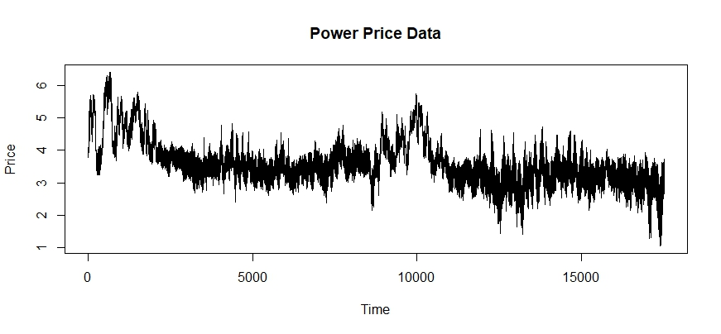
We see that there is a seasonality present at the beginning of the year with high price. The data is pretty volatile. there are peaks and troughs.
We did a random walk test to see if the data is time series. The Phillips-Perron Unit Root Test confirms that.

Slide 3
All the three components can be estimated using ACF and PACF plots.
ACF stands for Auto correlation plots
PACF for partial auto correlation plots.
ACF plot display the correlation between a series and its lags
PACF display the correlation between a variable and its lags that is not explained by previous lags.

Slide 4
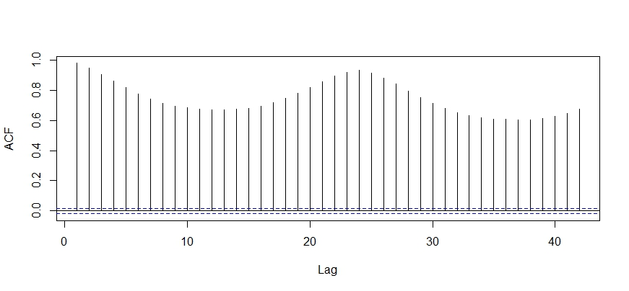
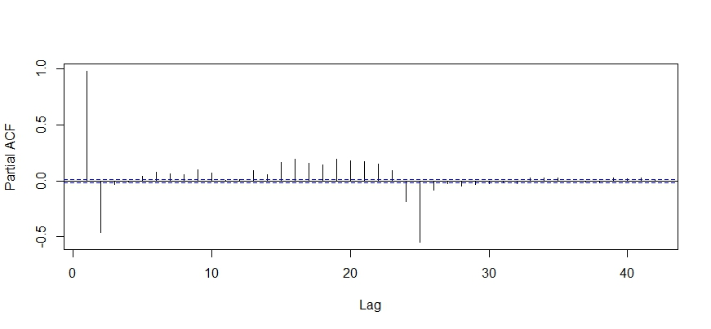

Slide 5
The Model was trained on 2014 and 2015 data and tested on 2016.
One day predictions and Full year predictions are made.
To Build an ARIMA Model, the data should be stationary. The Augmented Dickey Fuller Test confirms that.
After running the ARIMA model we got the three components as 4,1,3.
RMSE values were calculated for one day and full year of test data.
RMSE for one day 7.54 and full year it was 14.91

Slide 6
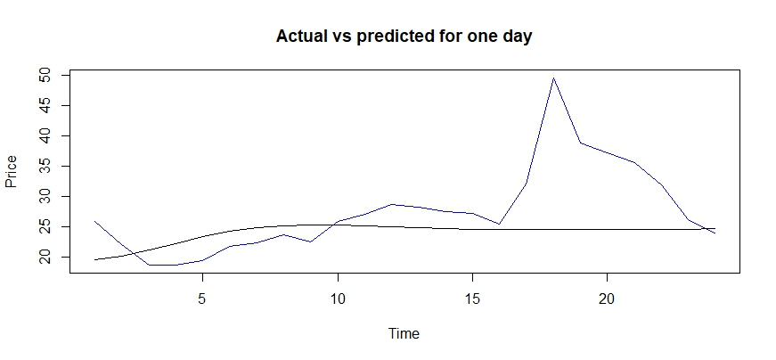
The Blue line is the actual data and Black is the predicted data

Slide 7
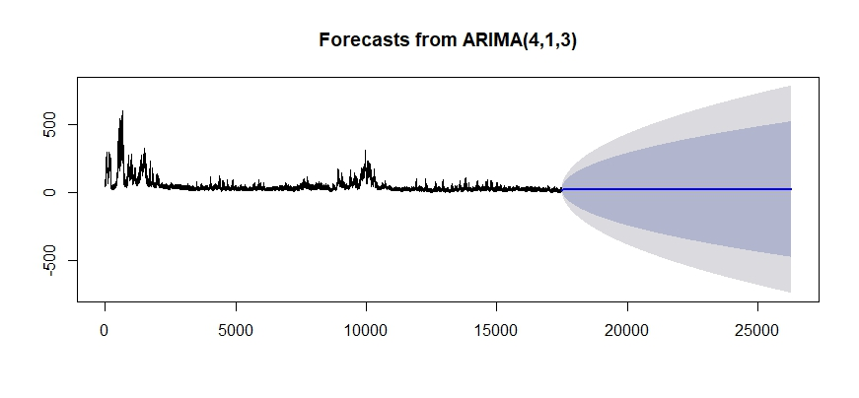


Slide 8
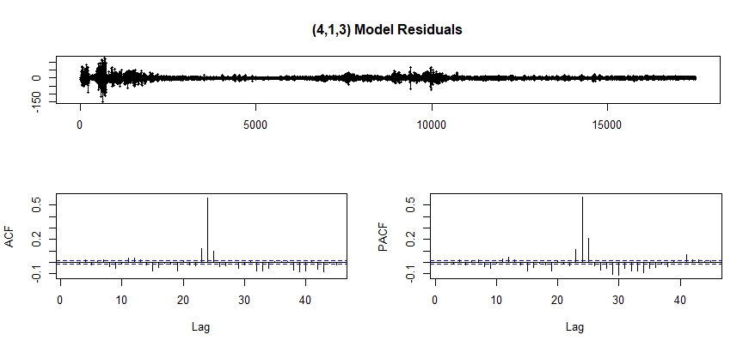

Slide 9
WT-SARIMAX
Time Series Data
Wavelet Transform
SARIMAX
Inverse WT

Slide 10
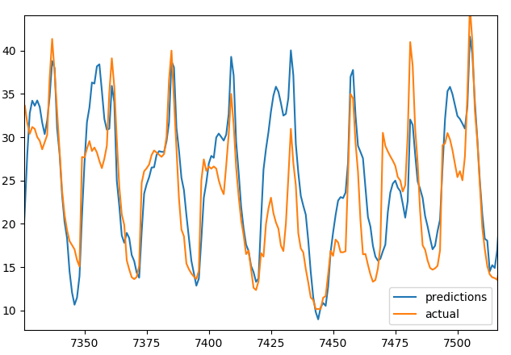
Actual vs Predicted- 33%RMSE

