Slide 1
Introduction to dbachecks
SQL Server Best Practices and Configurations

Slide 2
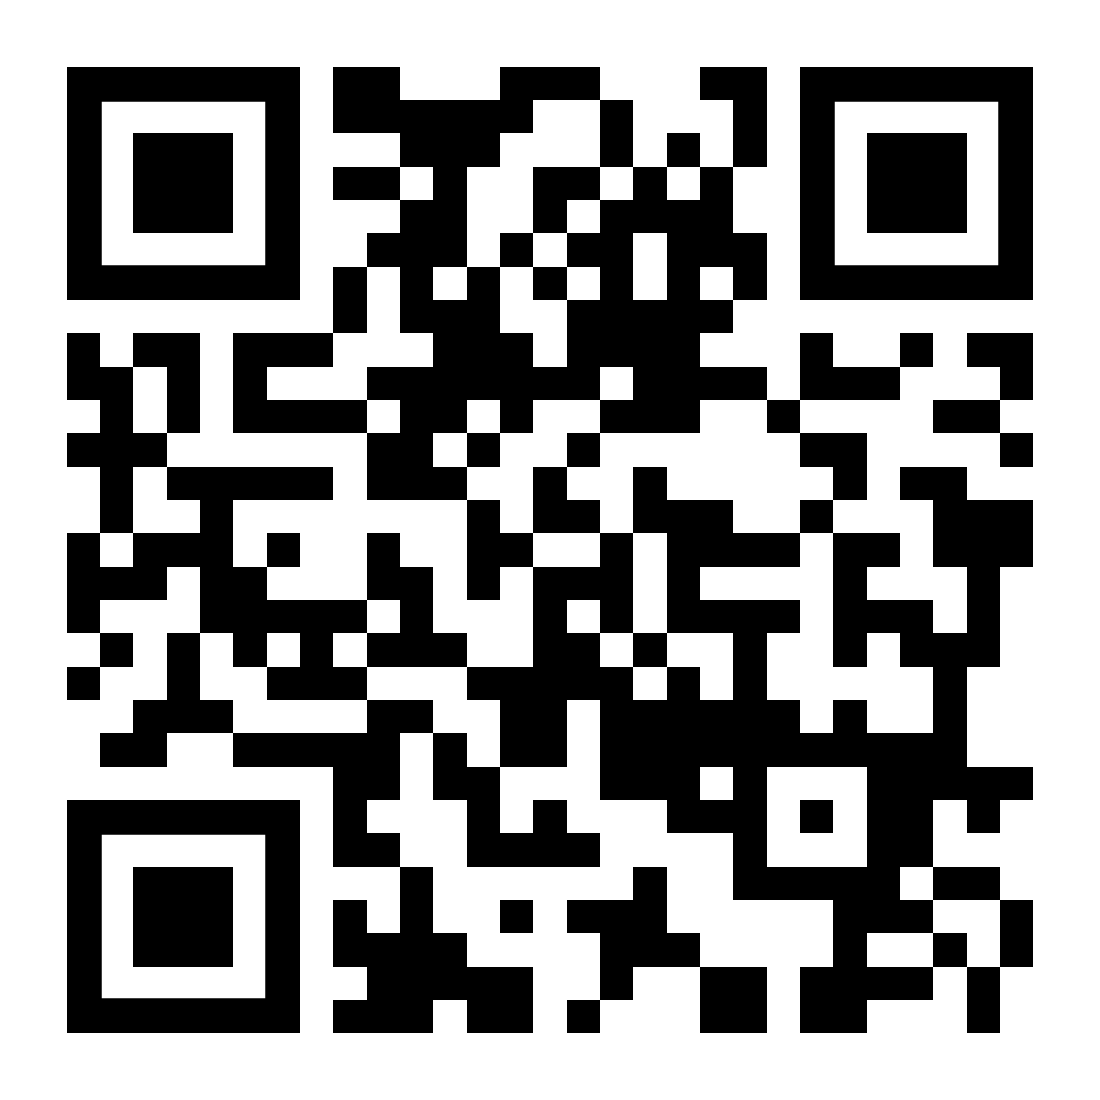
Get-Identity
linkedin.com/in/cviorel
twitter.com/viorelciucu

Slide 3
Agenda
dbachecks
demo

Slide 4
What is dbachecks?
A powerful PowerShell module leveraging the Pester testing framework for SQL Server instance validation
Purpose:
- Ensure that environments adhere to best practices and specific verification criteria
Key Features:
- Leverages Pester for testing
- Customizable checks
- Community-driven development
- Uses dbatools for most of its data gathering

Slide 5
Key Features of dbachecks
Comprehensive Checks:
- Over 100 predefined checks for SQL Server
Customizability:
- Ability to create custom checks
Integration:
- Integrates with CI pipelines
Reporting:
- Detailed reports and dashboards for visualization

Slide 6
How to use dbachecks
Installation:
Install-Module dbachecks
Basic Usage:
Invoke-DbcCheck -SqlInstance YourInstanceName -Check DatabaseStatus
Customization:
Customize checks or create new ones
Reporting:
Generate reports or integrate with Power BI

Slide 7
Benefits and Community
Benefits:
- Adherence to best practices
- Identification of issues
Time-saving
Community and Support:
- Community-driven development
Links:
- https://github.com/dataplat/dbachecks
- https://dbachecks.readthedocs.io

