Slide 1
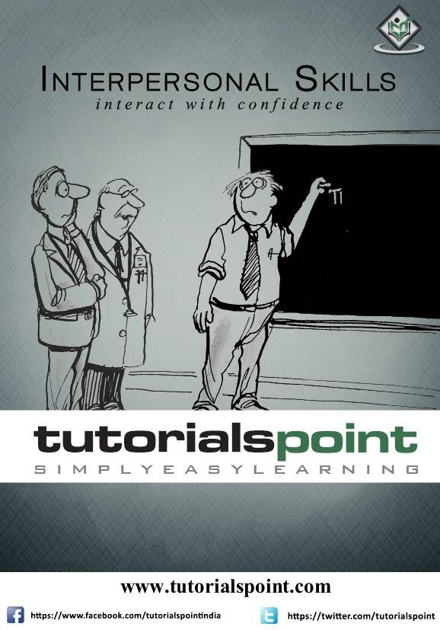

Slide 2
About the Tutorial
Interpersonal skills are sometimes referred to as people skills or social skills, and with good reason: these are skills that we use while communicating with others. Interpersonal skills include speaking, explaining, persuasion, and active listening. In the business world, it refers to a person's ability to communicate and interact effectively within the organization with colleagues and seniors.
Audience
This tutorial is designed primarily for the students and professionals who seek assistance in initiating conversation and building positive impression in social circles and also at work.
Prerequisites
Before proceeding with this tutorial, you are expected to have a calm mindset and be open to exploring the suggestions mentioned here.
Disclaimer & Copyright
© Copyright 2015 by Tutorials Point (I) Pvt. Ltd.
All the content and graphics published in this e-book are the property of Tutorials Point (I) Pvt. Ltd. The user of this e-book is prohibited to reuse, retain, copy, distribute, or republish any contents or a part of contents of this e-book in any manner without written consent of the publisher. We strive to update the contents of our website and tutorials as timely and as precisely as possible, however, the contents may contain inaccuracies or errors. Tutorials Point (I) Pvt. Ltd. provides no guarantee regarding the accuracy, timeliness, or completeness of our website or its contents including this tutorial. If you discover any errors on our website or in this tutorial, please notify us at contact@tutorialspoint.com
1

Slide 3
Table of Contents
About the Tutorial....................................................................................................................................i
Audience ..................................................................................................................................................i
Prerequisites ............................................................................................................................................i
Disclaimer & Copyright.............................................................................................................................i
Table of Contents ....................................................................................................................................ii
1. INTRODUCTION TO INTERPERSONAL SKILLS ........................................................................1
2. VERBAL COMMUNICATION .................................................................................................3
3. ACTIVE LISTENING ...............................................................................................................5
4. ART OF ASKING....................................................................................................................7
5. BODY LANGUAGE ................................................................................................................9
6. SMALL TALK AND ITS BENEFITS..........................................................................................10
7. PROCEEDING WITH A CONVERSATION ..............................................................................12
8. TIPS WHILE TALKING..........................................................................................................13
9. USING NAMES IN CONVERSATION.....................................................................................14
10. MAKING UP FOR FORGETTING NAMES..............................................................................15
11. INFLUENCING PEOPLE’S THOUGHTS..................................................................................16
12. NURTURING COMMON GROUNDS ....................................................................................17
13. MAINTAINING RELIABILITY AND TRUST .............................................................................18
14. THE “YOU WIN, I WIN” TECHNIQUE...................................................................................19
15. EMOTION HANDLING ........................................................................................................20
16. PITFALLS OF EMOTIONS ....................................................................................................22
2

Slide 4
17. INTERPERSONAL SKILLS WORKSHEET - I ............................................................................24
18. INTERPERSONAL SKILLS WORKSHEET - II ...........................................................................25
19. PUTTING YOUR OPINION FORWARD .................................................................................26
20. HOW TO NEGOTIATE.........................................................................................................27
21. MAKING AN IMPACT..........................................................................................................29
22. GETTING RESULTS THE RIGHT WAY ...................................................................................30
23. CONCLUSION.....................................................................................................................31
3

Slide 5

1. INTRODUCTION TO INTERPERSONAL SKILLS
Hello! Welcome to our guide on enhancing Interpersonal Skills! In this exciting and informative tutorial, you will learn what Interpersonal Skills are, what they include, and how to acquire them. Let's begin with what Interpersonal Skills really mean.
Have you met that dynamic, charismatic person who is the life of the party, who walks into a room and immediately changes the dynamics of any conversation, someone who people talk about for hours even after he leaves the place?
If you have, then you might have wondered at large as to what makes him so adorable to so many different people at the same time. In short, you would be interested in tracking down his "X-factor", which makes that person adorable.
The secret is behind understanding the difference between hearing and listening, using verbal skills to communicate effectively, sending subtle non‐verbal signals to move a conversation along to higher levels of conversation. Remember the

Slide 6
saying that successful people always remember names, know how to make a powerful introduction, and manage situations.

Slide 7

2. VERBAL COMMUNICATION
Interpersonal Skills, for all the mystery and high-talk surrounding them, could be something as simple as handling a conversation. It is all about learning the art of giving in rather than giving up. It also could be understanding how to use facts and emotions to get people on your side.
To communicate effectively, the first thing we need is not only a good collection of words, but also a good selection of words. Indeed, knowing how to speak is fine, but what to speak is the backbone of any conversation. The Collection- Selection Model of speech adds value and pleasure to any conversation you have. For example, take a look at the usage of the word astounding in the following sentences:
Incorrect: This soup tastes astounding.
Correct: What you have achieved is an astounding feat.
Proper usage of words and the right manner of communication will create ways of sharing opinions and expressing ideas in a positive manner. The objective of

Slide 8
Interpersonal Skills is to have a pleasant, informative, and valuable conversation that leaves a lasting positive impression of you in others' minds.
Business experts use well-honed communication skills to prepare their pitch for a deal, handle objections, and settle negotiations. A major part of successful bargaining depends on the rapport you manage to build with a prospect.

Slide 9

3. ACTIVE LISTENING
Communication is a two-way process where active listening plays as major a role as speaking fluently. Speaking fluently without listening will make any conversation a very short-lived one.
Hearing is simply picking up sound waves in our surrounding and realizing that there has been a source of sound, whether you have seen it or not. Listening, on the other hand, is not only picking up sound waves but also understanding the meaning of the words spoken, analyze them, interpret them, and act accordingly.
In short, hearing involves only the brain, but listening involves the mind too. Active listening helps in getting a deeper understanding of what the person is saying, which in return, will help you arrive at the most appropriate conclusion.

Slide 10
In addition to that, it also helps you to communicate more successfully and build a receptive, cooperative image in the mind of the speaker. The person will perceive you as a caring, attentive, and engaged listener with minute attention to details. Insurance Advisors and Investment Bankers all over the world have mastered this art as they understand that their customers are talking about the future of their earnings, which is a sensitive topic to most of them.

Slide 11

4. ART OF ASKING
Many people shy away from putting their queries forward. They think that asking questions would create an impression about them being rude, intrusive, or pesky. Although there are certain situations where it is best to refrain from putting your queries forward, asking questions is not some scornful activity in itself.
On the contrary, you could say that we human beings can attribute whatever we have learnt and our entire development curve to our propensity of asking questions. The trick is in seeking purposeful answers that the person can connect with and identify the thought behind the question.
Questions can be broadly classified under two categories:
Open-ended questions – These questions are also known as the "Wh- questions" as they are usually preceded by "who, when, where, what, how, and why". While answering these questions, people tend to focus more on giving descriptive answers. Example: “Why did you think this was the best decision of your life?"

Slide 12
Close-ended questions - These questions can be easily answered in a few words, even with a simple 'yes' or 'no'. They are asked to get a quick response from the listener about facts and figures. The listener tends to put more stress on his memory as compared to processing thoughts while answering these questions. Example: “Are you a resident citizen of this country?”

Slide 13
5. BODY LANGUAGE
Jarod Kintz had once written that "I am bilingual. I speak English and Body." This statement stresses how important body language is to the image we project of ourselves, and the image we perceive of people around us. Body language helps us generate and transmit messages to observers through our posture, gestures, and body movements.
Inconsistencies between verbal and non-verbal communication often confuses people, as they tend to put more emphasis on body language as compared to speech. If a person smiles while saying he is sad, his words will lose their value and the observer will take that statement as a lie.
The most important factors that sum up Body Language are:
Eye Contact – Steady eye contact (not continuous as in staring) indicates a sense of confidence and a willingness to connect with the discussion, as opposed to shying eyes and drooping eyes that give an impression of either under-preparedness, low confidence, or disinterest.
Facial Expression – A person can very easily give away his thoughts if one were to study his face. People who are genuinely happy tend to arch their eyebrows, as compared to those who smile only out of courtesy. These small hints can give many details and unspoken messages about people.
Posture – It is recommended that you always maintain a proper, straight, and crisp posture while standing or while sitting down. Slouchy posture is often associated with arrogance, sloth, and unproductivity. On the other hand, a person sitting straight in his chair will exude confidence and inspire respect.
Specific Gestures – Nodding is universally accepted as a signal for 'Yes', and five extended fingers denote the number 'five'. These are certain specific movements that you need to be careful of while speaking, so that there is no discrepancy in gesture and speech.
Physical Proximity – The way we shake hands and pat on the shoulders of other people give us either a friendly or amiable image. Standing too close or too far from a speaker could give a sense of intrusion or arrogance.

Slide 14

6. SMALL TALK AND ITS BENEFITS
Small Talk is the friendly, amiable conversation people have with one another on general topics such as weather or traffic that may open doorways to knowing each other better. Communication experts consider small talk as an art, and they believe a pleasant small talk can lead to many frank, detailed discussions on business too.
Although, it is easier said than done, walking up to a stranger and initiating a conversation may not be one of the easiest things for a lot of people, especially young sales-people and business development managers. Many think opening up a conversation as an arduous task and admit having no "small talk" skills at all.

Slide 15
Let's see how small talk leads two people to share details about each other:
Initiation – At this stage, the people in the conversation normally talk on general topics such as the weather, traffic, time of the day, busy schedule, etc. This gives an idea as to whether the other person is in a conversational mood or is avoiding conversation.
Knowing each other – This is where people introduce themselves to the other person and offer details about their name, work, and the reason they were at that particular place, for example – "I am Vineet. I am a trainer and I was on my way to delivering an online training session."
Opinion Sharing – Here the discussion moves towards slightly more "weighty" topics like politics, corporate way of life, philosophy, where the opinions of each other are listened to and valued.
Expressing Thoughts – Once all the above stages have been cleared, you reach the final stage where both the persons can feel sufficiently comfortable in each other's company to be able to disclose intimate details about each other.

Slide 16

7. PROCEEDING WITH A CONVERSATION
To improve your interpersonal skills, the most important step is to address the issues that prevent you from initiating a conversation with someone. It could be shyness, discomfort around authority figures, or lack of content. Knowing the reasons behind your hesitation could help you understand your areas of concern.
To be able to start a conversation and hold it pleasantly over a length of time, you need to be really interested and involved in the conversation. That will only be possible if you have a genuine love for meeting and knowing new people.
Having a collection of conversation starters will help if you have a few witty lines and introductory lines ready that will help you in all occasions. Simple gestures like smiling and then waiting for a return smile before introducing yourself, commenting on something in the vicinity, commenting on a shared interest are just some of the starters that can get the other person in a conversational mood.
The secret behind making a small talk is to relax. The more relaxed you are while talking, the more natural you will sound, and the more interested the other person will be in listening to what you are saying.

Slide 17

8. TIPS WHILE TALKING
While talking to someone, remember that people like to talk to people who can receive and share information simultaneously. If you dominate the conversation without giving any stress to what the other person is saying, that will end the talk very quickly. On the other hand, if you only listen and don't provide any intelligent or reasonable contribution to the discussion, people will think of you as someone not worth their time talking to.
While having a conversation, make sure that you completely understand what the other person is saying before making any remark on it. Misunderstanding or even partial understanding of somebody's statement could cause a serious social error. It is always advisable to use repetition in conversation, both to clarify your statements and also to understand what the other person meant by his words.
Examples – "Let me make myself clear here, so that everybody has understood exactly what I meant to say.", "If I understood you correctly..."
It is also important to keep summarizing the content as the conversation becomes more detail-oriented. There are times when a lot of facts are introduced which need to be kept in mind to understand the context of the discussion. Whenever you feel that the details are getting slightly difficult to understand, it is best to paraphrase and try to summarize the entire content so that any discrepancy can be addressed.

Slide 18

9. USING NAMES IN CONVERSATION
How do you feel when you are walking through a crowded street that is dense with strangers walking up and down the road, and amidst all that, you hear someone calling out your name? I guess you would drop whatever it is that you were doing
– be it walking, crossing the road, or talking over the phone – to look at the direction your name was called from.
We all have experienced similar situations and the reason is – a human being’s name is the shortest and quickest way to building an emotional attachment with him. Our names carry a powerful, emotional attachment with them. It is observed that people immediately start paying you more attention and giving you more chances of interaction if you mention their names correctly, especially when meeting them for a long time.
Start the introduction by mentioning your first name and your last name. That will also give a cue to the listener(s) to state their names. Once they do that, repeat their names by acknowledging their presence by saying – "It's a pleasure meeting you, Francis." It will create an immediate friendly atmosphere and lend an air of familiarity to the discussion.

Slide 19

10. MAKING UP FOR FORGETTING NAMES
We all have gone through times when somebody greets us and we have no idea as to what his name might be. It might be unnerving, especially so when he is referring to you constantly using your name. But the worst situation is when he gives you some business opportunity and asks you to mail your response to him! What do you do then?
Remember that using a name can add many advantages to your interpersonal skills which can be as easily subtracted on forgetting it too. Many people forget names thinking they might not be that important. Others have a genuine issue with their memory. But the trick is to never let the person know that you are still searching for his name in your mind.
Now, how to handle this situation? Always ask for a business card. If the guy doesn't carry one, ask him which email he uses for business purpose? When he replies, say that you knew that one, you just thought he has come up with something else.
If another colleague (whose name you know) is also in the vicinity, try introducing this person to him. Say – "Hi, let me introduce you to Sam, the HR of our company". The other person now has to give out his full name out of courtesy.
Problem Solved.

Slide 20

11. INFLUENCING PEOPLE’S THOUGHTS
I am sure many of us have wished, on seeing a hypnotist perform his art on a hapless member of the audience, if only this power would have been with you. Well, you got the next best thing! It is called Influencing People.
While we can safely agree that we don't have the power to control anyone telepathically, influencing people can give a powerful insight into the way they think and function, which helps you in approaching them in an agreeable way. This includes trying to understand their business and personal environment, knowing their business needs, personal feelings, and ethics.
Active Listening and sharp observation are the two very important skills needed to know what can convince other people. We all send subconscious messages when we interact and reading between the lines may give us the hint that we were looking for so far.
Empathizing, also known as "putting yourself in someone's shoes to see where the stone pinches", is a very effective way of understanding the other side of the story that the person wants to share with you. Understanding and addressing his needs will make him think highly of you as someone who cares.

Slide 21

12. NURTURING COMMON GROUNDS
A major part of the success you get in communicating with others depends on the style and language that you use in your communication. If you are talking to your supervisor explaining him a situation, you will agree that you won't use the sentences you use when you are talking to the neighborhood greengrocer.
What you say, combined with the way you say it, determines how the listeners perceive your message. There are times when the speaker has to be firm, and there are times when he has to be friendly. There could also be times when you have to exercise authority, but it is advised to keep listening intently and empathize whenever needed in all these cases.
Always remember that a person reacts under certain circumstances. In other words, circumstances dictate a person's behavior. Trying to communicate with “hmmm” without trying to understand the condition he is in will only lead to a massive fall-out.
Successful people have mastered the art of a “You win, I win” conversation, where they will listen, establish a common ground by empathizing and then finding a way to put their proposal through, without hurting anybody’s sentiments. That is only possible due to their constant understanding of the issues the listener is facing and partly consoling, partly validating, and part realizing the issues themselves.

Slide 22

13. MAINTAINING RELIABILITY AND TRUST
Many people complain that when they approach a business house to inquire about the services they need, the person talking to them treats them cordially, responds to their queries, builds a connection, and assures them of good service.
The customers happily sign up for the deal, but after the papers have been signed and the payment done, nobody responds to their repeated calls and emails. And the person who talked to them and gave them their word has now been replaced by a man with a stern voice. What went wrong?
Impressive presentation of your points and influencing skills can help you get the proverbial foot in the door, i.e., give you the initial opportunity of creating a positive image, and this lays the foundation for a solid and long-lasting relationship.
However, the most important part of it is to maintain the same relationship over a long period of time. That needs continuous commitment towards maintaining that relationship. You have to keep in touch with the people whom you have left a good impression on. For example, notification emails, emails or texts on birthdays and anniversaries will help build and maintain a long, steady, and productive business relationship.

Slide 23

14. THE “YOU WIN, I WIN” TECHNIQUE
While handling a negotiation, the most important thing to remember is that you are talking to a person who believes he has an equal right to opinion and an equal right to present his points. While you might be thoroughly prepared and be backed with facts, there will often be situations where the other person will choose to disagree with what you are saying for numerous reasons.
Some of them could be his own long-held beliefs, unwillingness to change or adapt, or simply the fact that he feels threatened in the presence of someone who is intellectually superior and refuses this fact to dominate his thought.
We can never know what factors influence a person toward denying certain things that are clearly right or accepting certain things that don't make any sense, but fighting with them and always trying to be right is a very poor approach towards knowing. Instead of trying to sound and appear right at all times by trying to rain facts and figures, it is a great idea to ask him to present his points and contribute to the discussion so that he feels that he is also bringing equal weight to the table.
There are times when we just have to concede a point or two, just so that the conversation, and subsequently the deal, does not fall through. It is no way being implied that you have to compromise on important points, but the very nature of a negotiation is to see that both sides win. When situations like these come, it is better to give in to a few changes, as compared to giving up on the deal altogether.

Slide 24

15. EMOTION HANDLING
If you observe closely, you will realize that companies that produce beauty products like skin-enhancing creams, body lotions, and anti-ageing products get soaring responses from their target audience primarily due to the kind of advertising they do. The advertisements don't promote the product at all!
They promote the results, the moral boost, the social acceptance, and the general improvement in standards of life that you get on using the product. The emotional quotient involved in them is very high. That results in a viewer getting immediately attached to the product.
It is found that the emotions run on a fixed path — first the advertisements start with negative emotions that talk about the current situation and stigma that the viewer might be facing, then they introduce the benefits of the product, and then they talk about the positive emotions that you are going to get by using the product.

Slide 25

Addressing the initial insecurity, then assuring with a solution, and concluding with a feel-good high is the secret behind the successful conveying of the message.
How about we adapt the same method while conversing with people too?
The next time you have a conversation with someone, listen to what makes him worried, then add observations that corroborate with what he says so that he is convinced that you are familiar with his concerns, and then offer a solution that will result in a much better outcome.
It is very important during this stage to show that this is an issue that affects you personally as well. If the listener does not feel that you are equally connected to his cause the way he is, you will start losing value and your words will start sounding hollow immediately.
Hence, you have to make sure that he understands your involvement too. The best way to do this will be through your body language. Your vibrant and energetic voice, your confident eye-contact, and your assured talking will do wonders to the reliability factor that the listener is trying to build with you.

Slide 26

16. PITFALLS OF EMOTIONS
While emotions might help you build the trust and the engagement you desire, too much of it might make a listener think that you are too emotional to take a tough decision or a level-headed discussion.
They might also think that you are riding on emotion alone for the success of your business, hence always back everything you are saying with facts and figures that prove what you are saying by providing a precedence.
Two skills are involved in introducing facts in a conversation in a manner that appears suitable and in accordance to what the listener is expecting to hear. One of them is separating the facts from opinion. At this stage of the discussion, people should be able to understand which statements can be proved and backed by facts, and which statements are only the thoughts of others.
After that, the second (and more important) skill is to use the facts to enhance the presentation of your argument and to support your decision. When this is done, the listener will have no other option but to appreciate what you are saying as you are not only using facts but also giving a logical thread of explanation that connects and relates all of them.

Slide 27
At this point, there is always a risk of the person feeling intellectually threatened, so back off a little and ask him for his opinion. Always keep the listener involved in a conversation.

Slide 28
17. INTERPERSONAL SKILLS WORKSHEET - I
Instructions – Read the statements mentioned in the sheet and start finishing off the sentences. You are not to take a lot of time in thinking out the answers. Just start writing what comes to your mind immediately after reading the lines.
Identify the emotions and feelings that you feel are responsible for the responses you had given in the Responses column. Write them up in the Why So? column and self-evaluate your strengths and areas of improvement.
Time to be Taken – 15 minutes
S. No. | Statements | Responses | Why So?
1 | I am responsible but…
2 | I am honest but…
3 | I show respect but…
4 | I am helpful but …
5 | I worry because…
6 | I will continue doing…
7 | My best quality is to…
8 | I care about others and…
Read your responses now. Think deeply about your answers and what are the areas of improvement that you think you need to address the issues from 1 to 5.
Also try and identify the good qualities you have that helped you get the responses to questions 6 to 8. These are the strengths that you have to nurture in your personality.

Slide 29
18. INTERPERSONAL SKILLS WORKSHEET - II
Improvements in personal life starts with changes. This exercise is designed to set goals for yourself that you need to achieve as a priority. Now decide the changes that you have to bring in your physical self and social interaction levels to achieve the goal.
Also, state the reason behind your mentioning the changes and how you think these changes will help you achieve the goals you have set for yourself.
Physical Changes to Yourself.
What physical change you would like to see in yourself?
Why?
How could you make this change?
Social Changes to Yourself.
What social change would you like to see in yourself?
Why?
How could you make this change?

Slide 30

19. PUTTING YOUR OPINION FORWARD
In a meeting or a social gathering, people will expect you to contribute to the discussion. In situations like these, it is very important to realize that even if your opinions might be honest and true, they could hurt the sentiments of a lot of people who might not be agreeing to these opinions of yours. Even if what you mentioned was correct, some might feel offended by your direct statements.
In these cases, it is always advisable to use a diplomatic tone. There is nothing wrong for two completely different persons to disagree on a point. But the objective should always be to put your contradicting thoughts in such a way that the listeners judge the sentence, and not you. This art is called agreeably disagreeing or constructive disagreeing.
In a constructive disagreement, which is bound to happen when a meeting of talented and dynamic people is held, the idea is to make sure that personal egos and prejudices don't overwhelm the discussion.
The focus of every agreement or disagreement should be to bring improvement and greater success, and on finding a solution and not settling personal scores or gaining one-upmanship. Mutual respect should be there for all participating members, even if their views could be clashing with yours.

Slide 31
20. HOW TO NEGOTIATE
Negotiation skills are the bedrock on which any successful, lasting, and productive business relationship is established. If a negotiation goes right, everybody comes out happy from the deal. On the other hand, if a negotiation does not work out, there will be dissatisfaction, resentment, and anger.
People who are not satisfied with a negotiation might still continue with the deal, however they might walk out at crucial junctures of the assignment for better offers, leaving the project incomplete, and at a risk of shutting down. Hence, the importance of a successful negotiation cannot be stressed enough on the people who are into team management or team building.
There are three stages of a negotiation:
Preparation
This is the stage when you research on the deal thoroughly and know the best offer in the market, the profile that is needed to qualify for that offer, and your own strengths and limitations. This will give you a good idea on what a good offer to you should be, considering the strengths and boundaries.
Clearly identify the areas of bargaining and the conditions that you would like to be satisfied with. Negotiations are normally an intense battle of nerves, where powerful persuasive powers are employed through selective usage of words and assertive body language. Prepare yourself emotionally and mentally for this.
Opening
Start with greeting and offering your respect to the others in the negotiation. Be courteous and break the ice with a courteous statement. Use small talk to establish rapport. Exchange pleasantries and share common interests. Build a positive and amiable image.
All the people who present in the negotiation are there for their interests and the sooner you address theirs, the sooner they will address yours too. Express respect for the other party, and openness to the negotiation. Listen carefully to what their offer is, evaluate it against your own evaluation of a best offer, describe your strengths and mention what your expectations are out of the deal.
You might have to give in to a few conditions, but that is natural in a negotiation. It is rare to walk away with everything you wanted, because other people's interests must be respected too.

Slide 32
Closing
While closing a negotiation, try to reinstate your points and the interest you have to be a part of the deal. Summarize your strengths and the advantages you will bring to the table. Turn on your charm and presentation skills to the highest knot at this stage and seal the deal. After you are sure that everybody is satisfied with the agreement, thank everyone for their time and engagement. Leave with a positive impression in their minds.

Slide 33

21. MAKING AN IMPACT
It is an oft-repeated phrase that creating a Powerful First Impression sets the tone for a pleasant and constructive conversation. The first impression a person draws of you is a gut instinct, and cues from body language are generally registered more strongly than mere verbal means of communication.
A few things that one should always keep in mind while meeting someone for the first time is to dress suitably as per the occasion and groom properly. Always try to have a positive mindset and the aim should be to be a problem-solver and not a problem-digger. Try to give options to a situation that you have been asked to analyze and most important of all, smile while communicating. Your body language and eye contact will tell volumes about your confidence levels.
It is also advised to not try and emulate someone else's thoughts, just for the sake of showing agreement to a particular line of thought. They will ask you to elaborate on it and subtle changes of disagreement in your voice and gestures will be easily visible to the trained eye. Hence, try to be yourself as much as possible.
Reinstate and summarize your interests and strengths respectively when the meeting comes to an end. Remember that people always appreciate those who are willing to go the extra mile in their quest for success.

Slide 34

22. GETTING RESULTS THE RIGHT WAY
In today’s result-oriented world, there is a lot of focus on achieving goals, setting targets, and meeting them. While that is crucial in today’s world, you will do good to remember that any relationship – be it personal or professional – owes its existence and value equally on the other person too. No relationship can be a lasting one if the other person is not being taken into consideration.
There is a tendency to be self-centered when you are eager to get good results out of a deal, but you should have the same eagerness towards meeting people too. Respecting people and their personal boundaries is a good way to give them respect. Over-eager calls on weekends and excessive mailing are only two examples of many ways in which you can easily tip to the other side of ambition.
Learn the act of making requests, and not commanding people to meet your demands even if you are a supervisor, or the boss. The ones who obey you when you shout at them do it out of fear your designation demands. You could say that they are respecting the designation, and not you.
Polite talking and respectfully presenting a point are not only easier than bossing over individuals, they also produce an amiable environment where the employees work out of a genuine sense of passion, as compared to a sense of obligation.

Slide 35
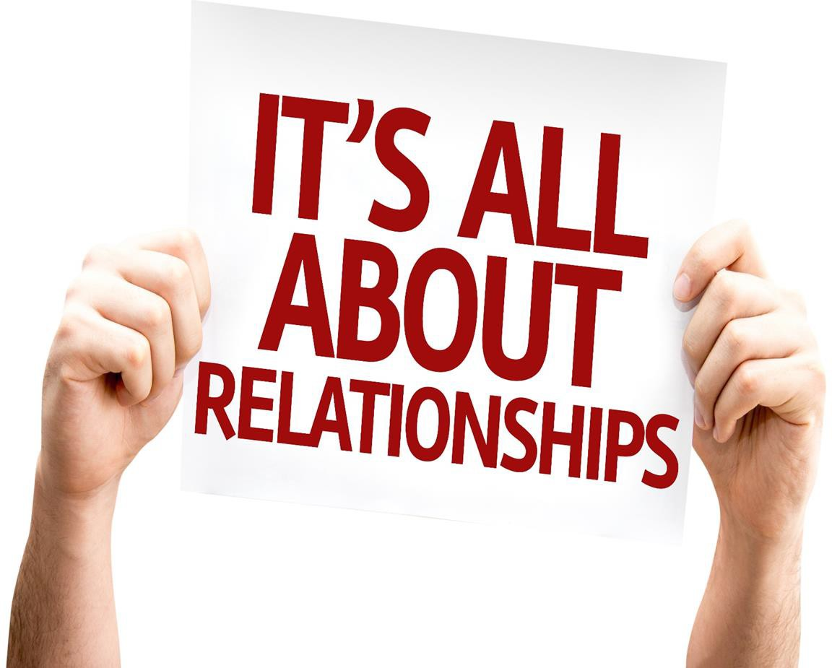
23. CONCLUSION
We hope that you are now ready to take a journey into the world of Improved Interpersonal Skills. Always remember that business is not numbers. Numbers are only the end-result of a successful network of happy customers, satisfied employees, enthusiastic co-workers, and a balanced lifestyle.
It is impossible to know what a person wants unless there is a conversation with him. The golden rule is to ask. Healthy relationships are built on healthy communication. Best of Luck!

