Slide 1

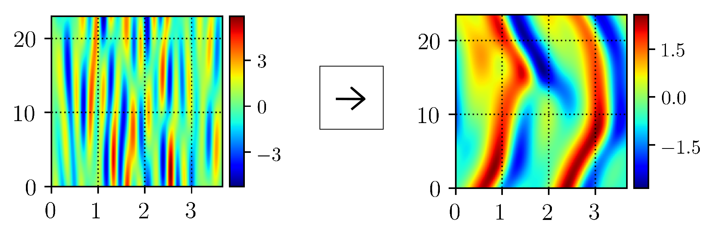

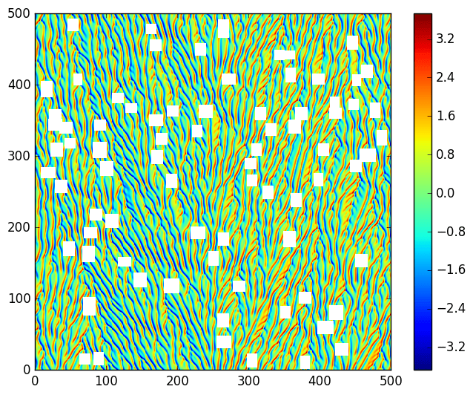
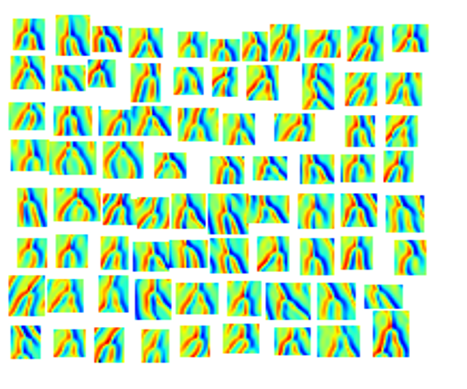
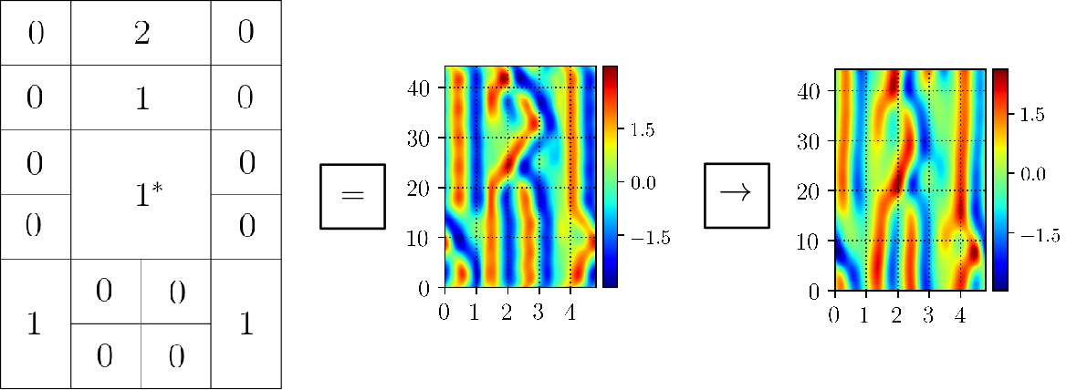
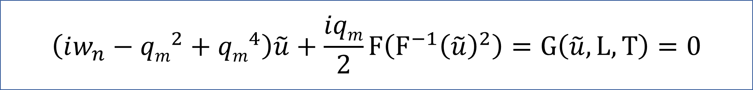
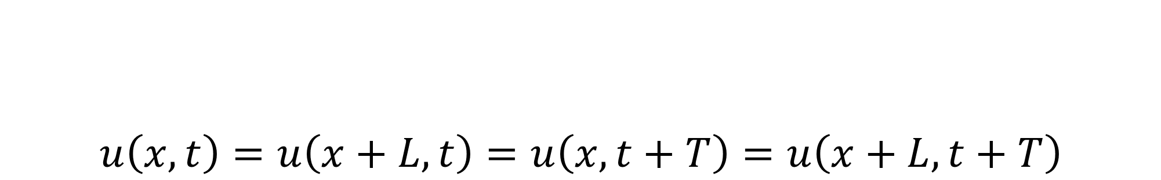

Using exact coherent structures to tile the infinite spacetime Kuramoto-Sivashinsky equation
Matthew Gudorf & Predrag Cvitanović
Georgia Institute of Technology
Abstract
Library of new solutions
Finding “exact coherent structures”[1] or ECSs has become an important approach to investigation of fluid dynamical turbulence. The reason for this is that ECSs can be used both to explain the observed spatiotemporal recurrences, as well as to compute dynamical averages for difficult computational problems such as turbulent pipe flow. This study offers a new perspective on the problem by offering a truly spatiotemporal foundation to description of turbulence.
Kuramoto-Sivashinsky Equation
Extracting “tile” solutions
$$u\left(x,t\right)=u\left(x+L,t\right)=u\left(x,t+T\right)=u\left(x+L,t+T\right)$$
Motivation via spatiotemporal recurrences
→
→
Frequent repetition of finite number of similar patterns across space and time. Initial value problems in chaotic systems are ill-posed problems [2].
→
Spatiotemporal symbolic dynamics
By using two-dimensional symbolic dynamics for spatiotemporal (“tile”) solutions, we generate initial conditions that converge to both new and known solutions.
s
Spatiotemporal Kuramoto-Sivashinsky Eqn.
$$\left(iw_{n}−{qm}^{2}+{qm}^{4}\right)\tilde{u}+\frac{iqm}{2}F\left(F^{−1}{\left(\tilde{u}\right)}^{2}\right)=G\left(\tilde{u},L,T\right)=0$$
Numerical Algorithms
Gluing ECS together
Solve nonlinear optimization problem,
$$I=\frac{1}{2}{\left|G\right|}^{2}=0$$
We solve this by using the Adjoint descent method [3] and a custom version of Newton’s method.
Contact
References
Matthew Gudorf
Georgia Institute of Technology
matthew.gudorf@gatech.edu
[1] F. Waleffe. (2001) Exact coherent structures in channel flow, J. Fluid. M. 435, 93—102.
[2] Wang et al. (2013) Towards scalable parallel-in-time turbulent flow simulations, Phys. Fluids 25, 110818.
[3] M. Farazmand, (2016) An adjoint-based approach for finding invariant solutions of Navier-Stokes equations, J. Fluid M. 795. 278—312.

