Slide 1

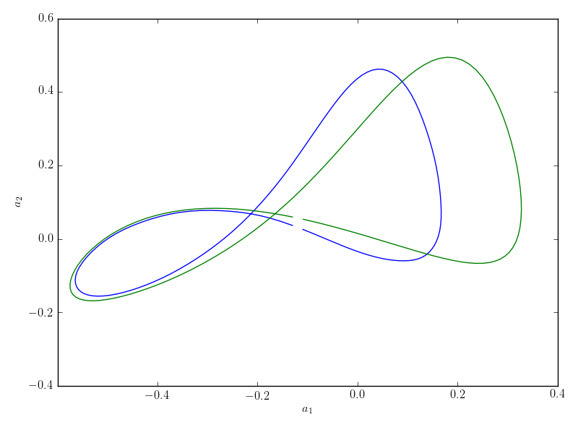


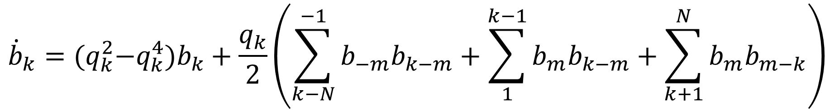
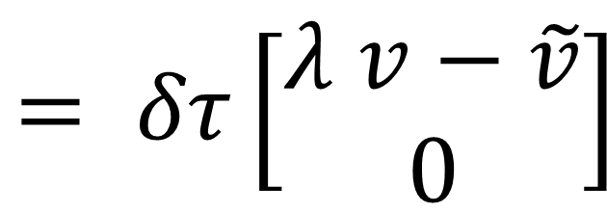
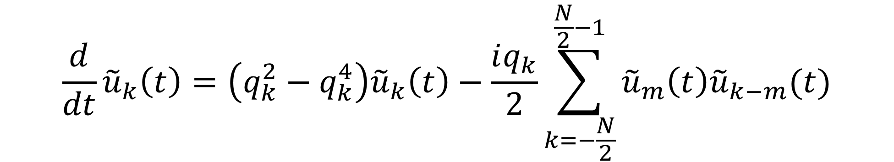



Tiling space-time: Spatiotemporal dynamics of the Kuramoto-Sivashinsky equation
Matthew Gudorf¹; Predrag Cvitanović¹
¹Georgia Institute of Technology
Abstract
Variational Newton Descent
Insights into dynamics of the 1D Kuramoto-Sivashinsky equation are often
helpful in developing intuition about turbulence in physical, 3D Navier-Stokes fluid flows [1]. In both settings there is by now strong evidence that the turbulent dynamics are shaped and organized by invariant solutions (equilibria, traveling waves, periodic orbits) and their invariant manifolds [2]. Among them, relative periodic orbits computed on spatially periodic domains, periodic in both in space and time, play important role in shaping structures that evolve in time while drifting in space[3]. One can view these invariant solutions as space-time rectangles that tile the spatiotemporal state space, infinite in both the time and the spatial directions. To demonstrate that in turbulence the space and time evolution can be thought of on the same footing, we evolve here in configuration space the Kuramoto-Sivashinsky states initiated on temporally periodic initial conditions. It turns out that such solutions are highly unstable, so new robust variational methods [4] will need to be developed in order to systematically locate and compute orbits (invariant 2-tori) doubly-periodic in both space and time.
Due to the repeller in space [5] we employ the variational Newton descent to locate periodic orbits. This is a variant of the damped Newton-Raphson method with step sizes being infinitesimally small [4]. The process deforms an initial guess loop into a periodic orbit by minimizing a cost functional which is a function of the difference between approximate tangents and the velocities. The corrections to the initial guess loop are found by solving the following differential equation, which can be rewritten in matrix form.
$$\frac{∂^{2}x}{∂s∂τ}−λA\frac{∂x}{∂τ}−v\frac{∂λ}{∂τ}=λv −\tilde{v}$$
$$\left[\begin{matrix}\hat{A} & −v \\ \hat{a} & 0\end{matrix}\right]$$
$$\left[\begin{aligned}δx \\ δλ\end{aligned}\right]$$
$$= δτ\left[\begin{aligned}λ v−\tilde{v} \\ 0\end{aligned}\right]$$
Kuramoto-Sivashinsky Equation
Rössler System
$$u_{t}=−\frac{1}{2}{\left(u^{2}\right)}_{x}−u_{xx}−u_{xxxx}$$
Variational Newton descent applied to the Rössler system,
Numerical Integration
We compare the numerical integration of a discretized time-periodic solution evolved in space with a discretized spatially periodic solution evolved in time, both taken from the shortest periodic orbit of the Kuramoto-Sivashinsky equation with system size L = 22.
Figure 3. Initial condition for periodic orbit search.
Figure 4. Periodic orbit found after application of
Newton descent.
Antisymmetric Kuramoto-Sivashinsky
Applying the variational Newton descent to locate periodic orbits of the antisymmetric subspace of the Kuramoto-Sivashinsky equation with L = 38.5.
This can be done by taking purely imaginary Fourier and the corresponding time evolution equation,
Figure 2. Spatial Integration of time periodic initial condition taken from the shortest periodic orbit of the Kuramoto-Sivashinsky equation.
$${\dot{b}}_{k}={(q}_{k}^{2}−q_{k}^{4}{)b}_{k}+\frac{q_{k}}{2}\left(\sum_{k−N}^{−1}{b_{−m}b_{k−m}}+\sum_{1}^{k−1}{b_{m}b_{k−m}}+\sum_{k+1}^{N}{b_{m}b_{m−k}}\right)$$
Figure 1. Time Integration of shortest periodic orbit of the Kuramoto-Sivashinsky equation
Time evolution equation
$$\frac{d}{dt}{\tilde{u}}_{k}\left(t\right)=\left(q_{k}^{2}−q_{k}^{4}\right){\tilde{u}}_{k}\left(t\right)−\frac{iq_{k}}{2}\sum_{k=−\frac{N}{2}}^{\frac{N}{2}−1}{{\tilde{u}}_{m}\left(t\right){\tilde{u}}_{k−m}(t)}$$
Spatial evolution equations
$$\frac{∂}{∂x}a_{k}^{(0)}=a_{k}^{(1)}$$
$$\frac{∂}{∂x}a_{k}^{(1)}=a_{k}^{(2)}$$
$$\frac{∂}{∂x}a_{k}^{(2)}=a_{k}^{(3)}$$
$$\frac{∂}{∂x}a_{k}^{(3)}=−iω_{k}a_{k}^{\left(1\right)}−a_{k}^{\left(2\right)}−\sum_{k=\frac{−N}{2}}^{\frac{N}{2}−1}{a_{m}^{(1)}a_{k−m}^{(0)}}$$
Superscripts indicate spatial derivatives. This type of redefinition is required to rewrite the spatial evolution equations as a system of equations.
Figure 5. Initial Condition (Blue) and periodic orbit (Green)
found with variational Newton descent. Projected onto first
and second Fourier mode coordinates.
Figure 6. Spatiotemporal plot of periodic orbit
from figure five.
Conclusion
The variational Newton descent is employed to find periodic orbits of the Rössler system as well as antisymmetric periodic orbits of the Kuramoto-Sivashinsky system, the next step is to apply this to the full-state space of Kuramoto-Sivashinsky to find periodic solutions with respect to the spatial equations and then finally apply this scheme to find invariant tori.
Contact
References
Matthew Gudorf
Georgia Institute of Technology
Email: matthew.gudorf@gatech.edu
[1] P. Holmes, J.L. Lumley and G. Berkooz (1996) Turbulence, Coherent Structures, Dynamical Systems and Symmetry, Cambridge Univ. Press.
[2] B. Hof et al. (2004) Experimental observation of nonlinear traveling waves in turbulent pipe flow, Science 305, 1594-1598
[3] P. Cvitanovic, R.L. Davidchack and E. Siminos (2014) On the state space geometry of the Kuramoto-Sivashinsky flow in a periodic domain, SIAM
J. Appl. Dyn. Syst. 9, 1-33.
[4] Y. Lan and P. Cvitanovic (2004) Variational method for finding periodic orbits in a general flow, Phys. Rev. E 69, 016217
[5] S. Lepri and A. Politi and A. Torcini (1996) Chronotopic Lyapunov analysis. (I) a detailed characterization of 1D Systems. J. Stat. Phys. 82 1429-
1452.

