Slide 1
Manifold learning of Poincaré sections
Evangelos Siminos
University of Gothenburg

Slide 2
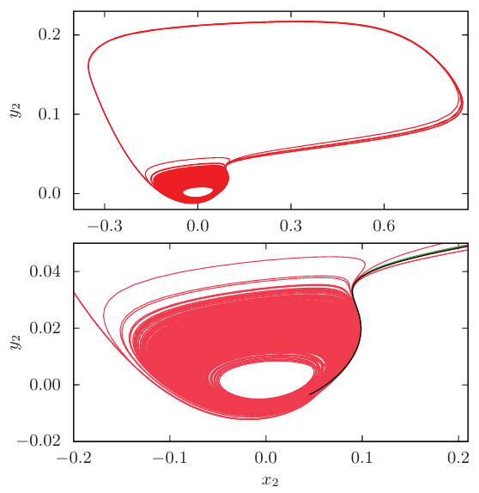
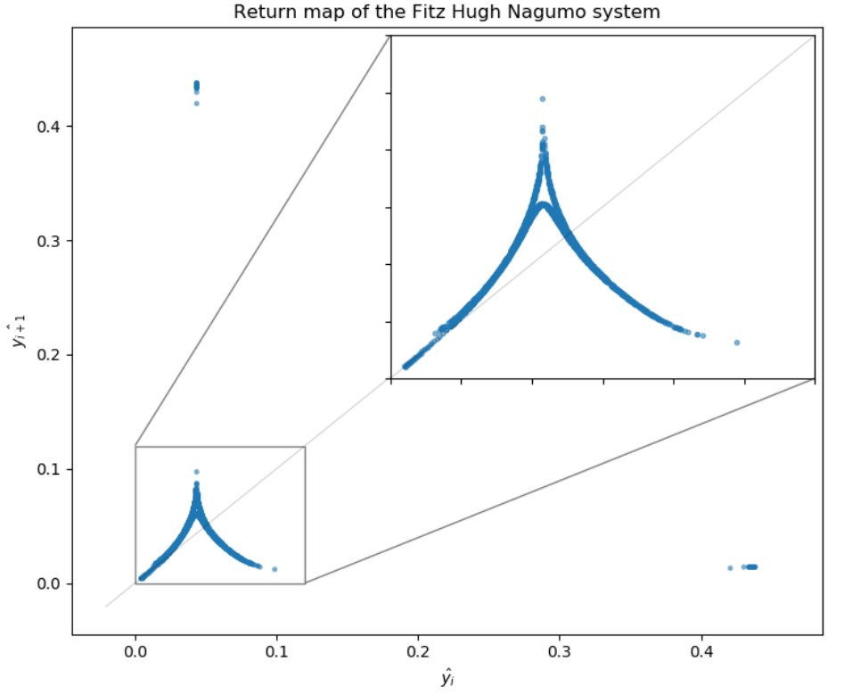
Motivation
G. Ansmann, R. Karnatak, K. Lehnertz, and U. Feudel
Phys. Rev. E 88, 052911 (2013)
Coupled FitzHugh-Nagumo oscillators
State space topology → extreme events?
Caroline Bükk, Oscar Johansson, Alexander Jonsson
BSc thesis, Chalmers University of Technology, 2019
Can manifold learning help?
Try in Kuramoto-Sivashinsky

Slide 3
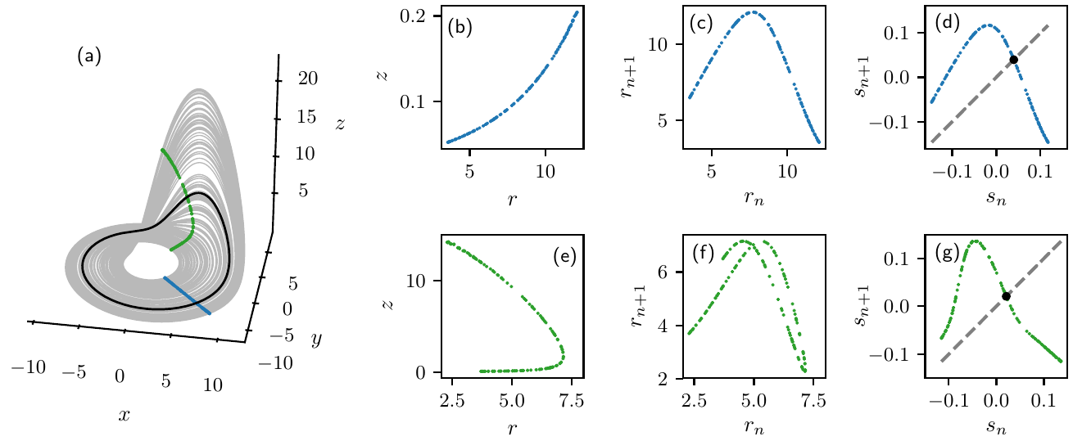
Problems with Poincaré sections
Rössler flow (ChaosBook.org, Chapter 3)
Poincaré sections at θ=π/2, θ=-π/2
Bad choice of section/parameterization → return map is not single-valued
In high-dimensions: usually no obvious parameterization
Intrinsic parameterization:
  Length along unstable manifold of equilibrium or PO (Lan & Cvitanovic PRE 2008).
  Manifold learning?

Slide 4
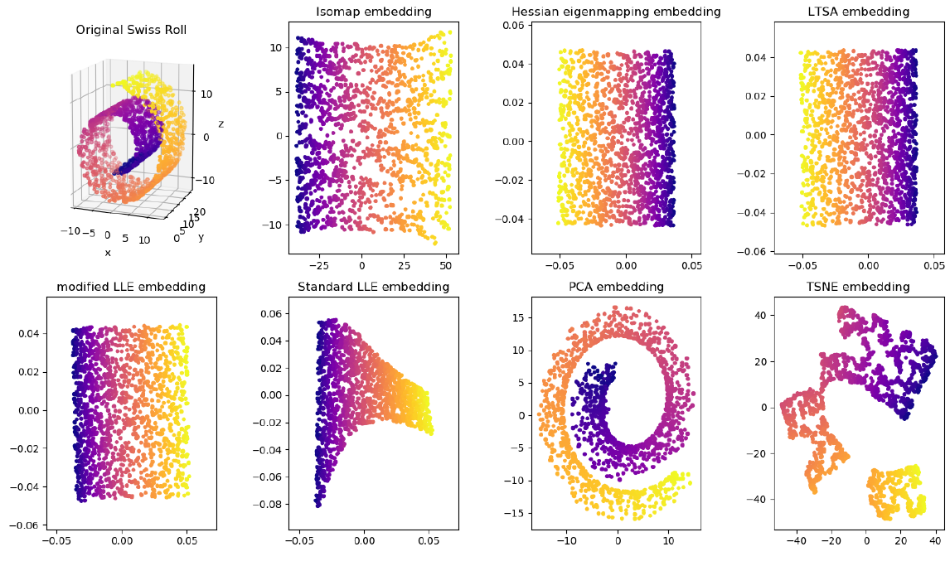
Manifold learning
n-dimensional manifold M embedded in D-dimensional space
Manifold learning re-embedds M in d-dimensional space (d≪D)
Most useful:
Isomap: Tenenbaum et al, Science 290, 2319 (2000)
Locally Linear Embedding: Roweis and Saul, Science 290, 2323 (2000)

Slide 5
Locally Linear Embedding (LLE)
Assume manifold is locally linear.
N data points (NxD matrix)
Find k closest neighbors for each point
Reconstruct each point from its neighbors (compute weights for local linear transformations)
Minimize reconstruction error in the embedding space in order to find the low dimensional coordinates (solve NxN sparse eigenproblem)

Slide 6
Isomap
Isomap is similar* but needs to compute geodesic distance from each point to all other points (NxN dense matrix)
I use the python implementations in
scikit-learn
Complexity:
  LLE
  Isomap

Slide 7
Manifold learning in dynamical systems?
E. Bollt, Int. J. Bif. Chaos 17, 1199 (2007)
  Uses Isomap to approximate attractors of several dynamical systems
  This is expensive since we need to sample along the flow
  It is not clear that we gain any insight on the topology
Topology can be encoded in return maps: manifold learning on the Poincaré section is all we need!

Slide 8
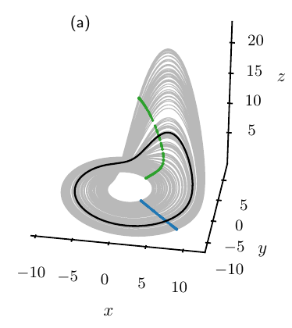
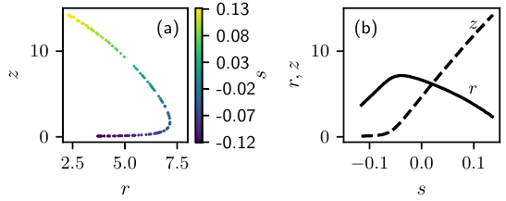
Learn Poincaré section for Rössler
Use LLE to re-embedd the points of intersection to d=1, intrinsic coordinate s
Map (z,r) → s
For points not in the training set:
  Find closest neighbors, compute reconstruction weights, compute s
  (provided in sklearn)
Inverse map s → (z,r)
For values of s not in the training set:
  Use linear interpolation to compute (z,r)

Slide 9
Learn Poincaré section for Rössler
Return map in s
In both (d) and (g) we have the same kneading sequence up to length 9:
K = 100101111

Slide 10
Kuramoto-Sivashinsky equation

Slide 11
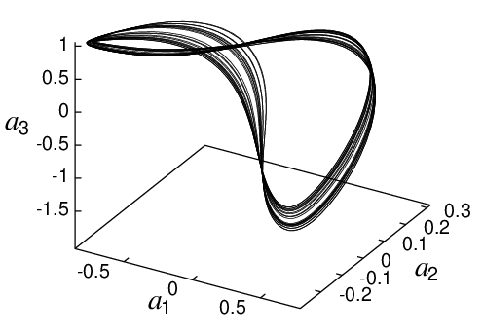
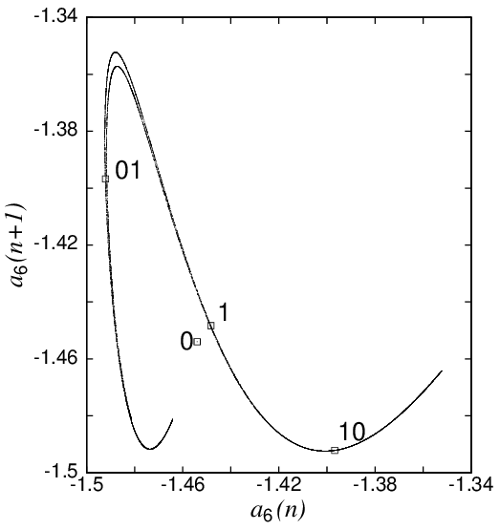
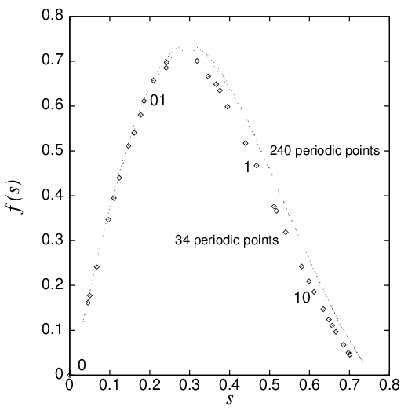
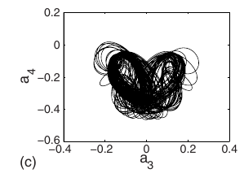
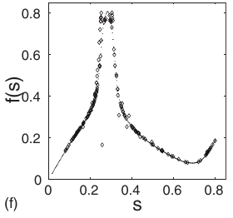
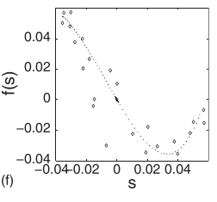
Kuramoto Sivashinsky return maps
Christiansen et al, Nonlinearity 10 55 (1997), ν=0.02991 (or L=36.3, ν=1)
Lan and Cvitanovic, PRE 78 026208 (2008), ν=0.0266 (or L=38.5, ν=1)

Slide 12
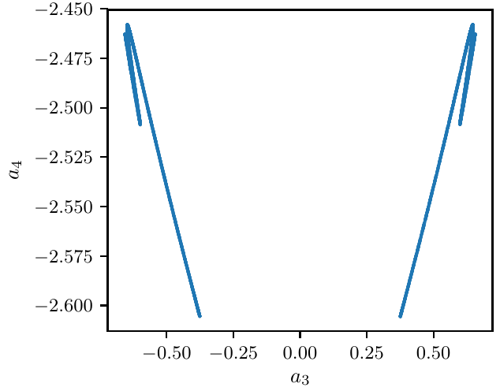
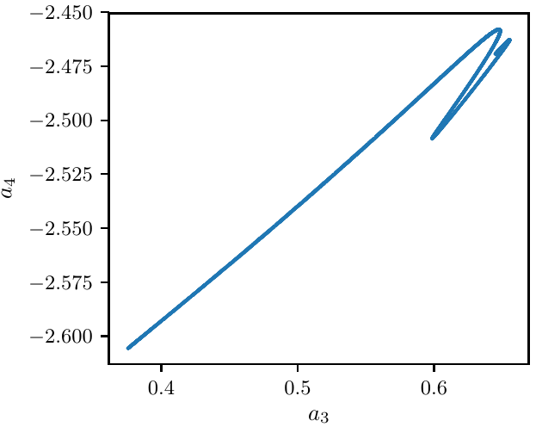
KS ν=0.0299 (or L=36.34, ν=1)
Full space
Fundamental domain

Slide 13
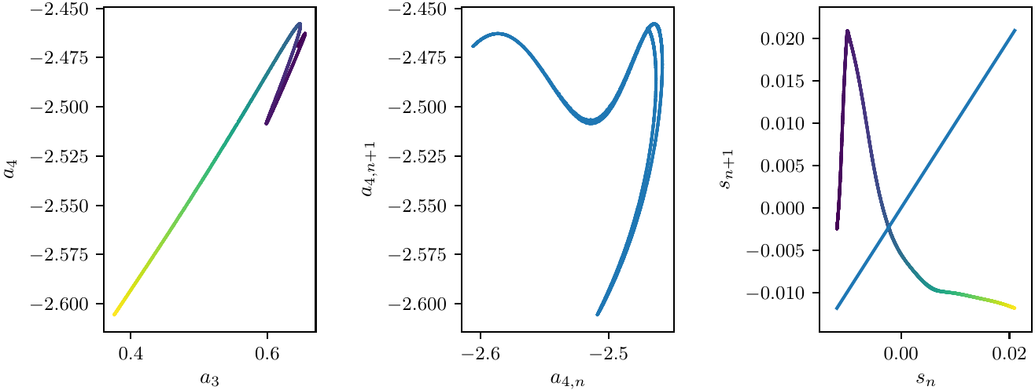
Apply LLE
Choose combination of integration time (~number of samples N) and
number of neighbors k in LLE such that we only consider neighbors
‘along the attractor’ and not ‘accross the attractor’.

Slide 14
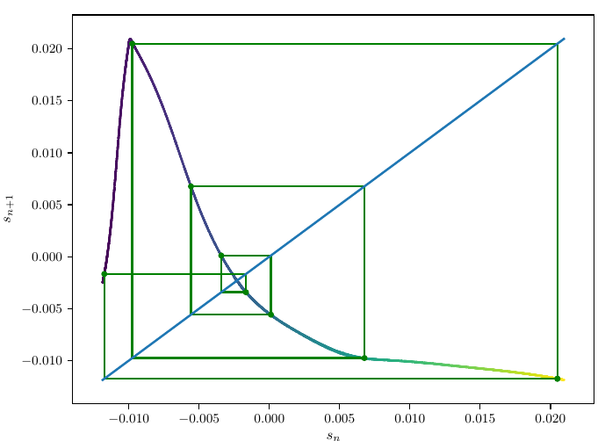
Periodic orbits
Use kneading theory to determine admissible orbits
Use interval arithmetic to determine intervals that bound periodic points
(Refine these by bisection of the return map)
Transform points back to state-space: guess for PO
Solve by scipy’s solve_bvp (collocation solver)
Project points back to s to verify symbolic dynamics
Shown: 01111111

Slide 15
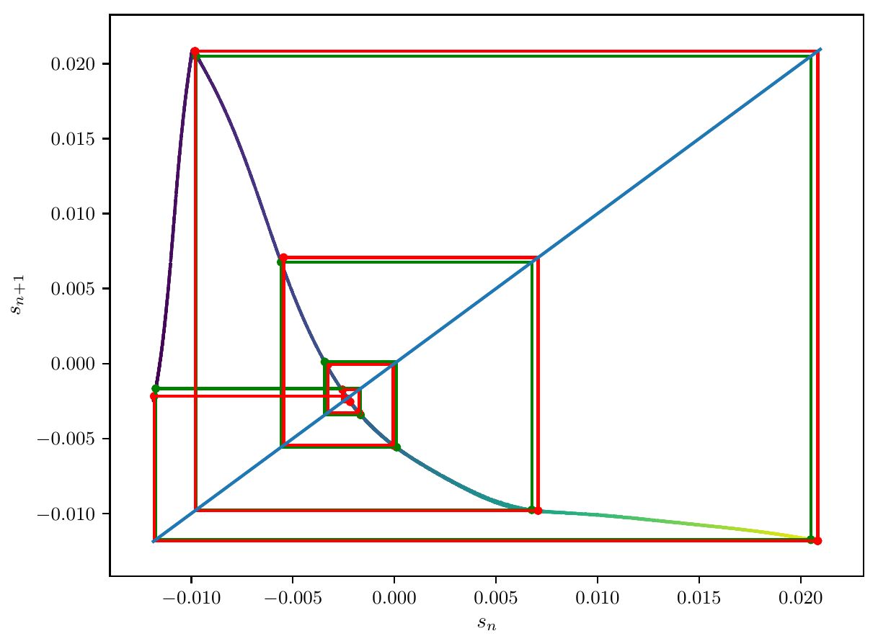
Periodic orbits
At length 10 kneading theory admits orbits that do not exist
Shown: 01111111 (red)
Shown: guess for 0111111111 (green)
Found ‘‘all’’ orbits up to length 18

Slide 16
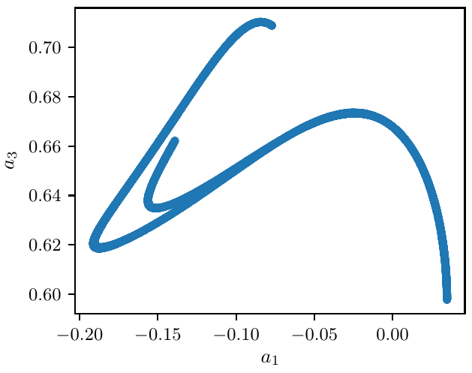
KS ν=0.02973 (or L=36.44, ν=1)

Slide 17
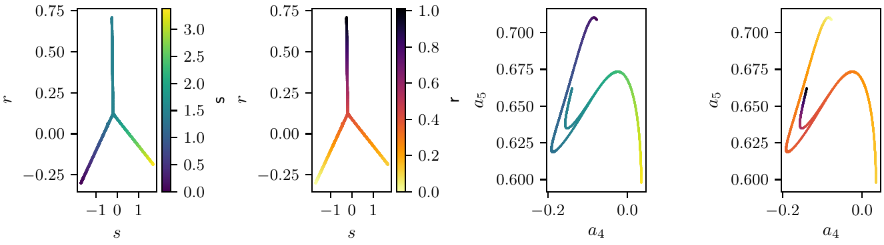
Isomap with d=2

Slide 18
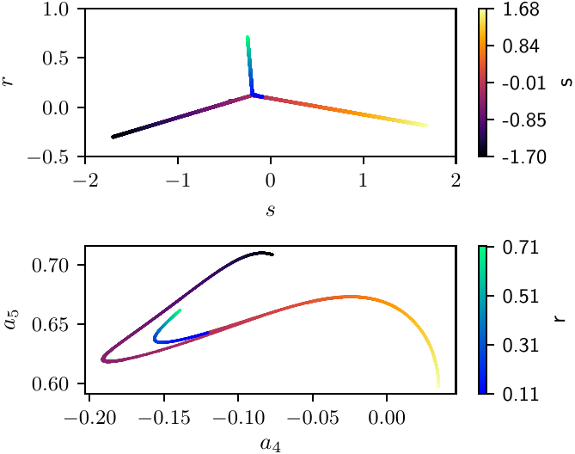
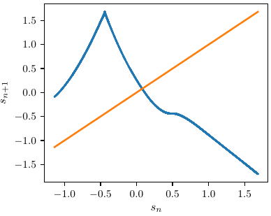
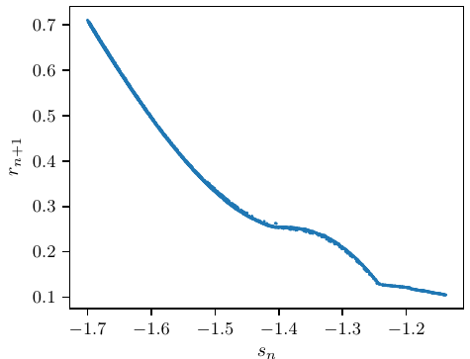
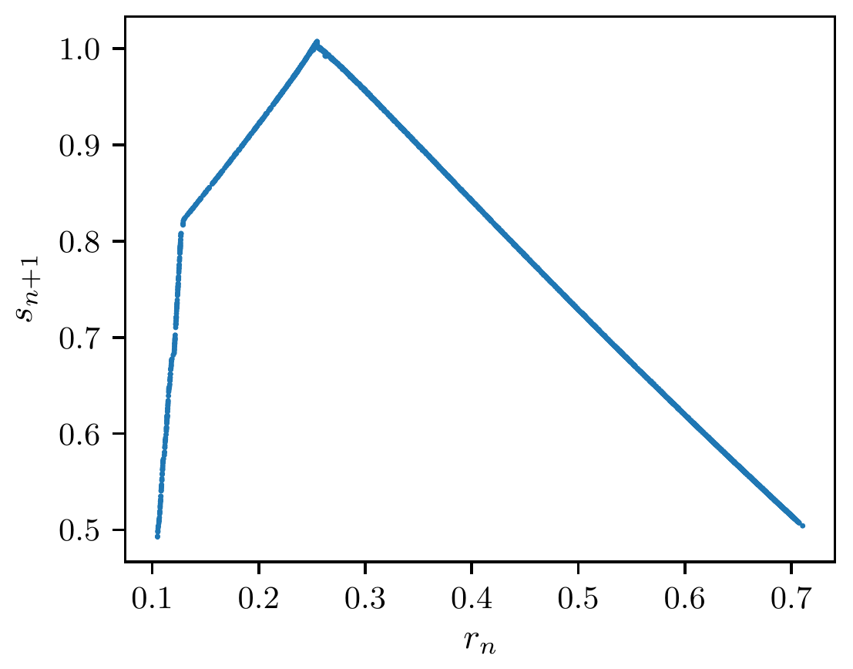
Isomap 2D to (1+1)-D
Separate the two branches:
s-manifold
r-manifold
Simplest choice r>R
Maps: s→ s, s→ r, r→ s
Baby version of Atlas proposal:
Cvitanovic et al, Chaos 22, 047506 (2012)

Slide 19
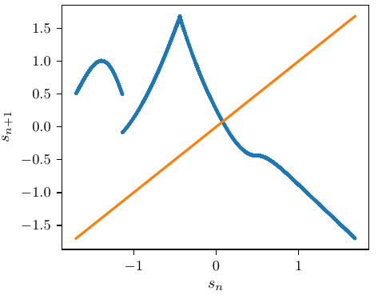
From 2D to (1+1)-D to 1D
Combine the maps by
function composition

Slide 20
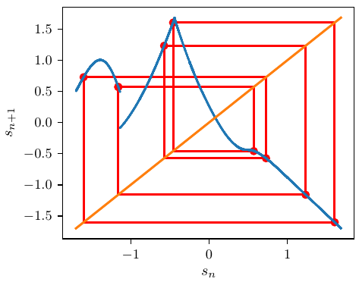
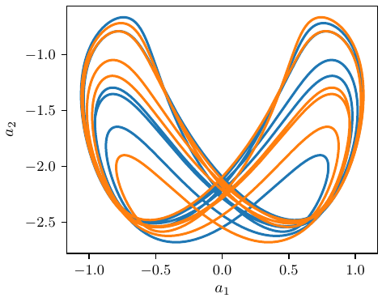
Periodic orbits

Slide 21
Ongoing and future work
Apply kneading theory for the multi-modal map
Compute averages by cycle expansions
Go back to the original problem of coupled oscillators
Refine the return maps by using either periodic points found or unstable manifolds
of periodic points
Use more efficient versions of Isomap (Landmark Isomap)

