Slide 1
Online Quiz Game An Asp.net application created by: Subham Banerjee & Chandraveer Kunwar

Slide 2
Specifications
Admin and Guest Users
Login and Registration Page
Admin Dashboard for management of questions
Quiz page with True or False Question / Answers
Terms and Conditions Download option
Display of Quiz Results

Slide 3
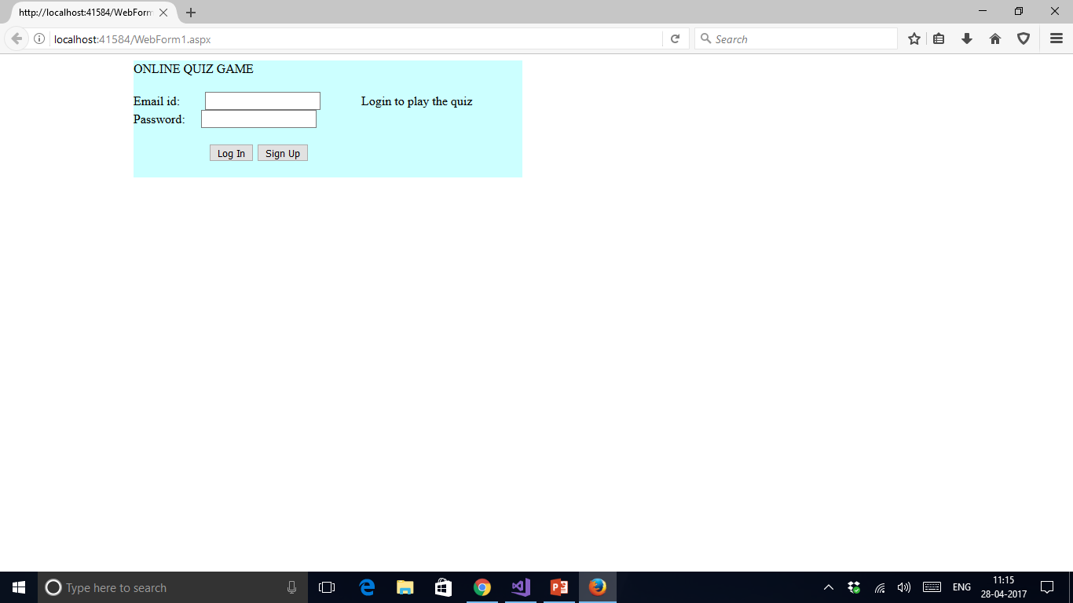
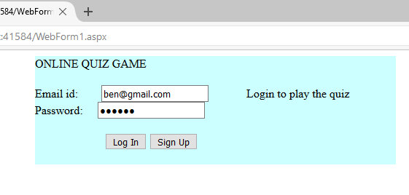
The Login Page ( Sessions have been used)

Slide 4
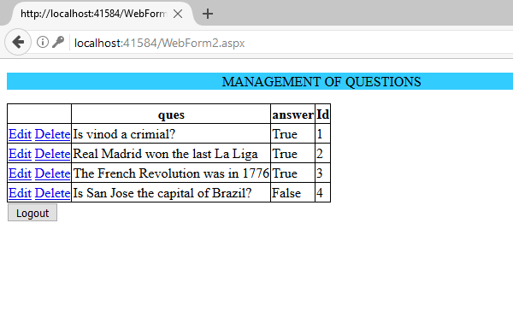
Admin Dashboard

Slide 5
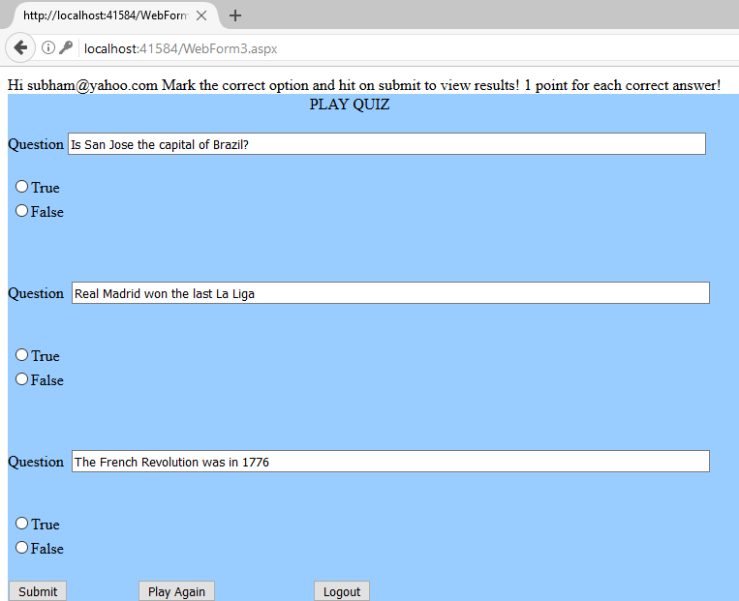
Quiz Page for Guests

Slide 6
Lets try out a demo of our quiz game! Play as well as enjoy admin privileges!

