Slide 1








Main header

Slide 2








icons

Slide 3
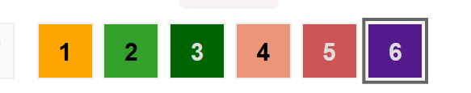
Foreshift and backshift
backshift
foreshift
before
planned
after
timeshift
before
planned
after

Slide 4

Foreshift and backshift
backshift
foreshift
before
planned
after
backshift
foreshift
before
planned
after

Slide 5
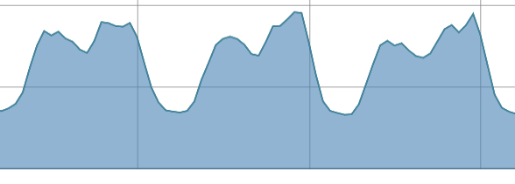
Fore and back, illustrated
Electric vehicles
backshift
foreshift
Heat pumps
Baseline demand
Baseline demand

Slide 6
Fitting curve
consumption
production
price
fitting formula

Slide 7
Fitting curve
demand
production
fitting formula
price
grid capacity

Slide 8
eflows architecture
Other packages can generate visualizations ready to use with the shiny framework
The exposed part of the package (functions and classes) allow web integration through HTTP APIs
Visualization
and dahsboarding
APIs and Integration with web infrastructure
eflows.viz
R6 classes and methods
Object-oriented approach to arrange and manipulate data in an standardized way
R functions
Exposed R functions wrapping C++
C++ core, for performance
C ++ algorithms

Slide 9
Functional approach is not enough
R functional approach is ideal to iterate over data
Building objects of interrelated data with self-contained methods helps to manage project entropy
Typical R code
eflows
Immutability
There is a distinction between "core" functions, written in C++, and the R functions, higher level.
The C++ functions require to pass each argument in an individual way, while the R functions are made to work with methods, and are more directly executable.
C++ functions are named in camelCase and suffixed by Cpp, to let clear that are the "core" functions.
Functional and OO design: the objects "are stuff" that are subject to functions. Manage project entropy
Nesting: Objects&methods(R functions(Cppfunctions())
Then, the objects are manipulated by other functions.
Objects:
- Use functions to modify objects, or to "exercise" something over objects
- Use methods so you "extract something through an object", or to get a result from an object that doesn't depend of other stuff except the fields of an object.
Most probably, more than objects what you want to do is to create active bindings so you can "extract" something while computating it.
At least you can make the methods of a call "idempotent". If you call them twice, it is ok, in this way the object behaves a bit in a "quasifunctional" way.
Functional paradigm
Object - Oriented paradigm

Slide 10
OOP
Inheritance and encapsulation
FP
Separation of data and functions and high level of abstraction

Slide 11

distribute()
input
return
- input
vol
- return
soc
flow
flow
soc
left
Energy / Power source
Storage

Slide 12
6h
12h
12h
6h
2h
2h
“I am not in a hurry”
“Just a minimum charge in case of an emergency”
“My battery is huge. Charge whenever it is better”

Slide 13
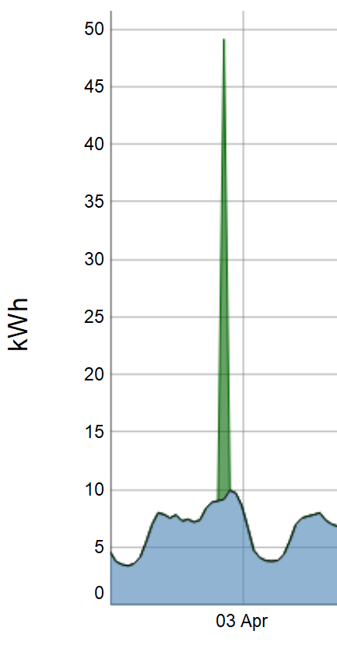
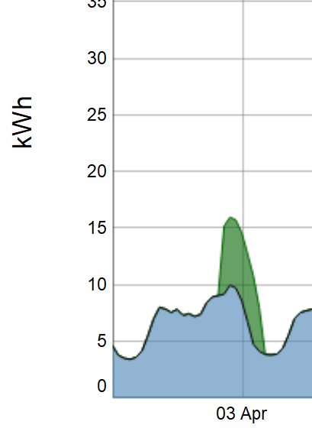
The instant demand is limited by the capacity to provide and take energy
2h
“I need my car charged as soon as possible”

Slide 14
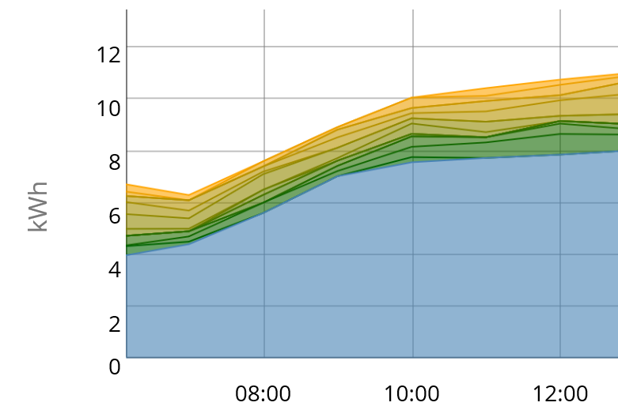
flex_15
…
flex_4
flex_3
flex_2
flex_1
fixed_demand

Slide 15
flex_15 will become flex_14. It can be re-allocated, but with one hour less of flexibility
15h
…
4h
flex_1 always has to be resolved in the next timestep (it becomes solid demand)
3h
At every timestep, the allocated flexible demand is reduced by one
2h
1h
Solid demand

Slide 16




Electric Vehicle API:
Preferences of charge.
State of charge and capacity.
Algorithm
EV and charging point:
How fast can charge the EV
On new connection, the preferences recalculate the flexible demand
Periodically, the server updates the charging station about how fast it should charge the EV

Slide 17
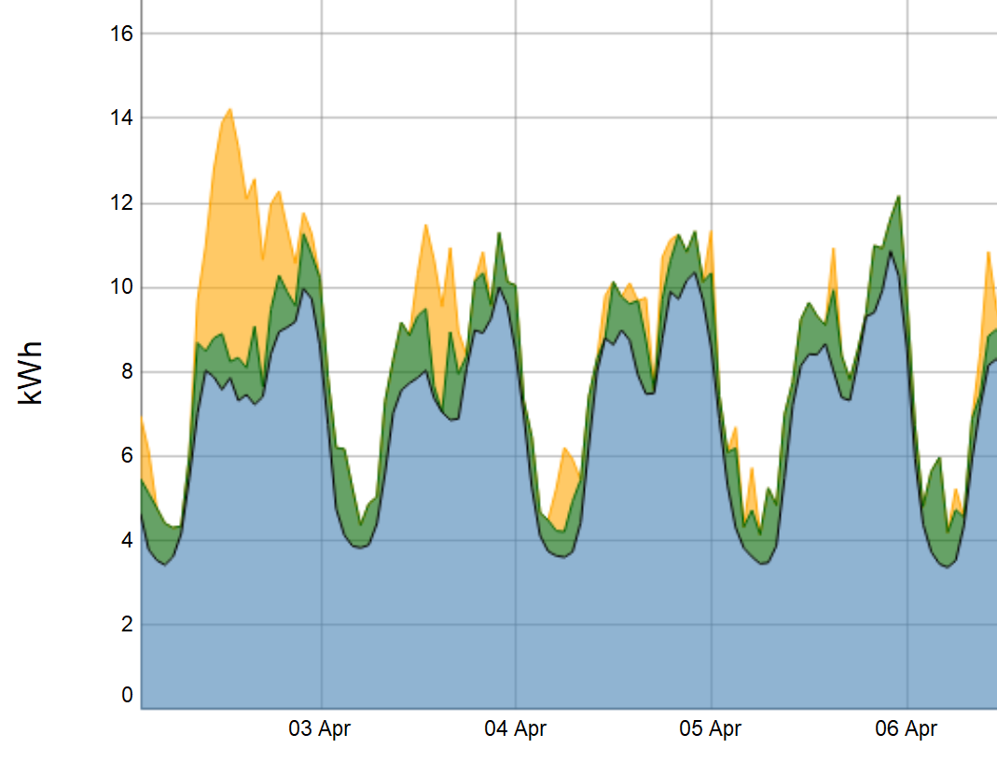
?
This is the fitting curve. So far it is the demand, but it could be anything
Electricity prices
Solar production
Grid congestion
Any combination of several factors

Slide 18
fit = ~ 1* .demand_fixed
fit = ~ 1* .demand
Portions of demand shall be allocated where the fitting curve is the lowest
The flexible demand is not considered. Therefore, the point where the new demand is allocated remains the same
The already allocated flexible demand is considered; therefore there is a new minimal point in the fitting curve
The demand tends to accumulate
The demand tends to “flatten out”

