Slide 1
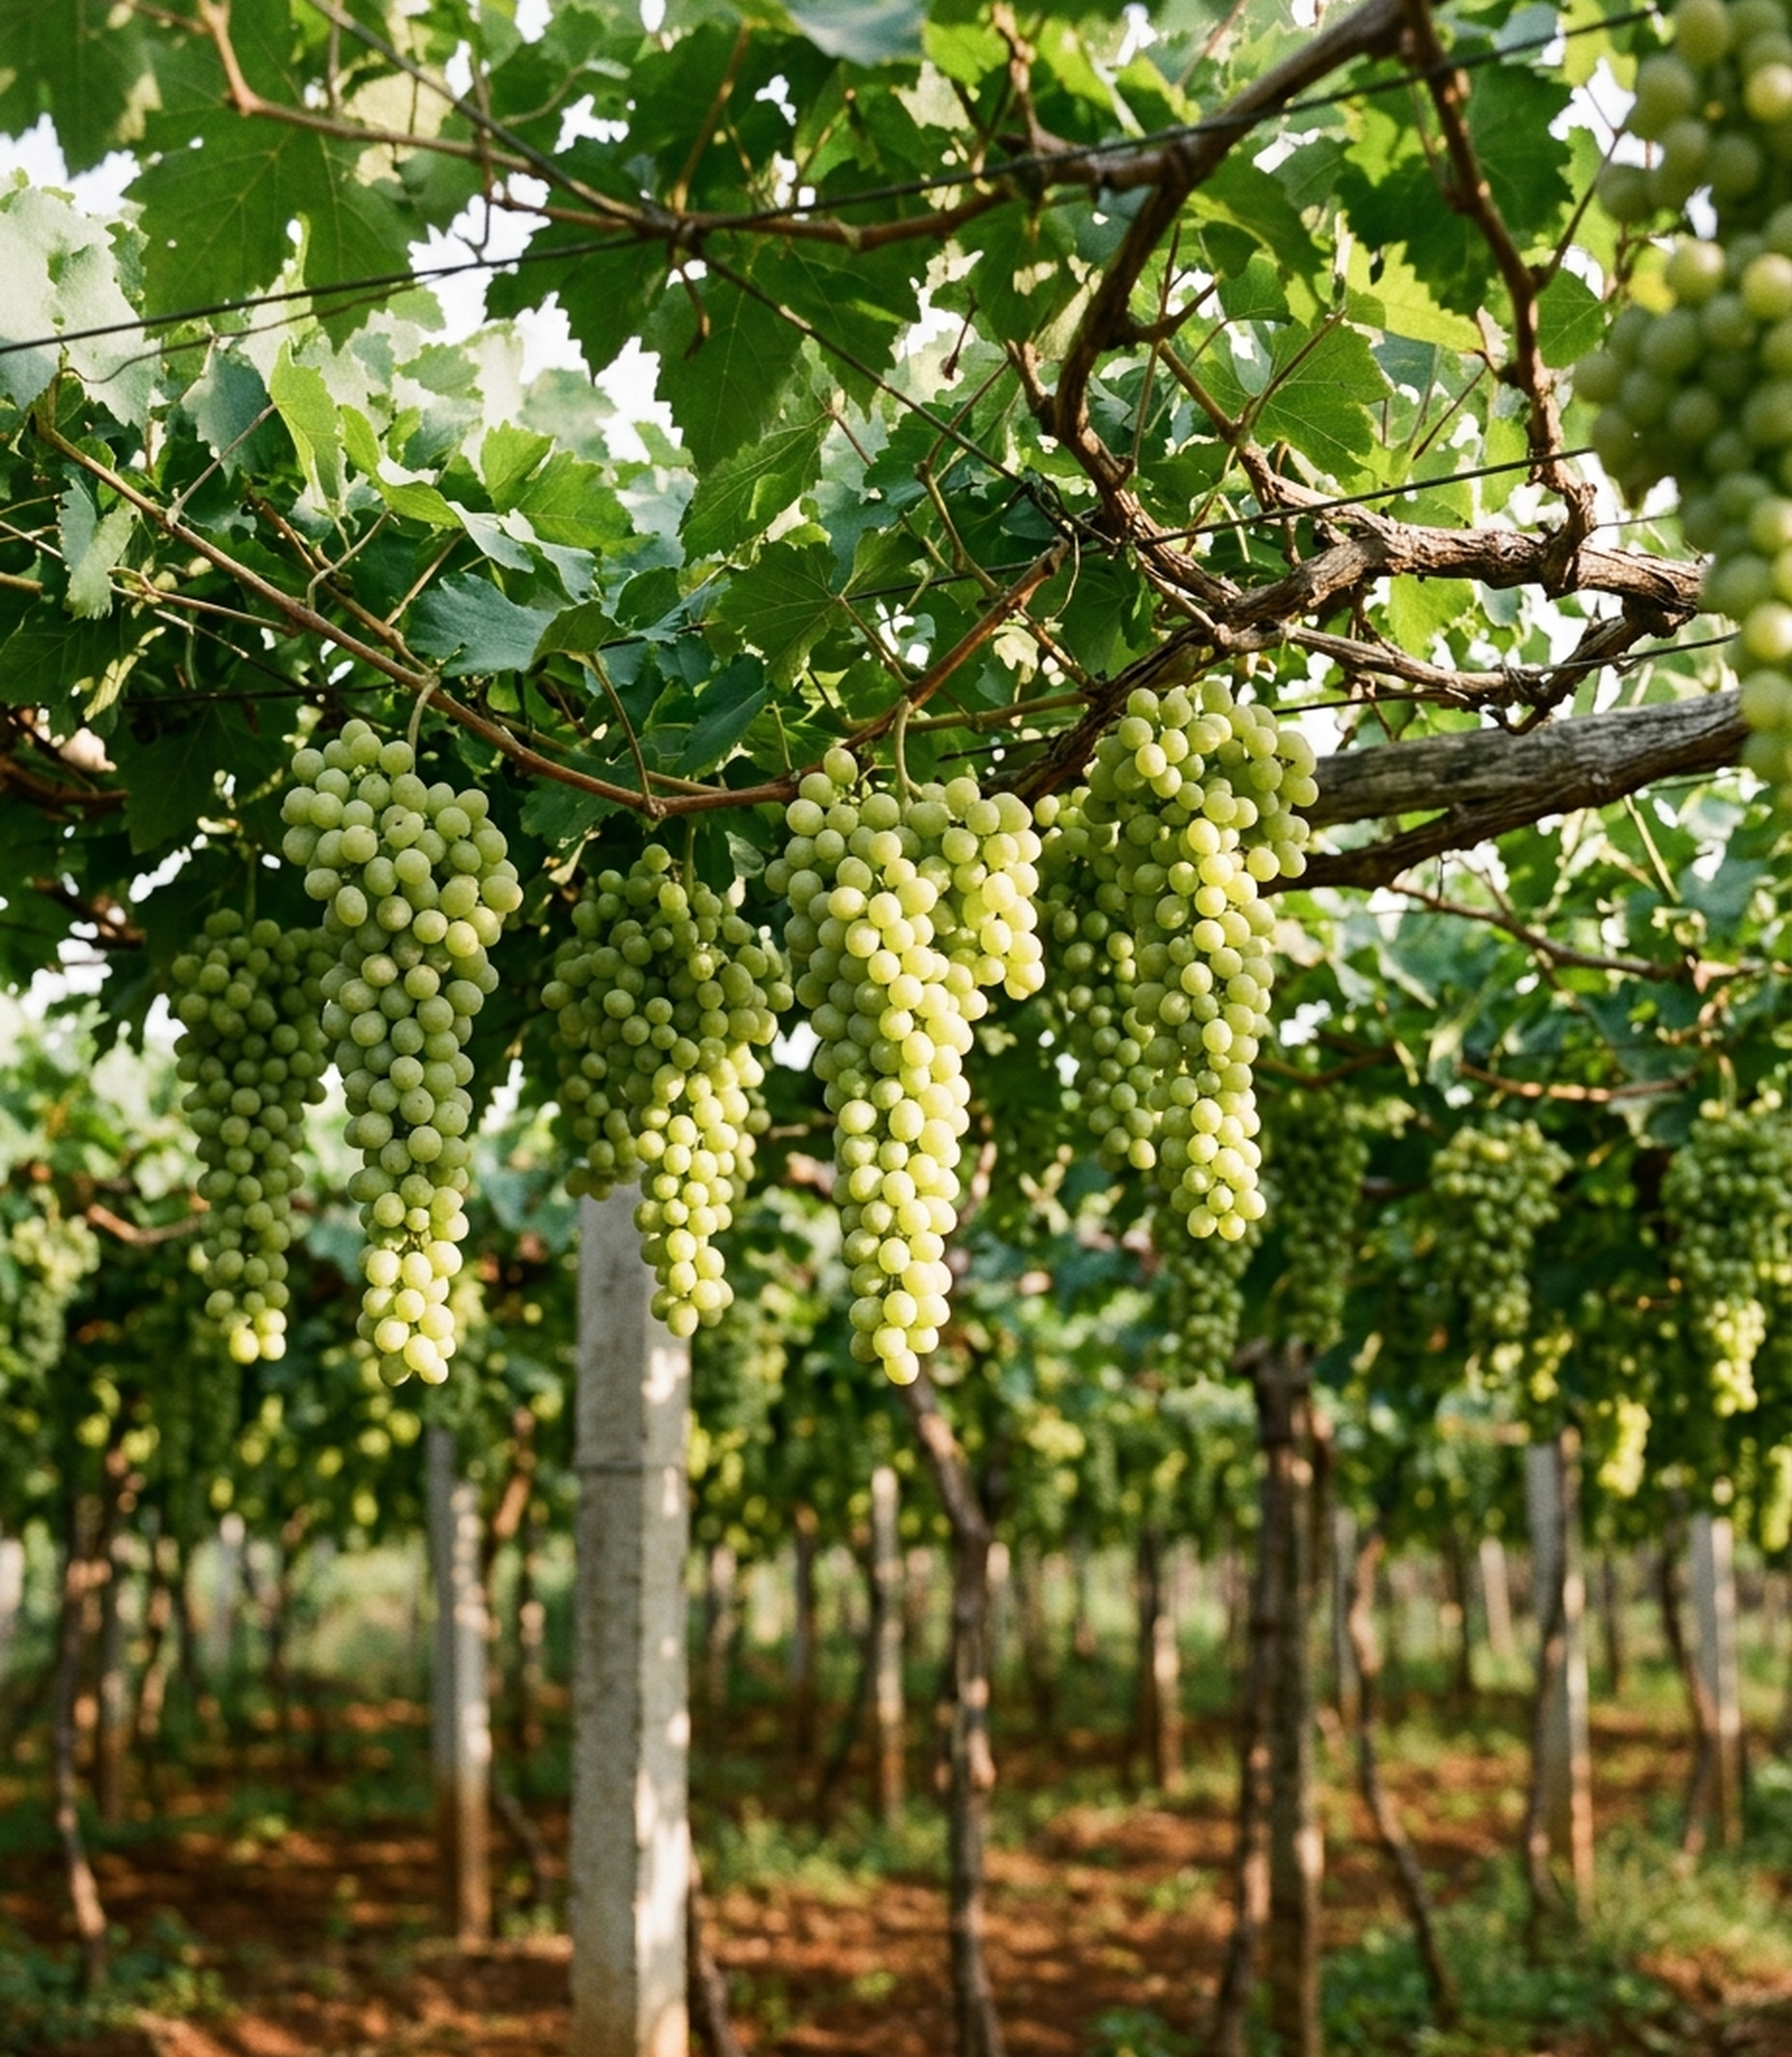
STUDY / RESEARCH · ARUNPATIL LABS
From Vine to Raisin
The Full Grape Growth Cycle & Raisin Formation
A comprehensive 173-day viticulture systems research record documenting pruning, bud-break, phenological stages, and precision shade-drying on a commercial overhead trellis vineyard at Basavana Bagevadi & Sindagi Taluk, Vijayapura, Karnataka.
Research Organization: ArunPatil Labs (Applied AI & Systems ML)
Principal Investigator: Arun Patil
Official Web Archive: arunpatillabs.com
Study / Research · ArunPatil Labs · Viticulture & Precision Agro-Tech · arunpatillabs.com

Slide 2
AGROTECH FIELD RECORD · 2025–26 SEASON
From Vine to
Raisin
The full grape growth cycle and raisin formation, documented in our vineyard at Basavana Bagevadi, Vijayapura, Karnataka.
October 2025 – April 2026
Built from 29 field photos, videos and CCTV clips
From Vine to Raisin · Vijayapura vineyard, 2025–26 season · arunpatillabs.com 1

Slide 3
The season at a glance
Tractor (Tarzan)
GPS Map telemetry logged: 1 Nov 2025
586208, Karnataka, India
Location: Basavana Bagevadi, Vijayapura district, Karnataka. India's premier raisin belt, offering a dry winter ideal for shade drying.
Crop: Green seedless table/raisin grapes on an overhead trellis with drip irrigation (Thompson Seedless clone).
147
days from the post-pruning spray (18 Oct) to harvest (14 Mar)
27
days from that spray to full flowering (14 Nov)
~4 : 1
kg of fresh grapes needed for 1 kg of raisins (typical)
173
days from the spray to finished golden raisins (9 Apr)
From Vine to Raisin · Vijayapura vineyard, 2025–26 season · arunpatillabs.com 2

Slide 4
Nine stages, one season
18 Oct
1
Fruit pruning &
bud-break spray
12 Nov
2
Bunch
emergence
14 Nov
3
Flowering
15 Jan
4
Berry
development
14-15 Feb
5
Ripening
18 Feb
6
Drying shed
built
14 Mar
7
Harvest &
pretreatment
Mar-Apr
8
Shade drying
on racks
9 Apr
9
Finished
raisins
Growth cycle: About 4 months from fruit pruning to ripe bunches, all completed within one dry winter season.
Raisin formation: About 4 weeks from vine harvest to finished, sorted, and packed raisins in the shade shed.
From Vine to Raisin · Vijayapura vineyard, 2025–26 season · arunpatillabs.com 3

Slide 5
PART 1
The growth cycle
From a pruned, leafless vine to ripe, sugar-rich bunches in about 150 days.
From Vine to Raisin · Vijayapura vineyard, 2025–26 season · arunpatillabs.com 4

Slide 6
A vineyard pruned twice a year
Overhead Trellis & Canopy Management
• Rows with drip lines and green inter-row cover hold soil moisture in the semi-arid Deccan plateau.
• Vines are trained overhead (bower system) to maximize solar interception while shading ripening bunches below.
• Two distinct pruning passes govern the annual cycle: foundation vegetative growth and fruit bud activation.
A April: foundation pruning
Canes are cut back hard after harvest. New vegetative canes grow vigorously through the summer monsoon to establish fruit buds for the coming season.
B October: fruit pruning
Mature canes are pruned back to fruitful node positions. This initiates the commercial fruiting cycle that culminates in the March harvest documented in this deck.
From Vine to Raisin · Vijayapura vineyard, 2025–26 season · arunpatillabs.com 5

Slide 7
STAGE 1 · 18 OCT 2025
Fruit pruning and bud-break spray
• Bare canes
The vine has no leaves. Each cane is precision-cut to the fruitful buds that will carry this season's bunches.
• Bud-break spray
A growth regulator (hydrogen cyanamide) is applied immediately so all dormant buds sprout simultaneously and evenly.
• Why it matters
Even sprouting lines up subsequent flowering, berry sizing, and ripening so the entire block can be harvested together.
• Ground cover
Green ground cover and weeds between rows help hold soil moisture and buffer against intense solar heating.
From Vine to Raisin · Vijayapura vineyard, 2025–26 season · arunpatillabs.com 6

Slide 8
FIELD RECORDING INSTRUMENTATION
Tech on the farm
01
Tractor GPS
Maps each pass and marks the farm block boundary across all 51 vineyard rows.
02
Tractor Camera
Mounted action camera records spray and tillage passes row by row to build baseline visual logs.
03
Fixed CCTV
Time-stamped cameras cover the vineyard rows and drying shed yard 24/7.
04
Dated Visual Log
Synchronized imagery, GPS coordinates, and CCTV feeds form the empirical ground-truth dataset for this study.
From Vine to Raisin · Vijayapura vineyard, 2025–26 season · arunpatillabs.com 7

Slide 9
STAGE 2 · 12 NOV 2025
Bunch emergence
• ~25 Days Post-Spray
Each new cane shoot carries one or two compact flower clusters (inflorescences) with curling tendrils.
• Hundreds of Flower Buds
Each emerging cluster holds hundreds of closed flower buds, which will pollinate and develop into individual berries.
• Canopy Thinning Work
Extra vegetative shoots are manually thinned so sunlight and air circulation reach the developing clusters.
From Vine to Raisin · Vijayapura vineyard, 2025–26 season · arunpatillabs.com 8

Slide 10
STAGE 3 · 14 NOV 2025
Flowering and berry set
• Full Bloom (~27 Days)
Flower caps (calyptras) fall off and pollen is shed, approximately 27 days after the bud-break spray.
• Berry Set
Fertilised flowers swell into tiny green berries (2–3 mm), establishing the cluster's potential crop load.
• Bunch Shaping & GA3
Growers apply gibberellic acid (GA3) to elongate the cluster rachis and thin berries, ensuring loose bunches that dry evenly.
From Vine to Raisin · Vijayapura vineyard, 2025–26 season · arunpatillabs.com 9

Slide 11
STAGE 4 · 15 JAN 2026
Berry development
• Rapid Cell Division & Water Fill
Berries swell rapidly—first by cell division, then by cells expanding and filling with water and tartaric acid.
• Green & Firm Physiology
Berries remain deep green, firm, and acidic with minimal soluble sugars during this vegetative sizing window.
• Canopy Shade Protection
Bunches hang under the overhead leaf canopy, preventing direct solar sunburn while drip lines maintain soil tension.
From Vine to Raisin · Vijayapura vineyard, 2025–26 season · arunpatillabs.com 10

Slide 12
STAGE 5 · 14–15 FEB 2026
Ripening: sugar builds, acid falls
• Veraison (Translucence)
Berries soften and turn from opaque deep green to a translucent golden yellow-green.
• Biochemical Transition
Soluble sugars accumulate rapidly while titratable acids drop precipitously.
• Harvest Trigger (°Brix)
Harvest timing is governed strictly by sugar concentration, tracked via refractometer (°Brix) toward the 22–24° target.
From Vine to Raisin · Vijayapura vineyard, 2025–26 season · arunpatillabs.com 11

Slide 13
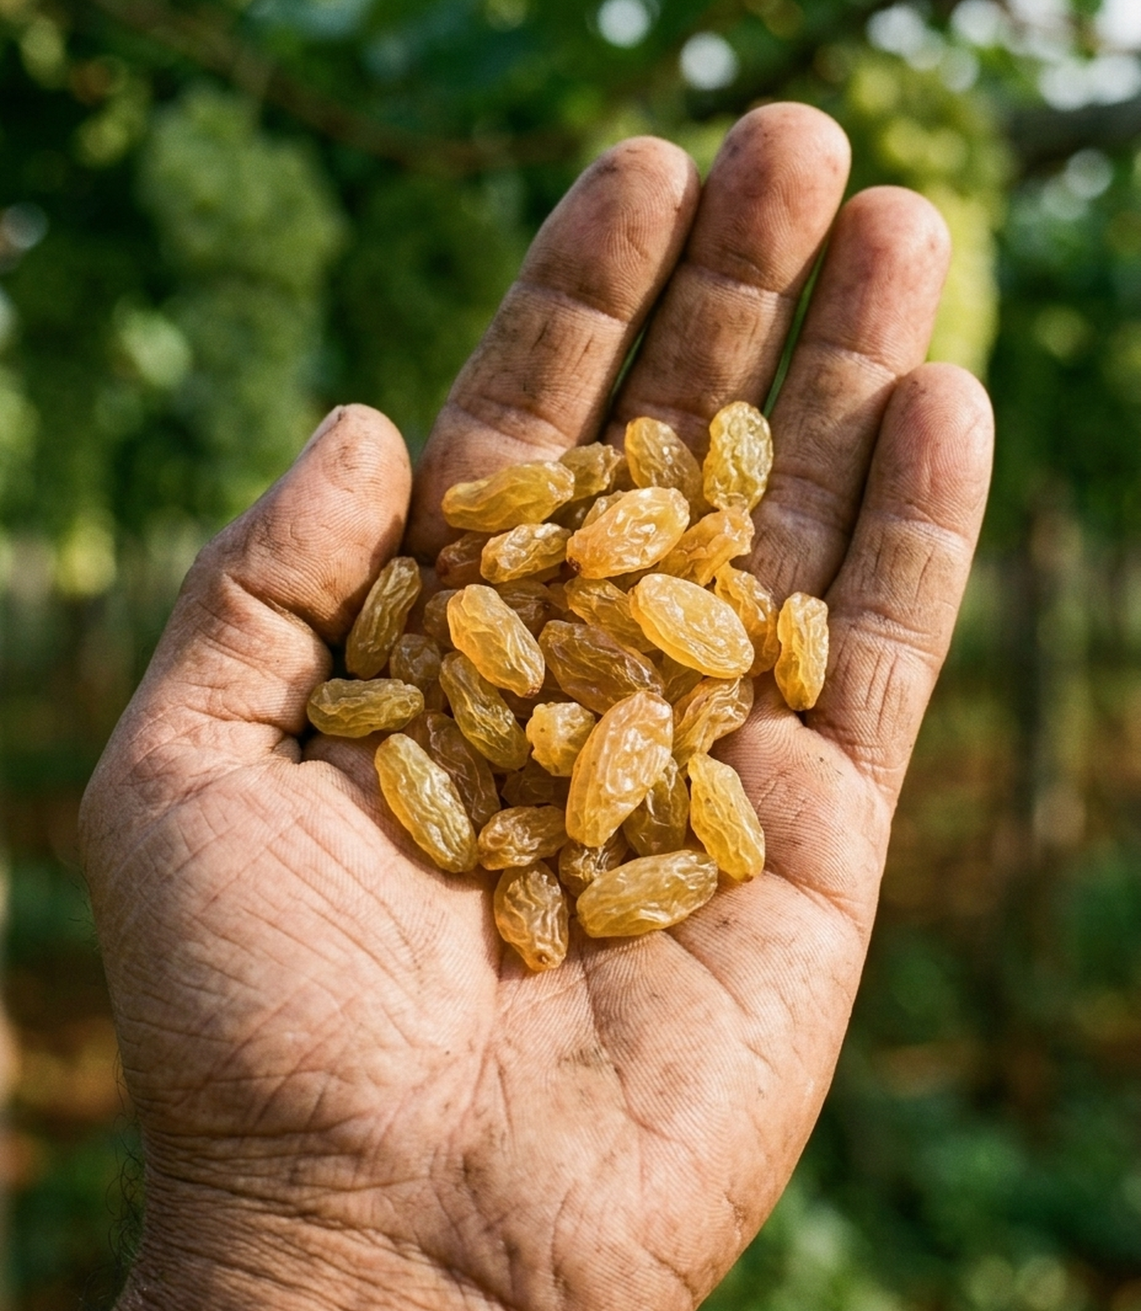
PART 2
Raisin formation
From ripe grapes to golden raisins in about four weeks, by pretreatment and shade drying.
From Vine to Raisin · Vijayapura vineyard, 2025–26 season · arunpatillabs.com 12

Slide 14
STAGE 6 · 18 FEB 2026
Building the drying shed
• Steel Frame Construction: Built directly adjacent to the vineyard, engineered to support multiple tiers of high-tension wire-mesh racks.
• Green Shade-Netting: Shade-net walls and roof block direct UV radiation while permitting free air circulation.
• Why Shade Drying?: Direct sunlight browns grapes into dark raisins. Shade drying preserves the lucrative golden-green hue that fetches top market prices.
• Airflow Dynamics: Continuous air movement through permeable net walls carries away the 70–80% moisture that berries release.
• Construction Timing: Erected ~4 weeks prior to harvest so the facility is cured and ready when grapes reach optimal Brix.
From Vine to Raisin · Vijayapura vineyard, 2025–26 season · arunpatillabs.com 13

Slide 15
STAGE 7 · 14 MAR 2026
Harvest and pretreatment
STEP 01
Harvested at Full Sugar
Picked carefully by hand directly into plastic crates once Brix readings confirm target sweetness.
STEP 02
Chemical Emulsion Dip
Bunches are dipped in a potassium carbonate (K2CO3) and ethyl oleate emulsion (dipping oil).
STEP 03
Skin Wax Degradation
The alkaline dipping oil dissolves the natural hydrophobic waxy cuticular bloom, allowing internal moisture to escape 2–3× faster.
From Vine to Raisin · Vijayapura vineyard, 2025–26 season · arunpatillabs.com 14

Slide 16
STAGE 7 · 14 MAR 2026
Checking sugar before drying
Refractometer Measurement Protocol
• Optical Hand Refractometer: A single drop of extracted grape juice placed on the prism refracts light to instantly display soluble sugar percentage.
• Economic Recovery Multiplier: Every additional degree of Brix substantially increases final dried raisin weight, improving the fresh-to-dried recovery ratio closer to ~4:1.
22–24 °Brix
Typical target sugar level for premium golden raisin grapes at harvest.
From Vine to Raisin · Vijayapura vineyard, 2025–26 season · arunpatillabs.com 15

Slide 17
STAGE 8 · MAR–APR 2026
Shade drying on racks
12–15
days in the shade drying shed (typical duration)
Drying Rack Management
• Thin Layer Loading: Bunches are spread thinly across wire-mesh tiers so air circulates over every individual berry.
• Manual Loosening: Workers gently turn and loosen drying bunches periodically to prevent clumped moisture pockets.
• Microclimate Monitoring: Shed temperature and relative humidity determine drying rate and prevent mold formation during humid spells.
~15%
final dried raisin moisture, down from ~80% in fresh grapes
From Vine to Raisin · Vijayapura vineyard, 2025–26 season · arunpatillabs.com 16

Slide 18
How a grape becomes a raisin
STEP 1
Skin opened
Dipping oil dissolves the hydrophobic waxy bloom, creating microscopic moisture evacuation pathways.
STEP 2
Water leaves
Warm, dry circulating shade air draws water vapor out. Berries shrink and develop characteristic wrinkles.
STEP 3
Sugar concentrates
Sugars remain trapped inside while water evaporates, concentrating to ~70% total sugar by dry weight.
STEP 4
Colour preserved
Shade canopy and alkaline dipping chemistry limit enzymatic browning, securing prized golden-green colour.
From Vine to Raisin · Vijayapura vineyard, 2025–26 season · arunpatillabs.com 17

Slide 19
STAGE 9 · 9 APR 2026
The finished product
1. Remove Stems
Dried bunches are mechanically rubbed or shaken over coarse mesh to cleanly detach individual berries from stalks.
2. Clean & Grade
Berries pass through pneumatic separators to remove dust, broken skin, and dark or undersized fruit.
3. Pack & Cold Store
Sorted golden raisins are sealed into airtight cartons and moved into cold storage to preserve colour until market dispatch.
From Vine to Raisin · Vijayapura vineyard, 2025–26 season · arunpatillabs.com 18

Slide 20
Closing the loop: back to the soil
• Organic Matter Return
Post-harvest vineyard biomass, prunings, and composted manure are returned to the soil to rebuild organic carbon.
• April Foundation Pruning
A hard cut-back of canes in April restarts the annual cycle, growing vigorous fruiting canes for next season.
• Permanent Infrastructure
The multi-tier shade shed remains preserved on site, ready for immediate deployment next harvest.
• Sensorized Next Season
Planned deployment of camera carts, GPS tracking, and IoT sensors to link per-block soil treatment with final raisin recovery.
From Vine to Raisin · Vijayapura vineyard, 2025–26 season · arunpatillabs.com 19

Slide 21
Season takeaways
1. ~150 Days
From October fruit pruning to a March harvest, with flowering starting ~4 weeks after pruning.
2. Even Start, Even Finish
A bud-break spray right after pruning lines up sprouting, bloom, and ripening across the entire block.
3. Sugar Decides Harvest
Pick strictly at full °Brix; higher initial sugar yields heavier, sweeter raisins and superior dried weight.
4. Shade + Dip = Golden
Alkaline pretreatment and shade-net drying turn fresh grapes into premium golden raisins in ~2 weeks.
From Vine to Raisin · Vijayapura vineyard, 2025–26 season · arunpatillabs.com 20

Slide 22
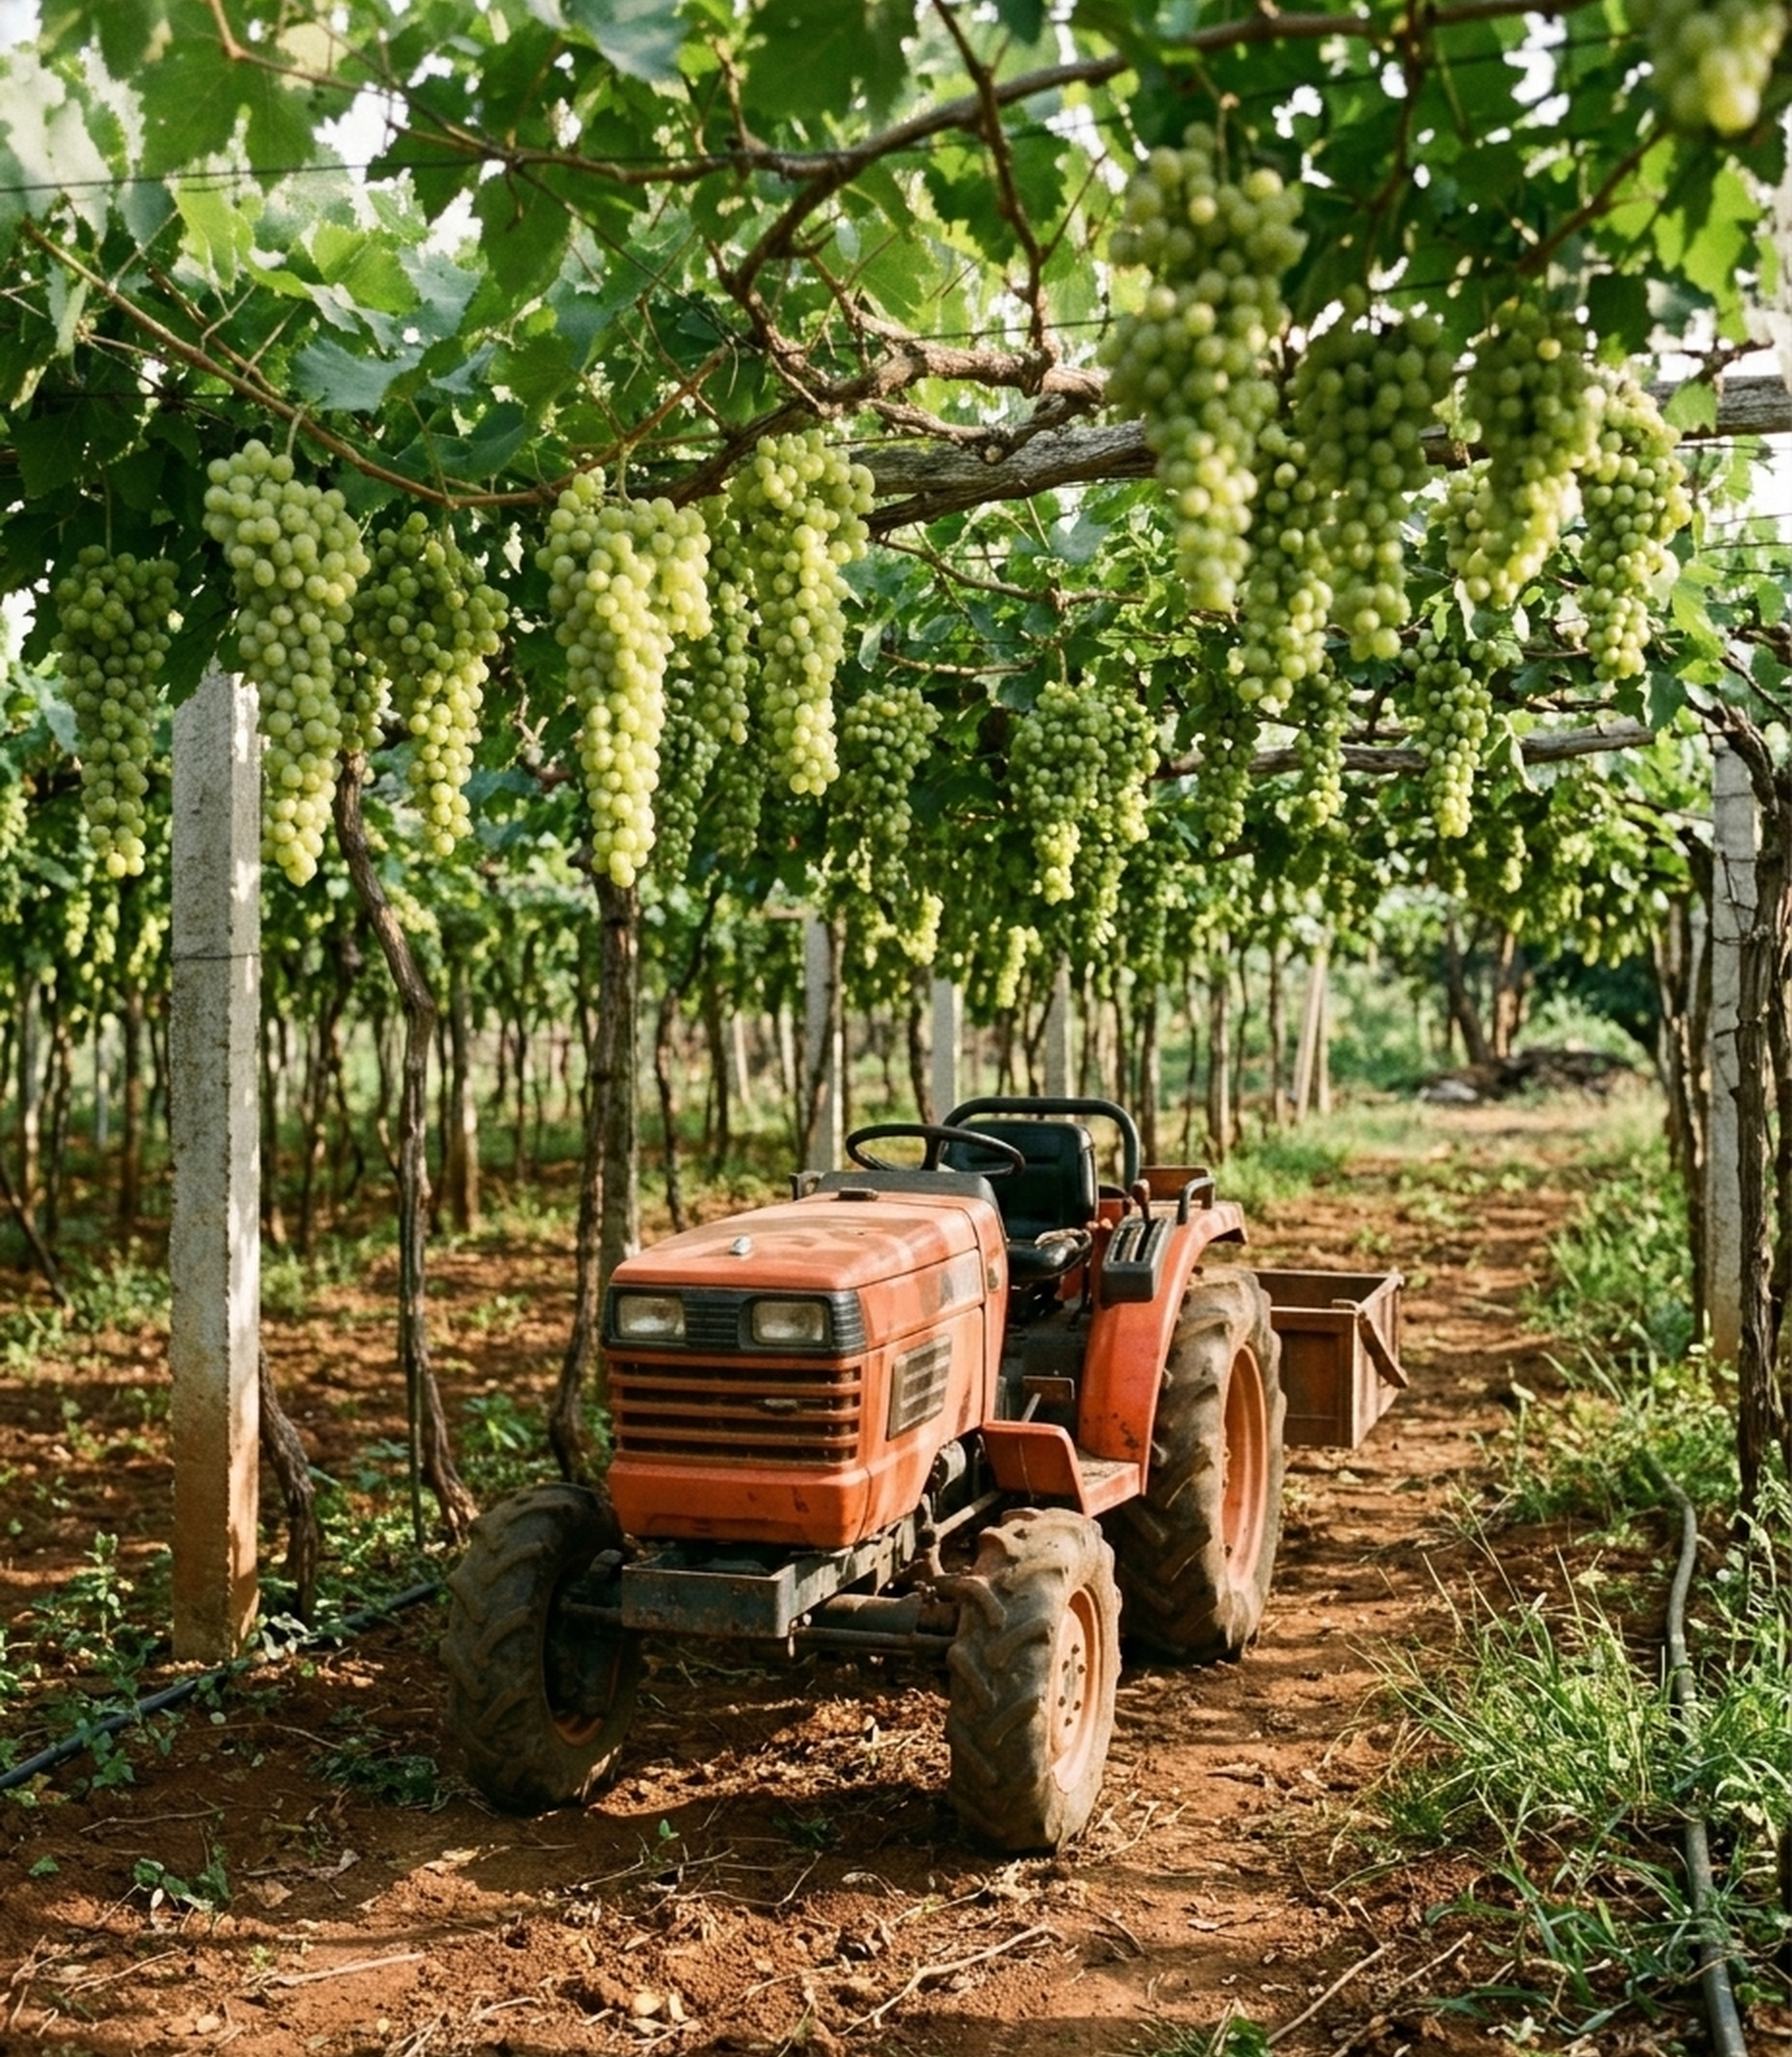
PART 3
What tech can do
Options for our 4.5-acre Thompson Seedless farm on a ₹3 lakh budget. Everything here is an option; nothing is decided yet.
From Vine to Raisin · Vijayapura vineyard, 2025–26 season · arunpatillabs.com 21

Slide 23
Our farm and goals
4.5
acres, Thompson Seedless
4,100
vines (≈4.4 m² each)
51
rows, ~80 vines & ~120m
~6 km
per full camera pass (~1.5h)
Already In Place
• Fyllo agricultural microclimate field station
• Kubota B2741S orchard tractor
• Tractor GPS speed and pass logging
• 4G outdoor CCTV perimeter cameras
• Mounted Action Camera
• Wi-Fi at drying shed (4G SIM backhaul)
Strategic Priorities
P1. Grape Yield: Bunch count per vine, berry sizing curves, row yield maps
P2. Raisin Quality: Brix at harvest, drying shed temperature/humidity, recovery
P3. Protect Crop: Early mildew alerts via Fyllo, yard theft alerts via CCTV
P4. Optimize Inputs: Variable-rate GA3, fertiliser, and water guided by row data
From Vine to Raisin · Vijayapura vineyard, 2025–26 season · arunpatillabs.com 22

Slide 24
Ideas we reviewed: reality check
Idea | What the evidence says | Verdict
Fixed cameras: theft | Person detection on CCTV is mature, reliable and cheap. | Do now
Labour headcount | Easy at the gate; simple disclosure to workers required (DPDP Act). | Do now
Labour heat map | Needs worker tracking via active GPS tags or dense high-angle cameras. | Hold
Per-plant yield (camera + GPS) | Bunch detection ~13% error per vine; R² ~0.81 on bunch counts. | Best first project
Sugar per bunch (hyperspectral) | Living Optics R² 0.71, ±1.24 °Brix in lab; La Rioja R² 0.92 at single site. | Research-grade
Robot cart scanning every grape | YouTube Short labelled 'AI'; research prototypes exist, none to buy. | Inspiration only
From Vine to Raisin · Vijayapura vineyard, 2025–26 season · arunpatillabs.com 23

Slide 25
Where tech fits in the season
Stage | Decision | Measure | Low-cost option | Upgrade
Pruning (Oct) | Even spray, every row covered? | Tractor path | Tractor GPS + camera (have) | Sprayer flow log
Shoots, bloom (Nov) | Shoots to keep? Disease risk? | Shoot count, wetness | Fyllo alerts (have) | Multispectral vigour
Full bloom (Nov) | How much fertiliser? | Petiole nutrients | Petiole lab test | —
★ Berry sizing (Nov–Dec) | GA3 / girdle? Which blocks? | Berry diameter curve | Scale card + camera | Global-shutter rig
Berry growth (Dec–Jan) | Crop load, thinning, yield | Bunches per vine | Action-camera pod | Depth camera
Ripening (Feb) | Pick order by row? | °Brix trend | Refractometer, tagged vines | Handheld NIR meter
Harvest (Mar) | Pick date, labour, theft | Brix, crates per row | Crate log + CCTV | AI person alerts
Drying (Mar–Apr) | Turn, vent, done? | Temp, humidity, weight | Shed sensors | Colour camera
From Vine to Raisin · Vijayapura vineyard, 2025–26 season · arunpatillabs.com 24

Slide 26
Berry-sizing window options
Option | Effect | Timing | Cost / Risk
GA3 sprays | Standard practice for bigger berries | Berry set, ~3–5 mm | Late sprays give less return
GA3 + CPPU | +5–20% berry size on Thompson Seedless | Same window | High dose can delay ripening ~3 weeks
Girdling | +10–30% berry weight, no chemical | From ~3 mm, done by 6–8 mm | Labour intensive; can kill cane if done badly
Thinning | Fewer berries, each bigger and sweeter | Early berry set | High manual labour requirement
Water | Stress now permanently limits berry size | Whole sizing phase | Fyllo soil tension sensors (have)
Fertiliser | Dose potash guided by petiole test (NHB) | Full bloom | Lab test cost < one wasted dose
Tech's job here: Measure berry diameter growth curves per block row-by-row, so growth regulator sprays and girdling are applied only to lagging blocks while still inside the narrow physiological sizing window.
From Vine to Raisin · Vijayapura vineyard, 2025–26 season · arunpatillabs.com 25

Slide 27
How data flows: five layers
1. Capture
• Action-camera pod
• Fyllo station
• CCTV cameras
• Shed sensors
• Refractometer
2. Identify
• Row-end number boards
• Trunk counting
• Date + GPS stamps
• Canopy flank ID
• Unique vine tags
3. Store
• Season folders
• Phenology stage blocks
• One row per measurement
• Raw footage archive
• Sync manifest
4. Analyse
• Bunch count AI
• Berry diameter sizing
• Vigour (NDVI / green)
• Shed drying curve
• Security person alerts
5. Act
• Spray / irrigate by block
• Selective pick order
• Shed ventilation alerts
• Weekly grower report
• Post-season review
Layer 2 is the foundation: Without a verifiable vine ID on every image, photos are just disconnected photos. At 4,100 vines across 51 rows, simple row boards plus trunk counting do the job accurately without needing costly RTK GPS base stations.
From Vine to Raisin · Vijayapura vineyard, 2025–26 season · arunpatillabs.com 26

Slide 28
Camera pod: two action cameras
Camera at ~1.4 m | mm / px | 3–7 mm berry | 12–18 mm berry
Dashcam, 1080p wide | ~4 | 1–2 px (No) | 3–5 px (No)
Action cam, 4K linear | ~0.7 | 4–10 px (Weak) | 16–25 px (Yes)
Industrial narrow lens | ~0.3–0.4 | 10–20 px (Yes) | 30–50 px (Yes)
Must-Have Specifications
• Auto-start on power: 100% no-touch operation
• Linear lens mode: zero fish-eye barrel distortion
• Fast locked shutter: ≥ 1/1500 s to kill motion blur
• External 12V power tapped from tractor ignition
• Interval photos: 1–2 raw frames per second
• Integrated LED light bars to penetrate dense canopy shade
Operational Recommendation: For the early 3–7 mm GA3 sizing window, pair action camera passes with close-up smartphone photos of tagged clusters against scale cards, upgrading to industrial global-shutter pods in Year 2.
From Vine to Raisin · Vijayapura vineyard, 2025–26 season · arunpatillabs.com 27

Slide 29
One pod, five platforms
Platform | Cost / pass | Operator | How often | Image quality | Main risk
P1 Tractor, spray passes | ₹0 | Farmer | Spray schedule | Mist, diesel shake | Dirty lenses
P2 Tractor, camera-only | ₹500 | Farmer | On request | No mist, low shake | Cost adds up
P3 Suzuki Access scooter | Fuel | You | Weekly | Less shake | Balance, bumps
P4 Push trolley | ₹0 | You / worker | On request | Best, steady frames | 1.5–2 h walk
P5 Hybrid Mix | Varies | Both | Weekly in windows | Good | Keep consistent
Likely Strategy (P5): Scooter or light push cart every week during late Nov–Dec (berry sizing) and around veraison ripening; free opportunistic spray passes during the remainder of the season. Tractor mount clamps to front frame, powered via ignition 12V.
From Vine to Raisin · Vijayapura vineyard, 2025–26 season · arunpatillabs.com 28

Slide 30
Data handling: two options
~60–130 GB per full vineyard pass (two cameras, photos or 4K video) — far too massive for rural 4G SIM upload.
D1 Weekly SD swap + laptop
• Hardware: 4 high-endurance SD cards, reader, 2–4 TB drive
• On farm: swap cards weekly (~5 min); farmer does nothing
• Software: Python ingestion script, row finder, vine counter
• Pros: cheapest, 100% reliable, full raw resolution preserved
• Cons: requires weekly physical visit; analysis delayed by days
D2 On-board computer, Wi-Fi sync
• Hardware: Jetson Orin Nano / RPi 5, global-shutter cams, SSD (~₹50k–1L)
• On farm: fully automated; uploads lightweight MB metrics via shed Wi-Fi
• Software: on-device inference, automated health checks, telemetry daemon
• Pros: fully no-touch, near-real-time row alerts
• Cons: higher initial cost, software complexity, field vibration risk
From Vine to Raisin · Vijayapura vineyard, 2025–26 season · arunpatillabs.com 29

Slide 31
What multispectral can do
Capabilities & Limits
• Vine vigour & stress map: YES
• Weak patches, nutrient diffs: YES
• Stress before visible disease: YES
• Berry size & bunch count: NO (needs standard RGB)
• Sugar (Brix) / raisin quality: NO (needs hyperspectral)
M1 Survey3 on our cart pod (~₹50–70k)
Side view under canopy suits bower trellis; provides NDVI vigour matched directly to per-vine bunch counts.
Status: Fits budget
M2 Hired drone survey service (Quote per flight)
1–2 flights per season; inspects top of canopy only, cannot image bunches hanging underneath.
Status: Fits budget
M3 Own pro drone + RedEdge-P (₹11.5 lakh + drone)
Calibrated 5-band research payload; far beyond realistic 4.5-acre budget.
Status: Over budget
From Vine to Raisin · Vijayapura vineyard, 2025–26 season · arunpatillabs.com 30

Slide 32
Macro + micro + ground truth
Macro: Fyllo Station
1 point, hourly
Tracks heat units (GDD), leaf wetness, relative humidity, soil moisture at 8"/16", rainfall, and light intensity.
Micro: Camera Cart
4,100 vines, weekly
Measures bunch counts per vine, berry sizing progression, canopy density (NDVI), and visual leaf symptoms.
Ground Truth: Manual
~20 tagged vines, key dates
Hand vernier caliper berry measurements, hand refractometer Brix curves, crates per row, and raisin recovery.
Macro predicts EXPECTED growth → Micro shows OBSERVED per vine → DEVIATION is what we act on
Where It Works: Heat units predict expected berry curve; farm-wide vs local slows distinguish irrigation deficits from vine pests; wet spells trigger targeted visual mildew inspection.
Limits: Single weather point cannot explain row-level soil variance; periodic hand sampling remains essential to calibrate cameras.
From Vine to Raisin · Vijayapura vineyard, 2025–26 season · arunpatillabs.com 31

Slide 33
Raisin shed and security options
Raisin Shed Quality Instrumentation
• Temp + humidity (3 tiers) (ESP32 + SHT31):
Humid spells trigger mold & dark browning
• Sample rack weight (Load cell):
Continuously tracks drying curve and true recovery ratio
• Berry colour tracking (Time-lapse camera):
Quantifies golden vs brown colour progression
• Pretreatment log (Log sheet / photo):
Links field harvest Brix directly to final market grade
Security Architecture (No Fixed IP)
• S1 Solar 4G Cameras (AI on device):
Detect people at camera level; sends alerts via vendor app. Plugs perimeter border gaps cheaply.
• S2 Small Shed Computer:
Reads existing cameras locally via RTSP, runs person detector, dispatches push alerts over 4G.
• S3 Private Mesh VPN (Tailscale):
ZeroTier / Tailscale deployed on S2 to stream camera feeds remotely without static public IP.
From Vine to Raisin · Vijayapura vineyard, 2025–26 season · arunpatillabs.com 32

Slide 34
Budget options within ₹3 lakh
Item | Cost Range | Need Tier
2 × 4K action cameras (locked shutter) | ₹60–90k | Core
MAPIR Survey3 + calibration panel (M1) | ₹50–70k | Option
Pod: clamps, dampers, sealed case, 2 LED bars, 12V | ₹15–25k | Core
GPS logger, row boards, scale cards, tags | ₹5–10k | Core
Shed: 3-tier sensors, load cell, time-lapse | ₹15–25k | Core
CCTV gaps: 2 solar 4G AI cameras (S1) | ₹25–40k | Option
SD cards + portable SSD (D1) | ₹8–12k | Core
Weather, soil, disease (Fyllo station) | ₹0 | Have
Contingency or D2 on-board upgrade later | ₹30–50k | Reserve
₹2.1–3 L
total project capital required, depending on optional modules selected.
₹25–65k
saved upfront because Fyllo IoT already covers weather, soil moisture, and microclimate.
From Vine to Raisin · Vijayapura vineyard, 2025–26 season · arunpatillabs.com 33

Slide 35
This season, step by step
Late Oct
1
Row boards, pilot pod, test lighting
Nov
2
Pod live, CCTV alerts, petiole test
Late Nov-Dec
3
Weekly berry curves → GA3 by block
Dec-Jan
4
Bunch counts, early yield map
Feb
5
Brix on tagged vines, pick order
Mar
6
Crates per row = real harvest yield
Mar-Apr
7
Shed drying curves, recovery ratio
May
8
Season report vs baseline records
Go / No-Go Gate at Each Step: Did this intervention save money or improve quality compared with last season? This empirical discipline requires establishing last season's farm records as the definitive operational baseline.
From Vine to Raisin · Vijayapura vineyard, 2025–26 season · arunpatillabs.com 34

Slide 36
Decisions and inputs still needed
1. Decide Strategy
• Platform mix: P1–P5 balance
• Data ingestion: D1 SD swap now, D2 on-board later?
• Multispectral: M1 Survey3, M2 drone, or standard RGB only
• Security: S1 cameras, S2 shed computer, or both
2. Request from Fyllo
• Full CSV historical sensor export
• REST API or automated webhook access
• Disease risk mathematical scores as raw data
• Service repair for air pressure sensor
• Exact GPS coordinate of soil moisture probe
3. Dig Out Farm Records
• Past spray & GA3 chemical application dates
• Fertiliser and input vendor purchase bills
• Labour muster days by operation
• Historical harvest crate counts by row
• Final dried raisin recovery weight, grade, and sale price
From Vine to Raisin · Vijayapura vineyard, 2025–26 season · arunpatillabs.com 35

Slide 37
Appendix: source media used
Slide Reference | Media File(s) | Timestamp Date
Slide 2 | IMG_0650.PNG (tractor GPS screenshot) | 1 Nov 2025
Slide 5 | VIDEO-2025-11-02-10-27-20.mp4 | 2 Nov 2025*
Slide 6 | f35cd164-....MP4 (CCTV camera) | 18 Oct 2025
Slide 7 | IMG_0653 / 0654 / 0655.HEIC | 2 Nov 2025
Slide 8 | PHOTO-2025-11-12-07-40-08.jpg (×2) | 12 Nov 2025
Slide 9 | IMG_0694–0707.HEIC, 200C36AD / A85AAFFF.JPG | 14 Nov 2025
Slide 10 | VIDEO-2026-01-15-13-48-46.mp4 | 15 Jan 2026*
Slide 11 | VIDEO-2026-02-14-..., VIDEO-2026-02-15-....mp4 | 14–15 Feb 2026*
Slide 13 | 20260218102201.MP4 (CCTV camera) | 18 Feb 2026
Slide 14–15, 17 | VIDEO-2026-03-14-12-11-52 / 13-00-19.mp4 | 14 Mar 2026*
Slide 16 | IMG_1316.MOV, IMG_1324.MOV | ~Apr 2026 (inferred)
Slide 18 | IMG_1313.HEIC | 9 Apr 2026
Slide 19 | 20260408080701.MP4 (CCTV camera) | 7 Apr 2026
* Date from WhatsApp filename timestamp (transmission date). Practices designated 'typical' represent regional horticultural standards.
From Vine to Raisin · Vijayapura vineyard, 2025–26 season · arunpatillabs.com 36

Slide 38
Appendix: Part 3 sources
Media Hardware References
• Slide 21, 22: Tractor photos (Kubota B2741S)
• Slide 23: AI-labelled Short screenshots
• Slide 25: PHOTO-2025-11-12-07-40-08.jpg
• Slide 27: IMG_0653.HEIC (tractor camera mount)
• Concept: Living Optics hyperspectral study
• Telemetry: Tractor & Fyllo app dashboards
Research Literature Sources
• Gutiérrez et al., on-the-go hyperspectral TSS, La Rioja (digibug.ugr.es/handle/10481/89025)
• Living Optics, Picking the Perfect Grape case study
• Santos et al., grape detection and tracking, WGISD (arXiv 1907.11819)
• YOLO bunch counting, Agronomy 2022; occlusion-robust detection, 2024
• Fairtrade Nashik weather app; Fyllo shared-unit model
• UC / NMSU / eXtension guides on GA3, CPPU, and cane girdling
• NHB (National Horticulture Board) grape nutrient guide (petiole testing)
• MAPIR Survey3 (seesense.eu); RedEdge-P India listing (xboom.in)
• WineOz SmartGrape berry-size app (Wine Australia)
• DPDP Act 2023 legal commentary (KS&K, EY)
Prices are rough budgetary ranges from public listings. Accuracy metrics originate from published scientific literature, not farm trials.
From Vine to Raisin · Vijayapura vineyard, 2025–26 season · arunpatillabs.com 37

Slide 39
STUDY & RESEARCH COMPLETED
ArunPatil Labs
Applied AI, Systems ML & Viticulture Intelligence
Bengaluru & Sindagi Taluk, Vijayapura, Karnataka
Explore models, field protocols and datasets: arunpatillabs.com
ArunPatil Labs · Applied AI Systems Research · arunpatillabs.com

