Slide 1
Clean, beautiful tests

Slide 2

Scope
Intro
Cristian Mocanu
20 years experience
in software development
DbSchema
https://dbschema.com/
Notes:
* clean test code
* testable production code
* if the production code is not easy to tests, the tests will be bad
* we won't discuss testable code principles
* it's important, but we don't have time

Slide 3
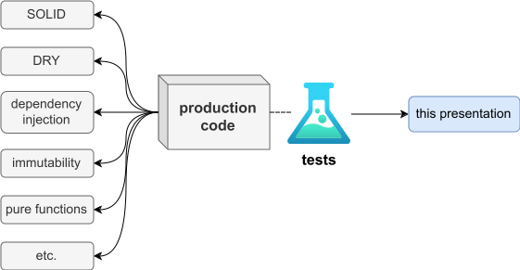
Scope
Scope
Notes:
* clean test code
* testable production code
* if the production code is not easy to tests, the tests will be bad
* we won't discuss testable code principles
* it's important, but we don't have time

Slide 4
Outline
Introduction
The coolness
More info

Slide 5
Introduction
The coolness
More info

Slide 6
What is Kotlin?
statically typed
on the JVM
  bytecode runnable on Java 6
  experimental Kotlin -> Javascript compiler
fully interoperable with Java
supports both OO and functional styles

Slide 7
What is Kotlin? (continued)
open source (Apache 2.0)
created by JetBrains (July 2011)
release 1.0 on February 2016
  compiler will be backwards compatible
used in production
  JetBrains (IntelliJ IDEA plugins, YouTrack vNext, CRM apps, new products etc.)
  prezi.com (backend, data processing and service development)
  other lesser known companies

Slide 8
Tool support
language was designed with tooling in mind
IntelliJ
  plugin developed in lockstep with the compiler
Eclipse
NetBeans
Maven
Gradle
Ant

Slide 9
Why Kotlin?
more concise than Java & more readable^{* :)}
safer than Java
  implementing advice from Effective Java
  nullability check in the type system
  final by default
  immutable collection views
  simpler generics
strong interoperability with Java
as performant as Java
pragmatic
  not a research language
  designed to solve real-world problems
  applying lessons learned from years of creating large-scale systems
Notes:
* this doesn’t mean that it’s impossible to write Kotlin code that is harder to read than Java. It does mean that it’s possible to write Kotlin code that is more readable that what you can do in Java

Slide 10
Introduction
The coolness
More info

Slide 11
see code in IntelliJ

Slide 12
IntelliJ Education plugin

Slide 13
Introduction
The coolness
More info

Slide 14
More info
Official docs
https://kotlinlang.org/docs/tutorials/
https://kotlinlang.org/docs/reference/
https://kotlinlang.org/docs/videos.html
Exercises
IntelliJ Education plugin
or https://github.com/Kotlin/kotlin-koans
Books
Kotlin in Action, by Dmitry Jemerov and Svetlana Isakova
Kotlin for Android Developers, by Antonio Leiva
Awesome Kotlin (list of resources)
https://github.com/mcxiaoke/awesome-kotlin

Slide 15

More info
https://github.com/cvmocanu/clean-tests-presentation/

