Slide 1

Clean, beautiful tests

Slide 2

Scope
Intro
Cristian Mocanu
20 years experience
in software development
DbSchema
https://dbschema.com/

Slide 3
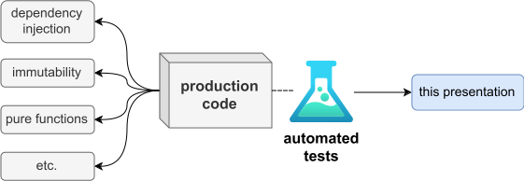
Scope
Scope
Notes:
* clean test code
* testable production code
* if the production code is not easy to test, the tests will be bad
* we won't discuss testable code principles
* it's important, but we don't have time

Slide 4
Outline
Why are good tests important?
Code smells and fixes

Slide 5
Why are tests important?
Code smells and fixes

Slide 6
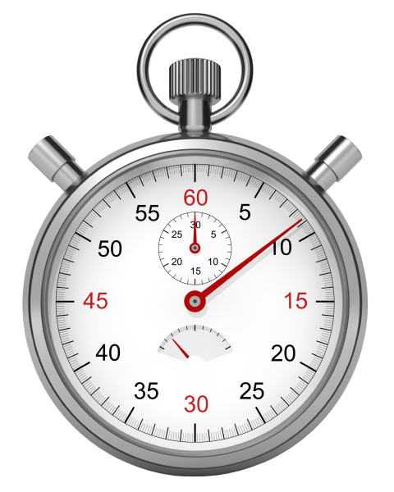


Why are good tests important?
Good tests
Bad tests
fast feedback
functional documentation
refactor fearlessly
lengthy debugging
documentation in code
refactor carefully
hard to maintain
fun
no fun
Notes:
* fast feedback
* reduced debugging time (you know what you just changed), compared to lengthy debugging, for a customer-reported bug
* functional documentation
* always up-to-date
* refactor fearlessly
* you have a safety net, that will tell you immediately if you broke anything (as opposed to reading a lot of code to sure that every little change is safe - it doesn't break anything)
* it’s fun
* refactor without care / safety net

Slide 7
Bad test disadvantages
false positives
lengthy debugging
no documentation
refactor carefully
time (and )
fun (refactor without care)
Notes:
* false positives
* the test fails even if the production code is still correct
* refactor fearlessly
* you have a safety net, that will tell you immediately if you broke anything (as opposed to reading a lot of code to sure that every little change is safe - it doesn't break anything)
* it’s fun
* refactor without care / safety net

Slide 8
What is Kotlin? (continued)
open source (Apache 2.0)
created by JetBrains (July 2011)
release 1.0 on February 2016
  compiler will be backwards compatible
used in production
  JetBrains (IntelliJ IDEA plugins, YouTrack vNext, CRM apps, new products etc.)
  prezi.com (backend, data processing and service development)
  other lesser known companies

Slide 9
Tool support
language was designed with tooling in mind
IntelliJ
  plugin developed in lockstep with the compiler
Eclipse
NetBeans
Maven
Gradle
Ant

Slide 10
Why Kotlin?
more concise than Java & more readable^{* :)}
safer than Java
  implementing advice from Effective Java
  nullability check in the type system
  final by default
  immutable collection views
  simpler generics
strong interoperability with Java
as performant as Java
pragmatic
  not a research language
  designed to solve real-world problems
  applying lessons learned from years of creating large-scale systems
Notes:
* this doesn’t mean that it’s impossible to write Kotlin code that is harder to read than Java. It does mean that it’s possible to write Kotlin code that is more readable that what you can do in Java

Slide 11
Introduction
The coolness
More info

Slide 12
see code in IntelliJ

Slide 13
IntelliJ Education plugin

Slide 14
Introduction
The coolness
More info

Slide 15
More info
Official docs
https://kotlinlang.org/docs/tutorials/
https://kotlinlang.org/docs/reference/
https://kotlinlang.org/docs/videos.html
Exercises
IntelliJ Education plugin
or https://github.com/Kotlin/kotlin-koans
Books
Kotlin in Action, by Dmitry Jemerov and Svetlana Isakova
Kotlin for Android Developers, by Antonio Leiva
Awesome Kotlin (list of resources)
https://github.com/mcxiaoke/awesome-kotlin

Slide 16

More info
https://github.com/cvmocanu/clean-tests-presentation/

