Slide 2
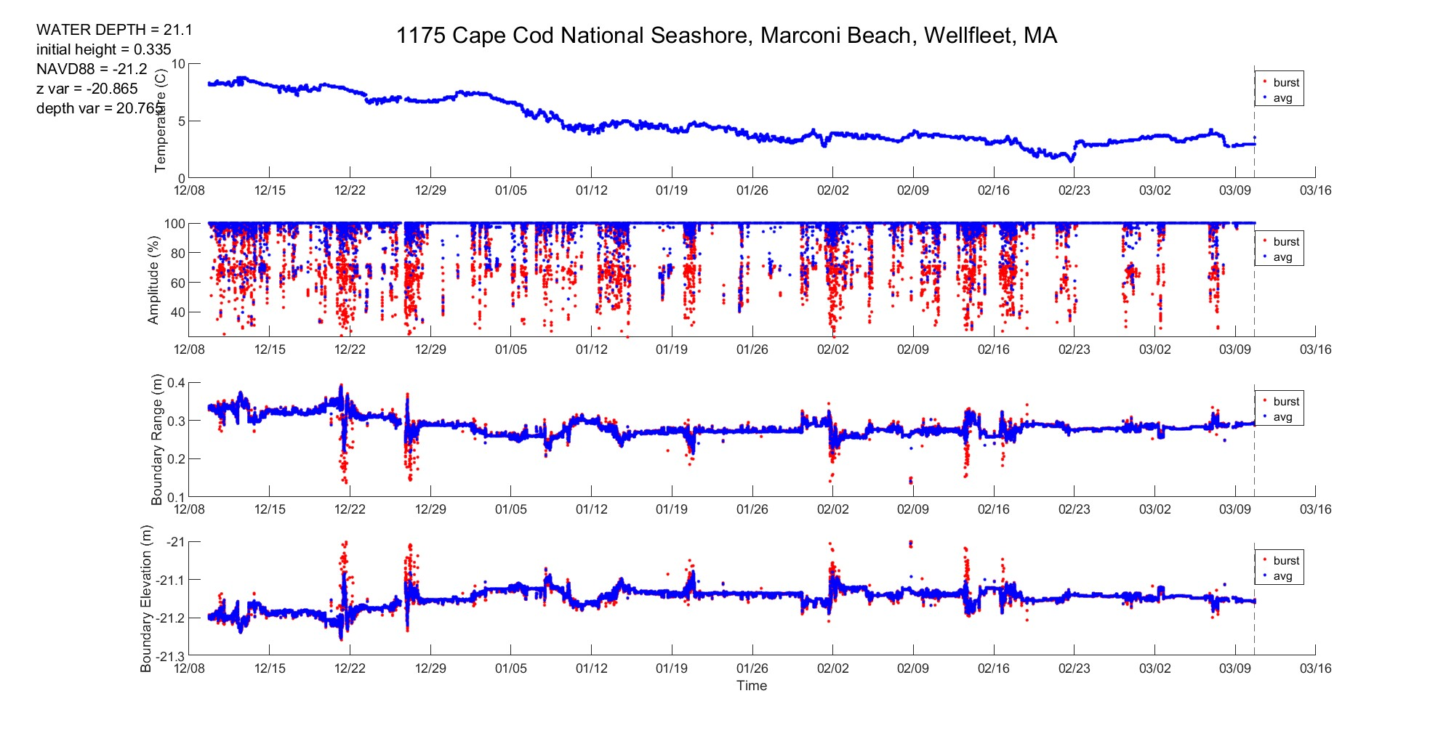
Depth (?) Range

Slide 3
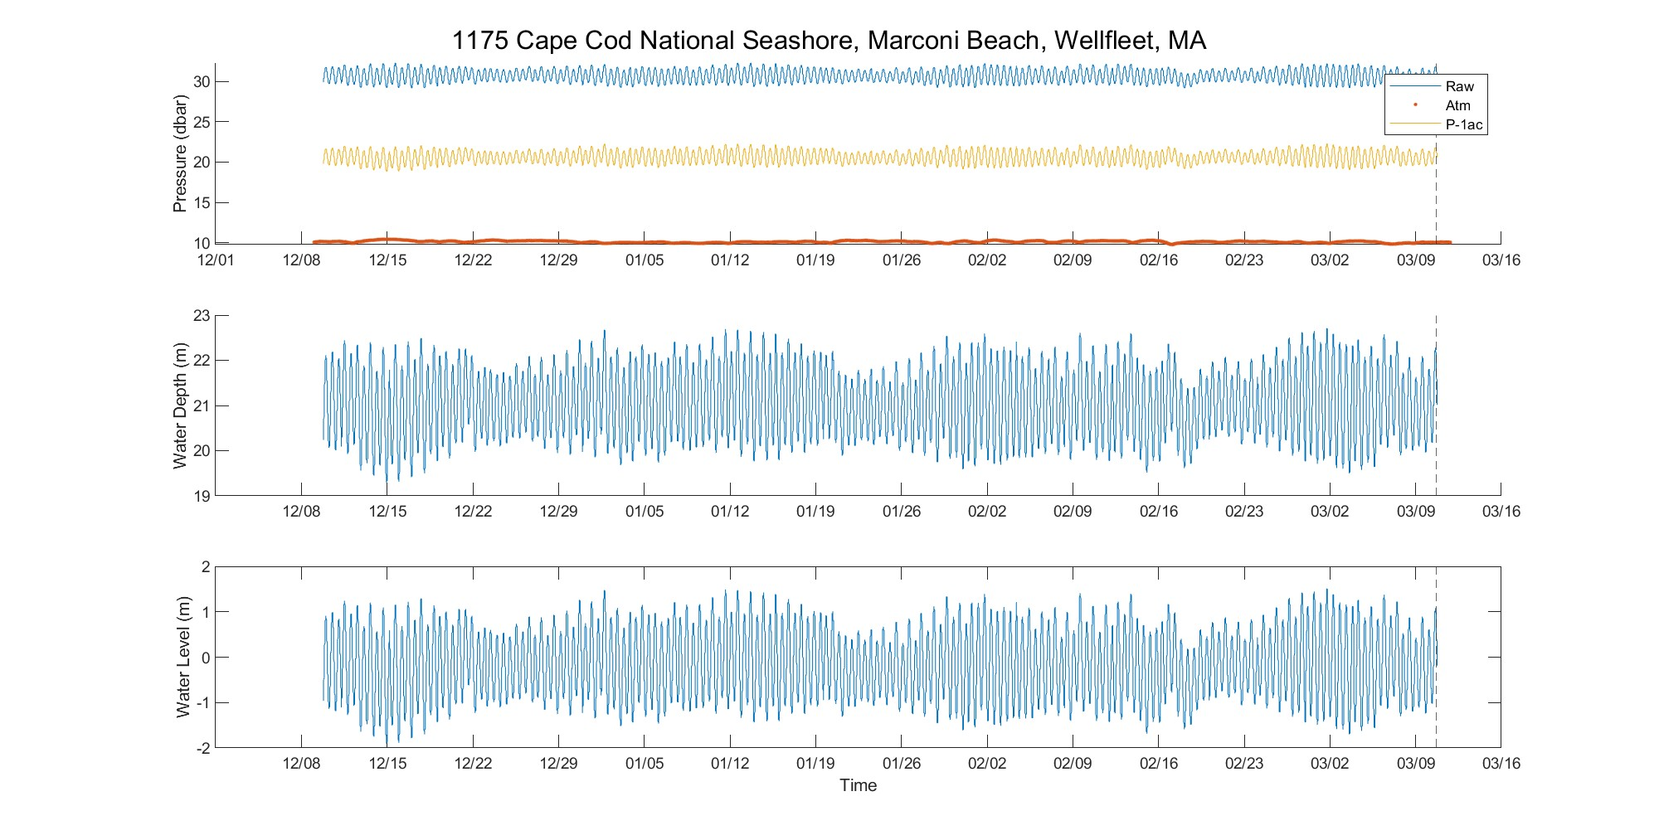
Tide Correction

Slide 4
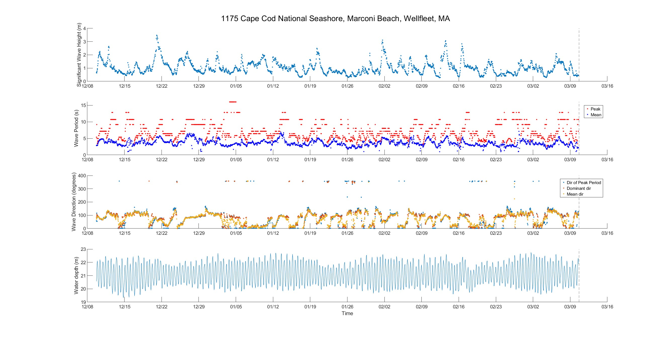
Wave Statistics

Slide 5
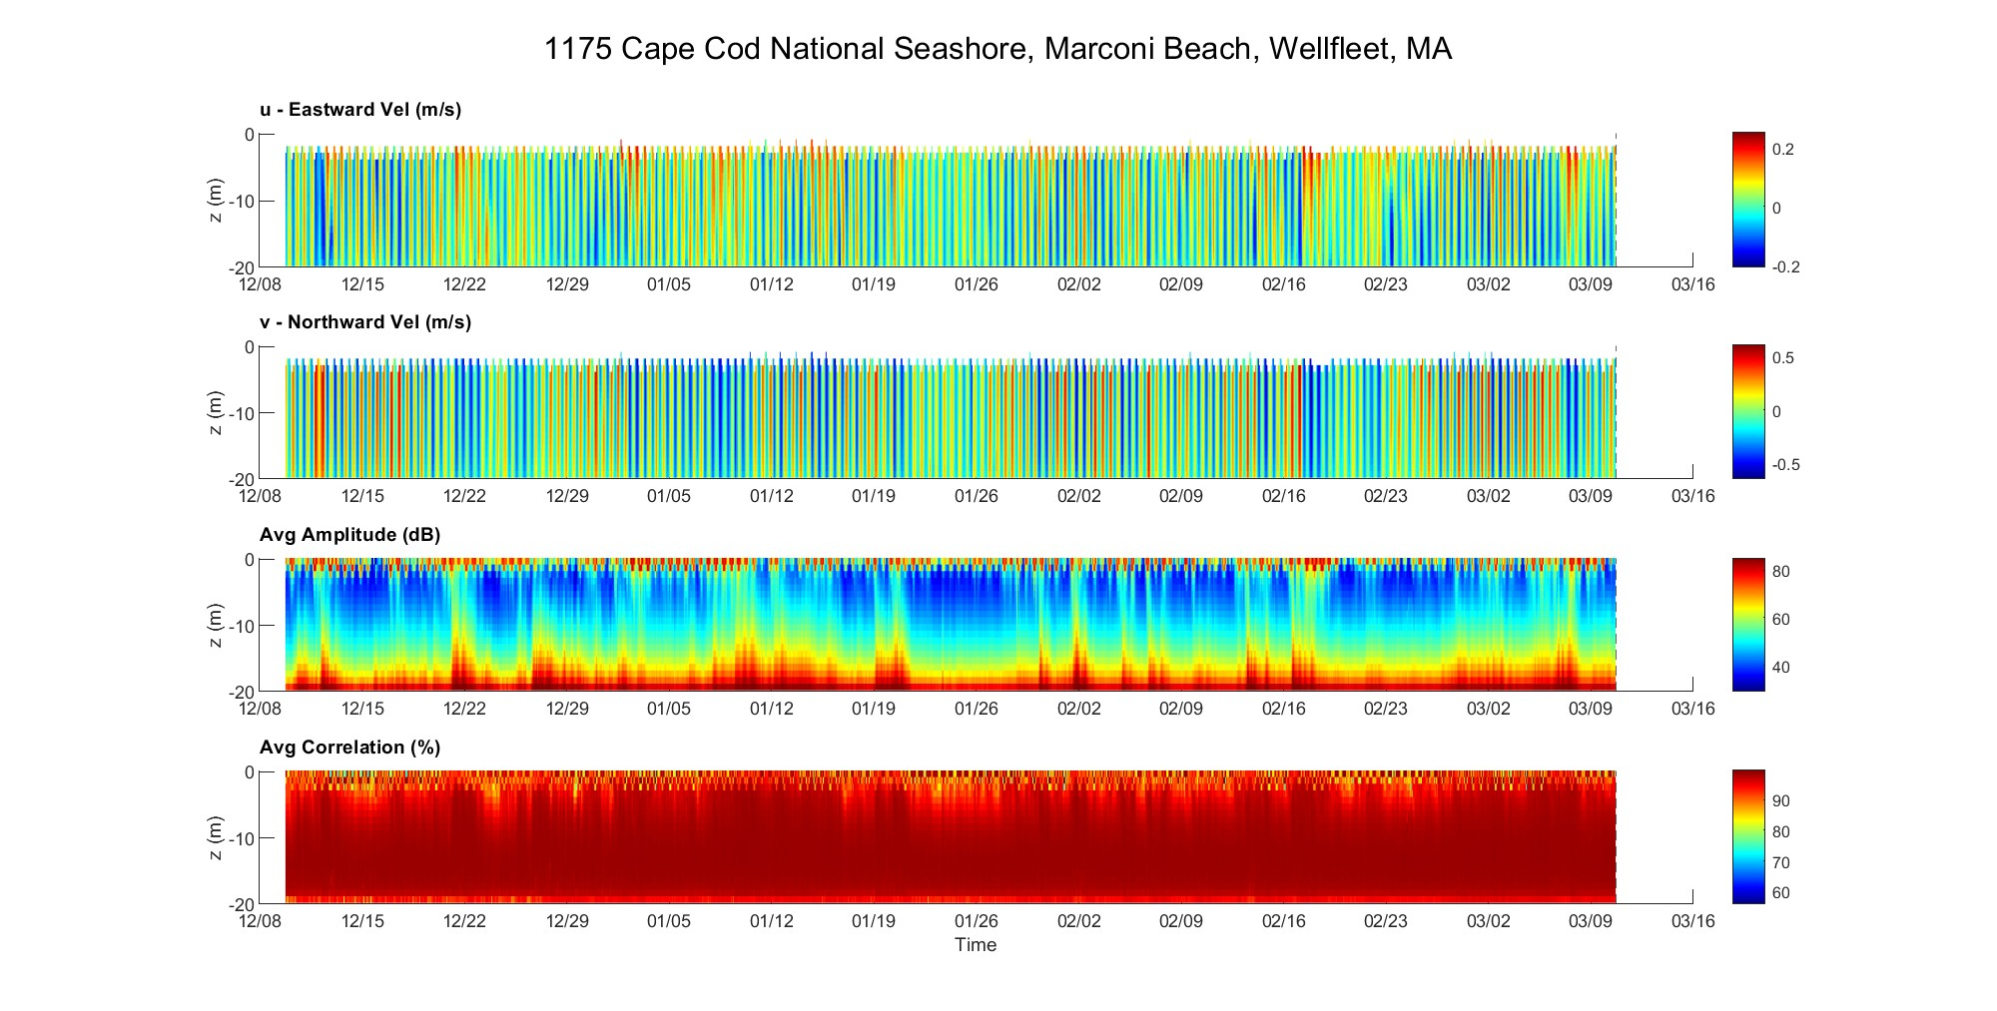
Horizontal Velocity

Slide 6
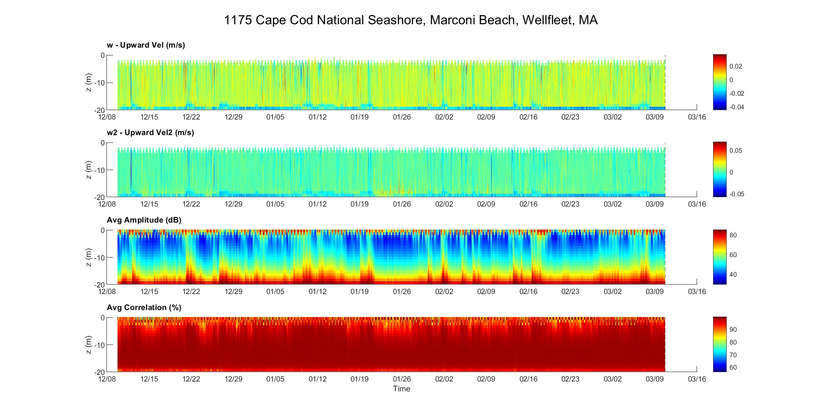
Upward Velocity

Slide 7
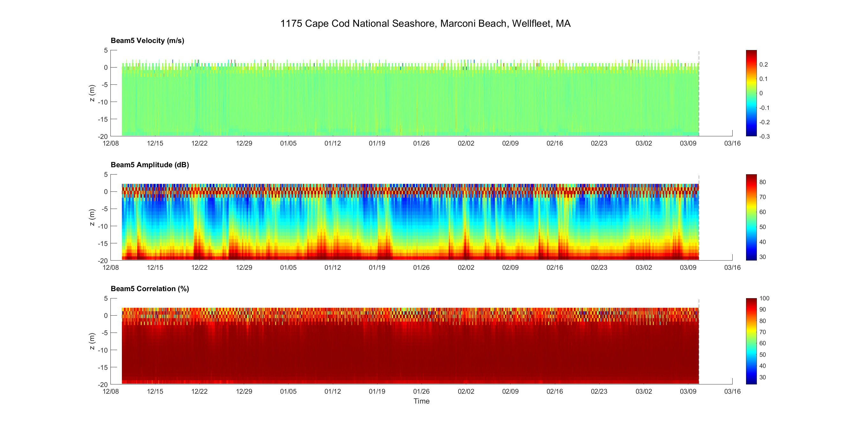
Amplitude/Velocity Correlation

