Slide 1
CE[326] - Εργασία 4
Ομάδα 4
Αθανασίου Ιωάννης 1822
Βουτσαδάκης Χρήστος 1737

Slide 2
4.1 Κορουτίνες
mycoroutines_init(ucontext_t *co)
mycoroutines_switchto(ucontext_t *co)
getcontext(co)
swapcontext(thisContext, co)
mycoroutines_create(ucontext_t *co, void (body) (void), void *arg)
mycoroutines_destroy(ucontext_t *co)
getcontext(co)
set up stack
makecontext(co, body, 1, arg)
free(co)

Slide 3
4.1 Κορουτίνες
main :
readFromFile:
writeToFile:
malloc for 3 coroutines
mycoroutines_init(mainCo)
mycoroutines_create(readCo, readFromFile, readFileName)
mycoroutines_create(writeCo, writeToFile, NULL)
mycoroutines_switchto(readCo)
printf(“Job complete!")
destroy all 3 coroutines
fileCompare()
int i = 0
while(not EOF){
buffer[i] = getc(file)
i++
if(buffer full){
i = 0
mycoroutines_switchto(writeCo)
}}
if(i>0){ mycoroutines_switchto(writeCo)}
mycoroutines_switchto(mainCo)
write to new output.txt file
for(i = 0; i<bufferSize; i++){
fputc(buffer[i], output.txt)}
mycoroutines_switchto(c2)

Slide 4
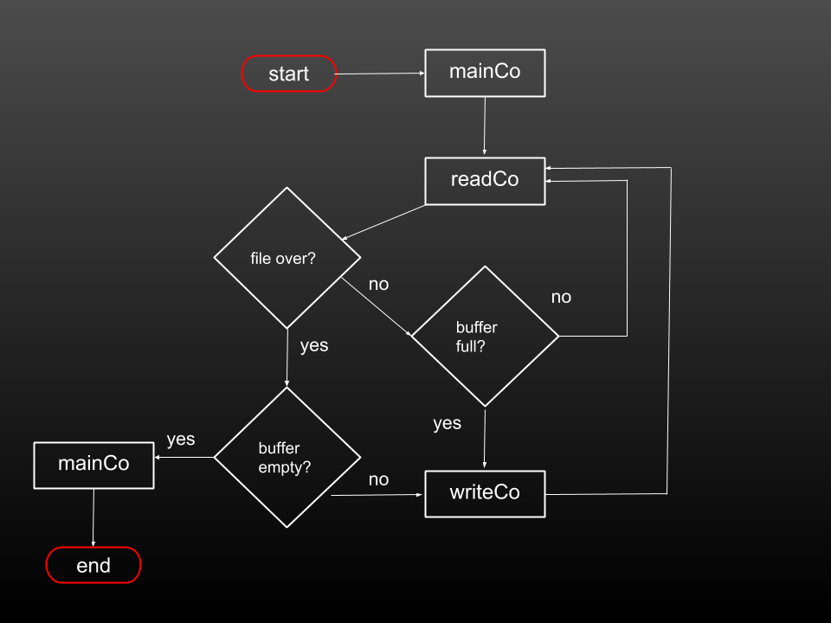

Slide 5
4.2 Νήματα με αυτόματη εναλλαγή
Thread struct - Scheduler
thread struct
mythreads_init()
int isAvailable, isTerminated
ucontext_t * context
setup_signals()
setup_timer()
thread_handler()
setup_signals sets thread_handler as signal handler
thread_handler creates the handlercontext with scheduler as the executed function and swaps to it after saving the current context
scheduler()

Slide 6
4.2 Νήματα με αυτόματη εναλλαγή
Thread functions
mythreads_create(thr_t *thread, void boy, void *arg)
mythread_join(thr_t *thread)
threadArray[threadCounter] = thread
threadArray[threadCounter]->isAvailable = 1
creates the thread context
threadCounter++
block while(thread->isTerminated != 1)
mythreads_yield()
thread->isAvailable = 0
sets a timer that sends a signal after an interval which executes thread->isAvailable =1

Slide 7
4.2 Νήματα με αυτόματη εναλλαγή
Thread termination
from mythreads_init()
handle_thread_termination()
for(max number of threads)
{ atexit(handle_thread_termination)}
thread->isAvailable = 0
thread->isTerminated = 1
swaps to handlerContext

Slide 8
4.2 Νήματα με αυτόματη εναλλαγή
Semaphores
sem_init(sem_t *sem, int value)
sem_down(sem_t *sem)
sets initial sem value
if(sem value > -1) {value--}
block while( sem value == -1)

