Slide 1

Pune Institute of Computer Technology
Department of Computer Engineering
Savitribai Phule Pune University · Academic Year 2025–26
A PROJECT PRESENTATION ON
High-Throughput Write-Optimised Key–Value Store using LSM Tree Engine
KiwiDB — A Log-Structured Merge Tree Storage Engine
Submitted by
Chaitanya Paraskar | Exam No: B400050361
Shreyash Dhas | Exam No: B400050389
Shreyash Gajbhiye | Exam No: B400050407
Shreyas Gopnarayan | Exam No: B400050418
Project Guide (Internal): Prof. M. V. Mane
Sponsorship: None (in-house academic project)
KiwiDB · LSM Tree Key–Value Store
1

Slide 2
Pune Institute of Computer Technology
Department of Computer Engineering
Savitribai Phule Pune University · Academic Year 2025–26
Introduction
▪ Key–value (KV) stores map keys to values — a simplified interface offering higher performance, scalability and availability than relational databases.
– They power Internet-scale infrastructure: Google BigTable, Amazon Dynamo, Facebook Cassandra.
▪ B+ trees give excellent reads but degrade on random writes — each mutation causes costly disk seeks.
▪ The Log-Structured Merge (LSM) tree fixes this by turning random writes into sequential ones — buffer in memory, flush sorted runs to disk, merge in the background.
– Adopted by LevelDB, RocksDB, Cassandra, HBase, BigTable.
▪ KiwiDB: a complete LSM-tree KV store built from scratch in Python 3.12+.
– ~6,600 lines of type-checked code · 25 modules · 211+ automated tests · async-native API · built-in web dashboard for live engine inspection.
KiwiDB · LSM Tree Key–Value Store
2

Slide 3
Pune Institute of Computer Technology
Department of Computer Engineering
Savitribai Phule Pune University · Academic Year 2025–26
Purpose and Motivation
▪ Purpose: build a write-optimised, crash-safe key–value store from first principles, and learn database internals by constructing them.
▪ Motivation — two gaps in existing LSM engines:
– Synchronous APIs: LevelDB / RocksDB expose blocking C++ interfaces; integrating them into async Python (FastAPI, asyncio) needs thread-pool wrappers that add latency and concurrency bugs.
– Opaque internals: production engines prioritise throughput over observability — memtable state, bloom hit-rates, and compaction progress are hard to inspect or learn from.
▪ Academic value: building the engine exposes write-ahead logging, memory management, disk persistence, concurrency control and background scheduling — usually studied only in theory.
KiwiDB · LSM Tree Key–Value Store
3

Slide 4
Pune Institute of Computer Technology
Department of Computer Engineering
Savitribai Phule Pune University · Academic Year 2025–26
Problem Statement
Design and implement a write-optimised key–value store that provides an async-native API, crash-safe persistence, background compaction with GIL bypass, and full observability via a web dashboard.
▪ Async-native API — no operation blocks the event loop.
▪ Crash-safe persistence — write-ahead log with CRC32 integrity verification.
▪ Background compaction — CPU-bound merging that bypasses CPython's Global Interpreter Lock.
▪ Full observability — real-time inspection of every stage of the data lifecycle.
KiwiDB · LSM Tree Key–Value Store
4

Slide 5
Pune Institute of Computer Technology
Department of Computer Engineering
Savitribai Phule Pune University · Academic Year 2025–26
Objectives
▪ Async-native API where put, get, delete, flush, close are async coroutines that never block the event loop.
▪ Write-ahead log with CRC32 integrity verification for crash recovery.
▪ Concurrent skip-list memtable — fine-grained per-node locking for writes, lock-free reads.
▪ SSTable persistence with bloom filters, sparse indexes and memory-mapped (mmap) reads.
▪ Parallel flush pipeline with event-chain ordered commits for concurrent SSTable writes.
▪ Subprocess-based compaction via ProcessPoolExecutor to bypass the GIL for true CPU parallelism.
▪ Web dashboard (FastAPI backend + React frontend) for real-time engine inspection.
KiwiDB · LSM Tree Key–Value Store
5

Slide 6
Pune Institute of Computer Technology
Department of Computer Engineering
Savitribai Phule Pune University · Academic Year 2025–26
Literature Survey (1 / 2)
▪ O'Neil et al. (1996) — The LSM Tree: buffer writes in memory, flush sorted runs to disk, merge in background; foundation of KiwiDB.
▪ Google LevelDB (2011): canonical LSM — skip-list memtable, WAL, leveled compaction; KiwiDB's primary baseline.
▪ Facebook RocksDB (2013): adds concurrent compaction, column families, and a lock-free (CAS) skip list.
▪ Wang et al. — LOCS (2014): concurrent flush to separate SSD channels; up to 4× throughput (hardware-level parallelism).
▪ Dayan et al. — Monkey (2017): optimal bloom-filter memory allocation across LSM levels to minimise false-positive I/O.
KiwiDB · LSM Tree Key–Value Store
6

Slide 7
Pune Institute of Computer Technology
Department of Computer Engineering
Savitribai Phule Pune University · Academic Year 2025–26
Literature Survey (2 / 2)
▪ Dayan & Idreos — Dostoevsky (2018): “lazy leveling” — tiering at the largest level, leveling at smaller levels; KiwiDB uses a similar L0-tiering / L1-leveling hybrid.
▪ Luo & Carey (2020): comprehensive LSM survey formalising the design space (merge policy, size ratio, trigger); identifies write amplification as the key bottleneck.
▪ Bloom (1970): the bloom filter — membership test with no false negatives and a tunable false-positive rate. KiwiDB uses MurmurHash3.
▪ Herlihy et al. (2006): provably-correct concurrent skip list — fine-grained locking for writers, lock-free traversal for readers.
▪ Lakshman & Malik — Cassandra (2010): distributed LSM; its commit-log → memtable → SSTable write path informed KiwiDB.
KiwiDB · LSM Tree Key–Value Store
7

Slide 8
Pune Institute of Computer Technology
Department of Computer Engineering
Savitribai Phule Pune University · Academic Year 2025–26
Requirements Analysis
Functional Requirements
Non-Functional Requirements
▪ Async put / get / delete operations (highest sequence number wins).
▪ Automatic & manual flush of memtable to SSTable.
▪ Crash recovery via WAL replay (skip already-flushed entries).
▪ Background compaction across L0–L3.
▪ Web dashboard, REPL, runtime configuration, live log streaming.
▪ Performance: O(log n) memtable insert/read; lock-free reads.
▪ Safety: WAL fsync before visibility; CRC32 on WAL, bloom & index; meta.json written last.
▪ Security: bandit static analysis on every change; no unsafe deserialization.
▪ Quality: 100% type-annotation coverage (mypy + basedpyright, strict).
▪ Assumptions: Python 3.12+, fsync-capable filesystem, single node, Node 18+ for UI.
KiwiDB · LSM Tree Key–Value Store
8

Slide 9
Pune Institute of Computer Technology
Department of Computer Engineering
Savitribai Phule Pune University · Academic Year 2025–26
Software and Hardware Requirements
Software
Hardware
▪ Python 3.12+ (PEP 695 type syntax), Node.js 18+, uv package manager.
▪ Core libraries: msgpack, mmh3, cachetools, structlog.
▪ Web: FastAPI, uvicorn, websockets, React + Vite.
▪ Quality: mypy, basedpyright, ruff, bandit, pytest + pytest-asyncio.
▪ OS: Linux, macOS, or Windows.
▪ Any modern x86_64 or ARM64 system.
▪ 2+ GB RAM.
▪ SSD storage recommended; NVMe optimal to realise the parallel-flush benefit.
▪ No GPU required.
▪ Standard POSIX file I/O (open, write, fsync, mmap).
KiwiDB · LSM Tree Key–Value Store
9

Slide 10
Pune Institute of Computer Technology
Department of Computer Engineering
Savitribai Phule Pune University · Academic Year 2025–26
Project Plan
Estimates & Methodology
Schedule (18 weeks) & Team
▪ ~6,600 lines of code · 25 modules · 25 test modules / 211+ tests.
▪ Effort: ~18 person-weeks across 4 members.
▪ SDLC: Iterative & Incremental — each subsystem designed, built and tested independently, then integrated.
▪ Tools: Git/GitHub, VS Code, weekly guide reviews.
▪ Requirements → Architecture → WAL + MemTable → SSTable → Flush → Compaction → Cache/Bloom → Web → Testing → Report.
▪ Chaitanya Paraskar — engine core & architecture.
▪ Shreyash Dhas — SSTable, bloom filter, sparse index.
▪ Shreyash Gajbhiye — compaction, flush pipeline, block cache.
▪ Shreyas Gopnarayan — web dashboard, observability, docs.
KiwiDB · LSM Tree Key–Value Store
10

Slide 11
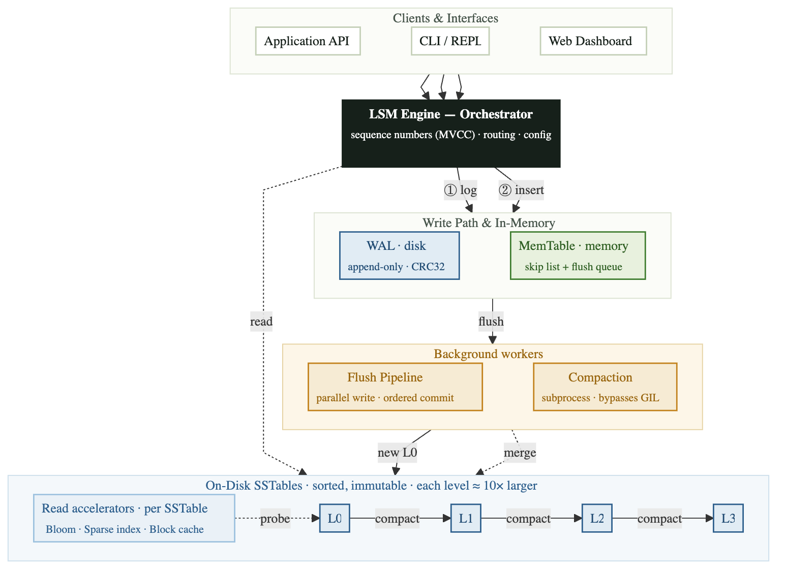
Pune Institute of Computer Technology
Department of Computer Engineering
Savitribai Phule Pune University · Academic Year 2025–26
Architecture (Block Diagram)
▪ Strict layered design: clients → LSM Engine → write path (WAL + MemTable) → background workers (Flush, Compaction) → on-disk SSTables (L0–L3).
▪ No module imports from a tier above it — prevents circular dependencies and lets each tier be tested in isolation.
KiwiDB · LSM Tree Key–Value Store
11

Slide 12
Pune Institute of Computer Technology
Department of Computer Engineering
Savitribai Phule Pune University · Academic Year 2025–26
Module Design
Module | Responsibility
app/engine/ | LSMEngine coordinator, WAL/MemTable/SSTable/compaction managers, flush pipeline
app/memtable/ | Concurrent skip list, active and immutable memtables
app/wal/ | Write-ahead log writer with msgpack + CRC32 framing
app/sstable/ | SSTable writer, reader, registry, metadata
app/bloom/ · app/index/ · app/cache/ | Bloom filter, sparse index, three-tier LRU block cache
app/compaction/ | Picklable task + subprocess merge worker (k-way merge)
app/common/ | ABCs/Protocols, CRC, encoding, merge iterator, RW-lock, UUIDv7
app/observability/ | Structured logging (structlog) + TCP log broadcast
web/ · frontend/ | FastAPI server (8 route modules) + React SPA dashboard
KiwiDB · LSM Tree Key–Value Store
12

Slide 13
Pune Institute of Computer Technology
Department of Computer Engineering
Savitribai Phule Pune University · Academic Year 2025–26
Mathematical Model
▪ State space: the engine is a function S : K → (V ∪ {⊥}), where ⊥ is a deleted/absent key; each operation carries a monotonic sequence number seq ∈ ℕ.
– put(k,v): S ↦ S[k↦v] with seq = seq_max+1. delete(k): S ↦ S[k↦⊥]. get(k) returns the value of the highest seq, or None.
▪ Bloom filter sizing (data-derived, per SSTable): m = ⌈ −n·ln p / (ln 2)² ⌉ , k = ⌈ (m/n)·ln 2 ⌉.
– Computed from the actual record count n at write time — right-sized filters, no global tuning.
▪ Skip list: MAX_LEVEL = 16, promotion probability p = 0.5 ⇒ E[height] = log₂ n; all operations O(log n).
▪ K-way merge (compaction): min-heap over K sorted iterators, N records ⇒ O(N log K) time, O(K) space.
▪ Write amplification: hybrid L0-tiering / L1-leveling reduces flush-time write amplification ~10× vs pure leveling.
KiwiDB · LSM Tree Key–Value Store
13

Slide 14
Pune Institute of Computer Technology
Department of Computer Engineering
Savitribai Phule Pune University · Academic Year 2025–26
Algorithms
Key Algorithms
K-Way Merge (Compaction)
▪ Concurrent skip-list insert — validate-then-retry with per-node locks; lock-free reads.
▪ K-way merge for compaction — min-heap, dedup by seq, tombstone garbage-collection.
▪ WAL recovery — replay entries with seq > on-disk max into a fresh memtable.
▪ Parallel flush with event-chain commits — parallel writes, FIFO-ordered commits.
▪ Bloom filter with data-derived sizing — optimal m, k from actual record count.
heap ← min-heap keyed on (key, −seq)
for each input iterator i:
push first record of i
last_key ← None
while heap not empty:
(key, seq, val) ← pop-min
if key ≠ last_key:
if val = TOMBSTONE and
seq < seq_cutoff:
skip # garbage-collect
else:
emit (key, seq, val)
last_key ← key
push next record from same i
⟹ O(N log K) time, O(K) space
KiwiDB · LSM Tree Key–Value Store
14

Slide 15
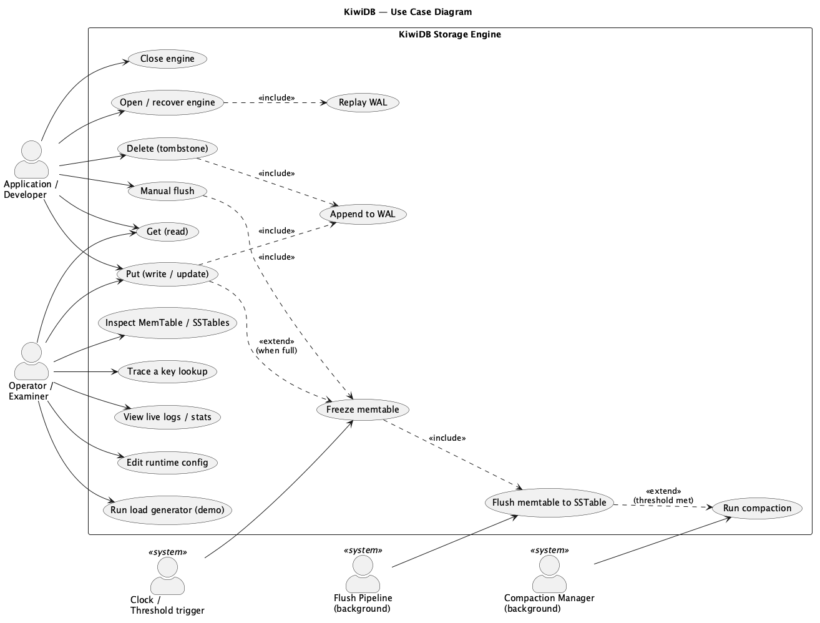
Pune Institute of Computer Technology
Department of Computer Engineering
Savitribai Phule Pune University · Academic Year 2025–26
UML — Use Case Diagram
Actors (Application/Developer, Operator/Examiner, background Flush & Compaction) and their use cases.
KiwiDB · LSM Tree Key–Value Store
15

Slide 16
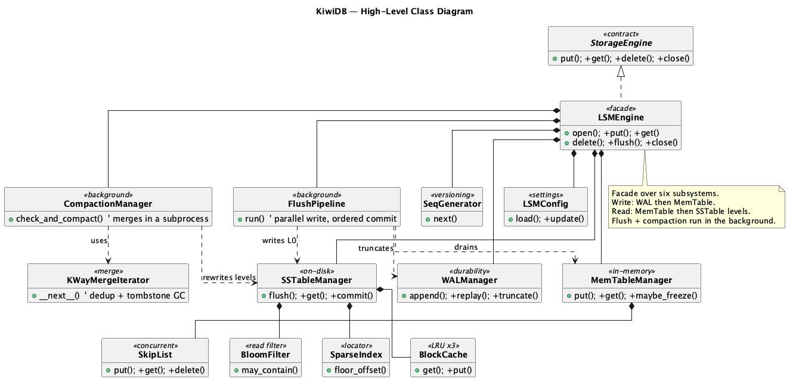
Pune Institute of Computer Technology
Department of Computer Engineering
Savitribai Phule Pune University · Academic Year 2025–26
UML — Class Diagram
Core class hierarchy: LSMEngine facade over WAL, MemTable, SSTable, compaction and read-accelerator classes.
KiwiDB · LSM Tree Key–Value Store
16

Slide 17
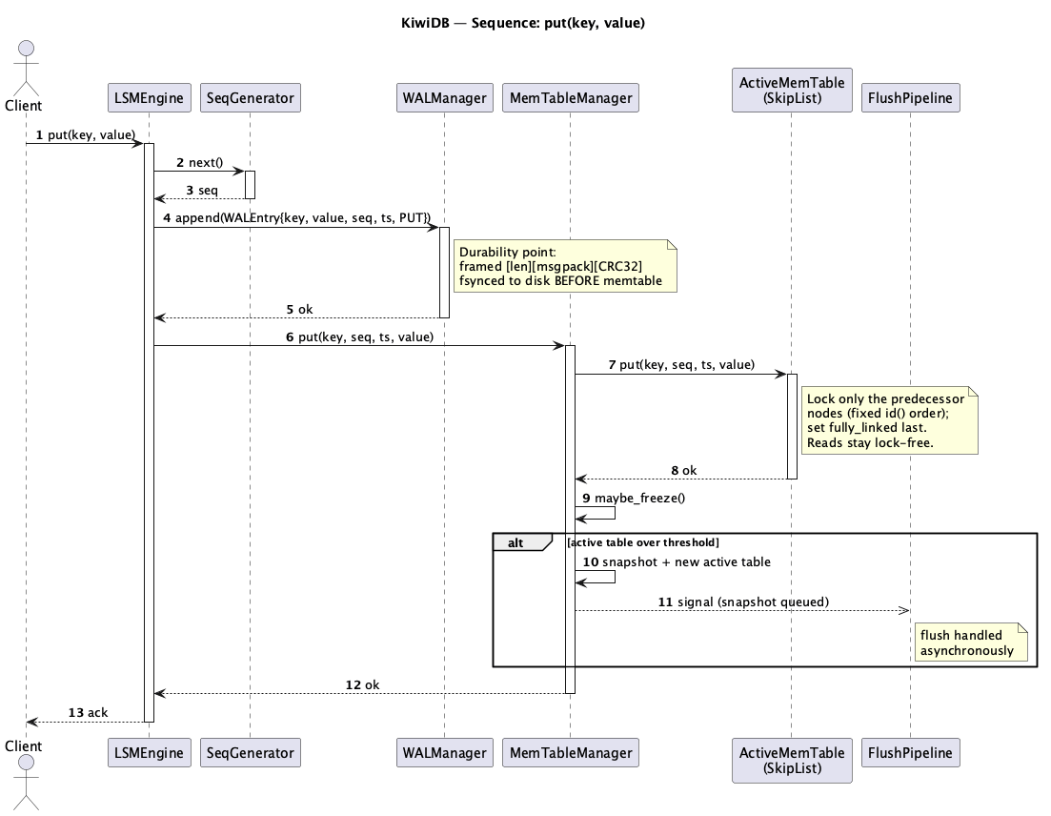
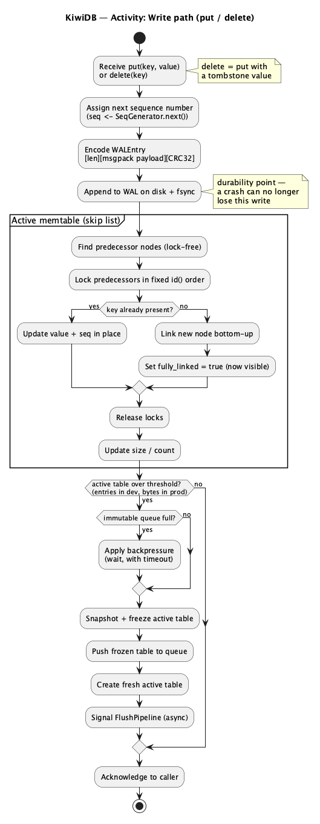
Pune Institute of Computer Technology
Department of Computer Engineering
Savitribai Phule Pune University · Academic Year 2025–26
UML — Sequence & Activity
Sequence: put(key, value)
Activity: write path
KiwiDB · LSM Tree Key–Value Store
17

Slide 18
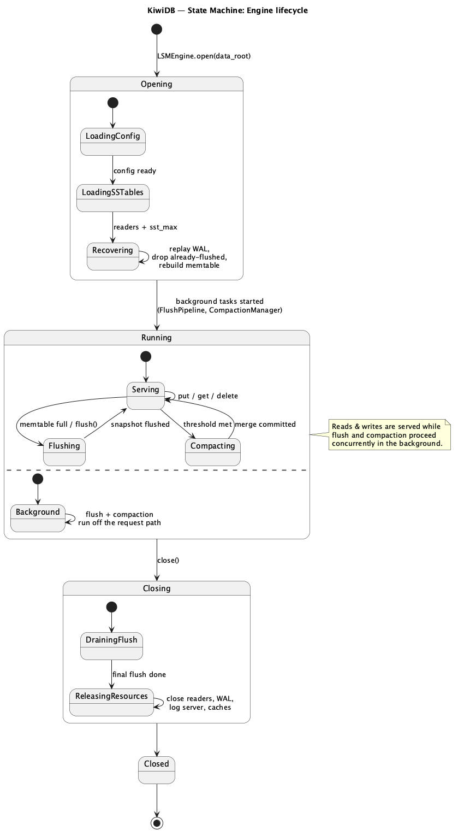
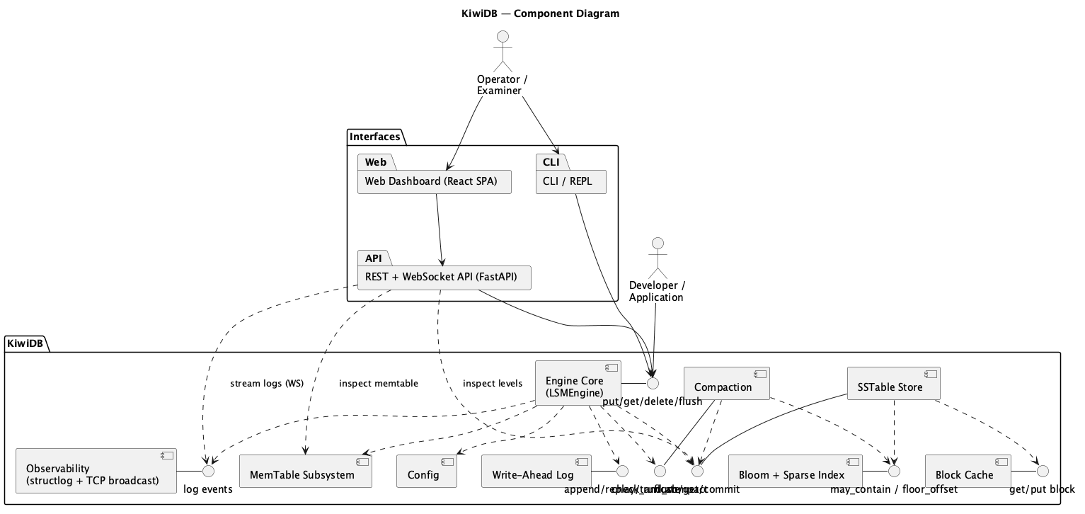
Pune Institute of Computer Technology
Department of Computer Engineering
Savitribai Phule Pune University · Academic Year 2025–26
UML — Component & State Machine
Component diagram
State machine: engine lifecycle
KiwiDB · LSM Tree Key–Value Store
18

Slide 19
Pune Institute of Computer Technology
Department of Computer Engineering
Savitribai Phule Pune University · Academic Year 2025–26
Testing & Validation
Testing approach
▪ 211+ unit tests across 25 modules (pytest) · integration tests for the full write→flush→read→recover cycle · async tests (pytest-asyncio) · dual strict type checking · bandit security scan · regression on every change.
Test Case | Expected Result | Status
put then get | Returns stored value | PASS
delete then get | Returns None (tombstone) | PASS
WAL recovery after crash | Data persists across restart | PASS
Concurrent skip-list inserts | All keys found, no lost writes | PASS
Bloom filter FPR at 1% | Observed FPR < 2% | PASS
Flush pipeline FIFO order | SSTables committed oldest-first | PASS
Compaction dedup + tombstone GC | Highest seq kept; old tombstones removed | PASS
WAL CRC integrity check | Corrupt entry detected | PASS
KiwiDB · LSM Tree Key–Value Store
19

Slide 20
Pune Institute of Computer Technology
Department of Computer Engineering
Savitribai Phule Pune University · Academic Year 2025–26
Analysis & Results — Outcomes
▪ Implemented a complete LSM-tree key–value store from scratch in Python 3.12+ (~6,600 LOC, 25 modules).
▪ Async-native API verified — the event loop never blocks on disk I/O (WAL fsync offloaded via to_thread; compaction in a subprocess).
▪ Crash recovery validated — all unflushed writes recovered via WAL replay; CRC32 detects any corruption.
▪ ~10× write-amplification reduction at flush time vs LevelDB's pure leveling (hybrid L0-tiering / L1-leveling).
▪ 211+ tests passing across 25 modules; mypy (strict) + basedpyright (strict) report zero errors.
▪ Web dashboard with 10 interactive pages — live memtable fill, SSTable layout, compaction progress, log streaming, in-browser REPL.
KiwiDB · LSM Tree Key–Value Store
20

Slide 21
Pune Institute of Computer Technology
Department of Computer Engineering
Savitribai Phule Pune University · Academic Year 2025–26
Applications
▪ Foundation for distributed KV stores: etcd, TiKV and CockroachDB layer consensus (Raft/Paxos) over a local LSM engine — KiwiDB's modular interfaces make it a candidate base.
▪ Embedded storage for applications: crash-safe local storage for message queues, caches and configuration stores, with no external database.
▪ Backend for write-heavy workloads: log ingestion, event sourcing, IoT and time-series data benefit from sequential-write optimisation.
▪ Storage-engine research & prototyping: experiment with compaction strategies, cache policies, bloom designs or on-disk formats without rewriting the engine.
▪ Observability / monitoring infrastructure: the dashboard and live log streaming give real-time visibility into the data lifecycle.
KiwiDB · LSM Tree Key–Value Store
21

Slide 22
Pune Institute of Computer Technology
Department of Computer Engineering
Savitribai Phule Pune University · Academic Year 2025–26
Paper Details
1. Survey Paper
“Survey of LSM Trees and Indexing Techniques in Key–Value Stores”
IEEE conference format · Authors: C. Paraskar, S. Dhas, S. Gajbhiye, S. Gopnarayan. Reviews the LSM design space and indexing techniques that inform KiwiDB.
2. Implementation Paper
“KiwiDB: An Async-Native Log-Structured Merge Tree Key–Value Store with Parallel Flush and Subprocess Compaction”
IEEE conference format. Covers the system architecture, the three design innovations (async-native API, parallel flush with event-chain commits, subprocess compaction), implementation details, and a comparison with LevelDB and RocksDB.
KiwiDB · LSM Tree Key–Value Store
22

Slide 23
Pune Institute of Computer Technology
Department of Computer Engineering
Savitribai Phule Pune University · Academic Year 2025–26
Event Participation
▪ Two IEEE-format papers prepared by the team — a survey paper and an implementation paper (see Paper Details).
▪ Project demonstrated at the Department of Computer Engineering project reviews (Term I and Term II evaluations), PICT.
▪ Open-source release with full documentation (MkDocs site) and an interactive web dashboard for live demonstration.
▪ [ To be updated with specific events — project competitions, conferences, hackathons, or exhibitions attended. ]
KiwiDB · LSM Tree Key–Value Store
23

Slide 24
Pune Institute of Computer Technology
Department of Computer Engineering
Savitribai Phule Pune University · Academic Year 2025–26
References
[1] N. Leavitt, “Will NoSQL databases live up to their promise?” Computer, 43(2), 2010.
[2] F. Chang et al., “Bigtable: A distributed storage system for structured data,” ACM TOCS, 26(2), 2008.
[3] A. Lakshman, P. Malik, “Cassandra: A decentralized structured storage system,” ACM SIGOPS OSR, 44(2), 2010.
[4] G. DeCandia et al., “Dynamo: Amazon's highly available key-value store,” ACM SOSP, 2007.
[5] P. O'Neil et al., “The log-structured merge-tree (LSM-tree),” Acta Informatica, 33(4), 1996.
[6] Apache HBase. https://hbase.apache.org
[7] Google, “LevelDB,” 2011. https://github.com/google/leveldb
[8] Facebook, “RocksDB,” 2013. https://rocksdb.org
[9] P. Wang et al., “LSM-tree based KV store on open-channel SSD,” ACM EuroSys, 2014.
[10] N. Dayan, M. Athanassoulis, S. Idreos, “Monkey: Optimal navigable KV store,” ACM SIGMOD, 2017.
[11] N. Dayan, S. Idreos, “Dostoevsky,” ACM SIGMOD, 2018.
[12] C. Luo, M. J. Carey, “LSM-based storage techniques: A survey,” VLDB Journal, 29, 2020.
[13] B. H. Bloom, “Space/time trade-offs in hash coding with allowable errors,” CACM, 13(7), 1970.
[14] M. Herlihy et al., “A provably correct scalable concurrent skip list,” OPODIS, 2006.
[15] W. Pugh, “Skip lists: A probabilistic alternative to balanced trees,” CACM, 33(6), 1990.
[16] MongoDB, “WiredTiger storage engine.” https://source.wiredtiger.com
[17] Python Software Foundation, “Global Interpreter Lock.” https://wiki.python.org/moin/GlobalInterpreterLock
KiwiDB · LSM Tree Key–Value Store
24

Slide 25
Pune Institute of Computer Technology
Department of Computer Engineering
Savitribai Phule Pune University · Academic Year 2025–26
Thank You
Questions & Discussion
High-Throughput Write-Optimised Key–Value Store using LSM Tree Engine
KiwiDB · LSM Tree Key–Value Store
25

