Slide 1

Multithreaded Merge Sort
CS5008 Spring 2023 - Group 10

Slide 2
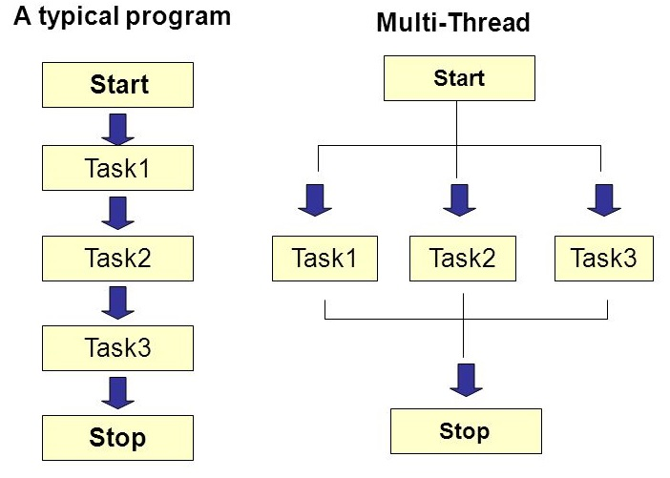
Serial Algorithm vs. Parallel Algorithm

Slide 3
Background/Assumptions
Multicores CPU & Multiprocessors
Thread:
Abstraction of “virtual processor”
Multithread: multithreading a single algorithm so that some of its instructions may be executed simultaneously
Shared Memory
Threads may switch/exchange data or results, shared memory allows each thread to directly access any location of memory
Greedy Scheduler
Scheduling problem: how to allocate potentially parallel strands of computation to available processors
greedy: assign as many strands to processors as possible in each time step

Slide 4
Key concepts
Work: Running time on a single processor, denoted by T₁
Span: Running time on an infinite number of processors, i.e., we could run each strand on its own processor, denoted by T_{Inf}
Parallelism: Ratio of the amount of work that can be done in parallel to the total amount of work required to complete a task
P = T₁ / T_{Inf}

Slide 5

Parallelism
Imagine you are cleaning up a park, there are 3 different tasks.
Each task must be done by at most one person.
Task 1: Pick up trash (2 hours)
Task 2: Sweep the paths (3 hours)
Task 3: Empty Trash (1 hour)
If you work alone, it will cost 6 hours to finish all the tasks.
But if you have enough people to help you, i.e., 3 people, it will cost overall 3 hours (sweep the paths).
Therefore, the parallelism is:
P = T₁ / T_{Inf} = 6 / 3 = 2

Slide 6
Slackness
We deﬁne the (parallel) slackness of a multithreaded computation executed on an ideal parallel computer with P processors to be the ratio：
S = (T₁ / T_{Inf}) / P

Slide 7

SLACKNESS
You are cleaning up a park, there are 3 different tasks, each task must be done by at most one person.
Task 1: Pick up trash (2 hours)
Task 2: Sweep the paths (3 hour)
Task 3: Empty Trash (1 hours)
If you work alone, it will cost 6 hours to finish all the tasks.
But if there are 5 people help you, the overall time consumption is still 3 hours (each task must be done by at most one person).
Therefore, the Slackness is:
S = (T_1 / T_Inf) / 6 = (6 / 3) / 6 = 0.33

Slide 8
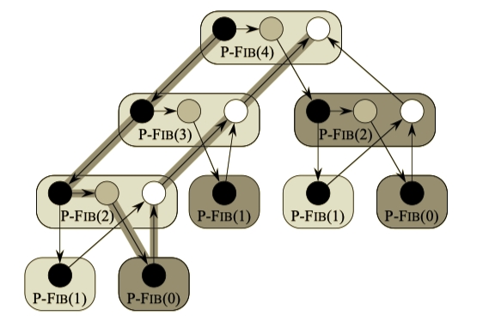
Key concepts
Spawn: when we call a procedure, the parent procedure may continue to execute in parallel.
parent node spawns child node in three threads T_A, T_B, T_C
parent node does not need to wait for the child to process and execute in parallel
Sync:
procedure must wait for all its spawned children to complete
Notes:
-apply spawn -> in thread A
-apply spawn -> in thread B
-sync starts whenever the children are completed, after the completion of thread A and B, sync in thread C
-merge will be executed
-previously single processor, fib is calculated into different process A and B
-whereas now process P1 go to thread A, process P2 go to process B
-combine these two thread using thread C

Slide 9
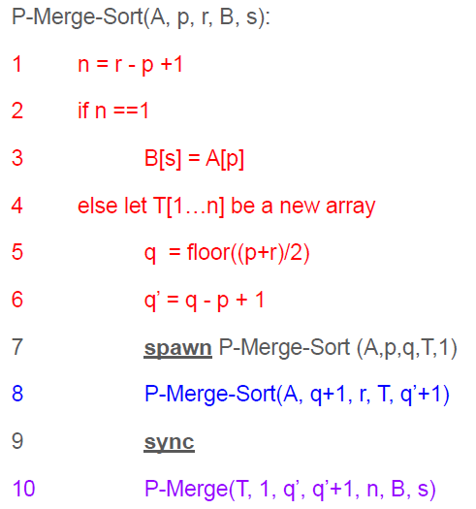
pseudocode - Multithreaded merge-sort
The source array is A[p...r].
The target array is B[s…].
q is the middle point of p and r.
T[1…q-1] and T[q…n] are used for storing the two merge-sorted subarray temporarily.
P-Merge() is also a multithreaded algorithm. We will be looking at it later in detail.

Slide 10
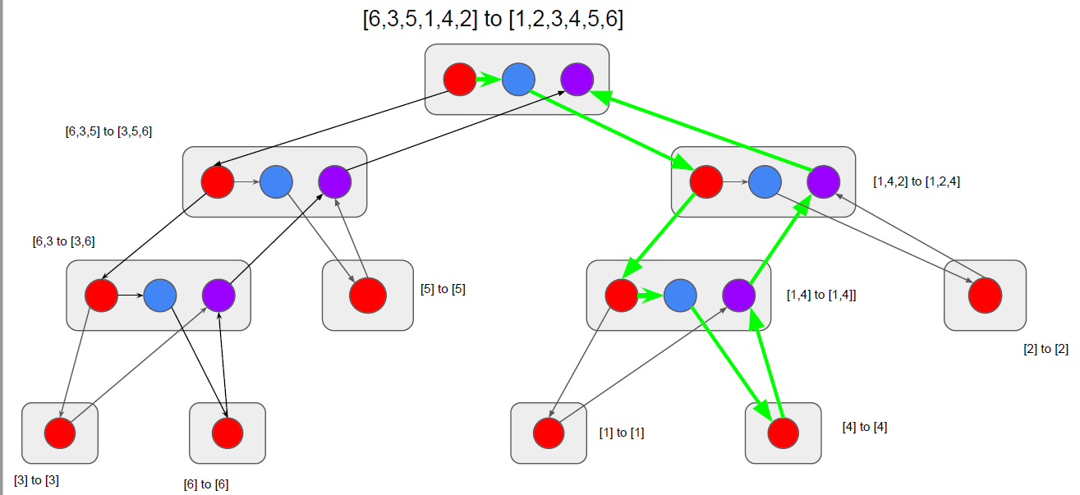
DAG (directed acyclic graph)
DAG of P-Merge-Sort() for A= [6,3,5,1,2,4]

Slide 11
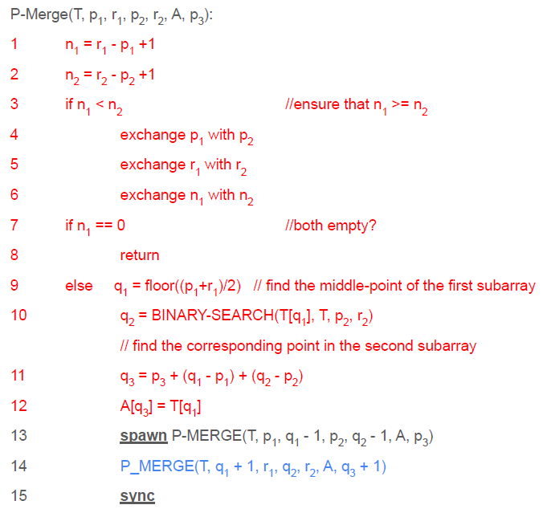
pseudocode – Multithreaded merging
Very similar to the merging we’ve learned
T[p₁...r₁] is the first subarray
T[p₂...r₂] is the second subarray
A[p₃…] is the merged result
Greatly improved the parallelism of multithreaded merge sort compared to the ordinary merging
Much easier to understand in pictures as we will see next

Slide 12

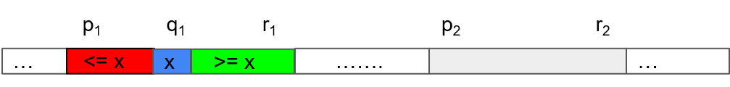
A sketch of the multithreaded merging
Given two sorted sub-arrays, we can assume the first one is longer WLOG (otherwise we swap them).
Find the middle-index of the first array q₁.

Slide 13
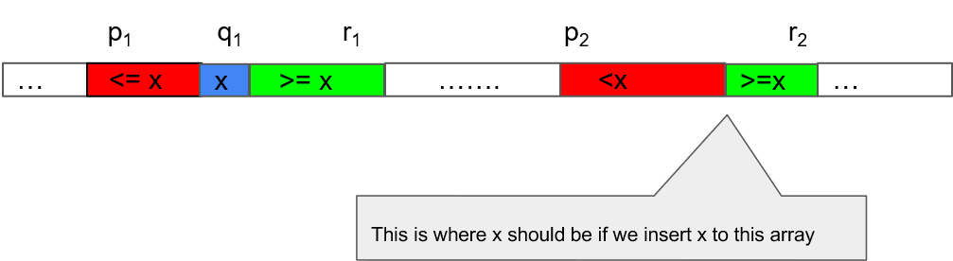
A sketch of the multithreaded merging
Let x be the value of the term in the middle.
Apply binary search to search the corresponding position (i.e., index) of x in the second array.

Slide 14
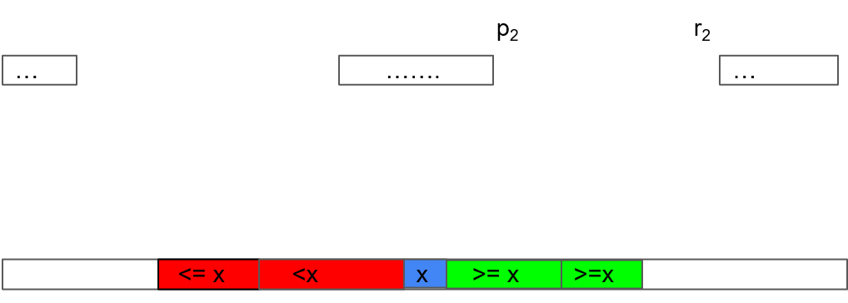
A sketch of the multithreaded merging
Apply the divide and conquer idea: merge the red and green parts separately (that’s how we make merging multithreaded) and combine them in a new array.

Slide 15
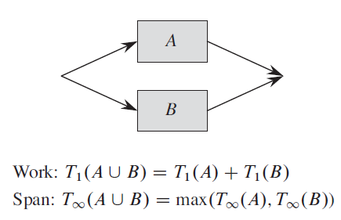
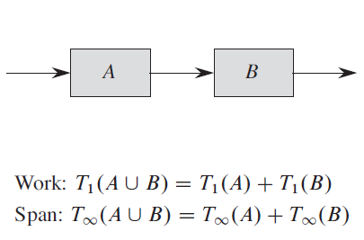
Performance Analysis of P-Merge()
Two important rules:

Slide 16
Performance Analysis of P-Merge()
Using these two rules, we can get the following relation:
Let n = n₁ + n₂
PM∞(n) = PM∞(¾ n) + Θ(lg₂n) ⇒ PM∞(n) = Θ(lg₂n)
PM₁(n) = PM₁(ɑn) + PM₁((1-ɑ)n) + O(lg₂n) for ¼ <= ɑ <= ¾ ⇒ PM₁(n) = Θ(n)

Slide 17
Performance Analysis of P-Merge-Sort()
PMS∞(n) = PMS∞( ½ n) + PM∞(n) ⇒ PMS∞(n) = Θ(lg₃n)
PMS₁(n) = 2*PMS₁(½ n) + PM₁(n) ⇒ PMS₁(n) = Θ(n lg₂n)
Hence the parallelism of P-Merge-Sort = PMS₁(n) / PMS∞(n) = Θ(n/ lg₂n)
We can also see that the work PMS₁(n) = Θ(n lg₂n) is the same as the time complexity of ordinary merge-sort, which means there is no essential difference between these two algorithms and also no extra operations are involved.
On the other hand, the multithreaded version is much faster:
compare PMS∞(n) = Θ(lg₃n) with Θ(n lg₂n) if you have enough processors.

Slide 18
Performance Analysis of P-Merge-Sort()
The last point: Why do we make the merging multithreaded as well?
By doing that, we increased the span from Θ(n) to Θ(lg₃n) and more importantly, increased the parallelism from Θ(lg₂n) to Θ(n / lg₂n), allowing better scalability, i.e., more processors can be involved without reaching the theoretical bound.

Slide 19
Q&A
Thank you!

Slide 20
references
Cormen, Thomas H., Leiserson, Charles E., Rivest, Ronald L. and Stein, Clifford. Introduction to Algorithms, Third Edition. Cambridge, Massachusetts London, England: The MIT Press, 2009.
Wikipedia. “Parallel algorithm.” https://en.wikipedia.org/wiki/Parallel_algorithm (accessed April 10, 2023).
Blelloch, Guy E. and Maggs, Bruce M. “Parallel Algorithms.” https://www.cs.cmu.edu/~guyb/papers/BM04.pdf (accessed April 10, 2023).
Bouguezzi, Safa. “Multithreaded Algorithms.” https://www.baeldung.com/cs/multithreaded-algorithms (accessed April 10, 2023).
Moore, Tamsin. “Multi-Threading in Java.” https://slideplayer.com/slide/9128173/ (accessed April 10, 2023).
Staff, Maker.io. “An Introduction to Multi-Threading C Programs.” https://www.digikey.com/en/maker/blogs/2022/an-introduction-to-multi-threading-c-programs (accessed April 10, 2023).
Suthers, Dan. “Multithreaded Algorithms.” http://www2.hawaii.edu/~suthers/courses/ics311f20/Notes/Topic-22.html (accessed April 11, 2023).

