Slide 1
Concepts for Multithreading Merge Sort

Slide 2
Parallelism
parallelism is defined as the ratio of the amount of work that can be done in parallel to the total amount of work required to complete a task.
The work is the running time on a single processor, denoted by T_1, while the span is the running time on infinite number of processors, i.e. we could run each strand on its own processor, denoted by T_Inf.
P = T_1 / T_Inf

Slide 3

Parallelism
S’pose you are cleaning up a park, there are 3 different tasks, each task must be done by at most one person.
Task 1: Pick up trash (2 hours)
Task 2: Sweep the paths (3 hour)
Task 3: Empty Trash (1 hours)
If you work alone, it will cost 6 hours to finish all the tasks.
But if you have enough people to help you, i.e. 3 people, it will cost overall 3 hours (sweep the paths)
Therefore, the parallelism is:
P = T_1 / T_Inf = 6 / 3 = 2

Slide 4
Slackness
We deﬁne the (parallel) slackness of a multithreaded computation executed on an ideal parallel computer with P processors to be the ratio：
S = (T_1 / T_Inf ) / P

Slide 5

Slackness
You are cleaning up a park, there are 3 different tasks, each task must be done by at most one person.
Task 1: Pick up trash (2 hours)
Task 2: Sweep the paths (3 hour)
Task 3: Empty Trash (1 hours)
If you work alone, it will cost 6 hours to finish all the tasks.
But if there are 5 people help you, the overall time consumption is still 3 hours (each task must be done by at most one person).
Therefore, the Slackness is:
S = (T_1 / T_Inf) / 6 = (6 / 3) / 6 = 0.33

Slide 6
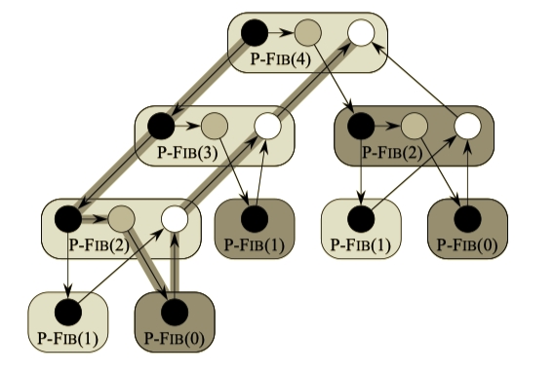
Spawn, Sync
Spawn: When we call a procedure, the parent procedure may continue to execute in parallel.
parent node spawn child node in three threads T_A, T_B, T_C
parent node don’t need wait for child process and execute in parallel
Sync: procedure must wait for all its spawned children to complete
Notes:
-apply spawn -> in thread A
-apply spawn -> in thread B
-sync starts whenever the children are completed, after the completion of thread A and B, sync in thread C
-merge will be executed
-previously single processor, fib is calculated into different process A and B
-whereas now process P1 go to thread A, process P2 go to process B
-combine these two thread using thread C

Slide 7
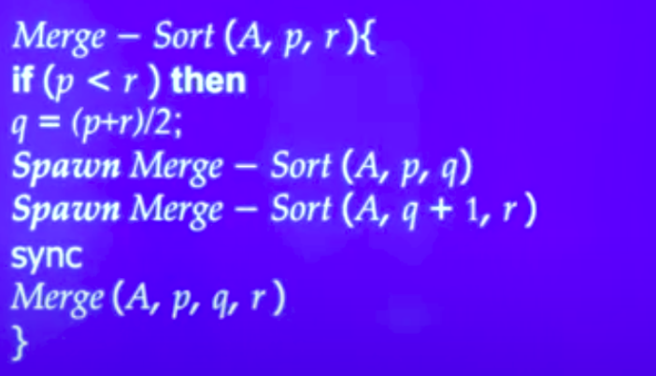
Merge Sort Parallel Version
Notes:
​​-merge sort 3 parameters: A is list, p is starting, r is ending
-find middle index q

Slide 8

Parallel Divide and Conquer
-the input array is divided into smaller sub-arrays, which are sorted independently using multiple threads
-Each thread handles a sub-array and sorts it using the classic merge sort algorithm.
-Once all sub-arrays are sorted, they are merged together using the second part of the algorithm.
Notes:
-apply spawn -> thread A
-apply spawn -> thread B
-sync starts whenever the children are completed, after the completion of thread A and B
-merge will be executed

Slide 9

Parallel Merging
- The sorted subarrays are merged together in a parallel fashion.
- Achieved using a priority queue and multiple threads.
- Each thread handles one or more sub-arrays and merges them together using the priority queue. The resulting sorted array is the final output of the algorithm.
Notes:
-previously single processor, list gets divided into process A and B
-whereas now process P1 go to thread A, process P2 go to process B
-combine these two thread using thread C

