Slide 1
B-Tree

Slide 2
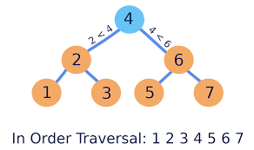
Binary Search Tree

Slide 3
Ternary Search Tree
10, 20
15, 19
70
2,6
12, 14
16, 18
55, 65
55, 65
55, 65

Slide 4
Four-way Search Tree
10, 20 ,40
2,6
70
15, 19
25, 35
12, 14
16, 18
37, 39
55, 65
22, 24

Slide 5
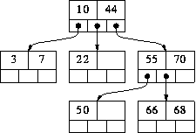

Slide 6
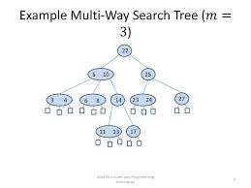
M-Way Search Trees

Slide 7
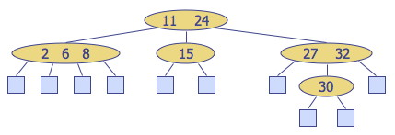

Slide 8
B Trees
B-Tree Node structure
P1 | K1 | P2 | K2 | P3 | K3 | P4 | Km-1 | PM

Slide 9
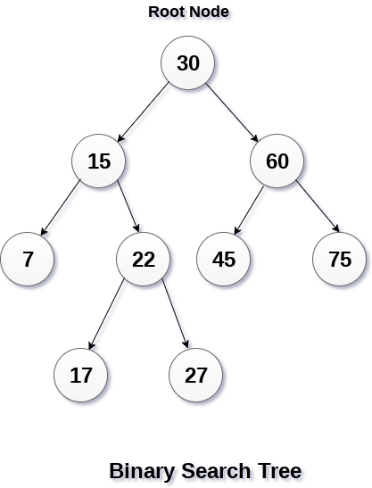

Slide 10
B-Tree Properties
A B-tree of order m is an m-way search tree. If the B-tree is not empty, the corresponding extended tree satisfy the following properties:
Property #1 - All the leaf nodes must be at the same level.
Property #2 - All nodes except root must have at least [m/2]-1 keys and maximum of m-1 keys.
Property #3 - All non leaf nodes except root (i.e. all internal nodes) must have at least m/2 children.
Property #4 - If the root node is a non leaf node, then it must have at least 2 children.
Property #5 - All the key values within a node must be in Ascending Order.
Example:B-Tree of Order 4 contains maximum 3 key values in a node and maximum 4 children for a node.

Slide 12
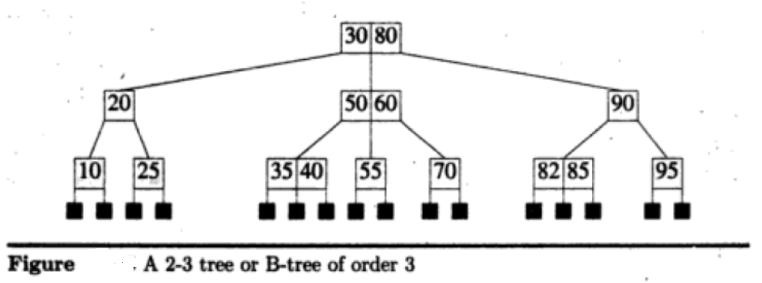
In a B-tree of order 3 , no internal nodes have either 2 or 3 children. So , a B-tree of order 3 is also known as 2-3 tree. Example for 2-3 B Tree is shown below

Slide 14
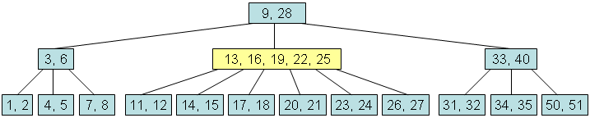

Slide 15
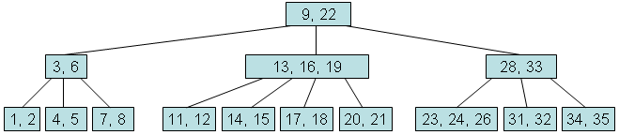

Slide 16
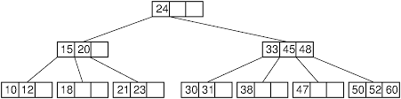
B Tree of order 4

Slide 17
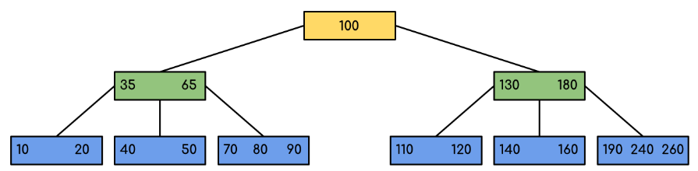
B Tree of order 5

Slide 18
Operations on B-tree:
The following operations are performed on a B-Tree...
Search
Insertion
Deletion
Search Operation in B-Tree
In a B-Ttree, the search operation is similar to that of Binary Search Tree. In a Binary search tree, the search process starts from the root node and every time we make a 2-way decision (we go to either left subtree or right subtree). In B-Tree also search process starts from the root node but every time we make n-way decision where n is the total number of children that node has. In a B-Ttree, the search operation is performed with O(log n) time complexity. The search operation is performed as follows...
Step 1: Read the search element from the user
Step 2: Compare, the search element with first key value of root node in the tree.
Step 3: If both are matching, then display "Given node found!!!" and terminate the function
Step 4: If both are not matching, then check whether search element is smaller or larger than that key value.
Step 5: If search element is smaller, then continue the search process in left subtree.
Step 6: If search element is larger, then compare with next key value in the same node and repeate step 3, 4, 5 and 6 until we found exact match or comparison completed with last key value in a leaf node.
Step 7: If we completed with last key value in a leaf node, then display "Element is not found" and terminate the function.

Slide 19
Insertion Operation in B-Tree
In a B-Tree, the new element must be added only at leaf node. That means, always the new keyValue is attached to leaf node only. The insertion operation is performed as follows...
Step 1: Check whether tree is Empty.
Step 2: If tree is Empty, then create a new node with new key value and insert into the tree as a root node.
Step 3: If tree is Not Empty, then find a leaf node to which the new key value cab be added using Binary Search Tree logic.
Step 4: If that leaf node has an empty position, then add the new key value to that leaf node by maintaining ascending order of key value within the node.
Step 5: If that leaf node is already full, then split that leaf node by sending middle value to its parent node. Repeat the same until sent value is fixed into a node.
Step 6: If the splitting is occurring to the root node, then the middle value becomes new root node for the tree and the height of the tree is increased by one.

Slide 20
Construct B-tree order 5 for the following data:20,40,30,350,75,375,360,80,60,90,70, 100,110 ,120, 385, 390,380
Step 1: insert (20)
Step 2: insert (40)
Step 3: insert (30)
Minimum children: round(5/2)=3
Minimum Keys: 2
20
20 , 40
20 , 30, 40
Step 4: insert (350)
20 , 30, 40, 350
Step 5: insert (75)
Adding 75 would over-fill it, so split it and promote the middle key
No space , so split
20 , 30, 40, 350
20 , 30, 40, 350
Temp
20 , 30, 40, 75, 350
Create new node of size M then move second half elements into new node then move middle element to Parent

Slide 21
Construct B-tree order 5 for the following data:20,40,30,350,75,375,360,80,60,90,70, 100,110 ,120, 385, 390,380
40
Step 6: insert (375)
40
Step 6: insert (360)
40
20 , 30,
75, 350
20 , 30,
75, 350,375
20 , 30,
75, 350,360, 375
Step 6: insert (80)
Adding 80 would over-fill it, so split the corresponding node node and promote the middle key
40
20 , 30,
75, 350,360, 375

Slide 22
Construct B-tree order 5 for the following data:20,40,30,350,75,375,360,80,60,90,70, 100,110 ,120, 385, 390,380
40 , 350
Step 7: insert (60)
20 , 30,
75, 80
360, 375

Slide 23
Example: Construct B-tree order 5 for the following data 20,40,30,350,75,375,360,80,60,90,70, 100,110 ,120, 385, 390,380
Step 1: insert (20)
Step 5: insert (75): Split and send middle element up
 | 20
 | 40
Step 2: insert (40)
 | 20 |  | 30
 | 75 |  | 350
 | 20 |  | 40
Step 6: insert (375):
Step3: insert (30)
 | 40
 | 20 |  | 30 |  | 40
 | 20 |  | 30
 | 75 |  | 350 |  | 375
Step 4: insert (350)
Step 7: insert (360):
 | 20 |  | 30 |  | 40 |  | 350
 | 40
 | 20 |  | 30
 | 75 |  | 350 |  | 360 |  | 375

Slide 24
Step 8: insert (80):Split
 | 40 |  | 350
 | 20 |  | 30
 | 75 |  | 80
 | 360 |  | 375
Step 9: insert (60):
 | 40 |  | 350
 | 20 |  | 30
 | 60 |  | 75 |  | 80
 | 360 |  | 375

Slide 25
Step 10: insert (90):
 | 40 |  | 350
 | 20 |  | 30
 | 60 |  | 75 |  | 80 |  | 90
 | 360 |  | 375
Step 11: insert (70):Split
 | 40 |  | 75 |  | 350
 | 20 |  | 30
 | 60 |  | 70
 | 80 |  | 90
 | 360 |  | 375

Slide 26
Step 12: insert (100)
 | 40 |  | 75 |  | 350
 | 20 |  | 30
 | 60 |  | 70
 | 80 |  | 90 |  | 100
 | 360 |  | 375
Step 13: insert (110)
 | 40 |  | 75 |  | 350
 | 20 |  | 30
 | 60 |  | 70
 | 80 |  | 90 |  | 100 |  | 110
 | 360 |  | 375

Slide 27




Step 13: insert (120):Split
 | 40 |  | 75 |  | 100 |  | 350
 | 360 |  | 375
Step 14: insert (385)
 | 40 |  | 75 |  | 100 |  | 350
 | 360 |  | 375 |  | 385

Slide 28





Step 15: insert (390)
 | 40 |  | 75 |  | 100 |  | 350
 | 360 |  | 375 |  | 385 |  | 390
Step 16: insert (380): Split at 2 levels
Split and send 380 to parent
Split and send 380 to parent

Slide 29
Deleting an Element From a B-Tree:
Deletion is divided into two cases:
The element to be deleted is in a leaf node
The element to be deleted is in a non leaf node
Case 1:
To delete value X from a B-tree, starting at a leaf node, there are 2 steps:
1.Remove X from the current node. Being a leaf node there are no subtrees to
worry about.
2.Removing X might cause the node containing it to have too few
If underflow does not occur, then we are finished the deletion process. If it does occur, it must be fixed.
NOTE: After deleting an element from B tree, the resultant tree must stratify B-tree Properties

Slide 30
Example 1: Let us take as a specific example, deleting 6 from this B-tree (of degree 5):
5, 10, 50
2, 3
6, 7
17,22,44,45
55, 66 ,68, 70

Slide 31
Example 2: Let us take as a specific example, deleting 6 from this B-tree (of degree 5):
 | 5 |  | 10 |  | 50
 | 2 |  | 3
 | 6 |  | 7
 | 17 |  | 22 |  | 44 |  | 45
 | 55 |  | 66 |  | 68 |  | 70
Fig.Before Deletion
Here 6 is in the leaf , so simply delete and observe the resultant.
 | 5 |  | 10 |  | 50
 | 2 |  | 3
 | 7
 | 17 |  | 22 |  | 44 |  | 45
 | 55 |  | 66 |  | 68 |  | 70
Removing 6 causes the node it is in to underflow, as it now contains just 1 value (7). Our strategy for fixing this is to try to `borrow' values from a neighbouring node. After borrowing from the neighbour, the resultant tree is shown below:
 | 5 |  | 17 |  | 50
 | 2 |  | 3
 | 7 |  | 10
 | 22 |  | 44 |  | 45
 | 55 |  | 66 |  | 68 |  | 70

Slide 32
Example 2: Let us take as a specific example, deleting 3 from this B-tree (of degree 5):
 | 5 |  | 10 |  | 50
 | 2 |  | 3
 | 6 |  | 7
 | 17 |  | 22 |  | 44 |  | 45
 | 55 |  | 66 |  | 68 |  | 70
Fig.Before Deletion
Here 6 is in the leaf , so simply delete and observe the resultant.
 | 5 |  | 10 |  | 50
 | 2
 | 6 |  | 7
 | 17 |  | 22 |  | 44 |  | 45
 | 55 |  | 66 |  | 68 |  | 70
Removing 3 causes the node it is in to underflow, as it now contains just 1 value (2). Our strategy for fixing this is to try to `borrow' values from a neighbouring node. However ,sib link too does not have ufficient number of elements .So , follow the combine strategy. The resultant tree is shown below:
 | 17 |  | 50
 | 2 |  | 5 |  | 7 |  | 10
 | 22 |  | 44 |  | 45
 | 55 |  | 66 |  | 68 |  | 70

Slide 33
Case 2:The element to be deleted is in a non leaf node
Case 2 is transformed into case 1 by replacing deleted element with either largest element in its left sub tree or smallest element in its right sub tree and then the replacing element is deleted from its original position. The replacing element is guaranteed to be in leaf.
Example :Delete 350 from below tree
Fig a: Before deletion

Slide 34

Fig a: After replacing 350 with largest element in its left subtree .

Slide 35

Now , delete 120 from its original position. The resultant tree is shown below
Fig b: After deleting 120 from its original position. Resultant tree is not B tree

Slide 36
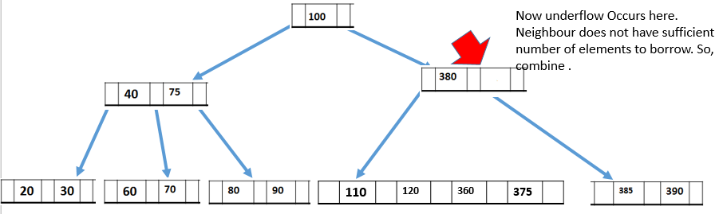
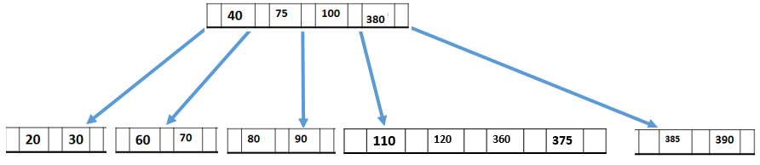
Observe the previous tree. After deleting 120, the corresponding node suffers from underflow. So, borrow from neighbour. However neighbour does not have sufficient number of elements. Then the solution is combine sib links along with their parent. The resultant tree is shown next.
Fig c: After combining at leaf level
Fig d: After combining at 2nd level. Final tree

Slide 37


Slide 38
Note 1: Refer Sahani& Good Rich text books to know the applications of various data structures
Note 2: Refer Record for programs
http://web.eecs.utk.edu/~bvanderz/teaching/cs140Sp18/BTrees/

